Slide 1
Data Structures and Algorithms
(ESO207)
Lecture 28:
Heap : an important tree data structure
Implementing some special binary tree using an array !
Binary heap

Slide 2

Heap
Definition: a tree data structure where :
value stored in a node ? value stored in each of its children.
$$<$$
4
7
11
13
71
9
18
23
37
19
21
47
43

Slide 3
Operations on a heap
Query Operations
Find-min: report the smallest key stored in the heap.
Update Operations
CreateHeap(H)
Insert(x,H)
Extract-min(H)
Decrease-key(p, ∆, H)
Merge(H1,H2)
: Create an empty heap H.
: Insert a new key with value x into the heap H.
: delete the smallest key from H.
: decrease the value of the key p by amount ∆.
: Merge two heaps H1 and H2.

Slide 4
Can we implement a binary tree using an array ?
Yes.
In some special cases

Slide 5
A complete binary tree
A complete binary of 12 nodes.

Slide 6



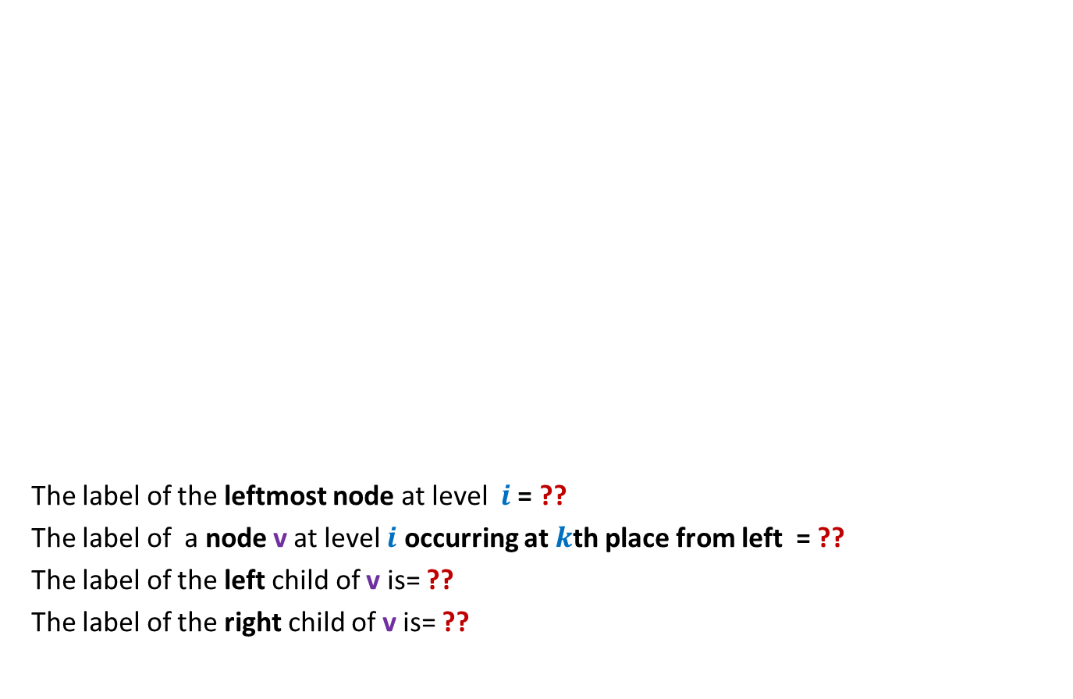



A complete binary tree
Can you see a relationship between label of a node and labels of its children ?
Level nodes
The label of the leftmost node at level $i$ = ??
The label of a node v at level $i$ occurring at $k$th place from left = ??
The label of the left child of v is= ??
The label of the right child of v is= ??
0
0 1
1 2
1 2
3 4 5 6
2 4
7 8 9 10 11
$$2^{i}−1$$
$$2^{i}+k−2$$
$$2^{i+1}+2k−3$$
$$2^{i+1}−1+ ?$$
$$2(k−1)$$
$$2^{i+1}+2k−2$$

Slide 7




A complete binary tree
Level nodes
Let v be a node with label $j$.
Label of left child(v) =
Label of right child(v) =
Label of parent(v) =
0
0 1
1 2
1 2
3 4 5 6
2 4
7 8 9 10 11
2 $j$+1
2$j$+2
$$\left\lfloor (j−1)/2\right\rfloor$$

Slide 8
A complete binary tree and array
Question: What is the relation between a complete binary trees and an array ?
Answer: A complete binary tree can be implemented by an array.
0
41
The most compact representation.
Advantages ?
1 2
9
17
3 4 5 6
57
33
1
70
7 8 9 10 11
91
37
25
88
35
41 17 9 57 33 1 70 91 37 25 88 35
0 1 2 3 4 5 6 7 8 9 10 11

Slide 9
Binary heap

Slide 10
Binary heap
a complete binary tree
satisfying heap property at each node.
4
14
9
17
23
21
29
91
37
25
88
33
H
4 14 9 17 23 21 29 91 37 25 88 33

Slide 11


Implementation of a Binary heap
$n$ : the maximum number of keys at any moment of time,
that we keep
H[]
size
: an array of size $n$ used for storing the binary heap.
: a variable for the total number of keys currently in the heap.

Slide 12
Find_min(H)
Report H[0].
4
14
9
17
23
21
29
91
37
25
88
33
H
4 14 9 17 23 21 29 91 37 25 88 33

Slide 13
Extract_min(H)
Think hard on designing efficient algorithm for this operation.
The challenge is:
how to preserve the complete binary tree structure as well as the heap property ?
4
14
9
17
23
21
29
91
37
25
88
33
H
4 14 9 17 23 21 29 91 37 25 88 33

Slide 14
Extract_min(H)
4
14
9
17
23
21
29
91
37
25
88
33
H
4 14 9 17 23 21 29 91 37 25 88 33

Slide 15
Extract_min(H)
33
14
9
17
23
21
29
91
37
25
88
4
H
33 14 9 17 23 21 29 91 37 25 88
4

Slide 16
Extract_min(H)
9
14
33
17
23
21
29
91
37
25
88
H
9 14 33 17 23 21 29 91 37 25 88

Slide 17

Extract_min(H)
We are done.
The no. of operations performed = O(no. of levels in binary heap)
= O(log $n$) …show it as an homework exercise.
9
14
21
17
23
33
29
91
37
25
88
H
9 14 21 17 23 33 29 91 37 25 88

Slide 18
Insert(x,H)
9
14
21
17
23
33
29
71
37
25
88
41
52
32
76
98
85
47
57
11
H
9 14 21 17 23 33 29 71 37 25 88 41 52 32 76 98 85 47 57
11

Slide 19
Insert(x,H)
9
14
21
17
23
33
29
71
37
25
88
41
52
32
76
98
85
47
57
11
H
9 14 21 17 23 33 29 71 37 25 88 41 52 32 76 98 85 47 57
11

Slide 20
Insert(x,H)
9
14
21
17
23
33
29
71
37
11
88
41
52
32
76
98
85
47
57
25
H
9 14 21 17 23 33 29 71 37 11 88 41 52 32 76 98 85 47 57
25

Slide 21
Insert(x,H)
9
14
21
17
11
33
29
71
37
23
88
41
52
32
76
98
85
47
57
25
H
9 14 21 17 11 33 29 71 37 23 88 41 52 32 76 98 85 47 57
25

Slide 22
Insert(x,H)
9
11
21
17
14
33
29
71
37
23
88
41
52
32
76
98
85
47
57
25
H
9 11 21 17 14 33 29 71 37 23 88 41 52 32 76 98 85 47 57
25

Slide 23

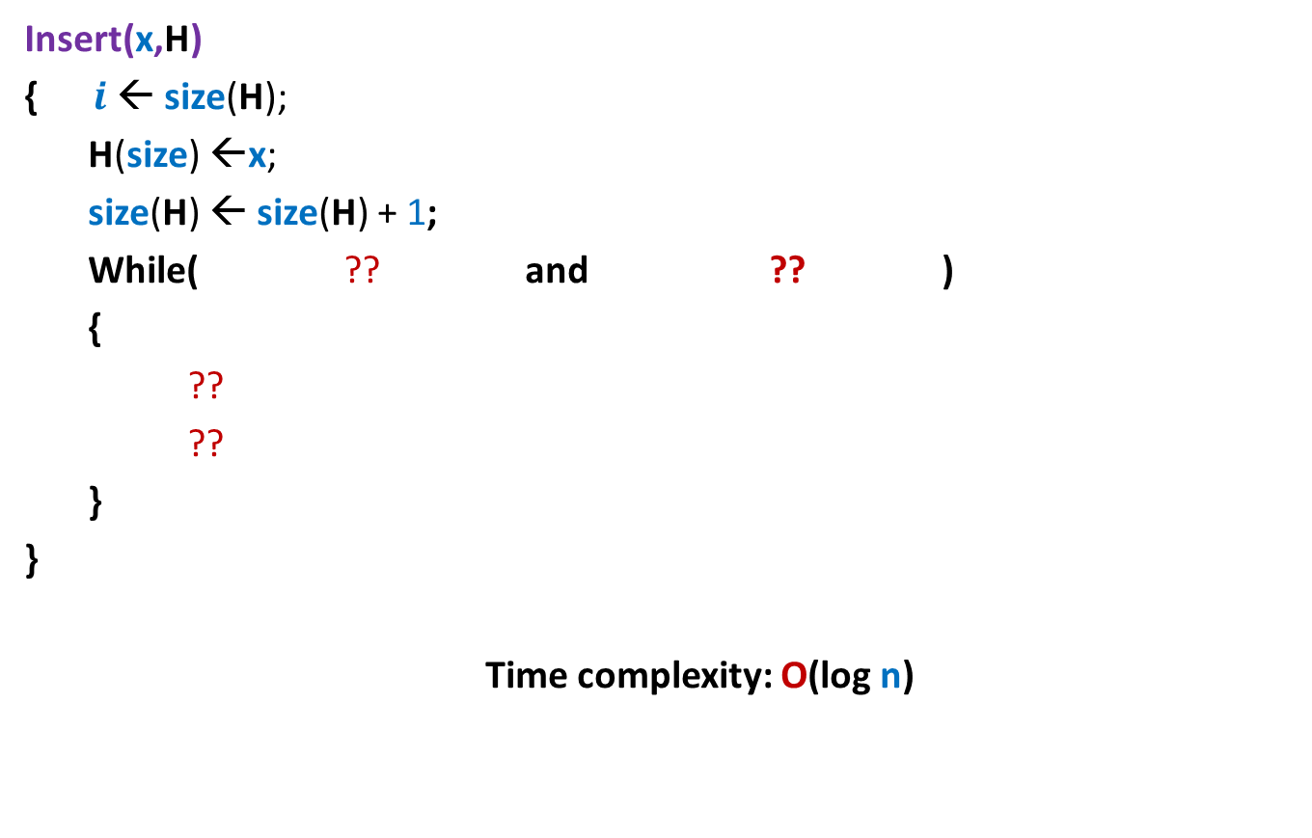



Insert(x,H)
Insert(x,H)
{ $i$← size(H);
H(size) ←x;
size(H) ← size(H) + 1;
While( ?? and ?? )
{
??
??
}
}
Time complexity: O(log n)
$i$> 0
H($i$) < H($\left\lfloor (i−1)/2\right\rfloor$)
H($i$) ↔ H($\left\lfloor (i−1)/2\right\rfloor$);
$i$ ← $\left\lfloor (i−1)/2\right\rfloor$ ;

Slide 24
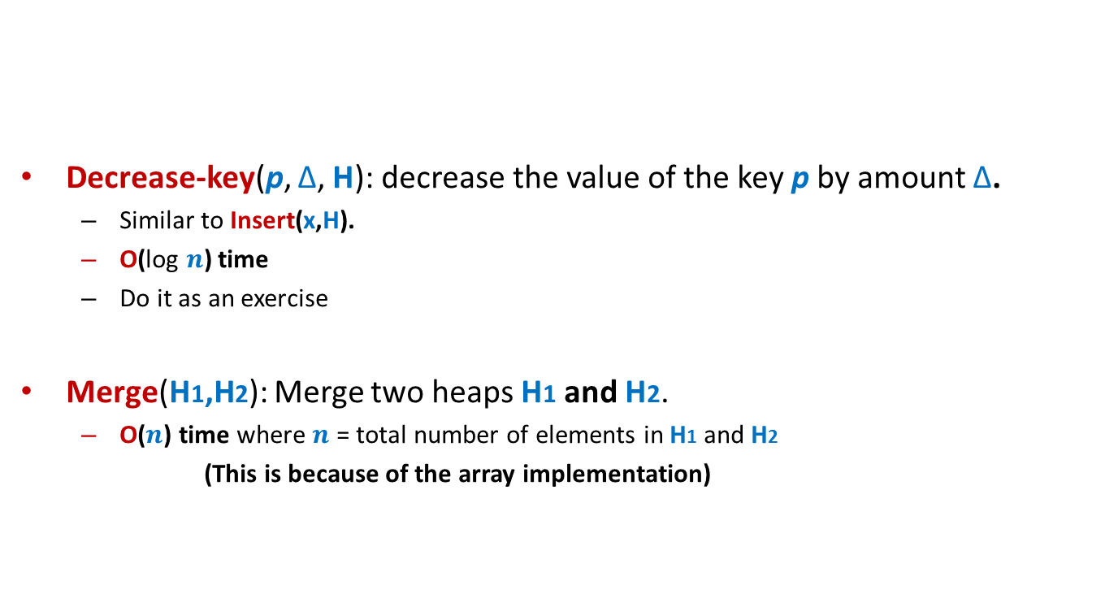
The remaining operations on Binary heap
Decrease-key(p, ∆, H): decrease the value of the key p by amount ∆.
  Similar to Insert(x,H).
  O(log $n$) time
  Do it as an exercise
Merge(H1,H2): Merge two heaps H1 and H2.
  O($n$) time where $n$ = total number of elements in H1 and H2
  (This is because of the array implementation)

Slide 25




Other heaps
Fibonacci heap : a link based data structure.
 | Binary heap | Fibonacci heap
Find-min(H)
Insert(x,H)
Extract-min(H)
Decrease-key(p, ∆, H)
Merge(H1,H2)
O(1)
O(1)
O(log $n$)
O(1)
O(log $n$)
O(log $n$)
O(log $n$)
O(1)
O($n$)
O(1)
Fibonacci Heaps are not part of this course.
You can read about them by yourselves.

Slide 26
Building a Binary heap

Slide 27
Building a Binary heap
Problem: Given n elements {$x_{0}$, …, $x_{n−1}$}, build a binary heap H storing them.
Trivial solution:
(Building the Binary heap incrementally)
CreateHeap(H);
For( $i$ = 0 to $n−1$ )
Insert($x_{i}$,H);
What is the time complexity of this algorithm?

Slide 28
Building a Binary heap incrementally
9
11
21
17
14
33
29
71
37
23
88
41
52
32
76
98
85
47
57
25
H
9 11 21 17 14 33 29 71 37 23 88 41 52 32 76 98 85 47 57
25

Slide 29


Time complexity
Theorem: Time complexity of building a binary heap incrementally is O($n$ log $n$).
A binary heap can be built in O($n$).

Slide 30
A complete binary tree

Slide 31
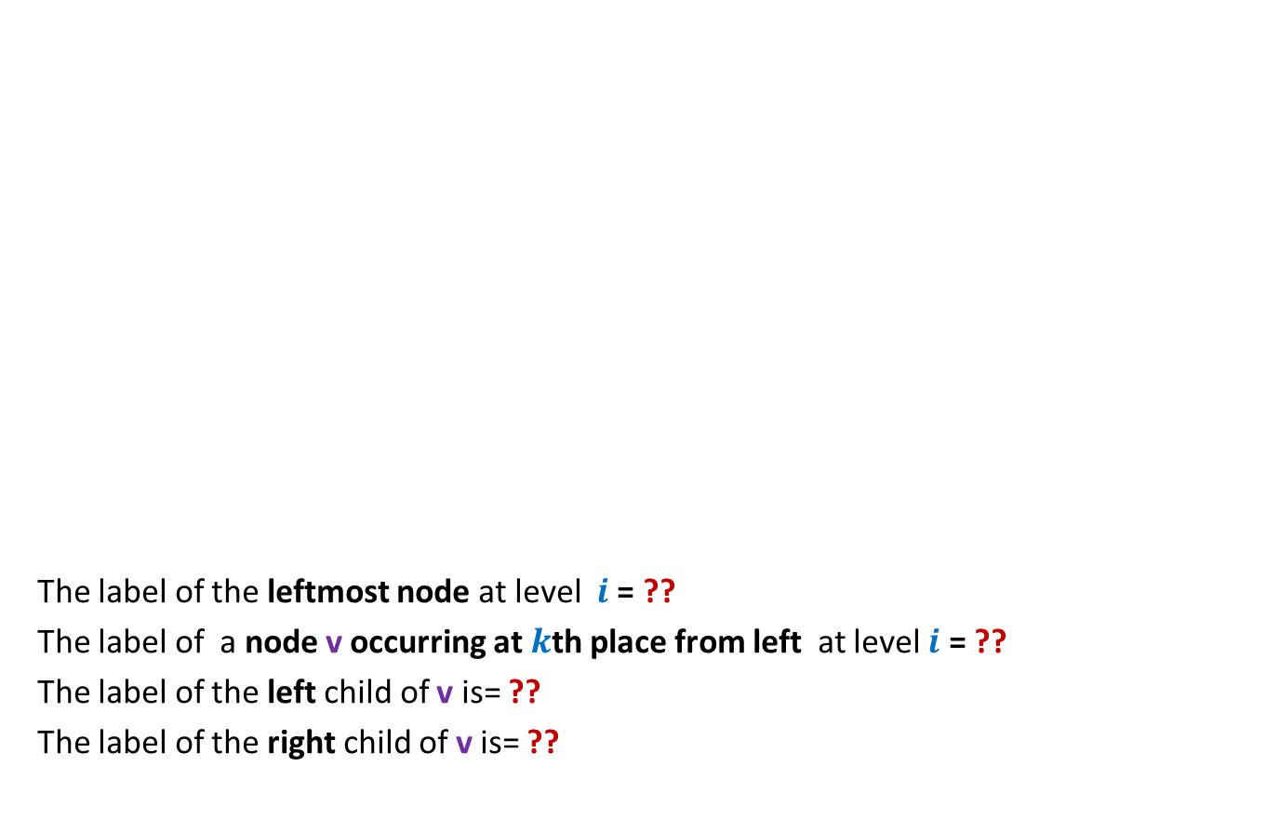
A complete binary tree
How many leaves are there in a complete Binary tree of size $n$ ?
No. of Leaf nodes = No. of Internal nodes + 1

Slide 32
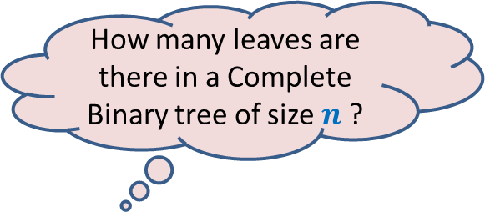
A complete binary tree
How many leaves are there in a Complete Binary tree of size $n$ ?
$$\left\lceil n/2\right\rceil$$
No. of Leaf nodes = No. of Internal nodes
No. of Leaf nodes = No. of Internal nodes
No. of Leaf nodes = No. of Internal nodes + 1

Slide 33
Building a Binary heap incrementally
The time complexity for inserting a leaf node = ?
# leaf nodes = $\left\lceil n/2\right\rceil$,
➔ Theorem: Time complexity of building a binary heap incrementally is O($n$ log $n$).
What useful inference can you draw from this Theorem ?
Top-down
approach
O(log $n$)

Slide 34
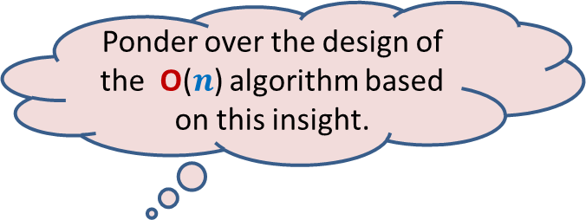
Building a Binary heap incrementally
Ponder over the design of the O($n$) algorithm based on this insight.
Top-down
approach
The O($n$) time algorithm must take O(1) time for each of the $\left\lceil n/2\right\rceil$ leaves.

