Slide 1
Data Structures and Algorithms
(ESO207)
Lecture 34
A new algorithm design paradigm:
part I
Greedy strategy

Slide 2

Path to the solution of a problem
Examples
intuition/insight
Strategy
Have perseverance
Failure ☹
Better Insight ☺
No formula
But there is a systematic approach which usually works ☺
Success ☺

Slide 3
Today’s lecture will demonstrate this approach ☺
Problem : JOB Scheduling
Largest subset of non-overlapping job

Slide 4
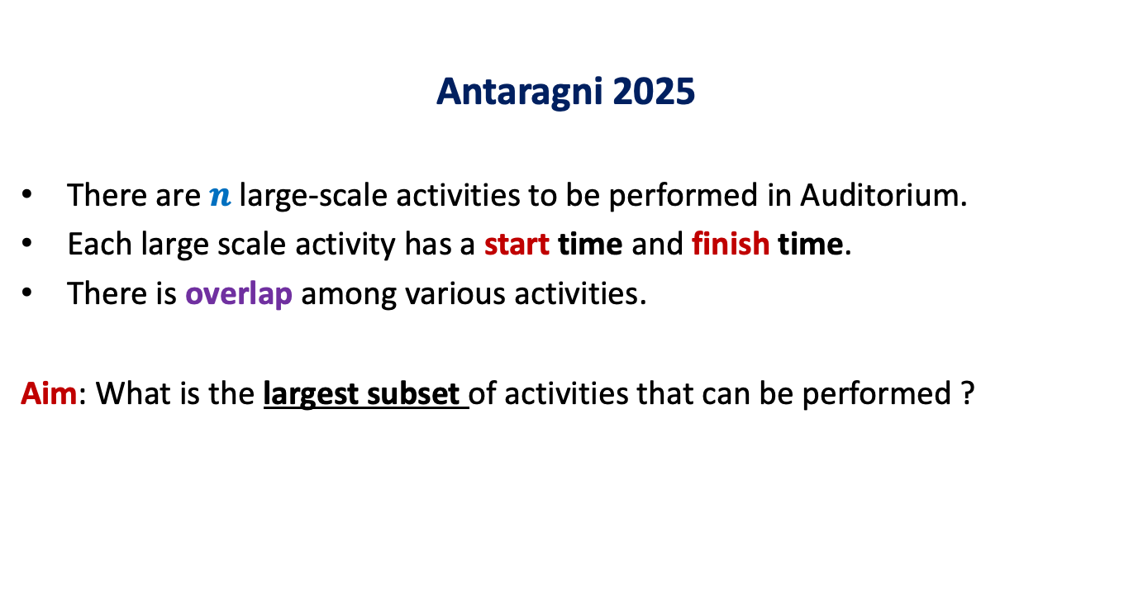
A motivating example
Antaragni 2025
There are $n$ large-scale activities to be performed in Auditorium.
Each large scale activity has a start time and finish time.
There is overlap among various activities.
Aim: What is the largest subset of activities that can be performed ?
Can you formulate the problem theoretically from this example?

Slide 5
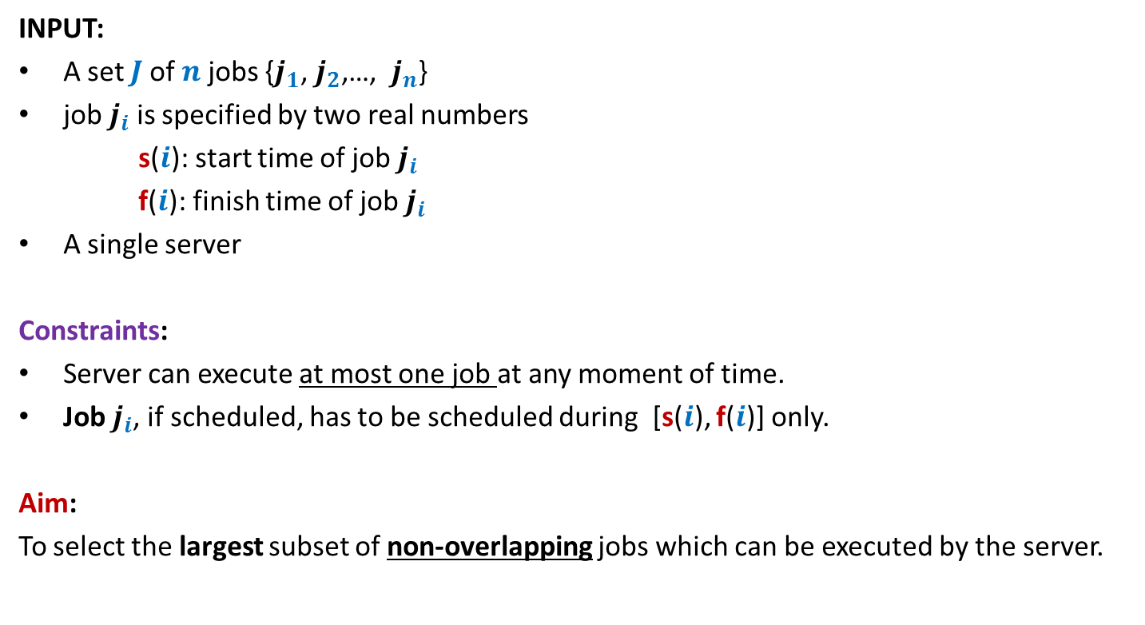
A job scheduling problem
Formal Description
INPUT:
A set $J$of $n$ jobs {$j_{1}$, $j_{2}$,…, $j_{n}$}
job $j_{i}$ is specified by two real numbers
s($i$): start time of job $j_{i}$
f($i$): finish time of job $j_{i}$
A single server
Constraints:
Server can execute at most one job at any moment of time.
Job $j_{i}$, if scheduled, has to be scheduled during [s($i$), f($i$)] only.
Aim:
To select the largest subset of non-overlapping jobs which can be executed by the server.

Slide 6

Example
INPUT: ($1$, $2$), ($1.2$, $2.8$), ($1.8$, $4.6$), ($2.1$, $3$), ($3$, $5$), ($3.3$, $4.2$), ($3.9$, $4.4$), ($4.3$, $5.4$)
job $i$ is said to be non-overlapping with job $k$if (s($i$), f($i$)) ∩(s($k$), f($k$)) = ∅
0 1 2 3 4 5 6 7
It makes sense to work with pictures than these numbers☺
Try to find solution for the above example.

Slide 7
Example
INPUT: ($1$, $2$), ($1.2$, $2.8$), ($1.8$, $4.6$), ($2.1$, $3$), ($3$, $5$), ($3.3$, $4.2$), ($3.9$, $4.4$), ($4.3$, $5.4$)
job $i$ is said to be non-overlapping with job $k$if (s($i$), f($i$)) ∩(s($k$), f($k$)) = ∅
0 1 2 3 4 5 6 7
What strategy come to your mind?

Slide 8
Designing algorithm for any problem
Choose a strategy based on some intuition
Transform the strategy into an algorithm.
Try to prove
correctness
of the
algorithm
c
Try to design a
conterexample
c
Stop as soon as either of these goals is reached

Slide 9
Designing algorithm for the problem
Strategy 1: Select the earliest start time job
Intuition:
It might be better to assign jobs as early as possible so as to make optimum use of server.
0 1 2 3 4 5 6 7
When one fails to prove the correctness of this strategy, one should search for a counterexample. Can you transform the above example into a counterexample ?

Slide 10
Designing algorithm for the problem
Strategy 1: Select the earliest start time job
Intuition:
It might be better to assign jobs as early as possible so as to make optimum use of server.
0 1 2 3 4 5 6 7

Slide 11
Designing algorithm for the problem
Strategy 1: Select the earliest start time job
Intuition:
It might be better to assign jobs as early as possible so as to make optimum use of server.
0 1 2 3 4 5 6 7
Instead of getting disappointed, try to realize that this counterexample points towards some other strategy which might work.
counterexample. ☹

Slide 12
Designing algorithm for the problem
Strategy 2: Select the job with smallest duration
Intuition:
Such a job will make least use of the server
➔ this might lead to larger number of jobs to be executed
0 1 2 3 4 5 6 7
When one fails to prove the correctness of this strategy, one should search for a counterexample. Can you transform the above example into a counterexample ?

Slide 13
Designing algorithm for the problem
Strategy 2: Select the job with smallest duration
Intuition:
Such a job will make least use of the server
➔ this might lead to larger number of jobs to be executed
0 1 2 3 4 5 6 7
Instead of getting disappointed, try to realize that this counterexample points towards some other strategy which might work.
counterexample. ☹

Slide 14
Designing algorithm for the problem
Strategy 3: Select the job with smallest no. of overlaps
Intuition:
Selecting such a job will result in least number of other jobs to be discarded.
0 1 2 3 4 5 6 7
When one fails to prove the correctness of this strategy, one should search for a counterexample. Can you transform the above example into a counterexample ?

Slide 15
Designing algorithm for the problem
Strategy 3: Select the job with smallest no. of overlaps
Intuition:
Selecting such a job will result in least number of other jobs to be discarded.
0 1 2 3 4 5 6 7
Have perseverance.
Think fresh.
counterexample. ☹

Slide 16
Designing algorithm for the problem
Strategy 4: Select the job with earliest finish time
Intuition:
Selecting such a job will free the server earliest
➔ hence more no. of jobs might get scheduled.
0 1 2 3 4 5 6 7

Slide 17
Designing algorithm for the problem
Strategy 4: Select the job with earliest finish time
Intuition:
Selecting such a job will free the server earliest
➔ hence more no. of jobs might get scheduled.
0 1 2 3 4 5 6 7

Slide 18
Designing algorithm for the problem
Strategy 4: Select the job with earliest finish time
Intuition:
Selecting such a job will free the server earliest
➔ hence more no. of jobs might get scheduled.
0 1 2 3 4 5 6 7

Slide 19
Designing algorithm for the problem
Strategy 4: Select the job with earliest finish time
Intuition:
Selecting such a job will free the server earliest
➔ hence more no. of jobs might get scheduled.
0 1 2 3 4 5 6 7
It is indeed a correct solution for this example. We should try to prove the correctness of the algorithm.☺But first we give a full description of the algorithm based on this strategy.

Slide 20
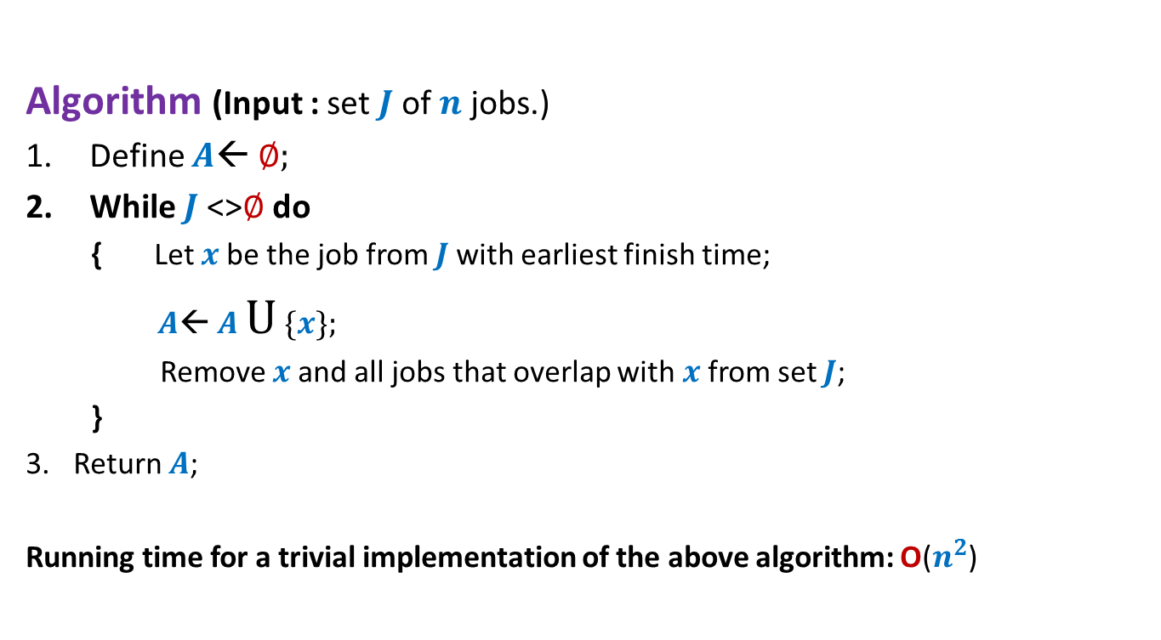
Algorithm “earliest finish time”
Description
Algorithm (Input : set $J$of $n$ jobs.)
Define $A$← ∅;
While $J$<>∅ do
{ Let $x$be the job from $J$with earliest finish time;
$A$← $A$ U {$x$};
Remove $x$and all jobs that overlap with $x$from set $J$;
}
Return $A$;
Running time for a trivial implementation of the above algorithm: O($n^{2}$)

Slide 21

Algorithm “earliest finish time”
Correctness
Let $x$ be the job with earliest finish time.
Lemma1: $x$is present in the optimal solution for $J$.
Too strong a claim !
Wrong
0 1 2 3 4 5 6 7

Slide 22
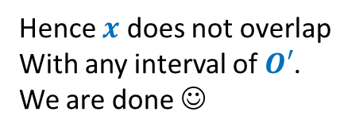






Algorithm “earliest finish time”
Correctness
Let $x$ be the job with earliest finish time.
Lemma1: There exists an optimal solution for $J$in which $x$is present.
Proof: Consider any optimal solution $O$ for $J$. Let us suppose $x$∉ $O$.
Let $y$ be the job from $O$ with earliest finish time.
Let $O′$← $O\backslash \{y\}$
$O^{′}∪\{x\}$ is also an optimal solution.
Reason: $O^{′}∪\{x\}$ has no overlapping intervals. Give arguments.
➔f($x$) $≤$ f($y$)
➔f($y$) < s($z$) $∀$ $z∈$ $O′$
➔f($x$) < s($z$) $∀$ $z∈$ $O′$
$$x$$
Hence $x$ does not overlap
With any interval of $O′$.
We are done ☺
$$y$$
0 1 2 3 4 5 6 7

Slide 23
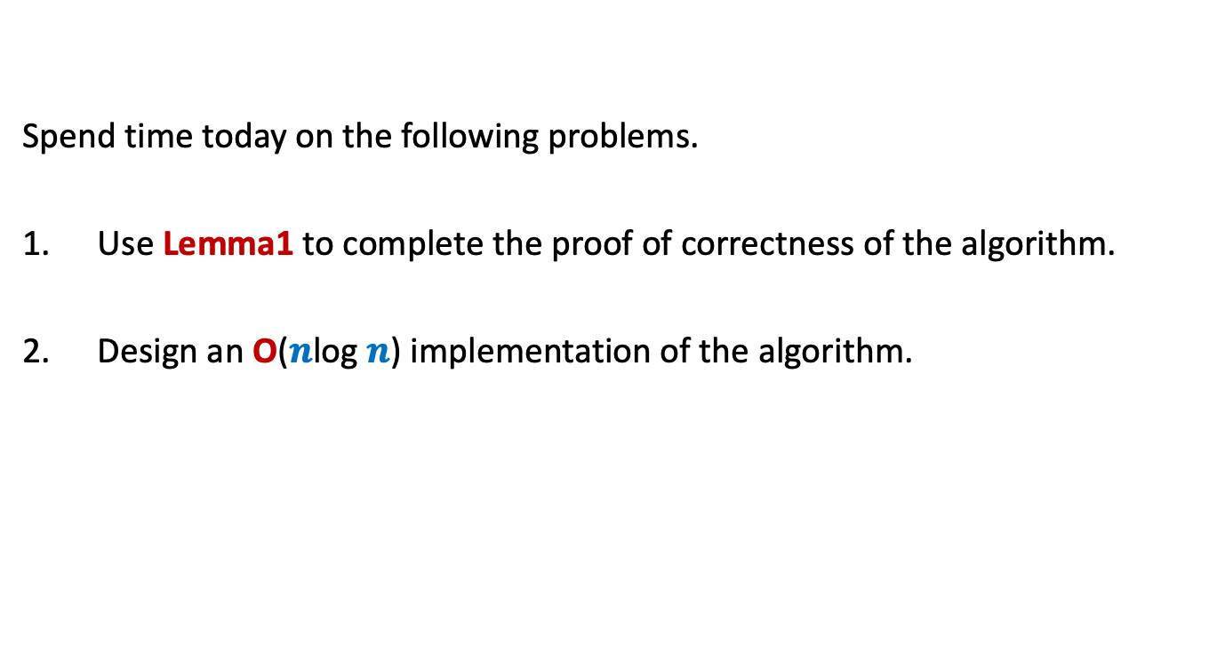
Homework
Spend time today on the following problems.
Use Lemma1 to complete the proof of correctness of the algorithm.
Design an O($n$log $n$) implementation of the algorithm.

