Slide 1
Data Structures and Algorithms
(ESO207)
Lecture 37
A new algorithm design paradigm:
part IV
Greedy strategy

Slide 2
Problem 3
Mobile towers on a road

Slide 3
Mobile towers on a road
A mobile tower can cover any cell phone within radius $d$.
$$d$$
Mobile tower

Slide 4
Mobile towers on a road
$$d$$
$$d$$
Problem statement:
There are $n$ houses located along a road.
We want to place mobile towers such that
Each house is covered by at least one mobile tower.
The number of mobile towers used is least possible.

Slide 5
Mobile towers on a road
$$d$$
$$d$$
Strategy 1:
Place tower at first house,
Remove all houses covered by this tower.
Proceed to the next uncovered house …
$$d$$
$$d$$

Slide 6
Mobile towers on a road
$$d$$
$$d$$
Strategy 2:
Place tower at distance $d$ to the right of the first house;
Remove all houses covered by this tower;
Proceed to the next uncovered house along the road…
Lemma: There is an optimal solution for the problem in which
the leftmost tower is placed at distance $d$ to the right of the first house
$$d$$
$$d$$
can we say anything about the optimal solution ?

Slide 7
Problems solved till now
Job Scheduling Problem
Mobile Tower Problem
MST
Did you notice anything commons in their solutions ?
Ponder over this question before moving ahead

Slide 8
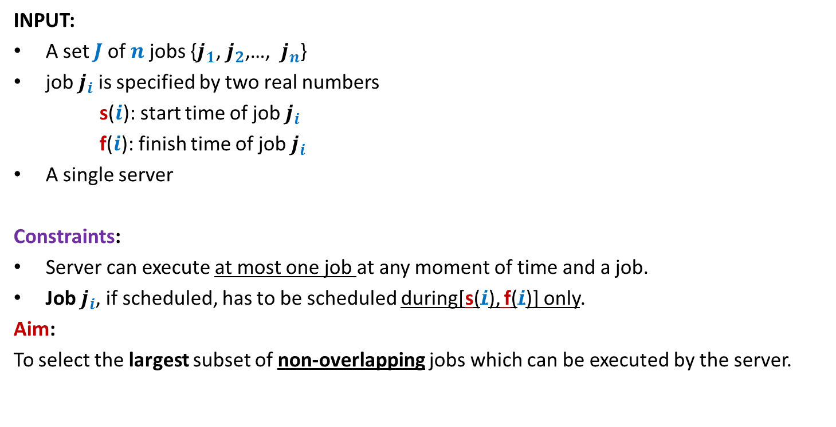
Problem 1
Job scheduling Problem
INPUT:
A set $J$of $n$ jobs {$j_{1}$, $j_{2}$,…, $j_{n}$}
job $j_{i}$ is specified by two real numbers
s($i$): start time of job $j_{i}$
f($i$): finish time of job $j_{i}$
A single server
Constraints:
Server can execute at most one job at any moment of time and a job.
Job $j_{i}$, if scheduled, has to be scheduled during[s($i$), f($i$)] only.
Aim:
To select the largest subset of non-overlapping jobs which can be executed by the server.
We could not say anything about the complete solution of this problem.

Slide 9


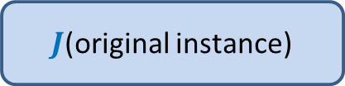

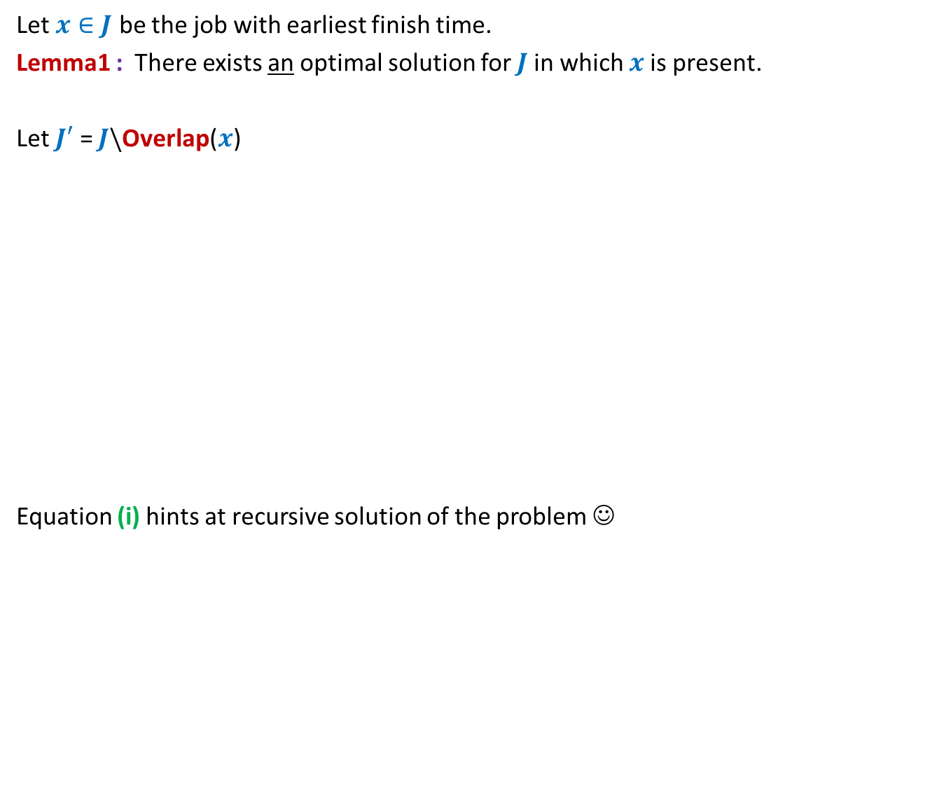

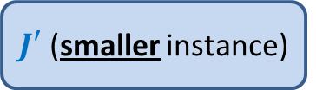
All that we could do was to make a local observation
Let $x∈J$ be the job with earliest finish time.
Lemma1 : There exists an optimal solution for $J$in which $x$is present.
Let $J′$ = $J\backslash$Overlap($x$)
Equation (i) hints at recursive solution of the problem ☺
Lemma 1 gives very small information about the optimal solution ☹
How to use it to compute this solution ?
$J$(original instance)
Opt($J$)
Greedy
step
Opt($J$)= Opt($J′$) + 1 -- (i)
Lemma1
$J′$ (smaller instance)
Opt($J′$)

Slide 10


Theorem: Opt($J$) = Opt($J′$) + 1.
Proof has two parts
Opt($J$) ≥ Opt($J′$) + 1
Opt($J′$) ≥ Opt($J$) – 1
Proof for each part is a proof by construction

Slide 11



Problem 2
Mobile Tower Problem
$$d$$
$$d$$
Problem statement:
There is a set $H$of $n$ houses located along a road.
We want to place mobile towers such that
Each house is covered by at least one mobile tower.
The number of mobile towers used is least possible.
We could not say anything about the complete solution of this problem.

Slide 12

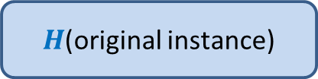



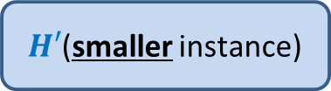
All that we could do was to make a local observation
Lemma 2: There is an optimal solution for the problem in which
the leftmost tower is placed at distance $d$ to the right of the first house.
Let $x$ be the tower located at $d$ to the right of the first house.
Let $H′$ = $H\backslash$ {all houses within distance $d$ from $x$}
Equation (i) hints at recursive solution of the problem ☺
Lemma 1 gives very small information about the optimal solution ☹
How to use it to compute this solution ?
$H$(original instance)
Opt($H$)
Opt($H$)= Opt($H′$) + 1
Greedy
step
Lemma 2
$H′$(smaller instance)
Opt($H′$)

Slide 13
What is a greedy strategy ?
A strategy that is
Based on some local approach
With the objective to optimize some function.
Note:
Recall that the divide and conquer strategy takes a global approach.

Slide 14
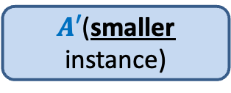
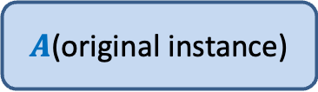
Design of a greedy algorithm
Let A be an instance of an optimization problem.
Make a local observation about the solution.
Use this observation to express optimal solution of A
in terms of
  Optimal solution of a smaller instance A’
  Local step
This gives a recursive solution.
Transform it into iterative one.
$A$(original instance)
Greedy
step
$A′$(smaller instance)

Slide 15
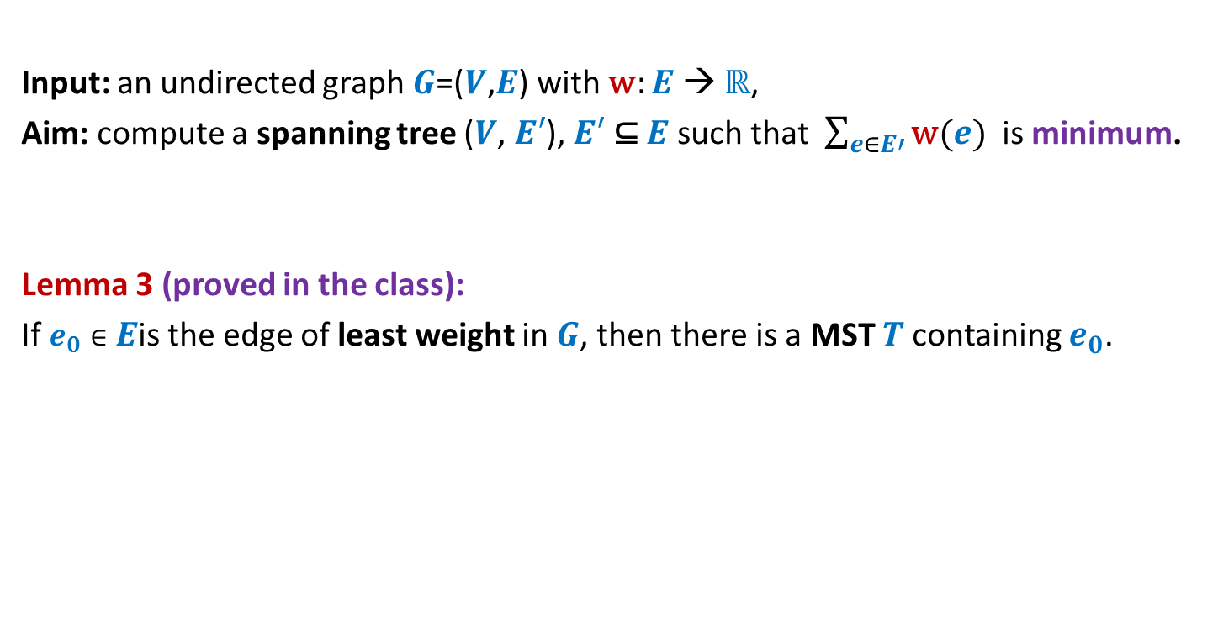
MST
Input: an undirected graph $G$=($V$,$E$) with w: $E$ → ℝ,
Aim: compute a spanning tree ($V$, $E′$), $E′$ ⊆ $E$ such that $\sum_{e∈E′}{\text{w}(e)}$ is minimum.
Lemma 3 (proved in the class):
If $e_{0}∈E$is the edge of least weight in $G$, then there is a MST $T$containing $e_{0}$.
If you have understood a generic way to design a greedy algorithm, then try to solve the MST problem.
How to use this Lemma to design an algorithm for MST ?

Slide 16
How to compute a MST ?
170
54
33
63
35
50
70
31
41
81
64
78
53
42
52
80
49
54
42
60
44
43
50
30
49
57
29
102

Slide 17
How to compute a MST ?
170
54
33
63
35
50
70
31
41
81
64
78
53
42
52
80
49
54
42
60
44
43
50
30
49
57
u
29
102
v

Slide 18
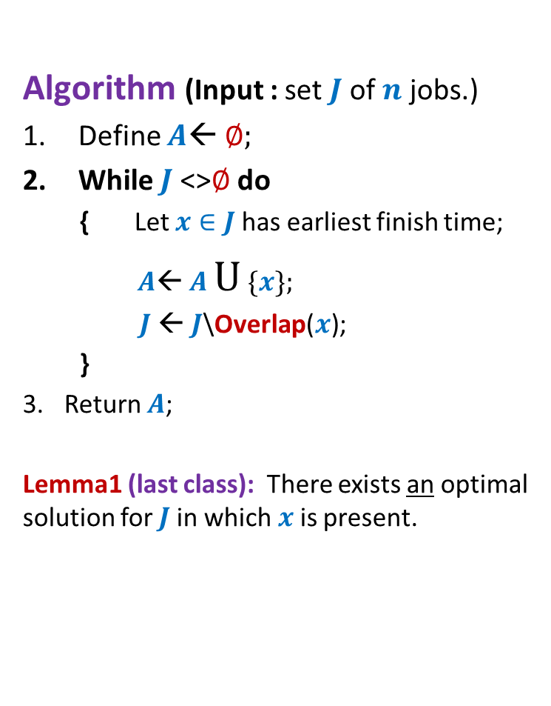
How to compute a MST ?
170
54
33
63
35
50
70
31
41
81
64
78
53
42
52
80
49
54
42
44
60
43
50
30
49
57
w
102
This is graph $G′$

Slide 19
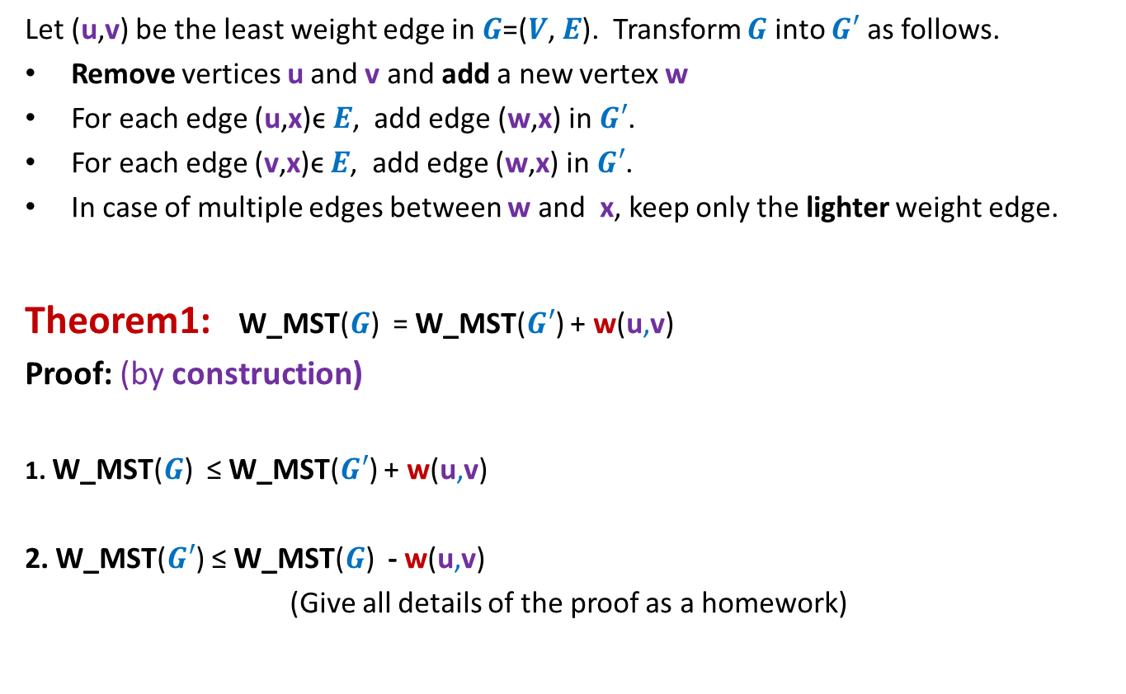
How to compute a MST ?
Let (u,v) be the least weight edge in $G$=($V$, $E$). Transform $G$ into $G′$ as follows.
Remove vertices u and v and add a new vertex w
For each edge (u,x)ϵ $E$, add edge (w,x) in $G′$.
For each edge (v,x)ϵ $E$, add edge (w,x) in $G′$.
In case of multiple edges between w and x, keep only the lighter weight edge.
Theorem1: W_MST($G$) = W_MST($G′$) + w(u,v)
Proof: (by construction)
1. W_MST($G$) ≤ W_MST($G′$) + w(u,v)
2. W_MST($G′$) ≤ W_MST($G$) - w(u,v)
(Give all details of the proof as a homework)
straightforward
Use Lemma 3

Slide 20
Problem 4
Overlapping Intervals
The aim of this problem is to make you realize that
it is sometime very nontrivial to design a greedy algorithm. In particular, it is quite challenging to design the smaller instance.

Slide 21
Problem 4
Overlapping Intervals

Slide 22

Overlapping Intervals
Problem statement:
Given a set A of $n$ intervals, compute smallest set B of intervals so that
for every interval I in A\B, there is some interval in B which overlaps/intersects with I.
A

Slide 23
Overlapping Intervals
Problem statement:
Given a set A of $n$ intervals, compute smallest set B of intervals so that
for every interval I in A\B, there is some interval in B which overlaps/intersects with I.
A
Not an optimal solution ☹
another optimal solution ☺
an optimal solution ☺

Slide 24
Overlapping Intervals
Strategy 1
Interval with maximum length should be there in optimal solution
Intuition:
Selecting such an interval will cover maximum no. of other intervals
There is a counter example ☹

Slide 25
Overlapping Intervals
Strategy 1
Interval with maximum length should be there in optimal solution
Intuition:
Selecting such an interval will cover maximum no. of other intervals
There is a counter example ☹

Slide 26
Overlapping Intervals
Strategy 2
Interval that overlaps maximum no. of intervals should be there in optimal solution
Intuition:
Selecting such an interval will cover maximum no. of other intervals
There is a counter example ☹

Slide 27
Overlapping Intervals
Strategy 2
Interval that overlaps maximum no. of intervals should be there in optimal solution

Slide 28
Overlapping Intervals
Strategy 2
Interval that overlaps maximum no. of intervals should be there in optimal solution
Not an optimal solution ☹

Slide 29
Overlapping Intervals
Strategy 2
Interval that overlaps maximum no. of intervals should be there in optimal solution
An optimal solution has size 2.
Think for a while :
After failure of two strategies, how to proceed to design the algorithm.

Slide 30
Overlapping Intervals
Let I* be the interval with earliest finish time.
Let I’ be the interval with maximum finish time overlapping I*.
Lemma1: There is an optimal solution for set A that contains I’.
Proof:(sketch) :
If I* is overlapped by any other interval in the optimal solution, say I^,
I’ will surely overlap all intervals that are overlapped by I^.
➔ Swapping I^ by I’ will still give an optimal solution.
I’
A
I*
Exploit the fact that I* has earliest finish time for this claim.

Slide 31
Overlapping Intervals
Question: How to obtain smaller instance A’ using Lemma 1 ?
I’
A
I*

Slide 32
Overlapping Intervals
Question: How to obtain smaller instance A’ using Lemma 1 ?
Naive approach : remove from A all intervals which overlap with I’. This is A’.
The problem is that some deleted interval (in this case I’’) could have been used for intersecting many intervals if it were not deleted. But deleting it from the instance disallows it to be selected in the solution.
There is a counter example ☹
A’
I’
A
I*
I’’

Slide 33
Homework
How will you form the smaller instance ?
Design an algorithm for the problem.
Give a neat, concise, and formal proof of correctness of the algorithm.

