Slide 1
Data Structures and Algorithms
(ESO207)
Lecture 40
Search data structure for integers :
Hashing

Slide 2
Data structures for searching
in O(1) time

Slide 3

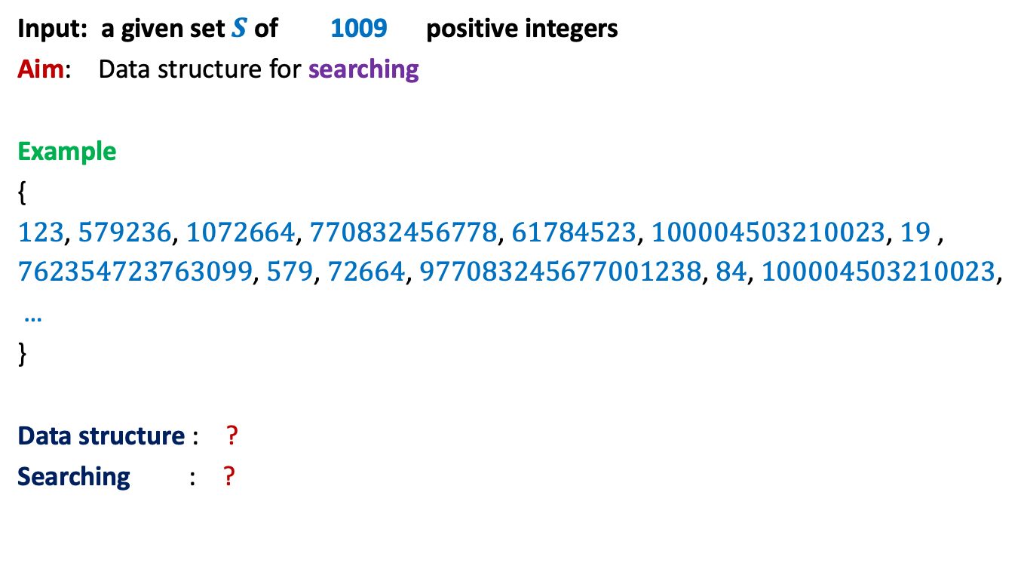


Motivating Example
Input: a given set $S$of 1009 positive integers
Aim: Data structure for searching
Example
{
$123$, $579236$, $1072664$, $770832456778$, $61784523$, $100004503210023$, $19$ ,
$762354723763099$, $579$, $72664$, $977083245677001238$, $84$, $100004503210023$,
…
}
Data structure : ?
Searching : ?
Array storing $S$ in sorted order
Binary search
Can we perform search in O($1$) time ?
O(log $|S|$) time

Slide 4

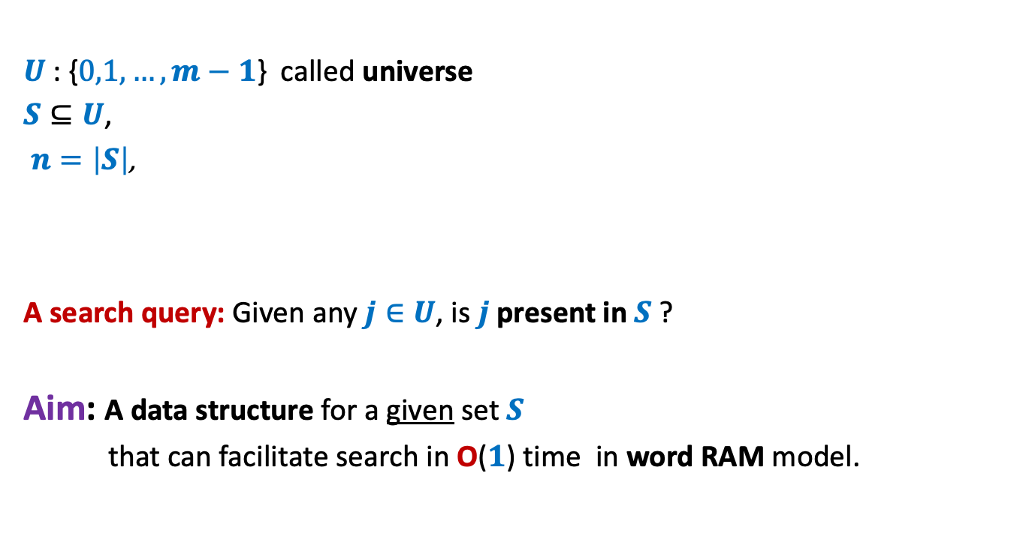
Problem Description
$U$: {$0,1,…,m−1$} called universe
$S⊆U$,
$n=\left|S\right|$,
A search query: Given any $j∈U$, is $j$ present in $S$ ?
Aim: A data structure for a given set $S$
that can facilitate search in O($1$) time in word RAM model.
$n≪$ $m$

Slide 5
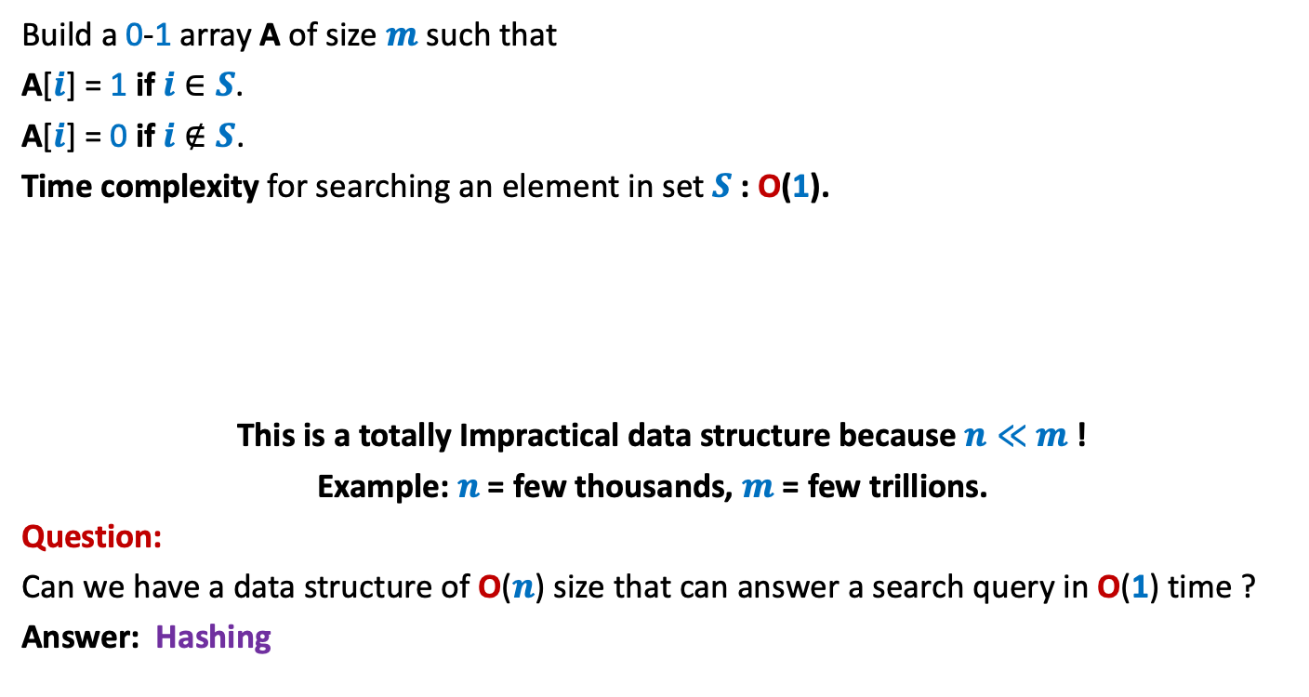
A trivial data structure for O(1) search time
Build a 0-1 array A of size $m$ such that
A[$i$] = 1 if $i$ $∈S$.
A[$i$] = 0 if $i$ $∉S$.
Time complexity for searching an element in set $S$: O(1).
This is a totally Impractical data structure because $n≪$ $m$!
Example: $n$ = few thousands, $m$ = few trillions.
Question:
Can we have a data structure of O($n$) size that can answer a search query in O(1) time ?
Answer: Hashing
0 1 2 3 4 … … $m$-1
A
0 0 1 0 0 … 0 1 0 … 0 0 1

Slide 6
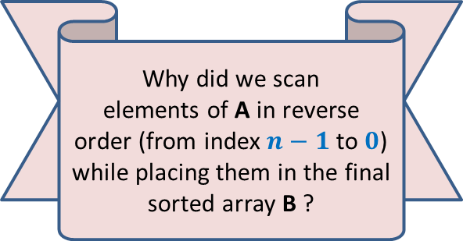
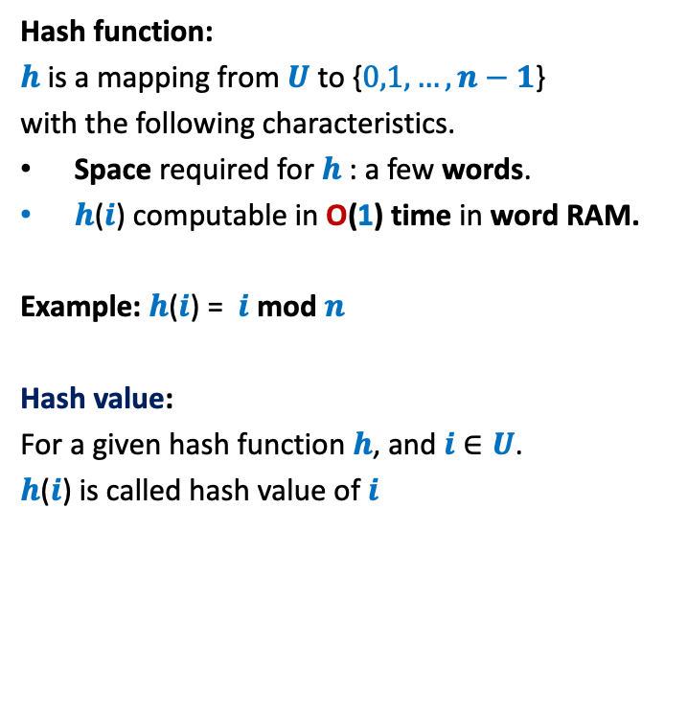
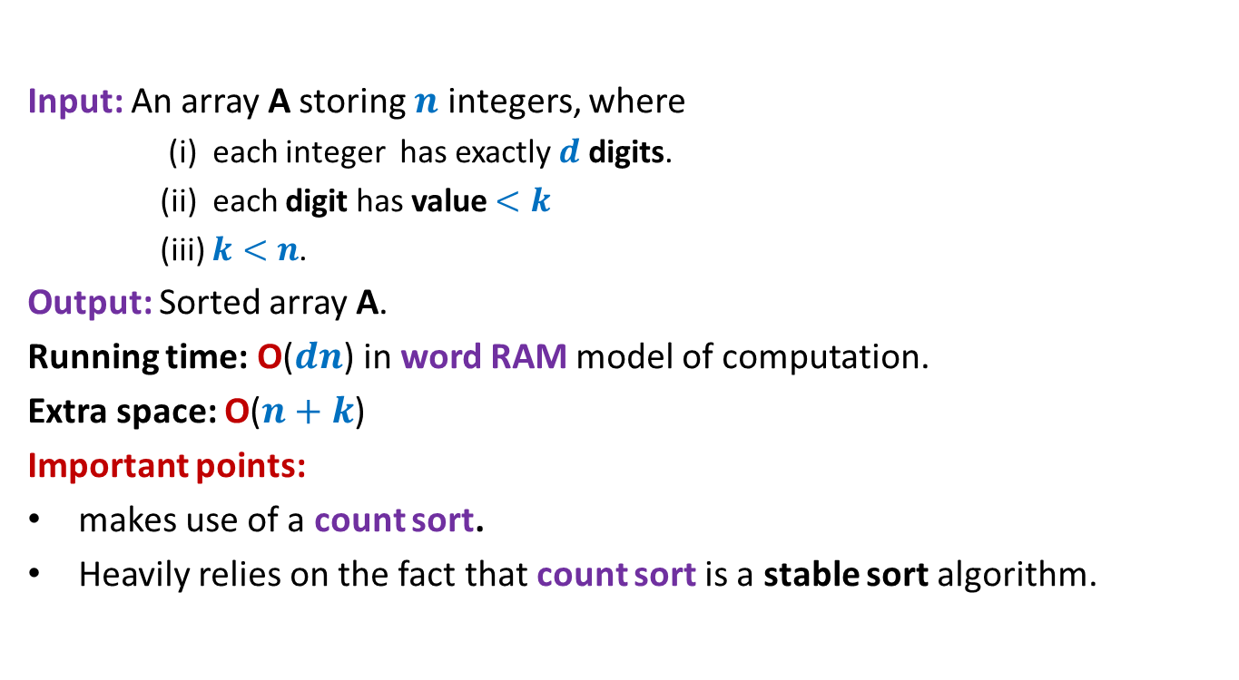
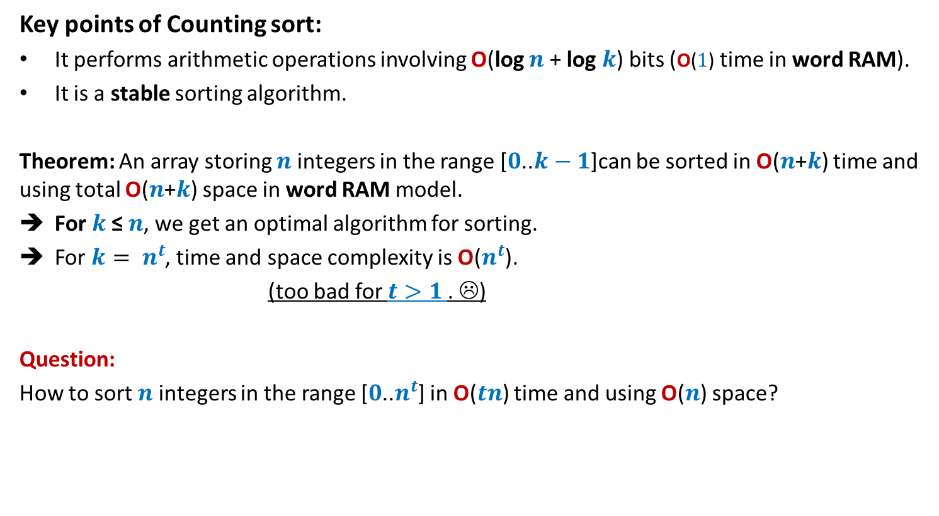
Hash function, hash value, hash table
Hash function:
$h$is a mapping from $U$ to {$0,1,…,n−1$}
with the following characteristics.
Space required for $h$: a few words.
$h$($i$) computable in O(1) time in word RAM.
Example: $h$($i$) = $i$ mod $n$
Hash value:
For a given hash function $h$, and $i$ $∈U$.
$h$($i$) is called hash value of $i$
0
1
2
.
.
.
.
.
.
.
.
.
.
.
$$m−1$$
0
1
.
.
$$n−1$$
$$h$$

Slide 7
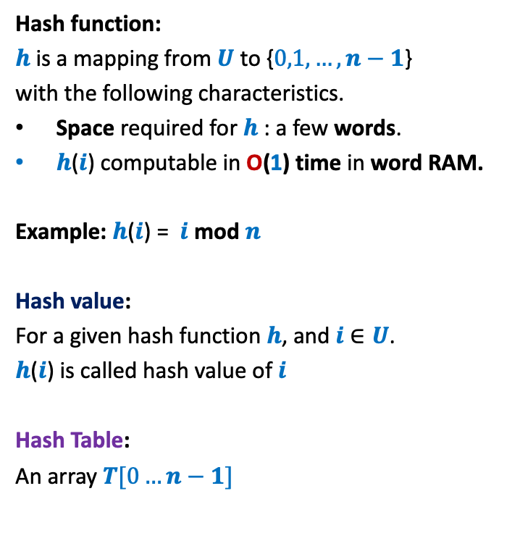


Hash function, hash value, hash table
Hash function:
$h$is a mapping from $U$ to {$0,1,…,n−1$}
with the following characteristics.
Space required for $h$: a few words.
$h$($i$) computable in O(1) time in word RAM.
Example: $h$($i$) = $i$ mod $n$
Hash value:
For a given hash function $h$, and $i$ $∈U$.
$h$($i$) is called hash value of $i$
Hash Table:
An array $T[0…n−1]$
0
1
2
.
.
.
.
.
.
.
.
.
.
.
$$m−1$$
$$T$$
0
1
.
.
.
.
.
$$n−1$$
$$h$$

Slide 8
Hash function, hash value, hash table
Hash function:
$h$is a mapping from $U$ to {$0,1,…,n−1$}
with the following characteristics.
Space required for $h$: a few words.
$h$($i$) computable in O(1) time in word RAM.
Example: $h$($i$) = $i$ mod $n$
Hash value:
For a given hash function $h$, and $i$ $∈U$.
$h$($i$) is called hash value of $i$
Hash Table:
An array $T[0…n−1]$
0
1
2
.
.
.
.
.
.
.
.
.
.
.
$$m−1$$
$$T$$
0
1
.
.
.
.
.
$$n−1$$
$$h$$

Slide 9


Hash function, hash value, hash table
Hash function:
$h$is a mapping from $U$ to {$0,1,…,n−1$}
with the following characteristics.
Space required for $h$: a few words.
$h$($i$) computable in O(1) time in word RAM.
Example: $h$($i$) = $i$ mod $n$
Hash value:
For a given hash function $h$, and $i$ $∈U$.
$h$($i$) is called hash value of $i$
Hash Table:
An array $T[0…n−1]$
0
1
2
.
.
.
.
.
.
.
.
.
.
.
$$m−1$$
$$T$$
0
1
.
.
.
.
.
$$n−1$$
$$h$$
$$S$$
of pointers storing $S$.

Slide 10
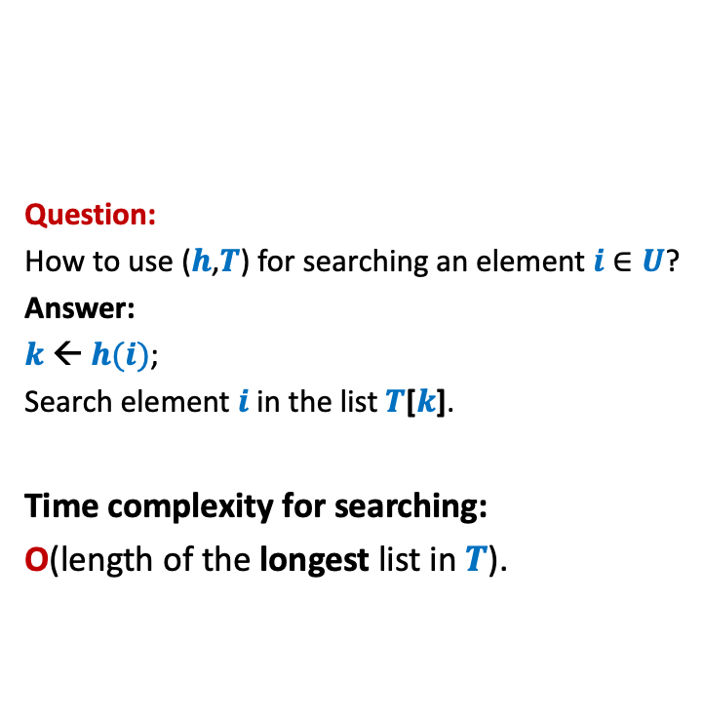
Hash function, hash value, hash table
Question:
How to use ($h$,$T$) for searching an element $i$ $∈U$?
Answer:
$k$← $h(i)$;
Search element $i$in the list $T$[$k$].
Time complexity for searching:
O(length of the longest list in $T$).
0
1
2
.
.
.
.
.
.
.
.
.
.
.
$$m−1$$
$$T$$
0
1
.
.
.
.
.
$$n−1$$
$$h$$
$$S$$

Slide 11

Efficiency of Hashing depends upon hash function
A hash function $h$ is good if it can evenly distributes $S$.
Aim: To search for a good hash function for a given set $S$.
There can not be any hash function $h$ which is good for every $S$.
Bad news

Slide 12


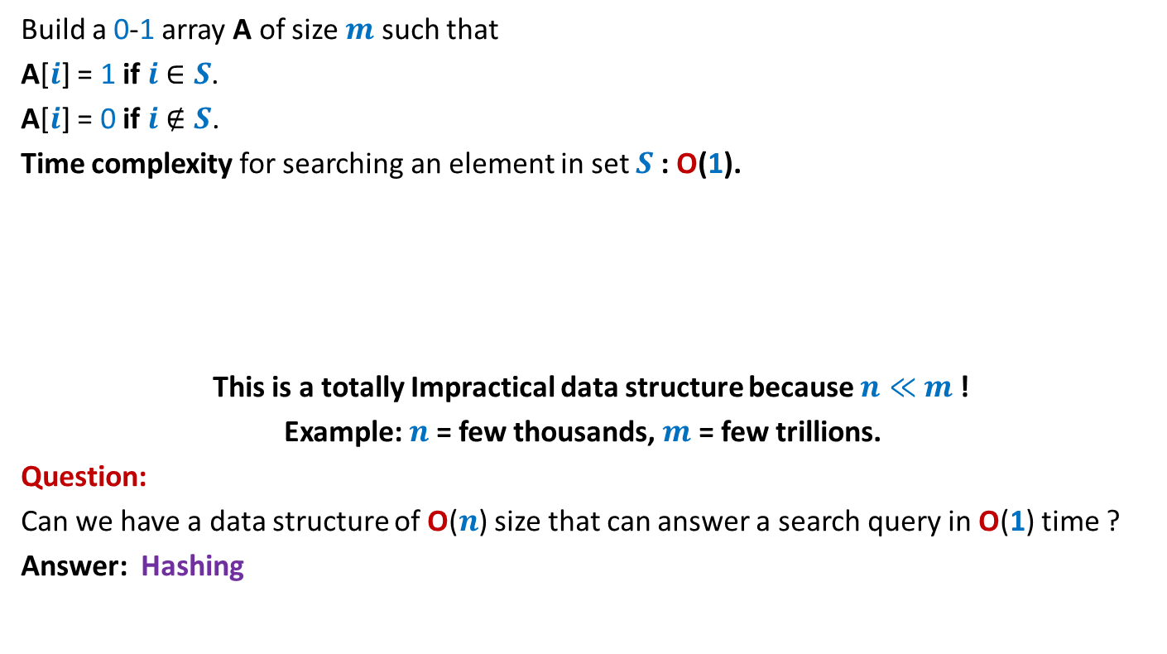
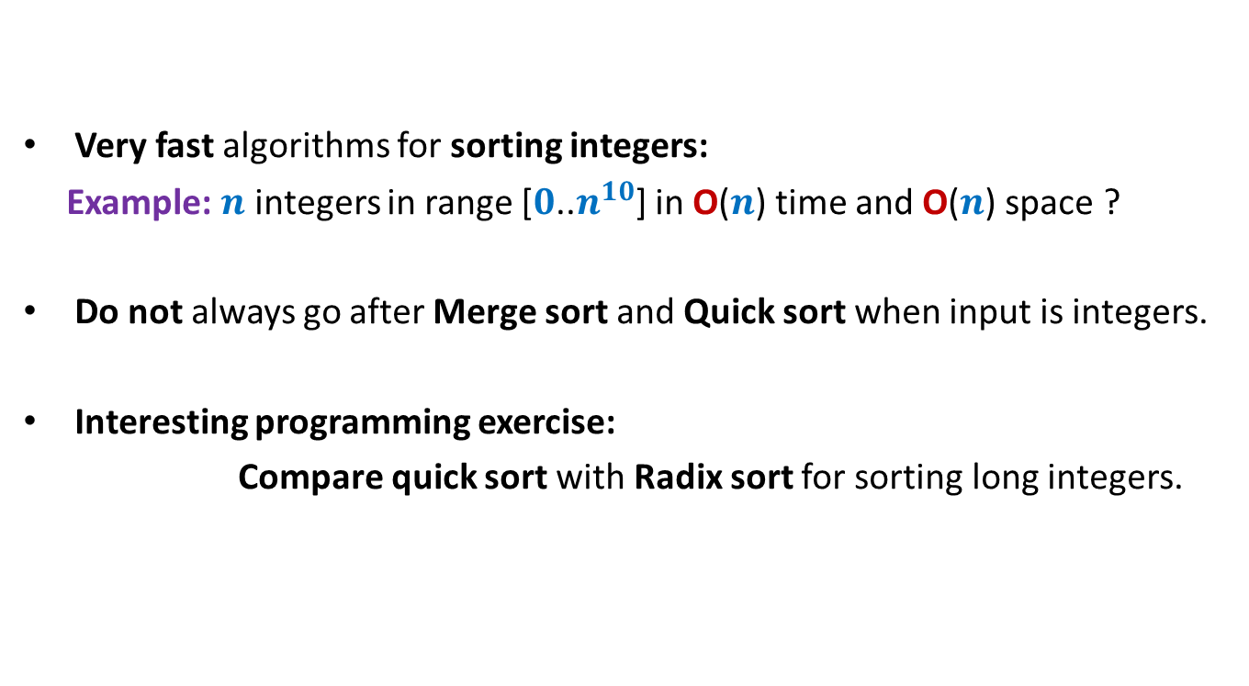
Hash function, hash value, hash table
0
1
2
.
.
.
.
.
.
.
.
.
.
.
$$m−1$$
For every $h$, there exists a subset of $\left\lceil \frac{m}{n}\right\rceil$ elements from $U$ which are hashed to same value under $h$.
So we can always construct a subset $S$ for which all elements have same hash value
All elements of this set $S$ are present in a single list of the hah table $T$ associated with $h$.
O($n$) worst case search time.
0
1
.
.
$$n−1$$
$$h$$

Slide 13

Why does hashing work so well in Practice ?
$$h\left(i\right)=i mod n$$
Because the set $S$ is usually a uniformly random subset of $U$.
Let us do a theoretical analysis to prove this fact.

Slide 14


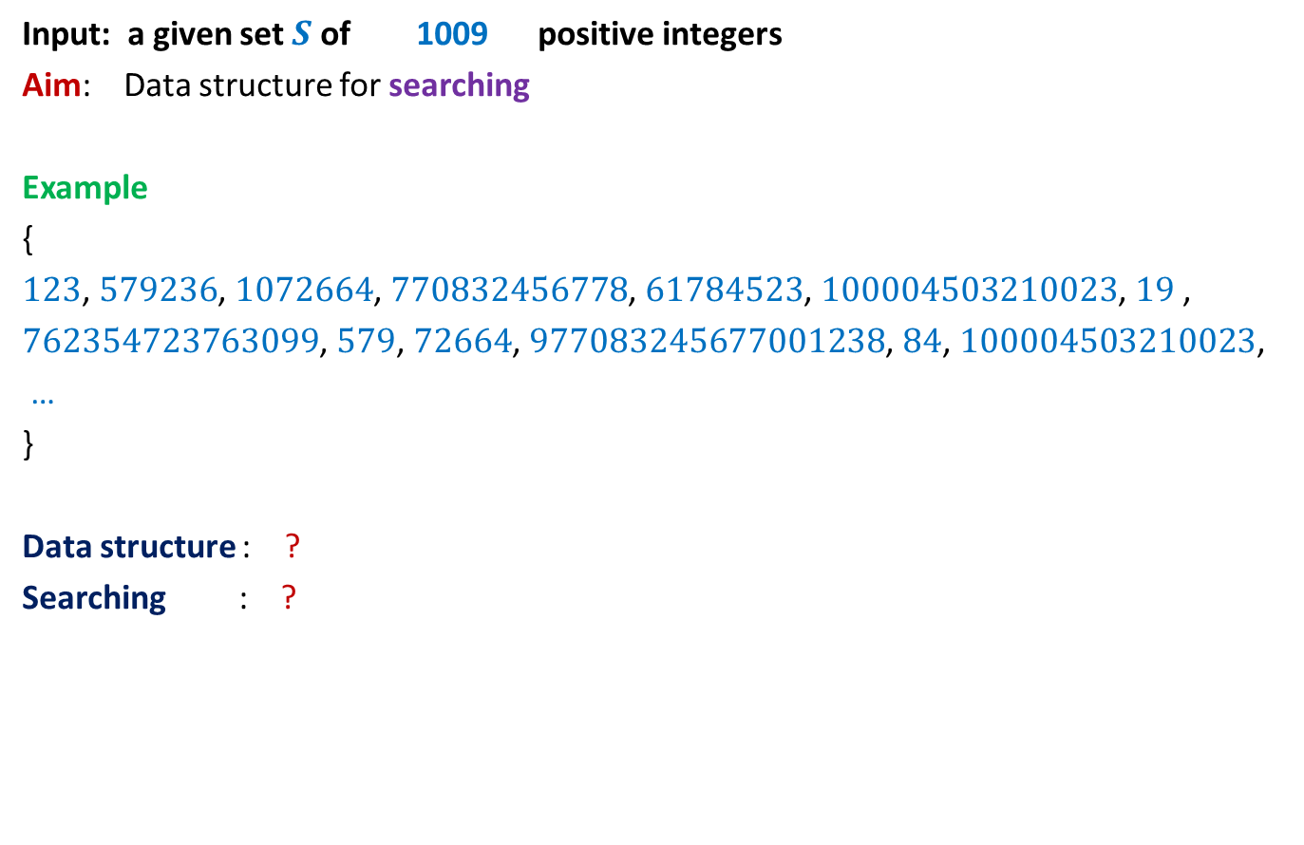

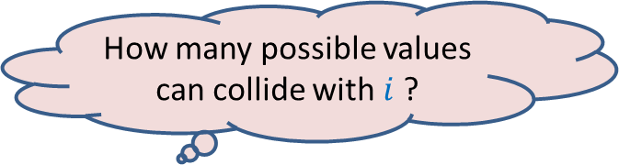
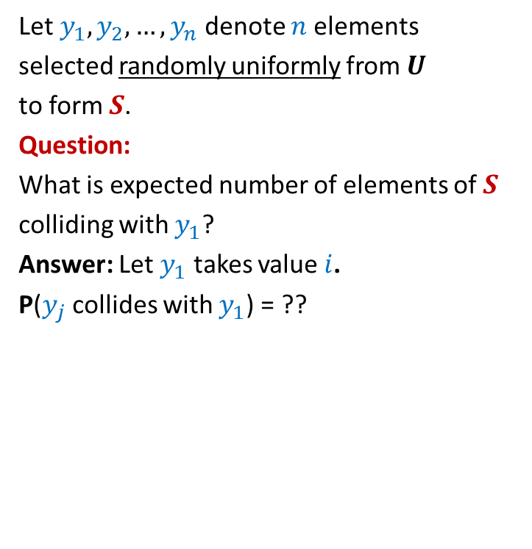




Why does hashing work so well in Practice ?
$$h\left(x\right)=x mod n$$
1
2
Let $y_{1},y_{2},…,y_{n}$ denote $n$elements
selected randomly uniformly from $U$
to form $S$.
Question:
What is expected number of elements of $S$
colliding with $y_{1}$?
Answer: Let $y_{1}$ takes value $i$.
P($y_{j}$ collides with $y_{1}$) = ??
$$⋮$$
$$i−n$$
$$i$$
How many possible values can $y_{j}$ take ?
$$i+n$$
$$m−1$$
$$i+2n$$
How many possible values can collide with $i$ ?
$$i+3n$$
$$⋮$$
m

Slide 15
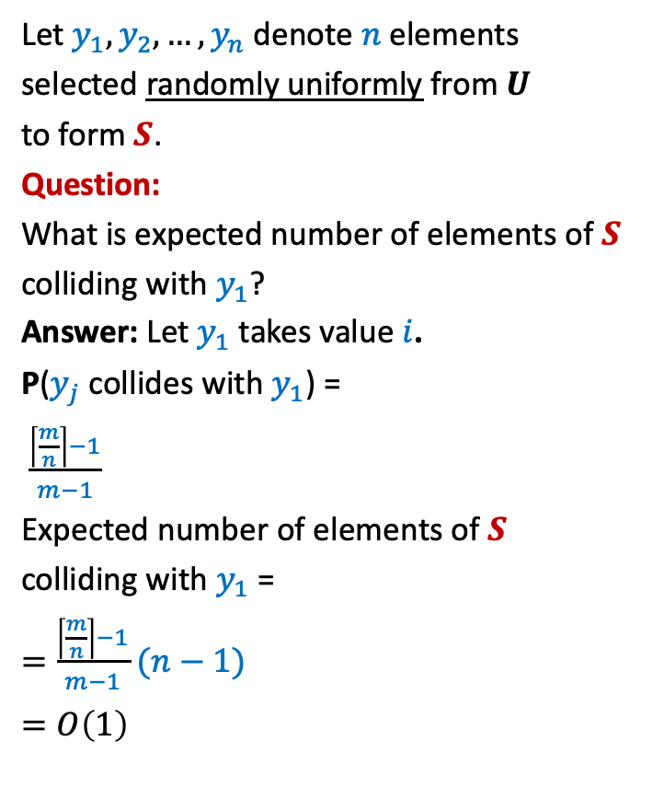

Why does hashing work so well in Practice ?
$$h\left(x\right)=x mod n$$
1
2
Let $y_{1},y_{2},…,y_{n}$ denote $n$elements
selected randomly uniformly from $U$
to form $S$.
Question:
What is expected number of elements of $S$
colliding with $y_{1}$?
Answer: Let $y_{1}$ takes value $i$.
P($y_{j}$ collides with $y_{1}$) =
$\frac{\left\lceil \frac{m}{n}\right\rceil −1}{m−1}$
Expected number of elements of $S$
colliding with $y_{1}$ =
$=\frac{\left\lceil \frac{m}{n}\right\rceil −1}{m−1}$ $(n−1)$
$=O\left(1\right)$
$$⋮$$
$$i−n$$
$$i$$
$$\left\lceil \frac{m}{n}\right\rceil −1$$
$$i+n$$
$$i+2n$$
$$i+3n$$
$$⋮$$
m

Slide 16
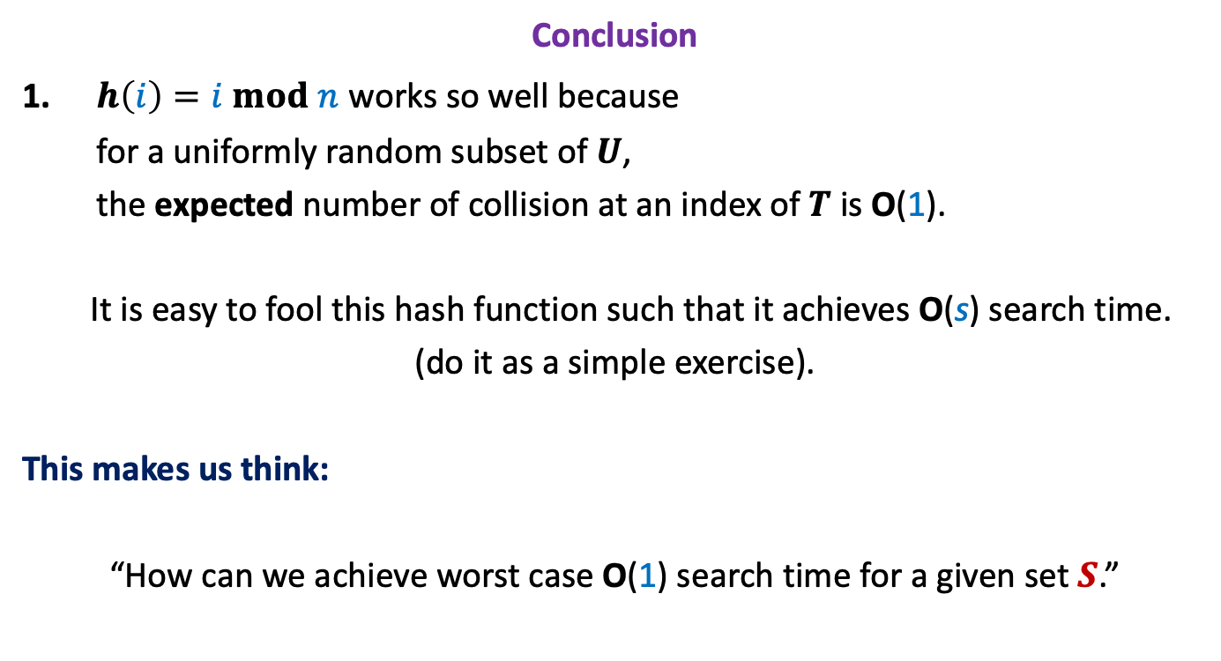
Why does hashing work so well in Practice ?
Conclusion
$h\left(i\right)=i mod n$ works so well because
for a uniformly random subset of $U$,
the expected number of collision at an index of $T$ is O(1).
It is easy to fool this hash function such that it achieves O(s) search time.
(do it as a simple exercise).
This makes us think:
“How can we achieve worst case O(1) search time for a given set $S$.”

Slide 17

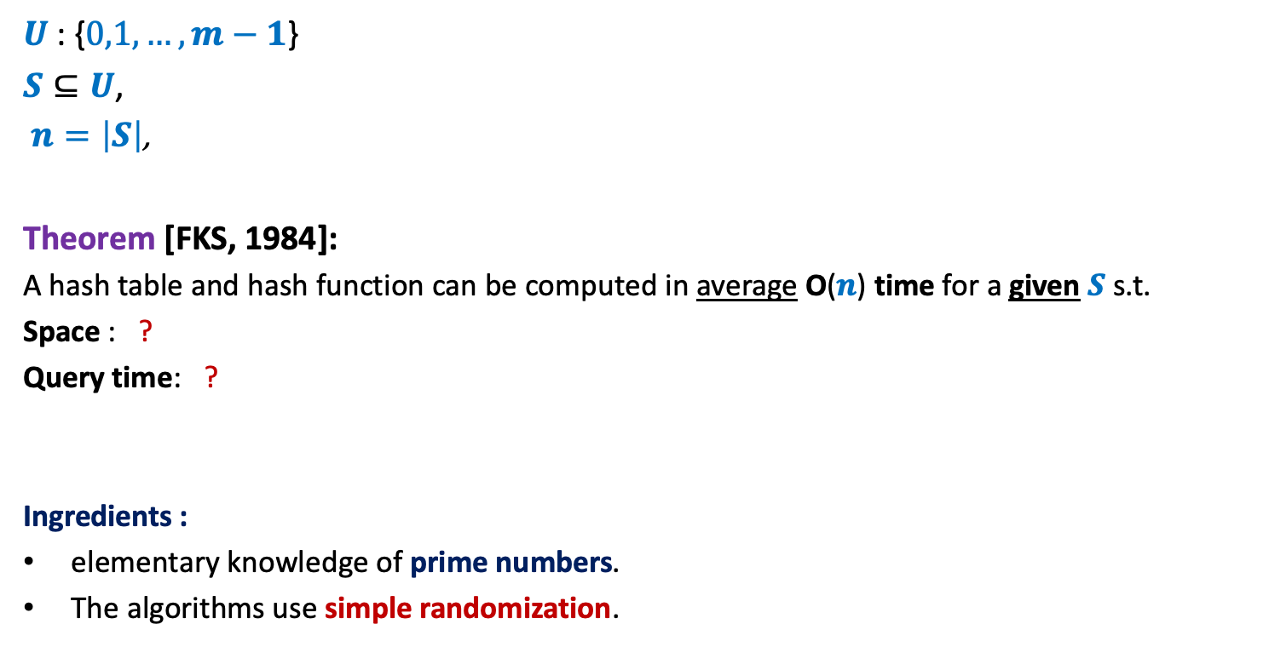

Hashing: theory
1953
$U$: {$0,1,…,m−1$}
$S⊆U$,
$n=\left|S\right|$,
Theorem [FKS, 1984]:
A hash table and hash function can be computed in average O($n$) time for a given $S$ s.t.
Space : ?
Query time: ?
Ingredients :
elementary knowledge of prime numbers.
The algorithms use simple randomization.
1984
O($n$)
worst case O($1$)

Slide 18





Order notation
Definition: Let f($n$) and g($n$) be any two increasing functions of n.
f($n$) is said to be of the order of g($n$)
if there exist constants c and $n_{0}$such that
f($n$) ≤ c g($n$) for all n > $n_{0}$
f($n$) = O(g($n$))
c g($n$)
f($n$)
$$n_{0}$$

Slide 19




Order notation extended
Definition: Let f($n$) and g($n$) be any two increasing functions of n.
f($n$) is said to be lower bounded by g($n$)
if there exist constants c and $n_{0}$such that
f($n$) ≥ c g($n$) for all n > $n_{0}$
$\frac{n^{2}}{100}= Ω$($10000 n log n$)
f($n$) = $Ω$(g($n$))
f($n$)
c g($n$)
$$n_{0}$$

Slide 20




Order notation extended
Observations:
f($n$) = O(g($n$))
One more Notation:
If f($n$) = O(g($n$))
Examples:
$\frac{n^{2}}{100}= Θ$($10000 n^{2}$)
if and only if
g($n$) = $Ω$(f($n$))
and
g($n$) = $O$(f($n$))
, then
g($n$) = $Θ$(f($n$))

Slide 21


Time complexity of Quick Sort is ?
Time complexity of Merge sort is ?
$Ω$($n$ log $n$)
$Θ$($n$ log $n$)

