Slide 1
Data Structures and Algorithms
(ESO207)
Lecture 13:
Majority element : an efficient and practical algorithm
Implementing Stack using a single Queue

Slide 2

Majority element
Definition: Given a multiset $S$ of $n$ elements,
$x∈ S$ is said to be majority element if it appears more than $n/2$ times in $S$.
$S$ = {$a,b,d,z,b,w,b,b,z,b,b,b,b,c$}

Slide 3

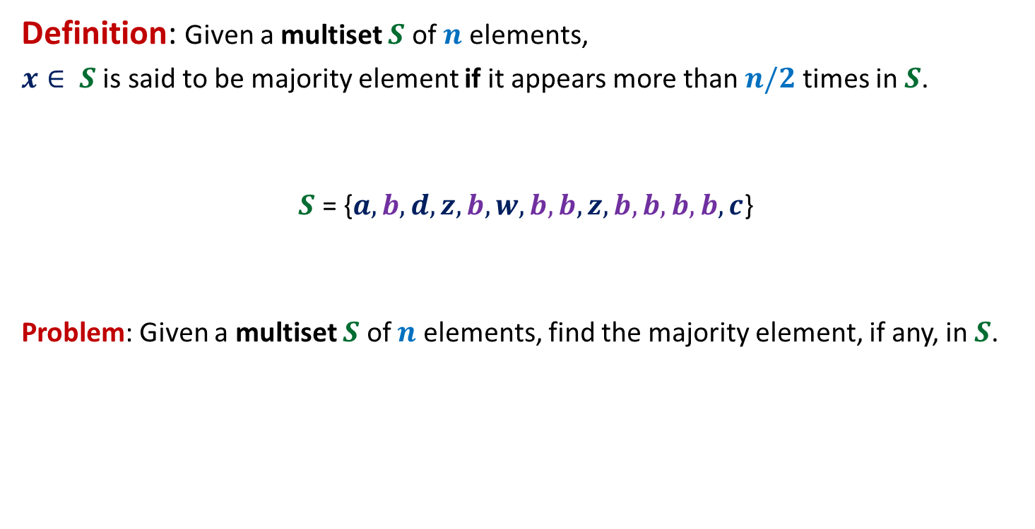
Majority element
Definition: Given a multiset $S$ of $n$ elements,
$x∈ S$ is said to be majority element if it appears more than $n/2$ times in $S$.
$S$ = {$a,b,d,z,b,w,b,b,z,b,b,b,b,c$}
Problem: Given a multiset $S$ of $n$ elements, find the majority element, if any, in $S$.
$$8$$

Slide 4

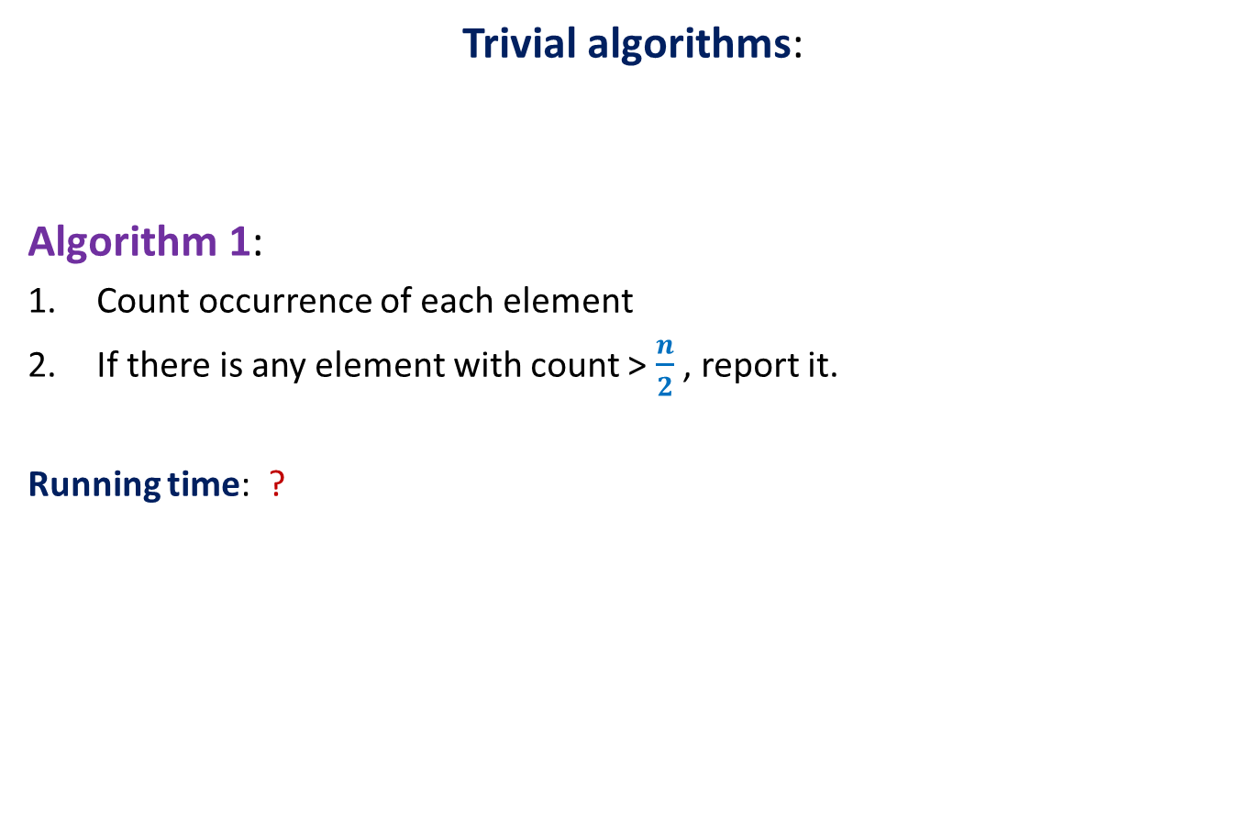
Majority element
Trivial algorithms:
Algorithm 1:
Count occurrence of each element
If there is any element with count > $\frac{n}{2}$ , report it.
Running time: ?
O($n^{2}$) time

Slide 5

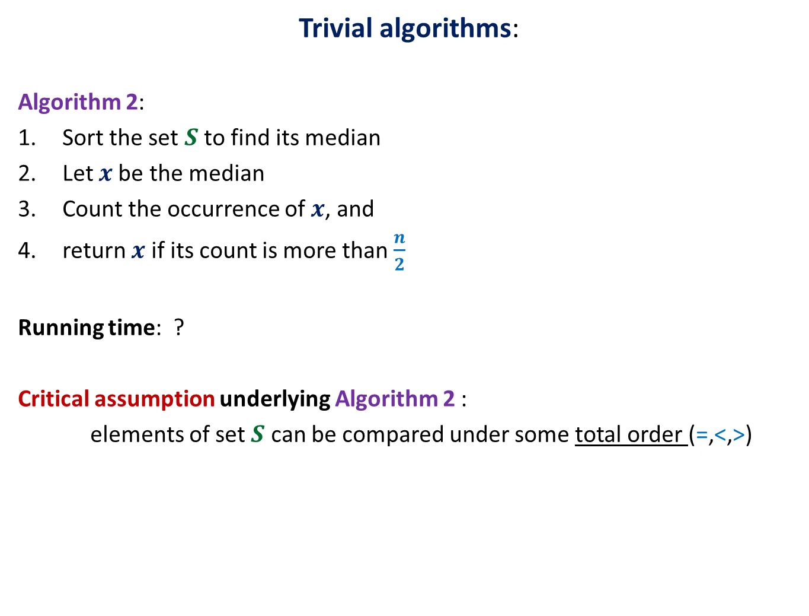
Majority element
Trivial algorithms:
Algorithm 2:
Sort the set $S$ to find its median
Let $x$be the median
Count the occurrence of $x$, and
return $x$ if its count is more than $\frac{n}{2}$
Running time: ?
Critical assumption underlying Algorithm 2 :
elements of set $S$ can be compared under some total order (=,<,>)
This assumption is
not justified in many real life applications.
O($n log n$) time

Slide 6
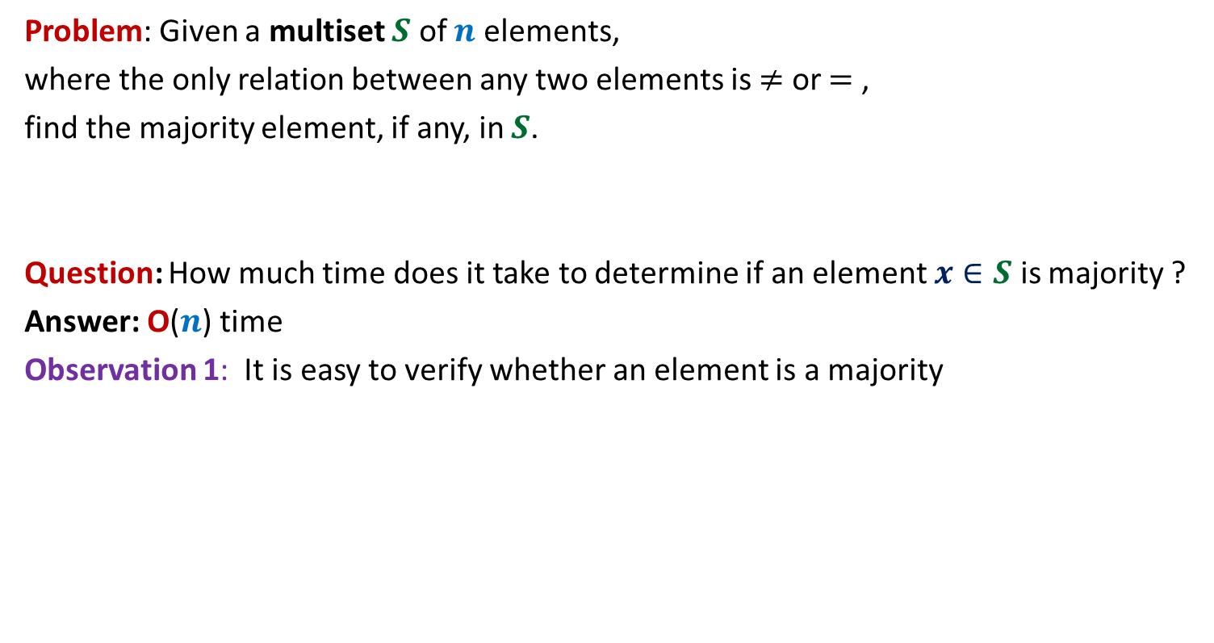
Some observations
Problem: Given a multiset $S$ of $n$ elements,
where the only relation between any two elements is $≠$ or $=$ ,
find the majority element, if any, in $S$.
Question: How much time does it take to determine if an element $x∈S$ is majority ?
Answer: O($n$) time
Observation 1: It is easy to verify whether an element is a majority

Slide 7


Some observations
Observation 2: whenever we cancel a pair of distinct elements from the array,
the majority element of the array remains preserved.
α
x
α
y
< $\frac{n}{2}$
> $\frac{n}{2}$
α
w
v
α
α
Majority
element
other
elements

Slide 8
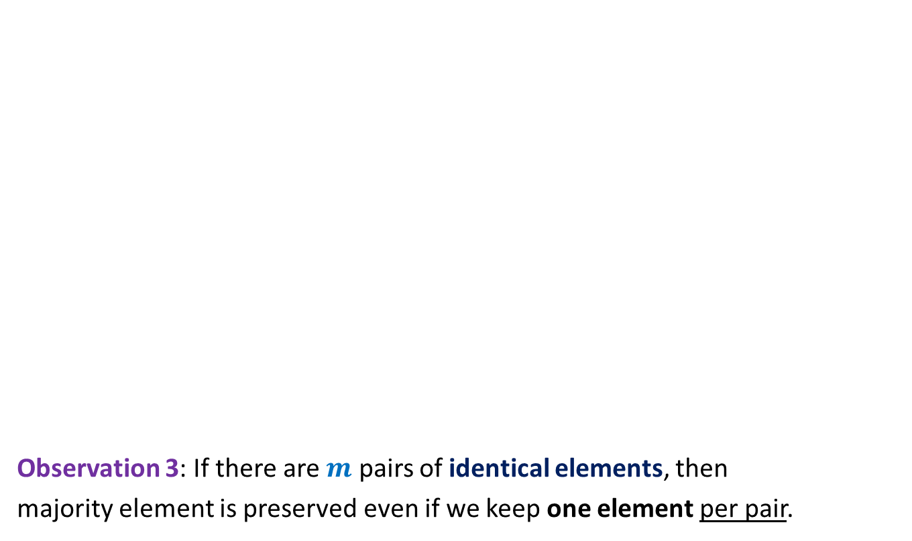


Some observations
Observation 3: If there are $m$ pairs of identical elements, then
majority element is preserved even if we keep one element per pair.
$a b c c c z c a b b c c c c d c$
$c c b b c c c c$
The problem size reduced by at least half.
$$c b c c$$

Slide 9

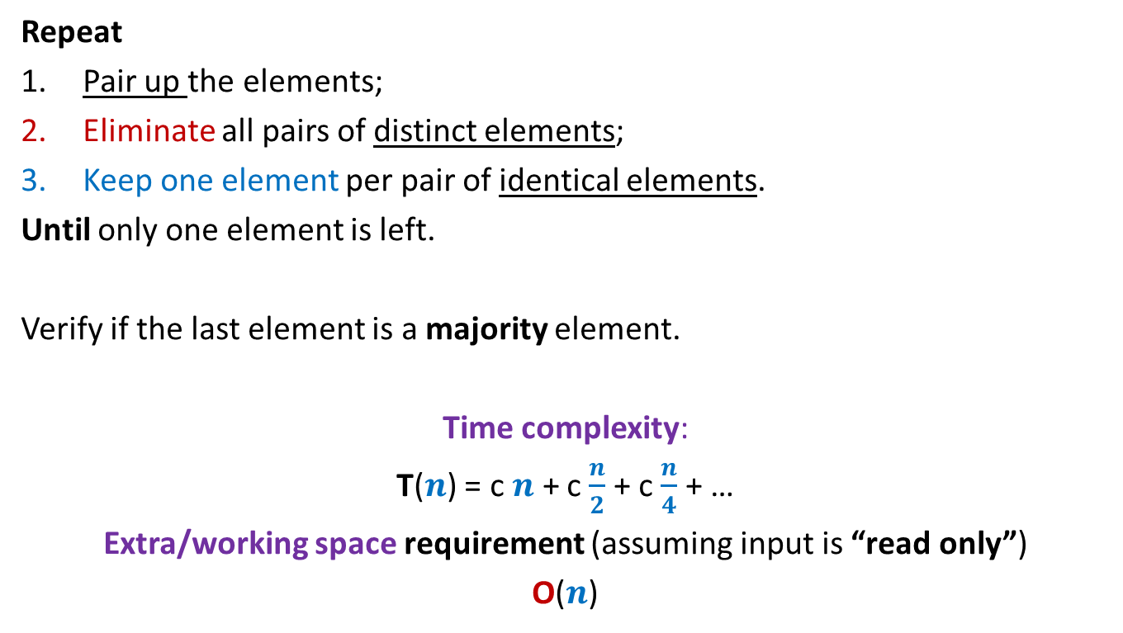
Algorithm for 2-majority element
Repeat
Pair up the elements;
Eliminate all pairs of distinct elements;
Keep one element per pair of identical elements.
Until only one element is left.
Verify if the last element is a majority element.
Time complexity:
T($n$) = c $n$ + c $\frac{n}{2}$ + c $\frac{n}{4}$ + …
Extra/working space requirement (assuming input is “read only”)
O($n$)
Take care if the no. of elements is odd
O($n$) time

Slide 10
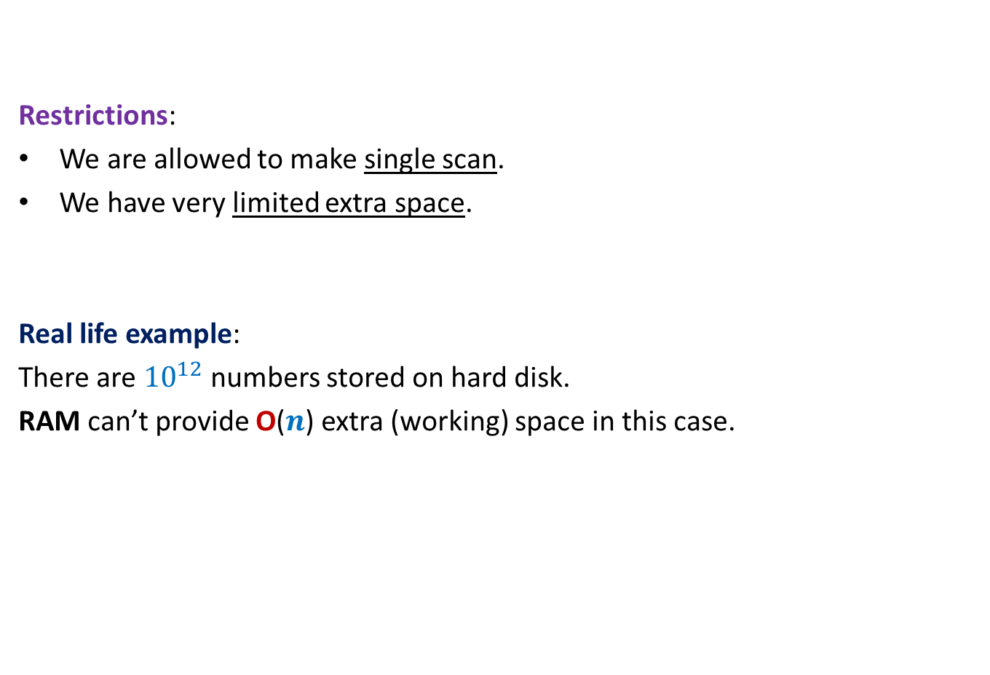
Further restrictions on the problem
Restrictions:
We are allowed to make single scan.
We have very limited extra space.
Real life example:
There are ${10}^{12}$ numbers stored on hard disk.
RAM can’t provide O($n$) extra (working) space in this case.
Our current algorithm doesn’t work
for this real life example.

Slide 11
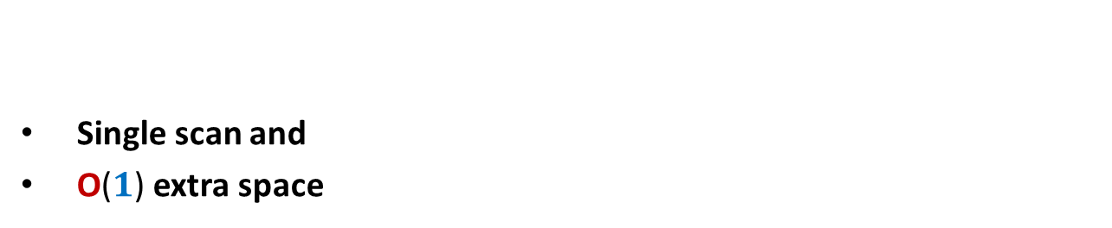
algorithm for 2-majority element
Single scan and
O($1$) extra space

Slide 12

Designing algorithm for 2-majority element single scan and using O($1$) extra space
Question: Should we design algorithm from scratch to meet these constraints ?
Answer: No! We should try to adapt our current algorithm to meet these constraints.
Question: How crucial is pairing of elements in our current algorithm ?
Think over this question before going ahead.

Slide 13
Designing algorithm for 2-majority element single scan and using O($1$) extra space
Insightful questions:
Do we really need to keep more than one element ?
Do we really need to keep multiple copies of an element explicitly ?
Ponder over these insights and make an attempt to design the algorithm
before moving ahead ☺
Single scan
$a b c c c z c a b b c c c c d c$
No. Just cancel suitably whenever we encounter two distinct elements.
No. Just keeping its count will suffice.

Slide 14
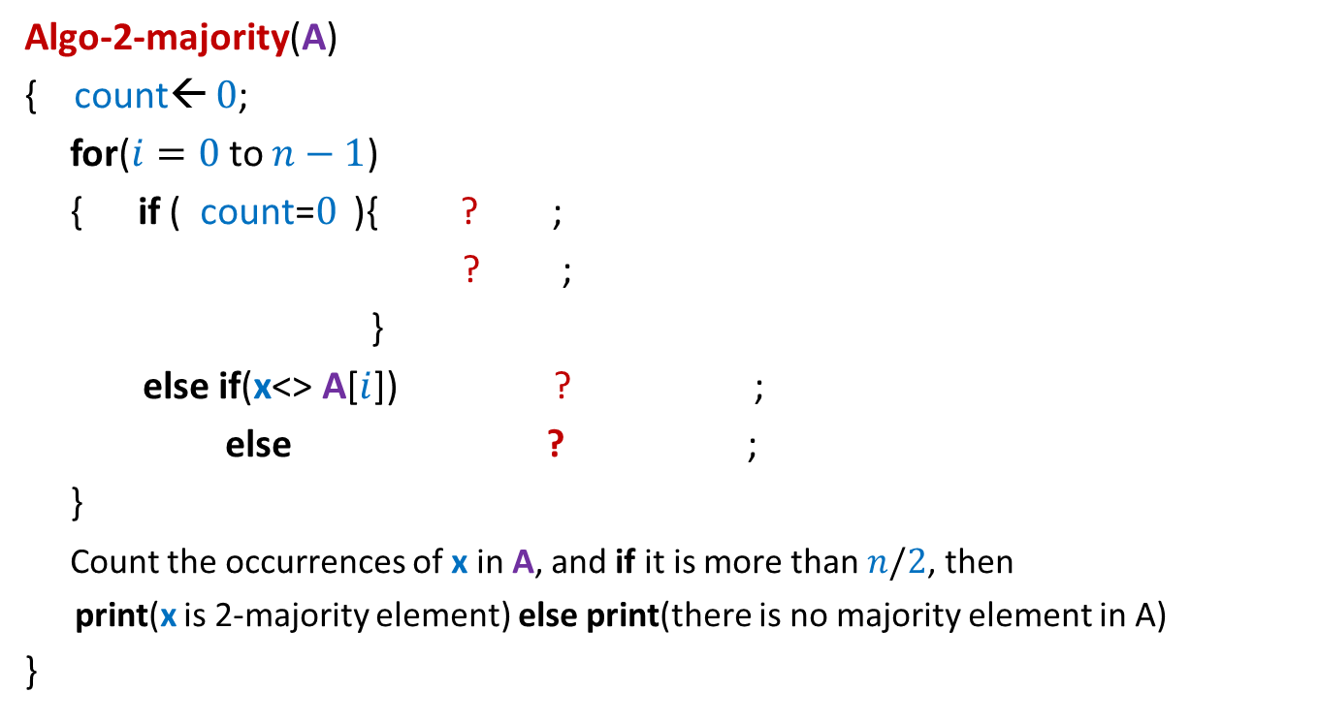


Algorithm for 2-majority element single scan and using O($1$) extra space
Algo-2-majority(A)
{ count← $0$;
for($i=0$to $n−1$)
{ if ( count=$0$ ){ ? ;
? ;
}
else if(x<> A[$i$]) ? ;
else ? ;
}
Count the occurrences of x in A, and if it is more than $n/2$, then
print(x is 2-majority element) else print(there is no majority element in A)
}
x← A[$i$];
count← 1;
count ← count - 1
count← count + 1

Slide 15
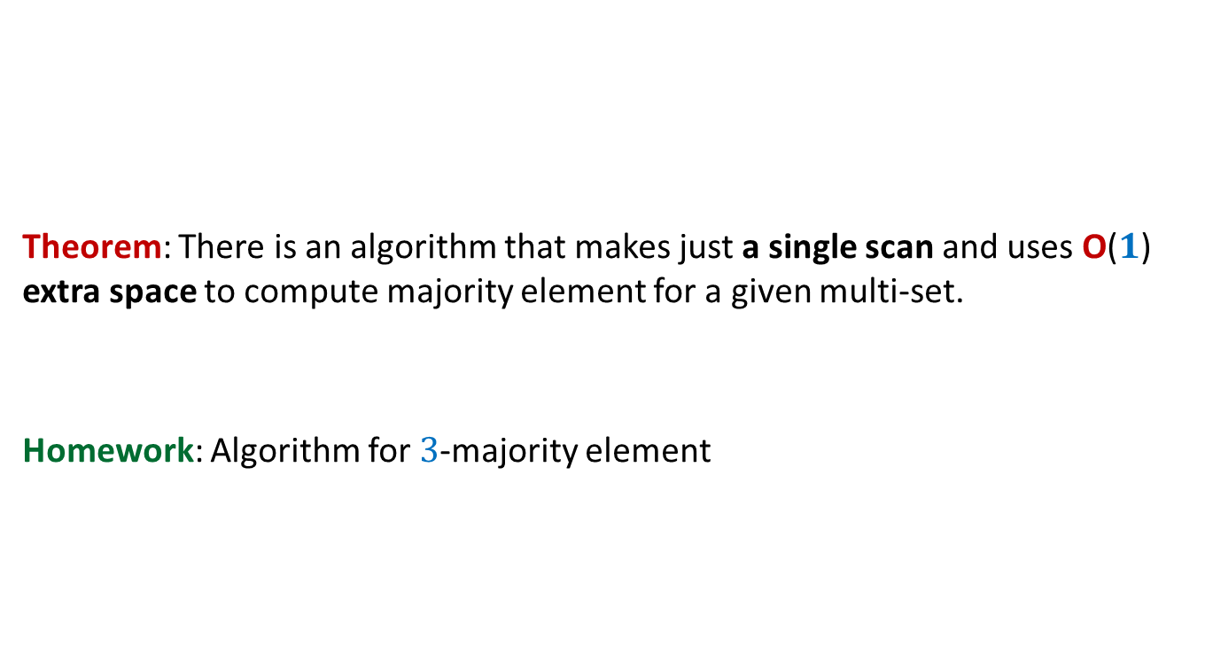

Algorithm for 2-majority element single scan and using O($1$) extra space
Theorem: There is an algorithm that makes just a single scan and uses O($1$) extra space to compute majority element for a given multi-set.
Homework: Algorithm for $3$-majority element

Slide 16
A nice programming exercise ?
0 1 2 3 4 5 6 7 8
x

Slide 17
A nice programming exercise ?
0 1 2 3 4 5 6 7 8
>x
<x
x

Slide 18
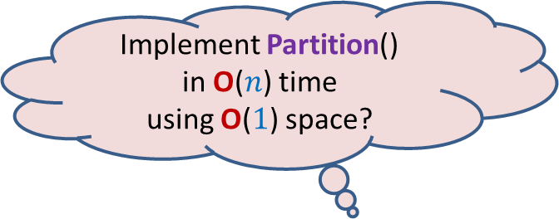
A nice programming exercise ?
This procedure is called Partition.
It rearranges the elements so that all elements less than x appear to the left of x and all elements greater than x appear to the right of x.
0 1 2 3 4 5 6 7 8
Implement Partition()
in O($n$) time
using O($1$) space?
0 1 2 3 4 5 6 7 8
<x
>x

Slide 19
Exercise Questions
Can you implement a stack using a single queue (you need to define the pop and push operations using enqueue and dequeue)?
What about the converse?
Can you implement a queue using
a) a single stack
b) two stacks
c) single stack and recursion?
Question 2 is left as an exercise.

Slide 20
Implementation of Stack using a Queue
We will implement a stack S using a queue such that the top of the stack corresponds to the rear of the queue.
Push(x,S){
Enqueue(x,S);
}
Pop(S){
if (IsEmpty(S) == true) return NULL;
else{
Enqueue(#,S); //add a marker symbol to denote the end
x← Dequeue(S);
y← Dequeue(S);
while(y <> #){
Enqueue(x,S);
x← y;
y← Dequeue(S);
}
return x;
}

