Slide 1
Data Structures and Algorithms
(ESO207)
Lecture 14:
Algorithm paradigms
Algorithm paradigm of Divide and Conquer

Slide 2
Algorithm Paradigms

Slide 3
Algorithm Paradigm
Motivation:
Many problems whose algorithms are based on a common approach.
A need of a systematic study of such widely used approaches.
Algorithm Paradigms:
Divide and Conquer
Greedy Strategy
Dynamic Programming
Local Search
Exhaustive Search

Slide 4
Divide and Conquer paradigm for Algorithm Design

Slide 5
Divide and Conquer paradigm
An Overview
Divide the problem instance
Solve each smaller instances
Combine the solutions of the smaller instances
to get the solution of the original instance.
into two or more instances of the same problem
recursively (base case suitably defined).
This is usually the main nontrivial step in the design of an algorithm using divide and conquer strategy

Slide 6
Example 1
Sorting

Slide 7
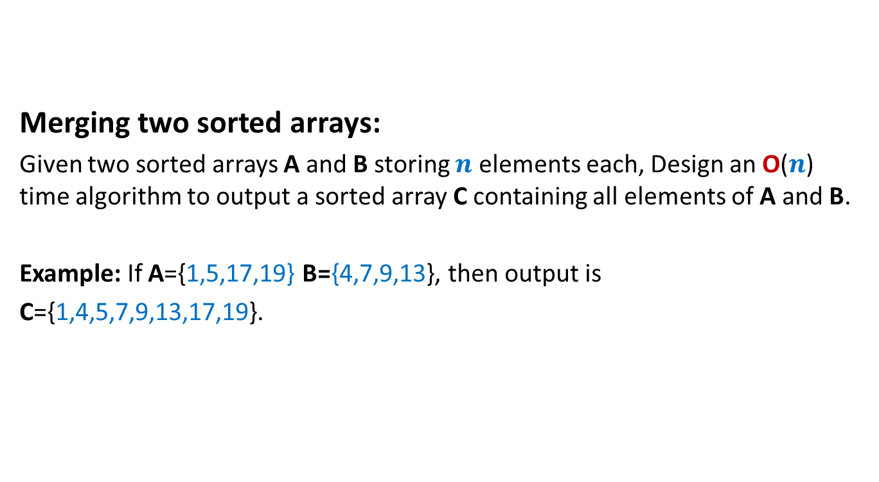
A familiar problem
Merging two sorted arrays:
Given two sorted arrays A and B storing $n$ elements each, Design an O($n$) time algorithm to output a sorted array C containing all elements of A and B.
Example: If A={1,5,17,19} B={4,7,9,13}, then output is
C={1,4,5,7,9,13,17,19}.

Slide 8
Merging two sorted arrays A and B
A
1
5
17 19
B
17 19
4
7
9
13
C
1
4
5
7 9 13

Slide 9
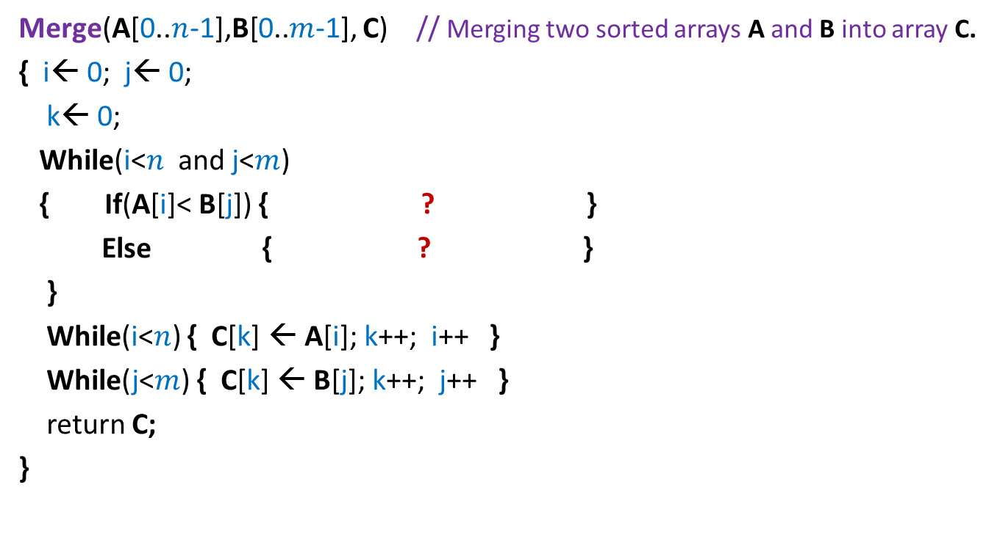
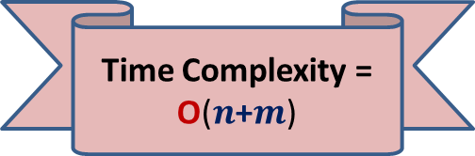
Pesudo-code for Merging two sorted arrays
Merge(A[0..$n$-1],B[0..$m$-1], C) // Merging two sorted arrays A and B into array C.
{ i← 0; j← 0;
k← 0;
While(i<$n$ and j<$m$)
{ If(A[i]< B[j]) { ? }
Else { ? }
}
While(i<$n$) { C[k] ← A[i]; k++; i++ }
While(j<$m$) { C[k] ← B[j]; k++; j++ }
return C;
}
Correctness : homework exercise
C[k] ← A[i]; k++; i++
C[k] ← B[j]; k++; j++
Time Complexity = O($n$+$m$)

Slide 10

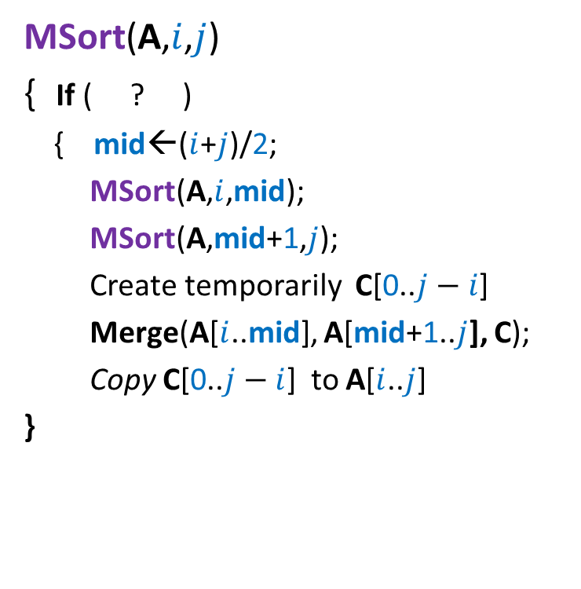
Divide and Conquer based sorting algorithm
MSort(A,$i$,$j$)
{ If ( ? )
{ mid←($i$+$j$)/2;
MSort(A,$i$,mid);
MSort(A,mid+1,$j$);
Create temporarily C[0..$j−i$]
Merge(A[$i$..mid], A[mid+1..$j$], C);
Copy C[0..$j−i$] to A[$i$..$j$]
}
// Sorting the subarray A[$i$..$j$].
i< j
Divide step
Combine/conquer step
This is Merge Sort algorithm

Slide 11
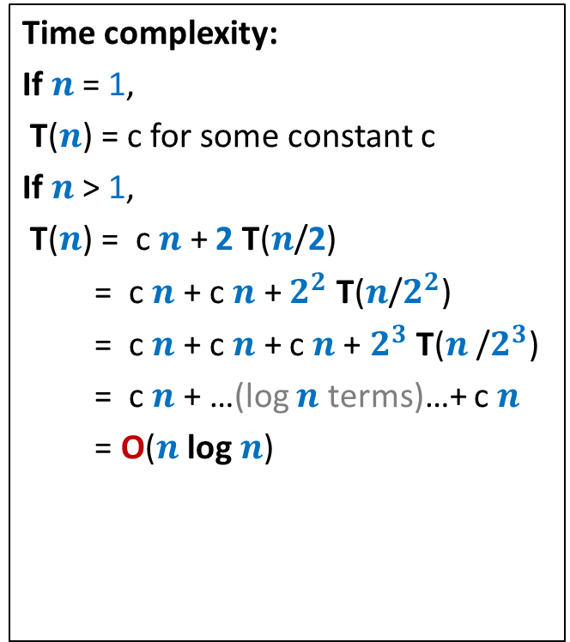




Divide and Conquer based sorting algorithm
MSort(A,$i$,$j$)
{ If ( ? )
{ mid←($i$+$j$)/2;
MSort(A,$i$,mid);
MSort(A,mid+1,$j$);
Create temporarily C[0..$j−i$]
Merge(A[$i$..mid], A[mid+1..$j$], C);
Copy C[0..$j−i$] to A[$i$..$j$]
}
Time complexity:
If $n$ = 1,
T($n$) = c for some constant c
If $n$ > 1,
T($n$) = c $n$ + 2 T($n$/2)
= c $n$ + c $n$ + $2^{2}$ T($n$/$2^{2}$)
= c $n$ + c $n$ + c $n$+ $2^{3}$ T($n$/$2^{3}$)
= c $n$ + …(log $n$ terms)…+ c $n$
= O($n$ log $n$)
// Sorting the subarray A[$i$..$j$].
i< j
T($n$/2)
T($n$/2)
c $n$

Slide 12
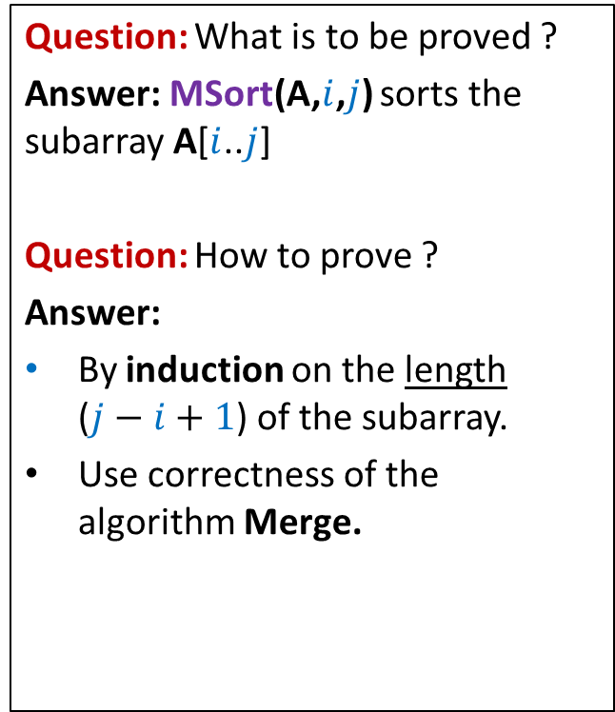
Proof of correctness of Merge-Sort
MSort(A,$i$,$j$)
{ If ( ? )
{ mid←($i$+$j$)/2;
MSort(A,$i$,mid);
MSort(A,mid+1,$j$);
Create temporarily C[0..$j−i$]
Merge(A[$i$..mid], A[mid+1..$j$], C);
Copy C[0..$j−i$] to A[$i$..$j$]
}
Question: What is to be proved ?
Answer: MSort(A,$i$,$j$) sorts the subarray A[$i$..$j$]
Question: How to prove ?
Answer:
By induction on the length ($j−i+1$) of the subarray.
Use correctness of the algorithm Merge.
// Sorting the subarray A[$i$..$j$].
i< j

Slide 13
Example 2
Faster algorithm for
multiplying two integers

Slide 14
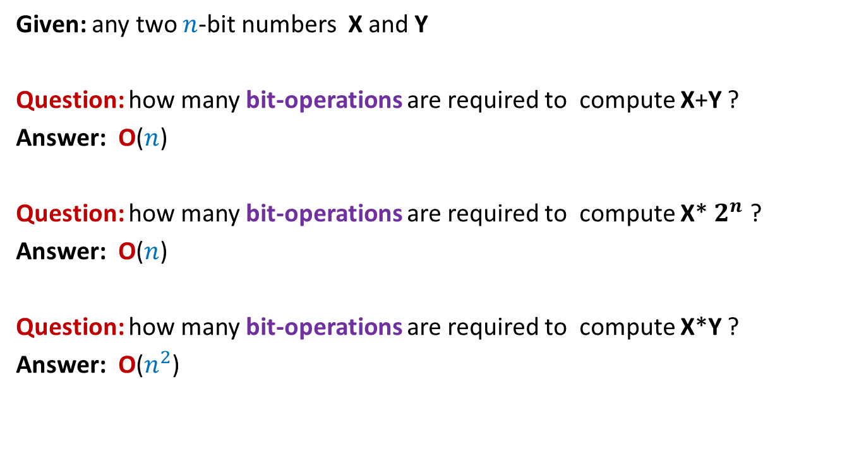

Addition is faster than multiplication
Given: any two $n$-bit numbers X and Y
Question: how many bit-operations are required to compute X+Y ?
Answer: O($n$)
Question: how many bit-operations are required to compute X* $2^{n}$ ?
Answer: O($n$)
Question: how many bit-operations are required to compute X*Y ?
Answer: O($n^{2}$)
[left shift the number X by $n$places, (do it carefully)]
X
Can we compute X*Y faster ??
 |  |  |  | 0
 |  |  |  | 0 | 0
$$+$$
 |  |  |  | 0 | 0 | 0

Slide 15

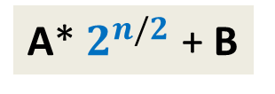
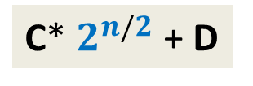

Pursuing Divide and Conquer approach
MSB
LSB
Question: how to express X*Y in terms of multiplication/addition of {A,B,C,D} ?
Hint: First Express X and Y in terms of {A,B,C,D}.
X = ? and Y = ? .
Hence …
X*Y = (A*C)* ?? + (A*D + B*C)* ?? + B*D
A
B
X
n-1 n-2…......………………n/2.............................2 1 0
4 multiplications
C
D
Y
A* $2^{n/2}$ + B
C* $2^{n/2}$ + D
$$2^{n}$$
$$2^{n/2}$$

Slide 16

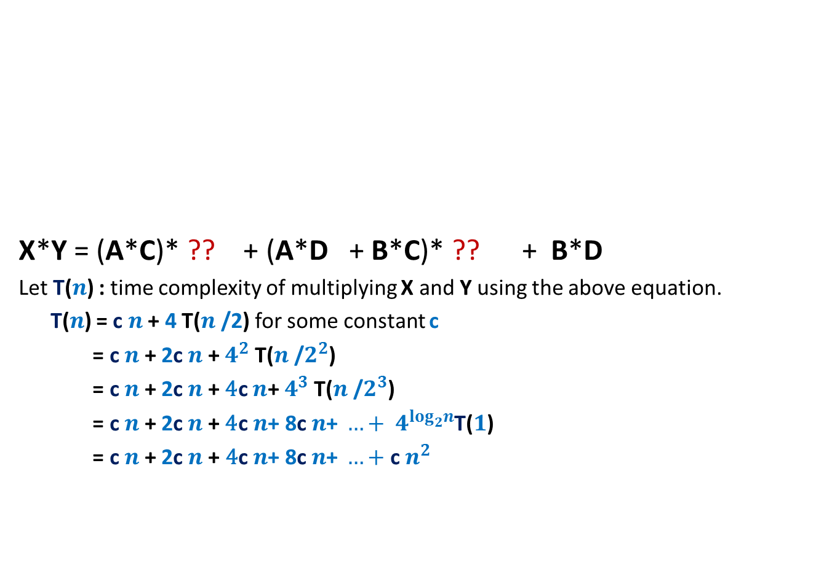


Pursuing Divide and Conquer approach
MSB
LSB
X*Y = (A*C)* ?? + (A*D + B*C)* ?? + B*D
Let T($n$) : time complexity of multiplying X and Y using the above equation.
T($n$) = c $n$ + 4 T($n$/2) for some constant c
= c $n$ + 2c $n$ + $4^{2}$ T($n$/$2^{2}$)
= c $n$ + 2c $n$ + ${\text{4}\text{c} n\text{+} 4}^{3}$ T($n$/$2^{3}$)
= c $n$ + 2c $n$ + ${\text{4}\text{c} n\text{+ 8}\text{c} n\text{+ }…+ 4}^{\log_{2}^{}n}$T($1$)
= c $n$+ 2c $n$+ ${\text{4}\text{c} n\text{+ 8}\text{c} n\text{+ }…+\text{c} n}^{2 }$
A
B
X
n-1 n-2…......………………n/2.............................2 1 0
C
D
Y
$$2^{n}$$
$$2^{n/2}$$
O($n^{2}$) time algo

Slide 17
Pursuing Divide and Conquer approach
MSB
LSB
X*Y = (A*C)* ?? + (A*D + B*C)* ?? + B*D
Observation: A*D + B*C = ? + ? + ?
Question: How many multiplications do we need now to compute X*Y ?
Answer: 3 multiplications :
A*C
B*D
(A-B)*(D-C) .
A
B
Expand and explore
(A-B)*(D-C)
X
n-1 n-2…......………………n/2.............................2 1 0
C
D
Y
$$2^{n}$$
$$2^{n/2}$$
(A-B)*(D-C)
A*C
B*D

Slide 18




Pursuing Divide and Conquer approach
MSB
LSB
X*Y = (A*C)* ?? + ((A-B)*(D-C) + A*C + B*D)* ?? + B*D
Let T($n$) : time complexity of the new algo for multiplying two $n$-bit numbers
T($n$) = c $n$ + 3 T($n$/2) for some constant c
= c $n$ + 3 c $\frac{n}{2}$ + $3^{2}$ T($n$/$2^{2}$)
= c $n$ + 3c $\frac{n}{2}$ + $\text{9}\text{c}\frac{n}{4}\text{+}$ + … + ?
= O($n^{\log_{2}^{}3}$) = O($n^{1.58}$)
A
B
X
n-1 n-2…......………………n/2.............................2 1 0
C
D
Y
$$2^{n}$$
$$2^{n/2}$$
$3^{\log_{2}^{}n}$ T($1$)

Slide 19
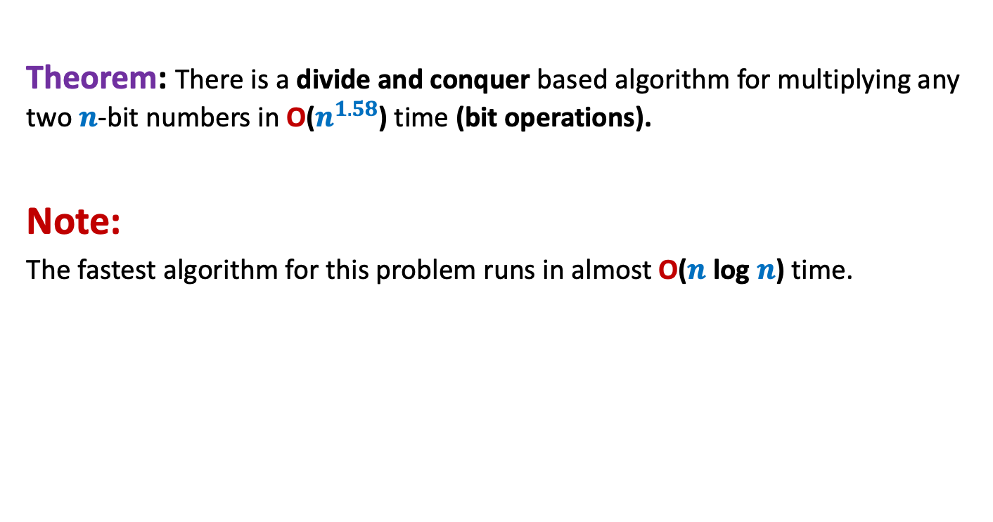
Conclusion
Theorem: There is a divide and conquer based algorithm for multiplying any two $n$-bit numbers in O($n^{1.58}$) time (bit operations).
Note:
The fastest algorithm for this problem runs in almost O($n$ log $n$) time.

Slide 20
Example 3
Counting the number of
“inversions” in an array

Slide 21
Counting Inversions in an array
Problem description
Definition (Inversion): Given an array A of size n,
a pair (i,j), 0≤i<j<n is called an inversion if
Example:
Inversions are :
(1,2), (1,4), (1,6),
(3,4),(3,6),
(5,6), (5,7)
AIM: An efficient algorithm to count the number of inversions in an array A.
A[i]>A[j].
0 1 2 3 4 5 6 7
A
3 15 8 19 9 67 11 27

Slide 22
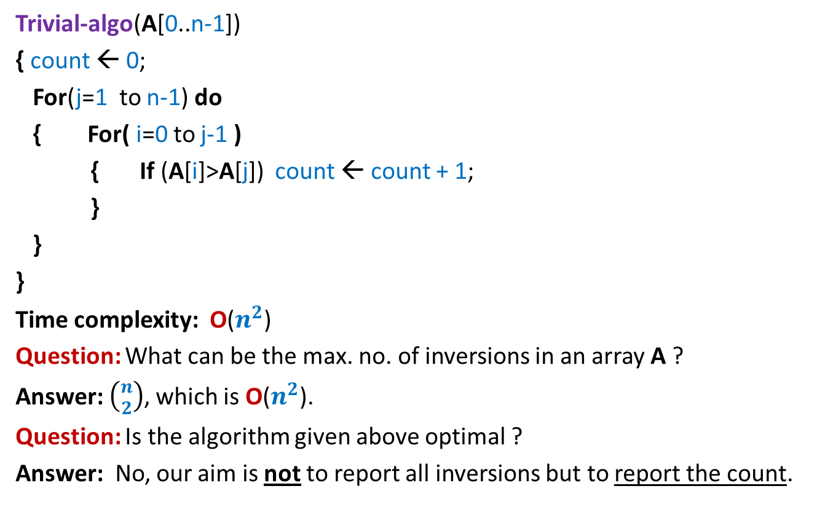
Counting Inversions in an array
Problem familiarization
Trivial-algo(A[0..n-1])
{ count ← 0;
For(j=1 to n-1) do
{ For( i=0 to j-1 )
{ If (A[i]>A[j]) count ← count + 1;
}
}
}
Time complexity: O($n^{2}$)
Question: What can be the max. no. of inversions in an array A ?
Answer: $\left({n \atop 2}\right)$, which is O($n^{2}$).
Question: Is the algorithm given above optimal ?
Answer: No, our aim is not to report all inversions but to report the count.
Ponder over the divide and conquer algorithm for this problem. We shall discuss it in the next class.

