Slide 1
Data Structures and Algorithms
(ESO207)
Lecture 19
Analysis of
  Red Black trees
  Nearly Balanced BST

Slide 2
A Red Black Tree is height balanced
A detailed proof from scratch

Slide 3
Red Black Tree
Red Black tree:
a full binary search tree
and satisfying the following properties.
Each node is colored red or black.
Each leaf is colored black and so is the root.
Every red node will have both its children black.
No. of black nodes on a path from root to each leaf node is same.
with each leaf as a null node
black height

Slide 4
A red-black tree
root
46
28
67
5
35
49
2
25
31
41

Slide 5
Terminologies
Full binary tree:
A binary tree where every internal node has exactly two children.
This node has exactly one child. So the current tree is not a full binary tree.
This is now a full binary tree.

Slide 6
Red-black tree: as a Full Binary Tree
root
46
28
67
5
35
49
2
25
31
41
48
Ignore the values

Slide 7
Red-black tree: as a Full Binary Tree
root
Ignore the distinction between internal nodes and leaf nodes

Slide 8
Red-black tree: as a Full Binary Tree
root

Slide 9
Properties of a Red-Black Tree viewed as a full binary tree
Relationship between
Number of leaf nodes and
Number of internal nodes

Slide 10
A full binary tree
This node must have a left child since the tree is a full binary tree
Any deepest node
This node must be a leaf node. Give reason.
Otherwise this node won’t be the deepest node.

Slide 11
A full binary tree
What happened to the number of internal nodes ?
What happened to the number of leaf nodes ?
Is it still a full binary tree ?
Yes.
Reduced by one
Reduced by one

Slide 12

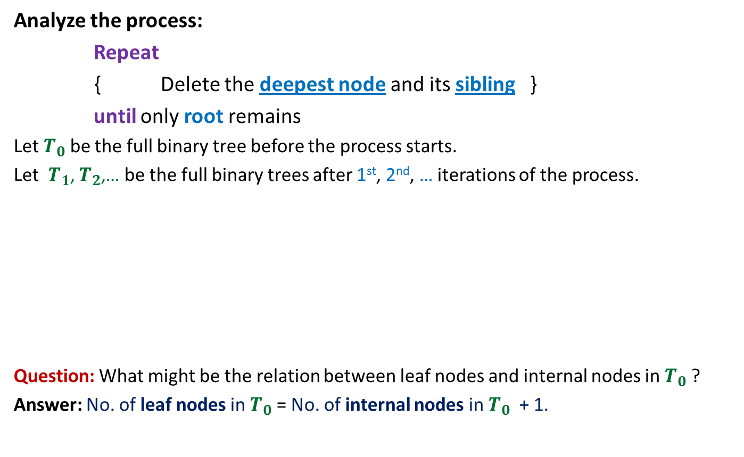
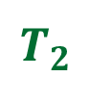

A full binary tree
Analyze the process:
Repeat
{ Delete the deepest node and its sibling }
until only root remains
Let $T_{0}$ be the full binary tree before the process starts.
Let $T_{1}$, $T_{2}$,… be the full binary trees after 1st, 2nd, … iterations of the process.
Question: What might be the relation between leaf nodes and internal nodes in $T_{0}$ ?
Answer: No. of leaf nodes in $T_{0}$ = No. of internal nodes in $T_{0}$ + 1.
Finally only
root node remains
$$T_{0}$$
# leaf nodes reduce by 1
$$T_{1}$$
# leaf nodes reduce by 1
$$T_{2}$$
# internal nodes reduce by 1
# internal nodes reduce by 1

Slide 13

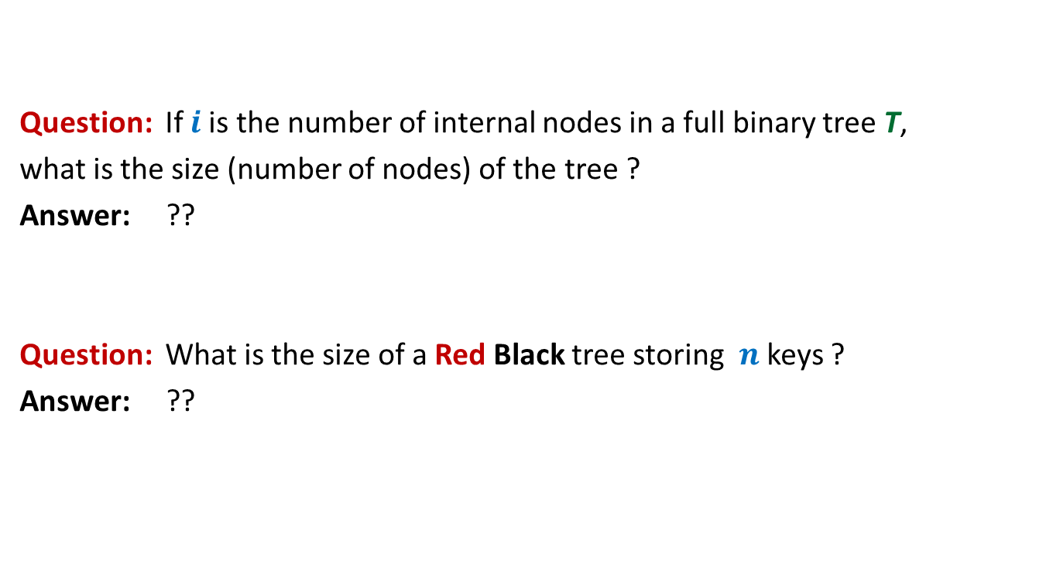

A full binary tree
Question: If $i$is the number of internal nodes in a full binary tree T,
what is the size (number of nodes) of the tree ?
Answer: ??
Question: What is the size of a Red Black tree storing $n$ keys ?
Answer: ??
$$2i + 1$$
$$2n + 1$$

Slide 14

A complete binary tree of height $h$ and its Properties

Slide 15
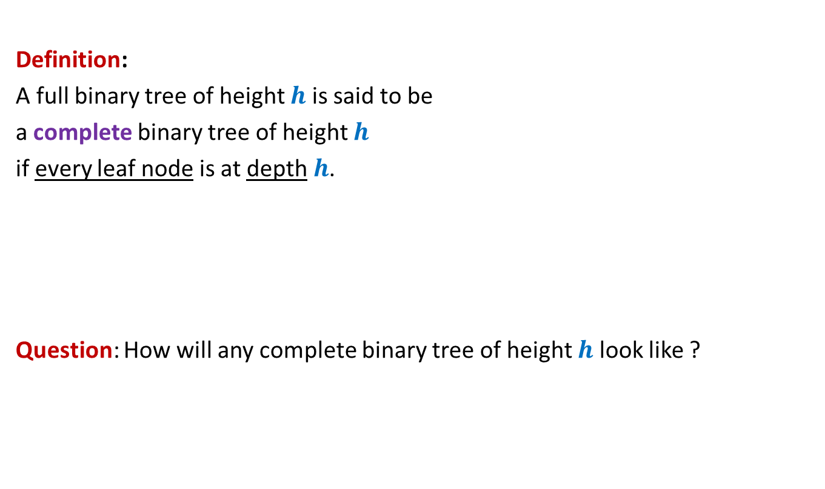


A complete binary tree of height $h$
Definition:
A full binary tree of height $h$ is said to be
a complete binary tree of height $h$
if every leaf node is at depth $h$.
Question: How will any complete binary tree of height $h$ look like ?
There is no reason to believe at this stage that there is a unique complete binary tree of height $h$.

Slide 16
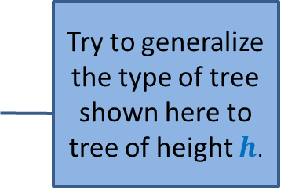
A complete binary tree of height $h$
Complete binary tree of height 1 ?
Complete binary tree of height 2 ?
Complete binary tree of height 3 ?
Try to generalize the type of tree shown here to tree of height $h$.

Slide 17





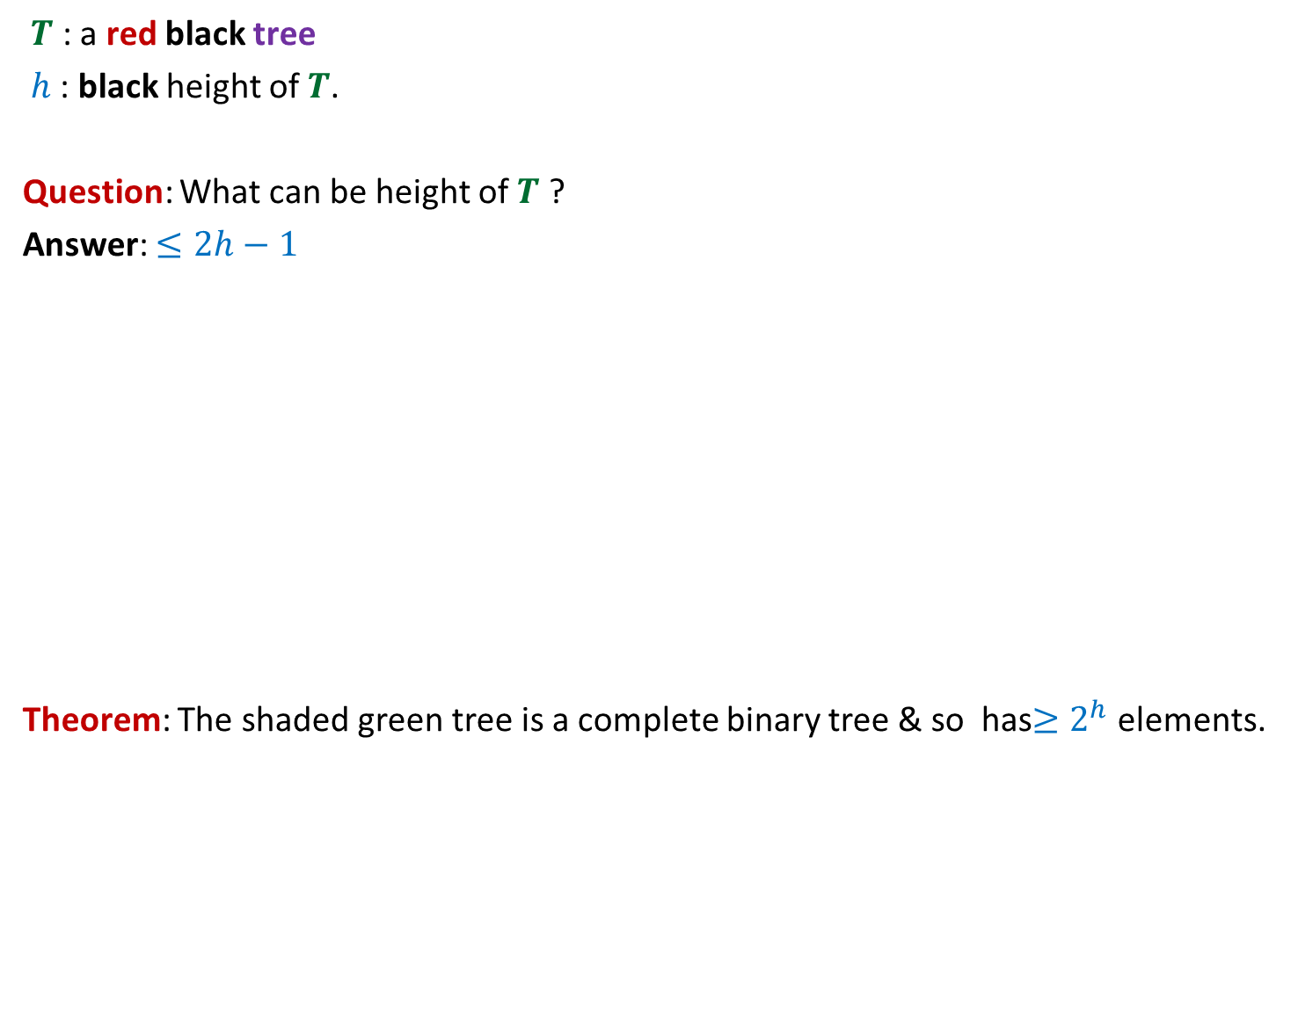

A complete binary tree of height $h$
No. of
nodes
Level
Total number of nodes =
1
$$1$$
$2^{h}$ - 1
2
$$2$$
i
$$2^{i−1}$$
$$h$$
$$2^{h−1}$$
Certainly this tree is a complete binary tree of height $h$ We shall now show that this is the only possible complete binary tree of height $h$.

Slide 18
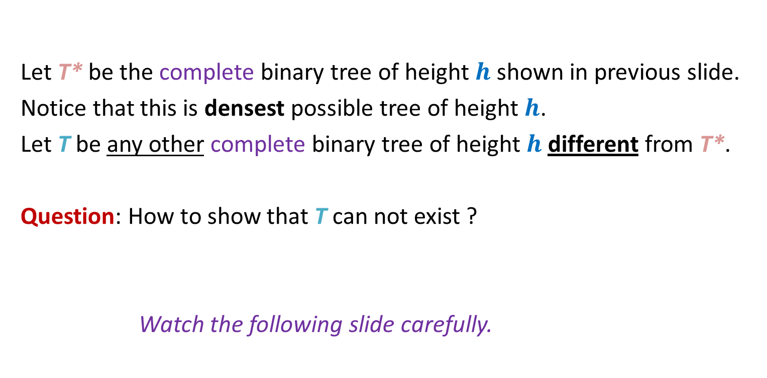

Uniqueness of a complete binary tree of height $h$
Let T* be the complete binary tree of height $h$ shown in previous slide.
Notice that this is densest possible tree of height $h$.
Let T be any other complete binary tree of height $h$ different from T*.
Question: How to show that T can not exist ?
Watch the following slide carefully.
Think over this question carefully.

Slide 19
Uniqueness of a complete binary tree of height $h$
x
At least one node present in T*
but absent in T
T*
T
Just place T symmetrically above T*.
If T is different from T*, then what will you see ?

Slide 20
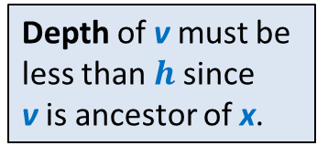


Uniqueness of a complete binary tree of height $h$
Since T is a full binary tree and right child of v is missing,
➔ v can not be an internal node in T .
➔ v must be leaf node.
1
Trace the path from x to root until we reach a node present in both T* and T.
Such a node v
must exist since both both T* and T meet at least at the root.
Note that one child (in this case the right child) of v is missing in T.
v
2
?
Depth of v must be
less than $h$since
v is ancestor of x.
i
x
Any node present in T* but absent in T
h
Hence v is a leaf node of T at depth < $h$
Hence
T is not a compete binary tree of height $h$

Slide 21
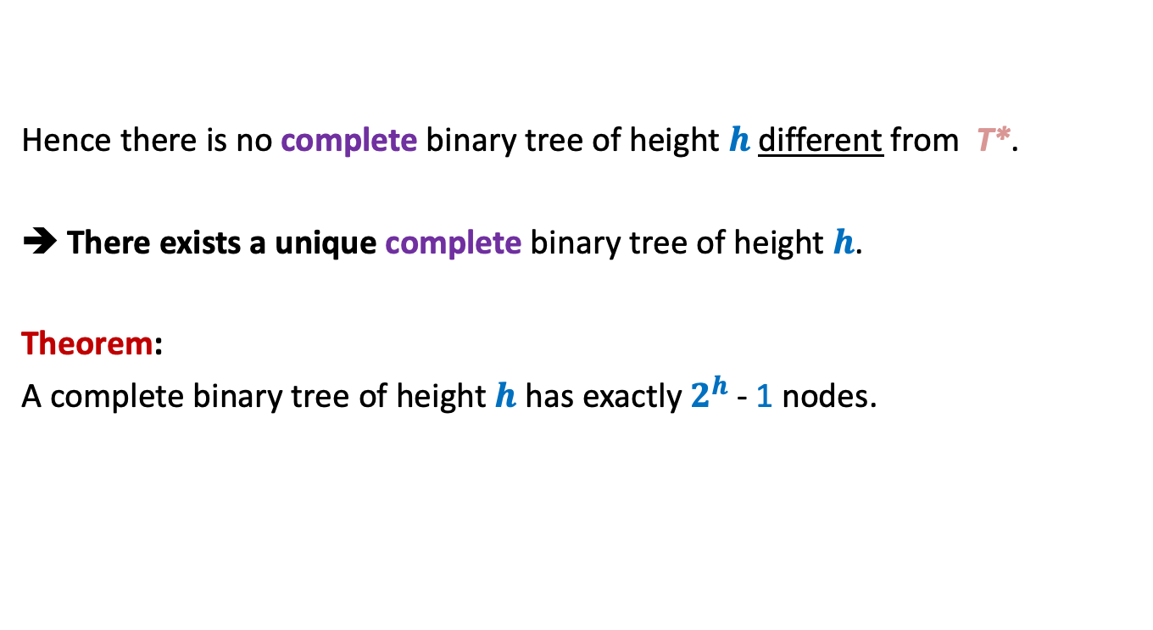
Hence there is no complete binary tree of height $h$different from T*.
➔ There exists a unique complete binary tree of height $h$.
Theorem:
A complete binary tree of height $h$ has exactly $2^{h}$ - 1 nodes.

Slide 22
A Red Black Tree is height balanced
The final proof

Slide 23

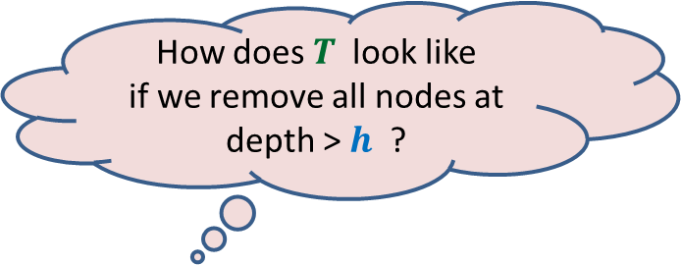





$T$ : a red black tree storing $n$ keys.
Total number of nodes =
$h$ : the black height
Every leaf node is at depth ≥ $h$
Hence $2n + 1$≥
➔${ 2}^{h}$ ≤ $2n + 2$
➔ $h$≤ $1+\log_{2}{(n+1)}$
So Height of $T,\text{say} H$
$$2n + 1$$
How does $T$ look like
if we remove all nodes at depth > $h$ ?
$2^{h}$ $− 1$
a complete binary tree of height $h$
≤ 2$h$ - 1
≤ 2 $\log_{2}{(n+1)}$ + 1

Slide 24
Nearly Balanced BST
Analysis

Slide 25
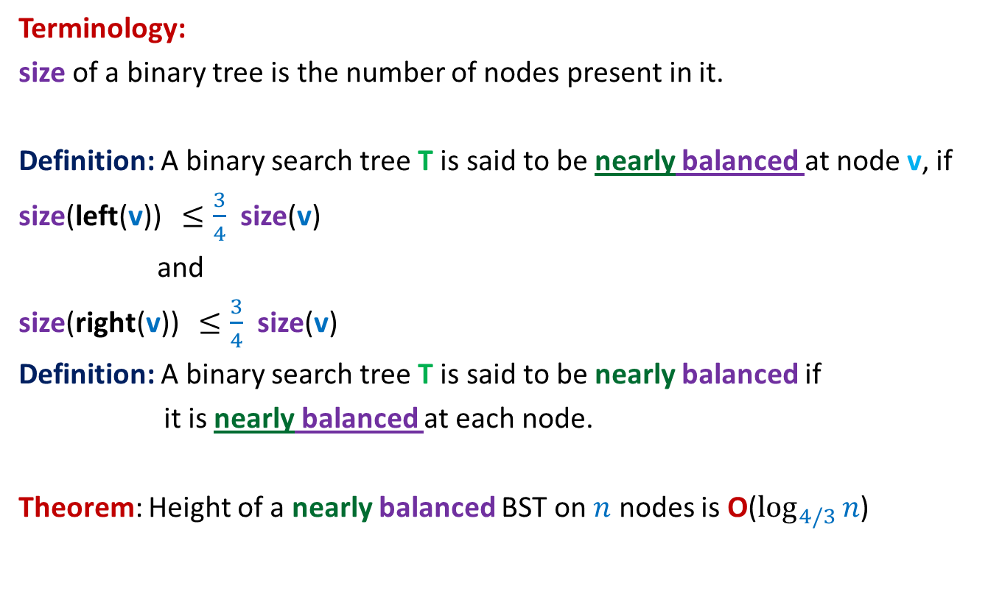
Nearly balanced Binary Search Tree
Terminology:
size of a binary tree is the number of nodes present in it.
Definition: A binary search tree T is said to be nearly balanced at node v, if
size(left(v)) $≤\frac{3}{4}$ size(v)
and
size(right(v)) $≤\frac{3}{4}$ size(v)
Definition: A binary search tree T is said to be nearly balanced if
it is nearly balanced at each node.
Theorem: Height of a nearly balanced BST on $n$ nodes is O($\log_{4/3}{n}$)

Slide 26
Nearly balanced Binary Search Tree
Maintaining under Insertion
Each node v in T maintains additional field size(v) which is the number of nodes in the subtree(v).
Keep Search(T,x) operation unchanged.
Modify Insert(T,x) operation as follows:
  Carry out normal insert and update the size fields of nodes traversed.
  If BST T is ceases to be nearly imbalanced at any node v,
  transform subtree(v) into perfectly balanced BST.

Slide 27


“Perfectly Balancing” subtree at a node v
v
> $\frac{3}{4}k$
$$k$$
$$k$$
Size differs by at most 1

Slide 28
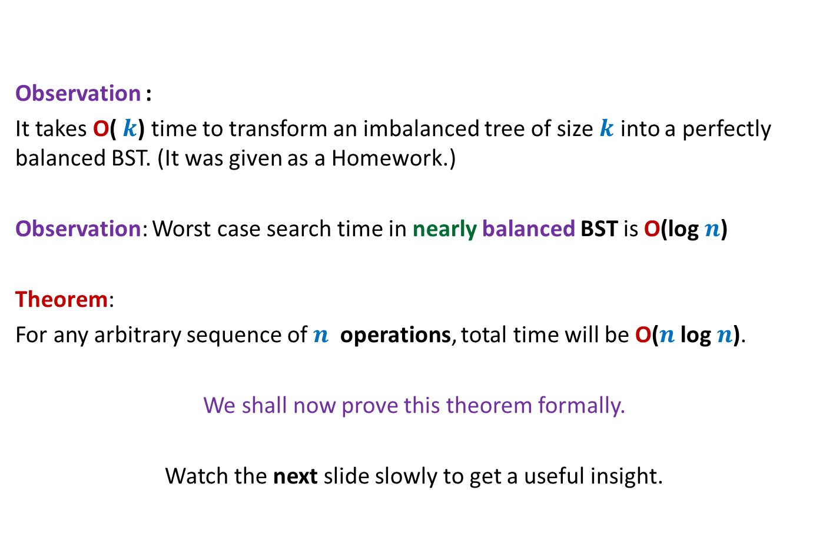
Nearly balanced Binary Search Tree
Observation :
It takes O( $k$) time to transform an imbalanced tree of size $k$ into a perfectly balanced BST. (It was given as a Homework.)
Observation: Worst case search time in nearly balanced BST is O(log $n$)
Theorem:
For any arbitrary sequence of $n$ operations, total time will be O($n$log $n$).
We shall now prove this theorem formally.
Watch the next slide slowly to get a useful insight.

Slide 29



How many new elements to make T(v) imbalanced ?
$$≥k$$
Suppose T(v) is perfectly balanced at some moment.
v
v
$$k$$
> $\frac{3}{2}k$
Size differs by at most 1
$$2k$$

Slide 30
The intuition for proving the Theorem
“A perfectly balanced subtree T(v) will have to have large number of insertions
before it becomes unbalanced enough to be rebuilt again.”
We shall transform this intuition into a formal proof now.

Slide 31







Notations
: no. of nodes in T($v$) at any moment.
For $k$th insertion,
$I_{k}(v)$ =
Question: For a nearly balanced BST, what is
$$\sum_{v}{I_{k}(v)}= ?$$
$$\sum_{k=1 to n}{\sum_{v}{I_{k}(v)}= ?}$$
$$size(v)$$
This is because
T, being nearly Balanced, has O(log $k$) height.
and
an insertion can increase size field for only the nodes lying along a root to leaf path.
$1 \text{if} k\text{th} \text{insertion} \text{increases} size\text{(}v$)
$$0 \text{Otherwise}$$
O(log $k$)
O($n$log $n$)

Slide 32





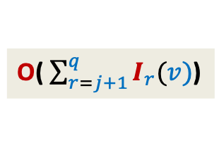




Journey of an element/node $v$ during $n$ insertions
$$t_{v}$$
$$j$$
$$q$$
$$n$$
Let $size(v)$ after $j$ insertions = $k$,
What is the $size(v)$ after $q$insertions ?
What might be $\sum_{r=j+1}^{q}{I_{r}(v)}= ?$
➔ Time complexity of rebalancing T($v$) after $q$th insertion = ?
Rebalancing at $v$
$$≥2k$$
$$≥k$$
O( $\sum_{r=j+1}^{q}{I_{r}(v)}$)

Slide 33
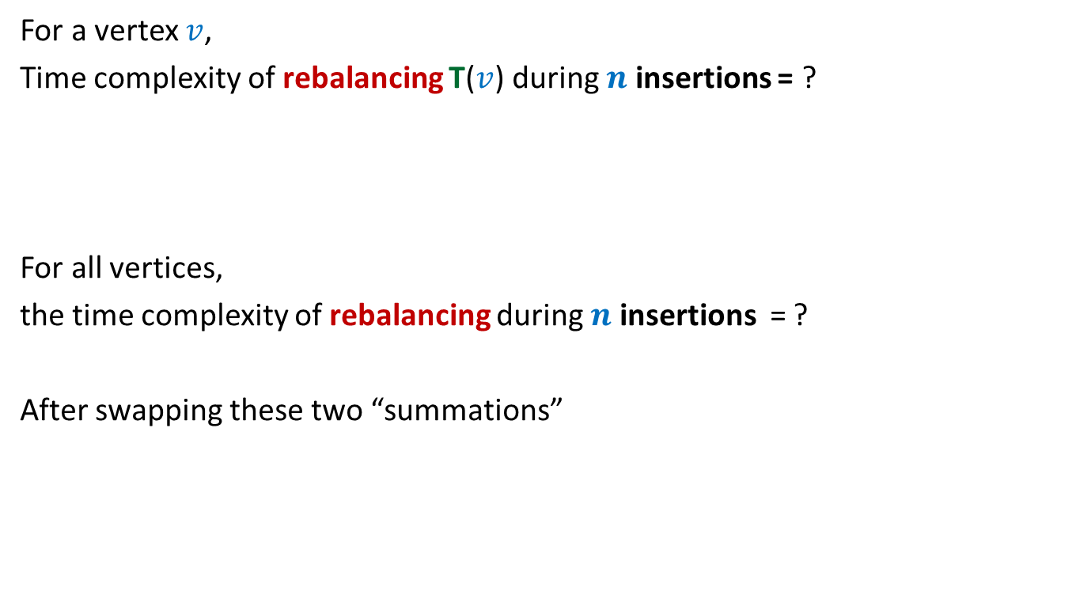
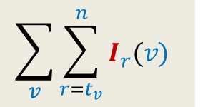


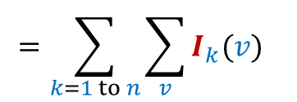
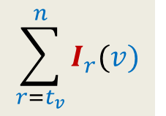
Time complexity of $n$ insertions
For a vertex $v$,
Time complexity of rebalancing T($v$) during $n$ insertions = ?
For all vertices,
the time complexity of rebalancing during $n$ insertions = ?
After swapping these two “summations”
$$\sum_{r=t_{v}}^{n}{I_{r}(v)}$$
$$\sum_{v}{\sum_{r=t_{v}}^{n}{I_{r}(v)} }$$
$$=\sum_{k=1 to n}{\sum_{v}{I_{k}(v)}}$$
= O($n$log $n$)

Slide 34

Theorem:
For any arbitrary sequence of $n$ insert operations, total time to maintain nearly balanced BST will be O($n$log $n$).

