Slide 1
Data Structures and Algorithms
(ESO207)
Lecture 3:
Time complexity, Big “O” notation
Designing Efficient Algorithm
  Maximum sum subarray Problem

Slide 2
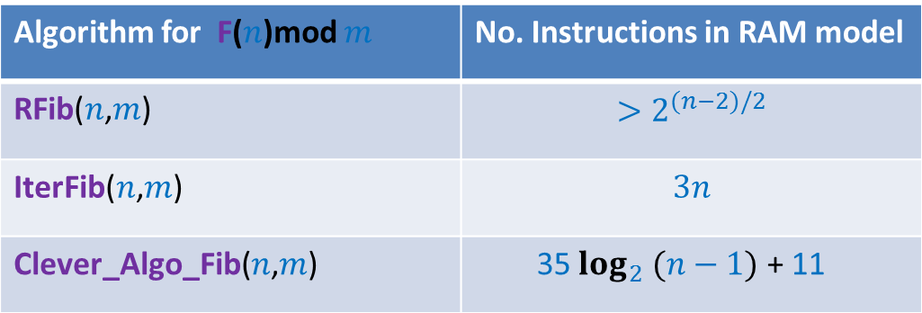
Three algorithms
Algorithm for F($n$)mod $m$ | No. Instructions in RAM model
RFib($n$,$m$) | $$>2^{(n−2)/2}$$
IterFib($n$,$m$) | $$3n$$
Clever_Algo_Fib($n$,$m$) | 35 $\log_{2} (n−1)$ + 11
Which algorithm turned out to be the best ?
experimentally ?

Slide 3
Lesson 1 from Assignment 1 ?
No. of instructions executed by algorithm in RAM model
?
Proportional to
Time taken by algorithm in real life
?
May be different for different input
Dependence on input

Slide 4



Time complexity of an algorithm
Definition:
the worst case number of instructions executed
as a function of the input size
Examples to illustrate input size :
Homework: What is the time complexity of Rfib, IterFib, Clever-Algo-Fib ?
(or a parameter defining the input size)
The number of bits/bytes/words
Problem | Input size
Computing F($n$)mod $m$ for any positive integers $n$and $m$
$\log_{2}n+\log_{2}{m}$ bits
Whether an array storing $j$numbers (each stored in a word) is sorted ?
$j$ words
Whether a $n×m$ matrix of numbers (each stored in a word) contains “14” ?
$nm$ words

Slide 5






Example:
Whether an array A storing $n$numbers (each stored in a word) is sorted ?
IsSorted(A)
{ $i$←$1$;
flag← true;
while($i<$ $n$ and flag==true)
{
If (A[$i$]< A[$i−1$]) flag←false ;
$i$ ←$i+1$;
}
Return flag ;
}
$1$time
$1$time
$n−1$times in the worst case
$1$time
Time complexity = $2n+1$

Slide 6

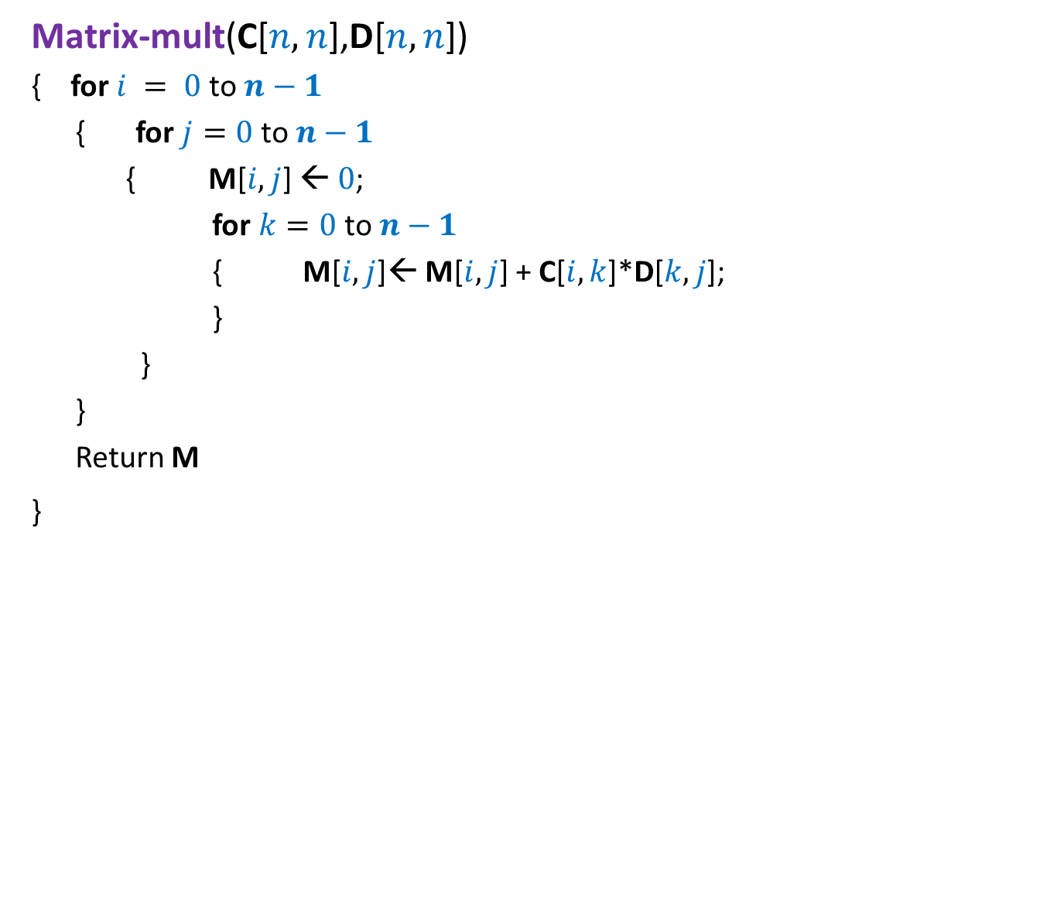



Example:
Time complexity of matrix multiplication
Each element of the matrices occupies one word of RAM.
Matrix-mult(C[$n,n$],D[$n,n$])
{ for $i = 0$to $n−1$
{ for $j=0$to $n−1$
{ M[$i,j$] ← $0$;
for $k=0$ to $n−1$
{ M[$i,j$]← M[$i,j$] + C[$i,k$]*D[$k,j$];
}
}
}
Return M
}
$n$times
$n$times
$n+1$ instructions
$1$time
Time complexity = $n^{3}+n^{2}+1$

Slide 7
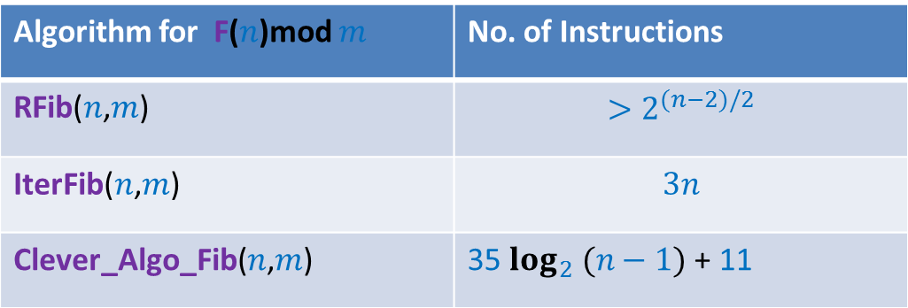


Lesson 2 learnt from Assignment 1 ?
Algorithm for F($n$)mod $m$ | No. of Instructions
RFib($n$,$m$) | $$>2^{(n−2)/2}$$
IterFib($n$,$m$) | $$3n$$
Clever_Algo_Fib($n$,$m$) | 35 $\log_{2} (n−1)$ + 11
Question: What would have been the outcome if
No. of instructions of Clever_Algo_Fib($n$,$m$) = 100 $\log_{2} (n−1)$ + 1000
Answer: Clever_Algo_Fib would still be the fastest algorithm ...
100
1000
for large value of $n$.

Slide 8
Comparing Efficiency of algorithms

Slide 9
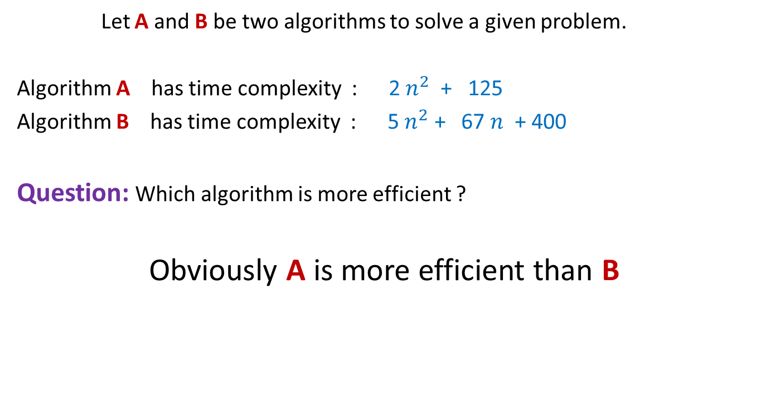
Comparing efficiency of two algorithms
Let A and B be two algorithms to solve a given problem.
Algorithm A has time complexity : 2 $n^{2}$ + 125
Algorithm B has time complexity : 5 $n^{2}$ + 67 $n$ + 400
Question: Which algorithm is more efficient ?
Obviously A is more efficient than B

Slide 10
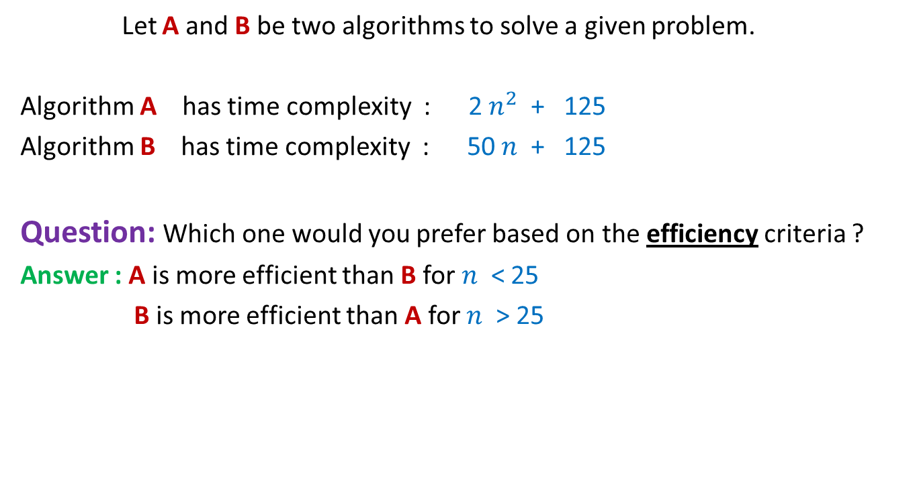
Comparing efficiency of two algorithms
Let A and B be two algorithms to solve a given problem.
Algorithm A has time complexity : 2 $n^{2}$ + 125
Algorithm B has time complexity : 50 $n$ + 125
Question: Which one would you prefer based on the efficiency criteria ?
Answer : A is more efficient than B for $n$ < 25
B is more efficient than A for $n$ > 25
Time complexity is really an issue only when the input is of large size

Slide 11
Rule 1
Compare the time complexities of two algorithms for
asymptotically large value of input size only

Slide 12

Comparing efficiency of two algorithms
Algorithm B with time complexity 50 $n$+ 125
is certainly more efficient than
Algorithm A with time complexity : $2n^{2}$ + 125

Slide 13
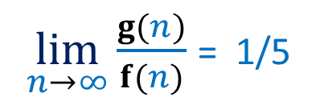

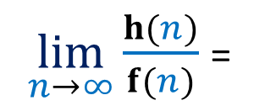
A judgment question for you !
Algorithm A has time complexity f($n$)= ${5 n}^{2}$ + $n$+ 1250
Researchers have designed two new algorithms B and C
Algorithm B has time complexity g($n$) = $n^{2}$ + 10
Algorithm C has time complexity h($n$) = ${10 n}^{1.5}$ + 20 $n$ + 2000
Which of B and C is an improvement over A in the true sense ?
$\lim_{n→∞}{\frac{g(n)}{f(n)}}$ = 1/5
$\lim_{n→∞}{\frac{h(n)}{f(n)}}$ =
?
0
C is an improvement over A in the true sense.

Slide 14
Rule 2
An algorithm X is superior to another algorithm Y if
the ratio of time complexity of X and time complexity of Y
approaches 0 for asymptotically large input size.

Slide 15
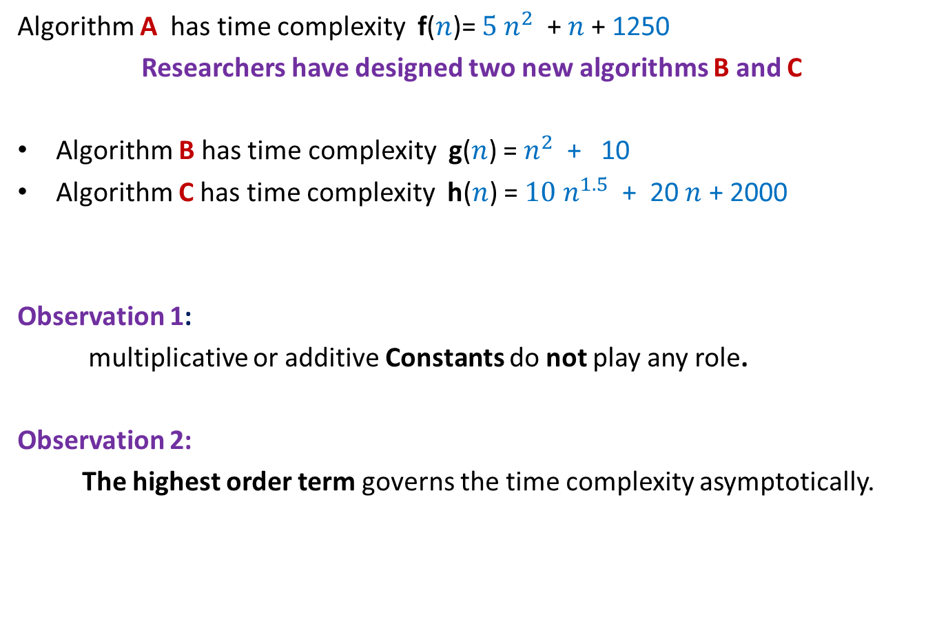
Some Observations
Algorithm A has time complexity f($n$)= ${5 n}^{2}$ + $n$+ 1250
Researchers have designed two new algorithms B and C
Algorithm B has time complexity g($n$) = $n^{2}$ + 10
Algorithm C has time complexity h($n$) = ${10 n}^{1.5}$ + 20 $n$ + 2000
Observation 1:
multiplicative or additive Constants do not play any role.
Observation 2:
The highest order term governs the time complexity asymptotically.
Algorithm C is the most efficient of all.

Slide 16
Order Notations
A mathematical way
to capture the intuitions developed till now.
(reflect upon it yourself)

Slide 17


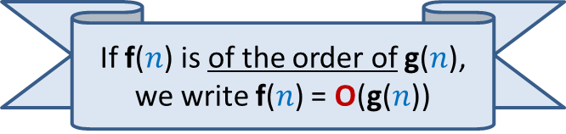


Order notation
Definition: Let f($n$) and g($n$) be any two increasing functions of n.
f($n$) is said to be of the order of g($n$)
if there exist constants c and $n_{0}$such that
f($n$) ≤ c g($n$) for all n > $n_{0}$
c g($n$)
f($n$)
$$n_{0}$$
If f($n$) is of the order of g($n$), we write f($n$) = O(g($n$))

Slide 18

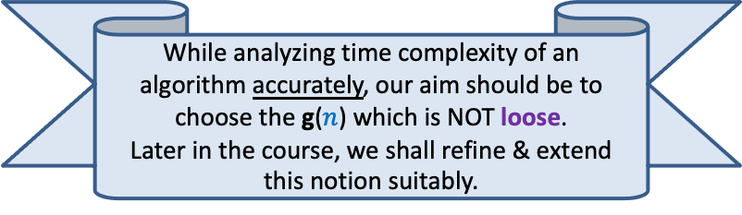
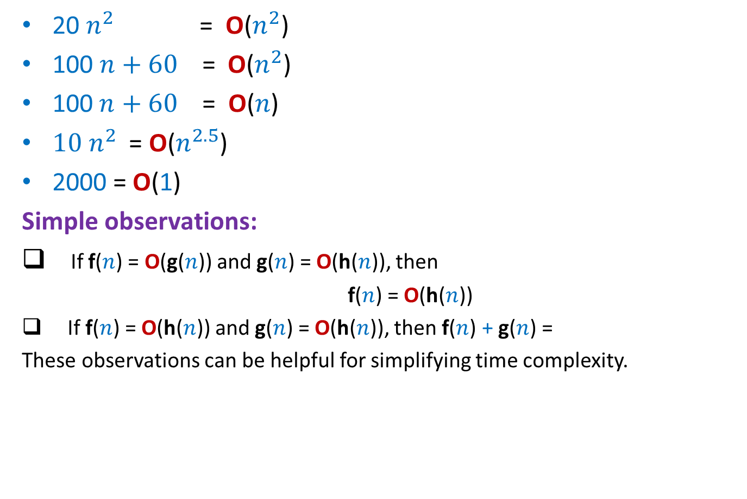



Order notation :
Examples
20 $n^{2}$ = O($n^{2}$)
100 $n+60$ = O($n^{2}$)
$\text{100 }n+60\text{ = }\text{O}\text{(}n\text{)}$
${10 n}^{2}$ = O($n^{2.5}$)
2000 = O(1)
Simple observations:
If f($n$) = O(g($n$)) and g($n$) = O(h($n$)), then
f($n$) = O(h($n$))
If f($n$) = O(h($n$)) and g($n$) = O(h($n$)), then f($n$) + g($n$) =
These observations can be helpful for simplifying time complexity.
$c=$20, $n_{0}=$1
Loose
$c=$1, $n_{0}=$160
$c=$160, $n_{0}=$1
Loose
While analyzing time complexity of an algorithm accurately, our aim should be to choose the g($n$) which is NOT loose.
Later in the course, we shall refine & extend this notion suitably.
?
O(h($n$))
Prove these observation as Homeworks

Slide 19
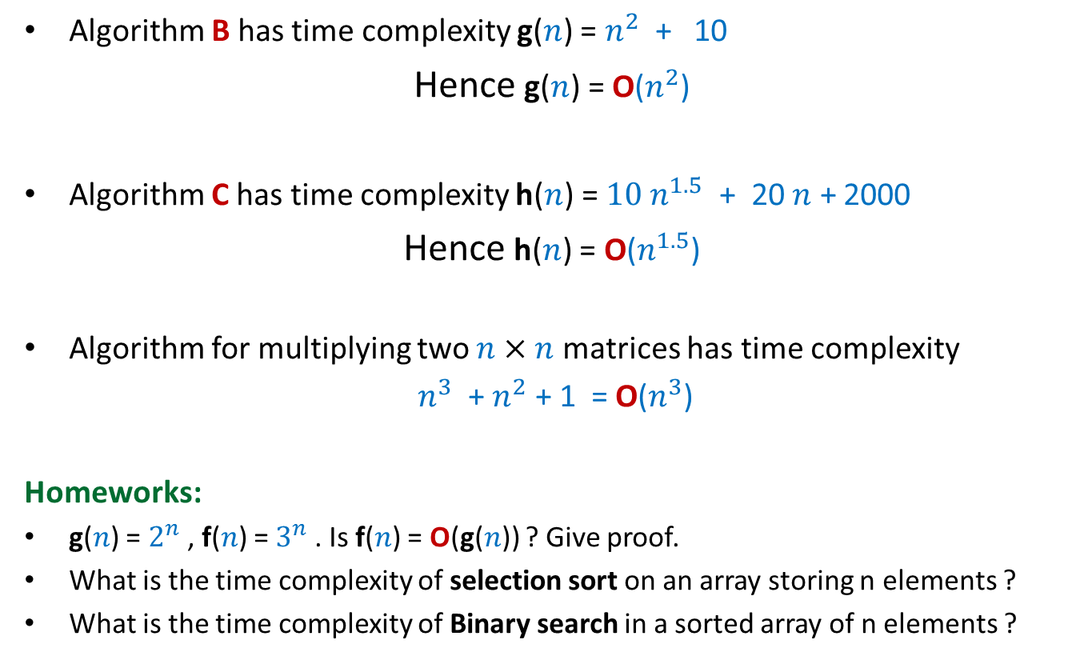
A neat description of time complexity
Algorithm B has time complexity g($n$) = $n^{2}$ + 10
Hence g($n$) = O($n^{2}$)
Algorithm C has time complexity h($n$) = ${10 n}^{1.5}$ + 20 $n$ + 2000
Hence h($n$) = O($n^{1.5}$)
Algorithm for multiplying two $n×n$ matrices has time complexity
$n^{3}$ + $n^{2}$ + 1 = O($n^{3}$)
Homeworks:
g($n$) = $2^{n}$, f($n$) = $3^{n}$. Is f($n$) = O(g($n$)) ? Give proof.
What is the time complexity of selection sort on an array storing n elements ?
What is the time complexity of Binary search in a sorted array of n elements ?

Slide 20
How to Design Efficient Algorithm ?
(This sentence captures precisely the goal of theoretical computer science)

Slide 21
Designing an efficient algorithm
Facts from the world of algorithms:
No formula for designing efficient algorithms.
Every new problem demands a fresh approach.
Designing an efficient algorithm or data structure requires
  Ability to make key observations.
  Ability to ask right kind of questions.
  Lots of perseverance.
We shall demonstrate the above facts during this course many times.

Slide 22
Max-sum subarray problem
Given an array A storing n numbers,
find its subarray the sum of whose elements is maximum.
4
7
A
3 -5 3 8 2 -4 9 -6 3 -2 -8 3 -5 1 7 -9
18
-2

Slide 23

Max-sum subarray problem:
A trivial algorithm
A_trivial_algo(A)
{ max← A[0];
For i=0 to n-1
For j=i to n-1
{ temp ← compute_sum(A,i,j);
if max< temp then max← temp;
}
return max;
}
compute_sum(A, i,j)
{ sum←A[i];
For k=i+1 to j sum← sum+A[k];
return sum;
}
Homework: Prove that its time complexity is O($n^{3}$)

Slide 24

Max-sum subarray problem:
Question: Can we design O($n$) time algorithm for Max-sum subarray problem ?
Answer: Yes.
Think over it with a fresh mind ….
We shall design it together in the next class…☺

