Slide 1
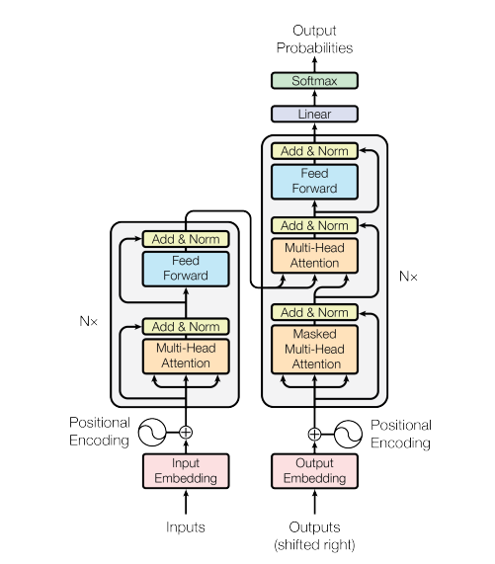
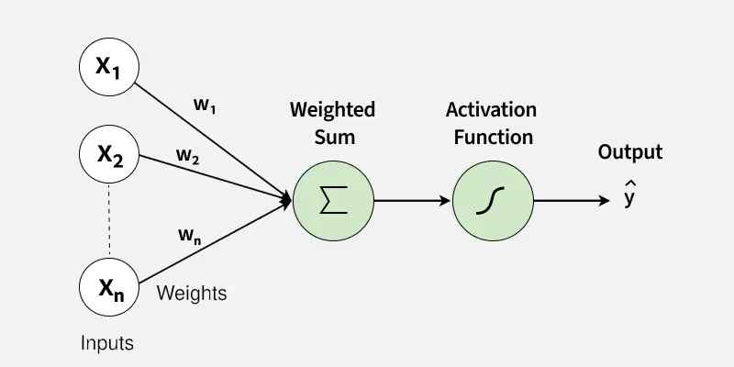
Perceptron to Transformer
Chandradip Karmakar
Supervisor: Dr. Soumya Dutta

Slide 2
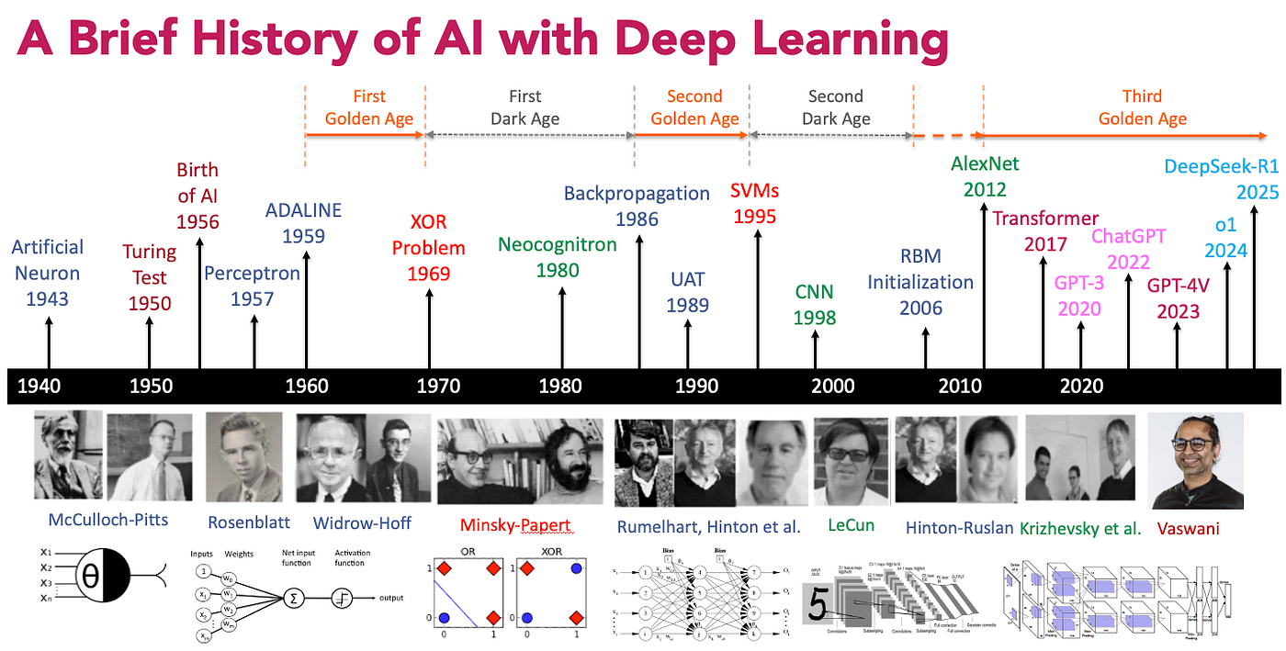

Slide 3
Topics to cover
Perceptron
Applications , advantages and limitations of Perceptron
Artificial Neural Networks(ANN)
Applications , advantages and limitations of ANNs
Convolutional Neural Network(CNN)
Applications , advantages and limitations of CNNs
Recurrent Neural Network(RNN)
Applications , advantages and limitations of RNNs
Long Short-Term Memory(LSTM)
Applications , advantages and limitations of LSTM
Attention Mechanism and Transformer Architechture
Applications , advantages and limitations of Transformer

Slide 4
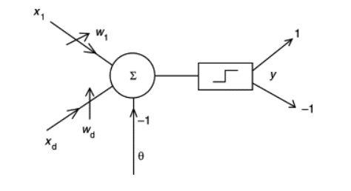
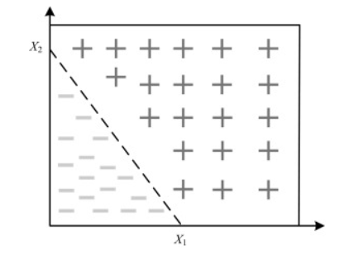
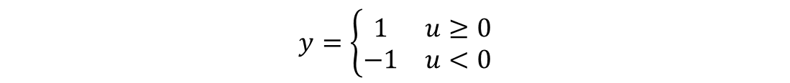
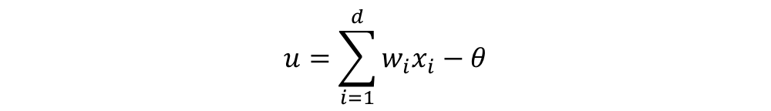
Perceptron
The perceptron is the simplest architecture for a neural network. Its architecture is based on a single neuron with weighted inputs.
Let x₁, x₂, …, x_{d} be the inputs of the neuron, w₁, w₂, …, w_{d} the corresponding weights. A specific ‘input’ consists in the threshold θ.
$$u=\sum_{i=1}^{d}{w_{i}x_{i}−θ}$$
$$y=\left\{\begin{matrix}1 & u≥0 \\ −1 & u<0\end{matrix}\right.$$
Hence , It can be used only when patterns are linearly separable.

Slide 5
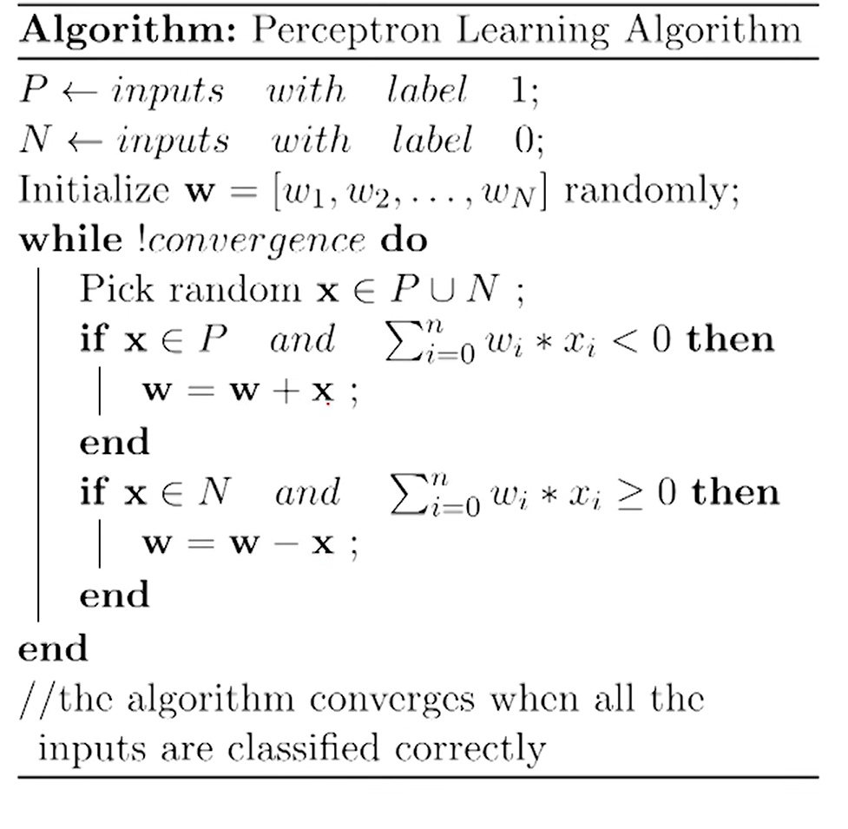

Slide 6
Application
1. Binary Classification: Used for simple yes/no decision problems such as spam detection or basic quality checks.
2. Logic Gate Modelling: Implements linearly separable gates like AND or NAND with perfect accuracy.
3. Pattern Recognition Basics: Helps identify simple patterns where classes can be separated with a straight line.
4. Feature Importance Insight: Weight values indicate which features influence the output more strongly.

Slide 7
Advantages
1. Simplicity : The mathematical structure of a perceptron is straightforward: it computes a weighted sum of inputs and applies a threshold function.
2. Computational Efficiency : In hardware implementations, perceptrons can perform classifications almost instantaneously, making them ideal for high-speed, real-time applications where linear separability is guaranteed.
3. Guaranteed Convergence : If a dataset is linearly separable , the perceptron learning algorithm is mathematically guaranteed to find a solution in a finite number of steps.
4. High Interpretability : By looking at the weights( Wi ) , assigned to each input, one can directly see which features the model considers most important. A higher absolute weight indicates a stronger influence on the final output. The decision-making process can be visualized as a simple geometric boundary, making it easy to explain to non-technical people.
5. Real-time Adaptation : Perceptrons do not require the entire dataset to be stored in memory. As new data arrives, the perceptron adjusts its weights immediately and discards the sample, which is highly effective for streaming data.

Slide 8
Limitations
1. Linear Separability Constraint : A perceptron cannot solve the XOR (exclusive OR) logic gate because the outputs cannot be divided by a single straight line. And this led to a period of reduced interest in neural network research known as the "AI Winter."
Most real-world data (such as images, speech, and natural language) is highly non-linear and cannot be classified using simple hyperplanes.
2. Lack of Probabilistic Output : The output is strictly 0 or 1. It cannot tell the confidence of its prediction. Also as the step function is not differentiable at the threshold, perceptrons cannot use Gradient Descent—the primary optimization algorithm used to train modern AI.
3. Overfitting to Extremes : A single outlier that is far from its cluster can significantly pull the decision boundary, ruining the model's ability to generalize to new data.
4. No Feature Extraction : Perceptrons rely entirely on the quality of the input features provided to them. Unlike deep networks, they cannot learn to identify shapes or patterns within raw data; they only weigh the inputs they are given.

Slide 9

Then What is the solution???
Artificial Neural Network !!!

Slide 10
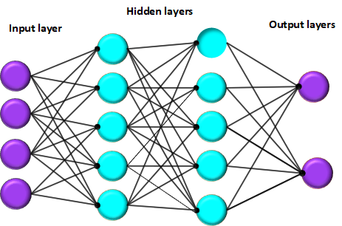
Artificial Neural Network(ANN)
An Artificial Neural Network (ANN) is a computational model inspired by the way biological neural networks in the human brain process information.
It has multiple layers like input layer , hidden layer , output layer. So it is also called Multi Layered Perceptron(MLP)

Slide 11
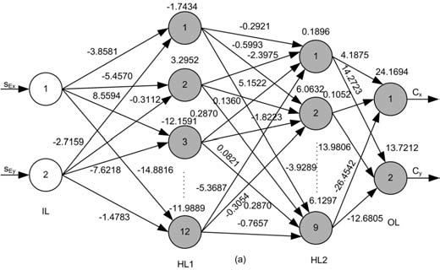
Core Components
Neurons (Nodes)
Basic units of an ANN.
Receive input, process it, and pass the output to the next layer.
2.Layers
Input Layer: The layer that receives the input data.
Hidden Layers: Intermediate layers where the processing is done. There can be one or more hidden layers.
Output Layer: Produces the final output of the network.
3. Weights
Parameters that are adjusted during training.
Represent the strength of the connection between neurons.
4. Bias
An additional parameter in each neuron that allows the model to fit the data better.
5. Activation Function
A mathematical function is applied to the output of each neuron.
Introduces non-linearity to the model.
Common activation functions include Sigmoid, Tanh, ReLU (Rectified Linear Unit), and Softmax.

Slide 12
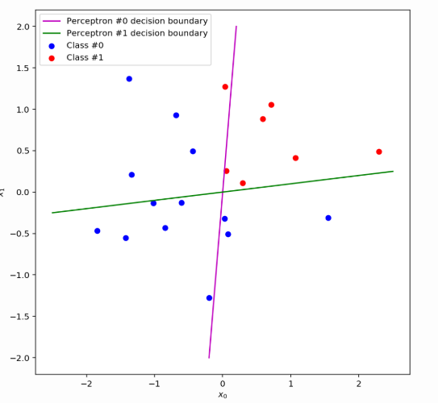
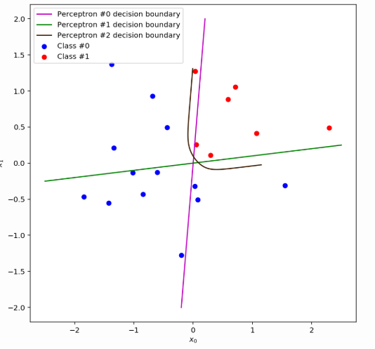

Slide 13
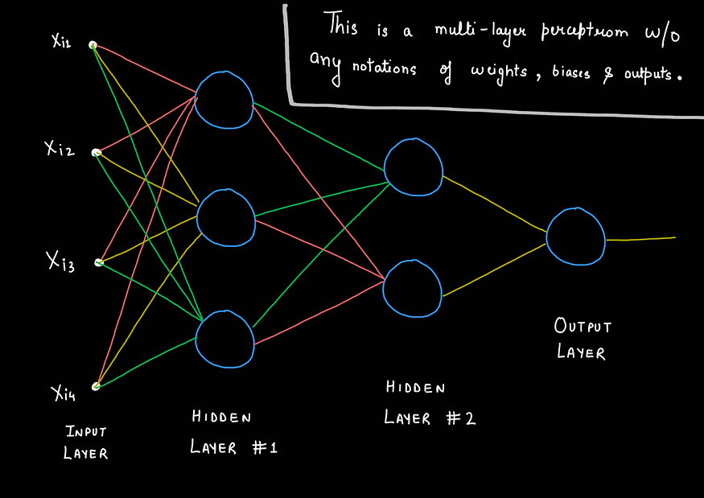
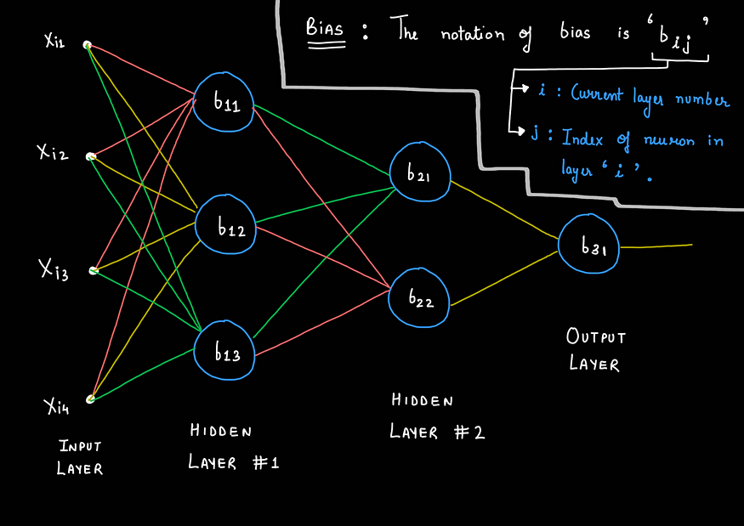
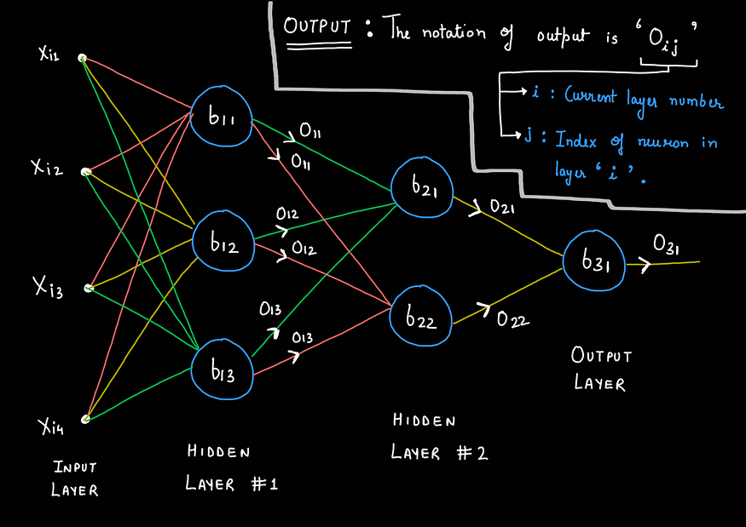
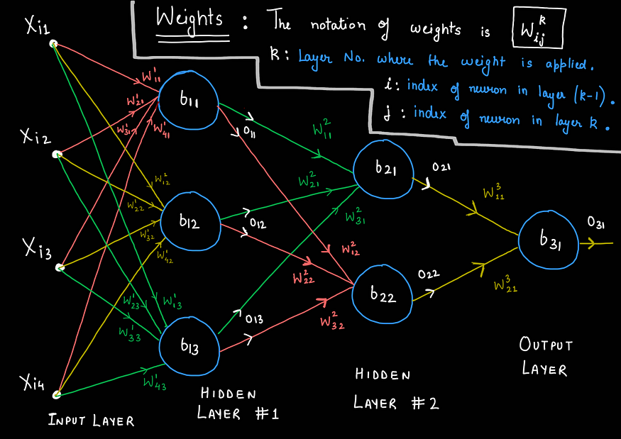

Slide 14
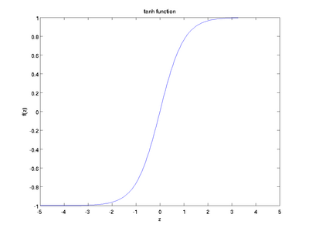
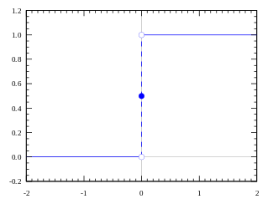
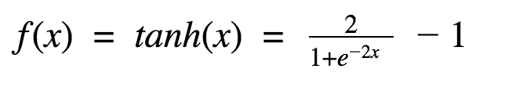

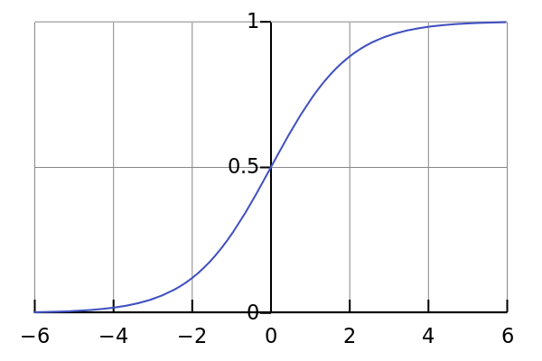

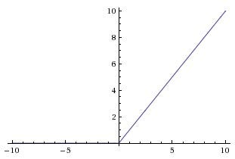
Activation Functions
Step function
Tanh Function
Sigmoid Function
ReLu
A(x) = max(0,x)

Slide 15
Functioning of an ANN
Forward Propagation
Input data is fed into the input layer.
Data is passed through hidden layers, where neurons process it using weights, biases, and activation functions.
Final output is produced at the output layer.
2. Loss Calculation
The output is compared to the actual target values using a loss function (e.g., Mean Squared Error for regression, Cross-Entropy for classification).
The loss function measures how far the predicted output is from the actual target.
3. Backward Propagation
The error is propagated back through the network.
Weights and biases are adjusted to minimize the loss using optimization algorithms like Gradient Descent.
4. Training
The processes of forward propagation, loss calculation, and backward propagation are repeated iteratively.
The network learns to make better predictions by adjusting the weights and biases.

Slide 16
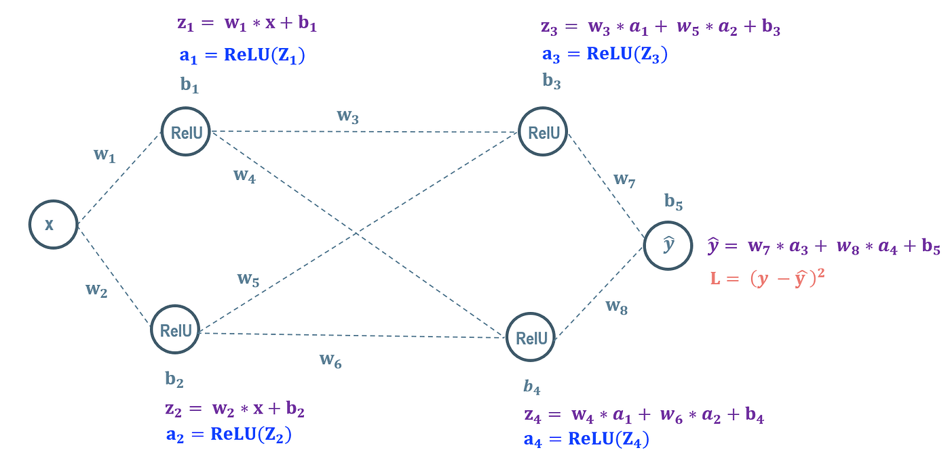

Slide 17
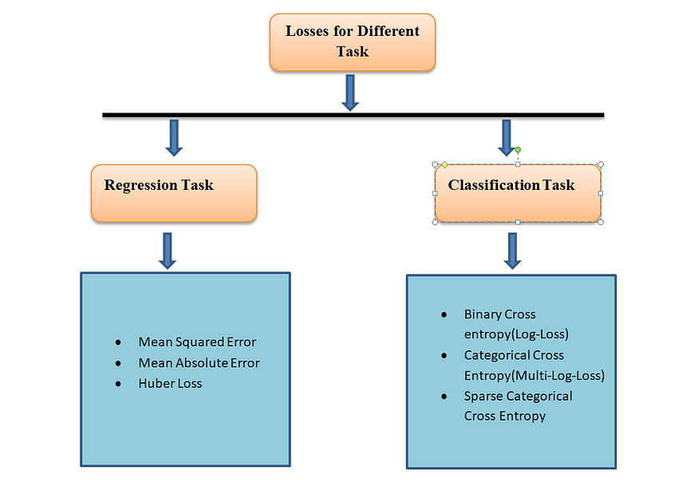
Loss Functions
Loss function is a method with which we can evaluate or measure how our model is working.
If the value of the loss function is lower then our model is working well otherwise we have to change the parameter of the model to reduce or minimize the loss. It guides the learning algorithm in adjusting the model’s parameter i.e weights and biases during the training time.

Slide 18
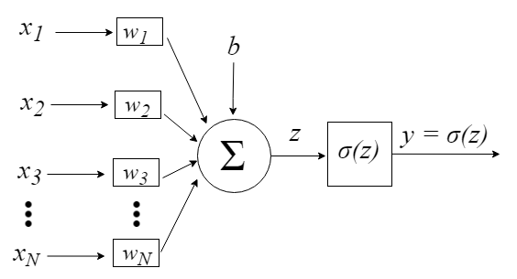

Backpropagation
The idea of the backpropagation algorithm is, based on error (or loss) calculation, to recalculate the weights array w in the last neuron layer, and proceed this way towards the previous layers, from back to front, that is, to update all the weights w in each layer, from the last one until reaching the input layer of the network, for this doing the backpropagation of the error obtained by the network. In other words, we calculate the error between what the network predicted to be and what it was indeed, then we recalculate all the weights values, from the last layer to the very first one, always intending to decrease the neural network error.

Slide 19
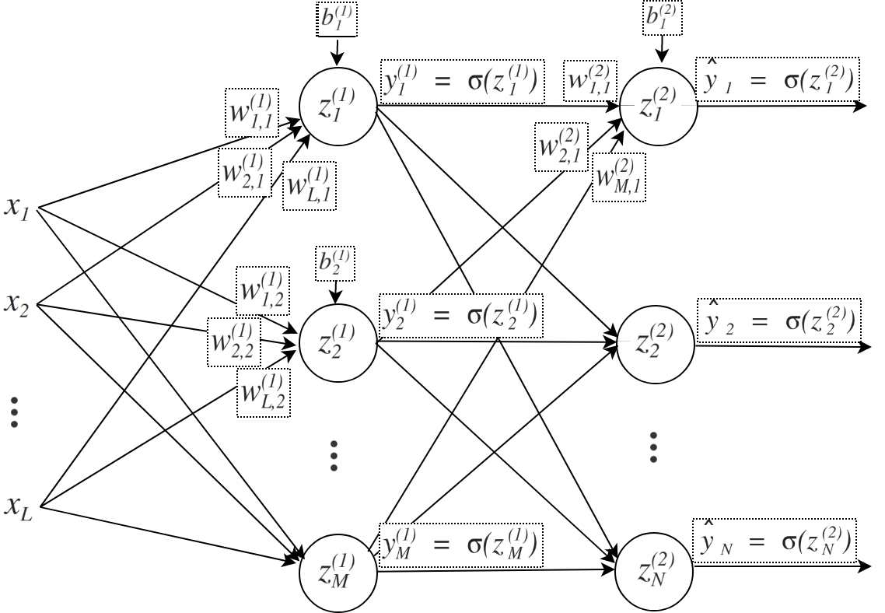

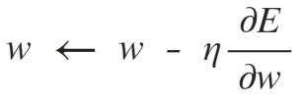
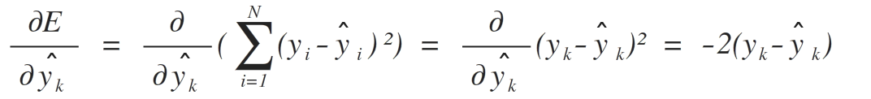


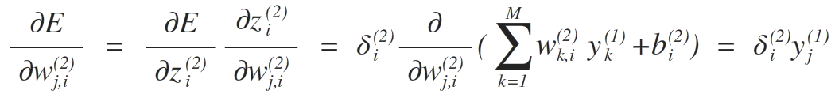




Slide 20







Slide 21
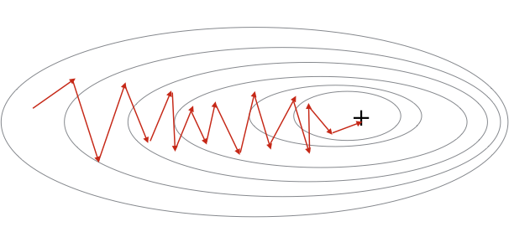
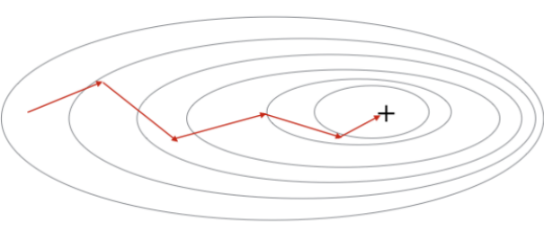
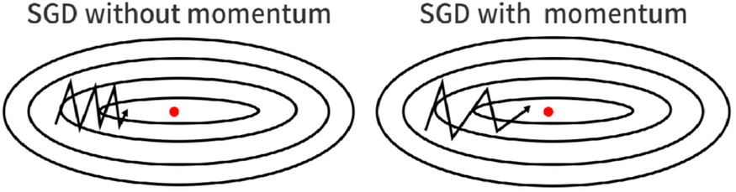
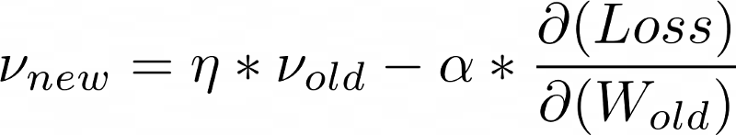
Optimizer
Stochastic Gradient Descent
Mini-Batch Gradient Descent
SGD with Momentum

Slide 22
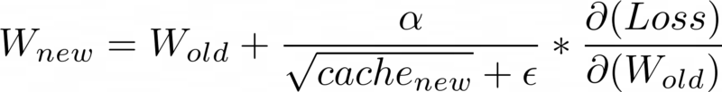

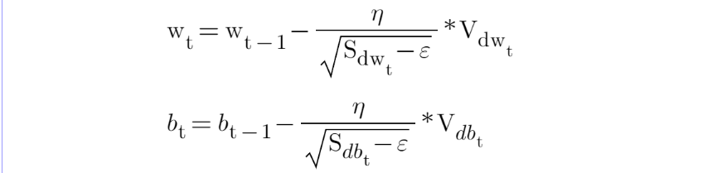
AdaGrad(Adaptive Gradient Descent)
RMS-Prop (Root Mean Square Propagation)
Adam(Adaptive Moment Estimation)

Slide 24
Advantages
1. Nonlinear Mapping: MLPs can approximate nonlinear functions, making them suitable for modelling complex relationships in data.
2. Feature Learning: Through hidden layers, MLPs can automatically learn hierarchical representations of features from raw input data.
3. Versatility: MLPs have demonstrated effectiveness across various domains, including image recognition, speech recognition, and time series prediction.
4. Scalability: With advancements in hardware and optimisation techniques, MLPs can scale to accommodate large datasets and complex architectures.

Slide 25
Limitations
1. Overfitting: MLPs are prone to overfitting, especially when trained on small datasets or with excessive model capacity.
2. Gradient Vanishing/Exploding: Deep MLPs may suffer from vanishing or exploding gradients during training, hindering convergence.
3. Hyperparameter Sensitivity: The performance of MLPs is sensitive to hyperparameters such as learning rate, batch size, and network architecture, requiring careful tuning.
4. Computationally Intensive: Training deep MLPs can be computationally expensive, especially without access to high-performance hardware or parallel processing capabilities.

Slide 26
What if the input data is an image or a video???
Convolutional Neural Network(CNN)

Slide 27
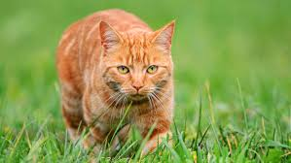
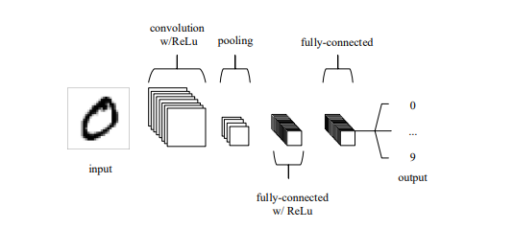
Convolutional Neural Network(CNN)
CNNs primarily focus on the basis that the input will be comprised of grid data like images , videos etc. This focuses the architecture to be set up in way to best suit the need for dealing with the specific type of data.
CNNs are comprised of three types of layers. These are convolutional layers, pooling layers and fully-connected layers. When these layers are stacked, a CNN architecture has been formed.

Slide 28
Layers
1. Input Layer: The input layer holds the pixel values of the image.
2. Convolutional layer : It determines the output of neurons of which are connected to local regions of the input through the calculation of the scalar product between their weights and the region connected to the input volume. The rectified linear unit (ReLu) aims to apply an ‘elementwise’ activation function such as sigmoid to the output of the activation produced by the previous layer.
3.Pooling layer : It simply performs downsampling along the spatial dimensionality of the given input, further reducing the number of parameters within that activation.
4. Fully-connected layers : It performs the same duties found in standard ANNs and attempt to produce class scores from the activations, to be used for classification. It is also suggested that ReLu may be used between these layers, as to improve performance.

Slide 29
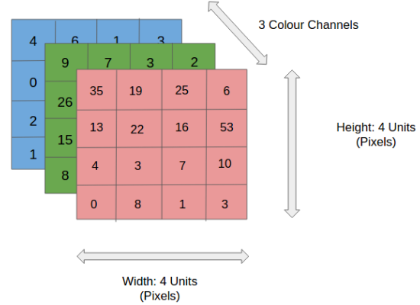
Input Layer
The input layer receives the raw image data and passes it to the network for processing. In CNNs, input is typically a 3D volume (width × height × depth).
Stores pixel values of the image (e.g., 32 × 32 × 3 for RGB images).
Preserves the spatial structure of the image for further feature extraction.

Slide 30
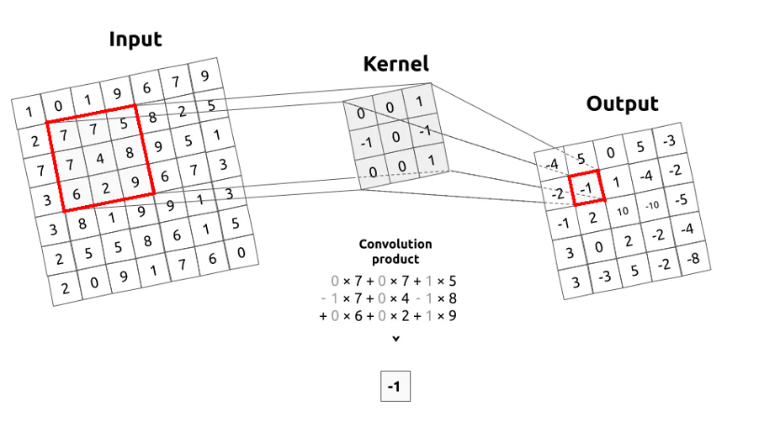
Convolutional Layer
The Convolutional Layer is responsible for extracting important features from the input data. It applies a set of learnable filters (kernels) that slide over the image and compute the dot product between the filter weights and corresponding image patches, producing feature maps.
Uses small filters (e.g., 2×2, 3×3, 5×5) to scan the input image.
Generates feature maps that capture patterns such as edges, textures and shapes.

Slide 31
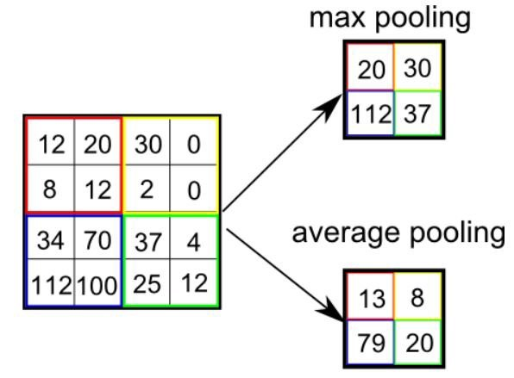
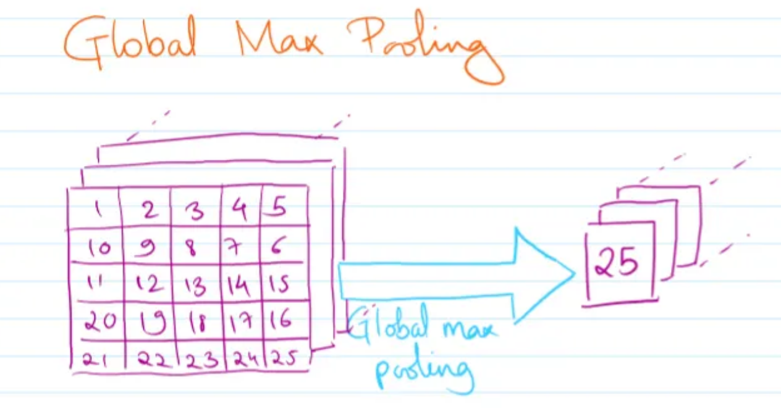
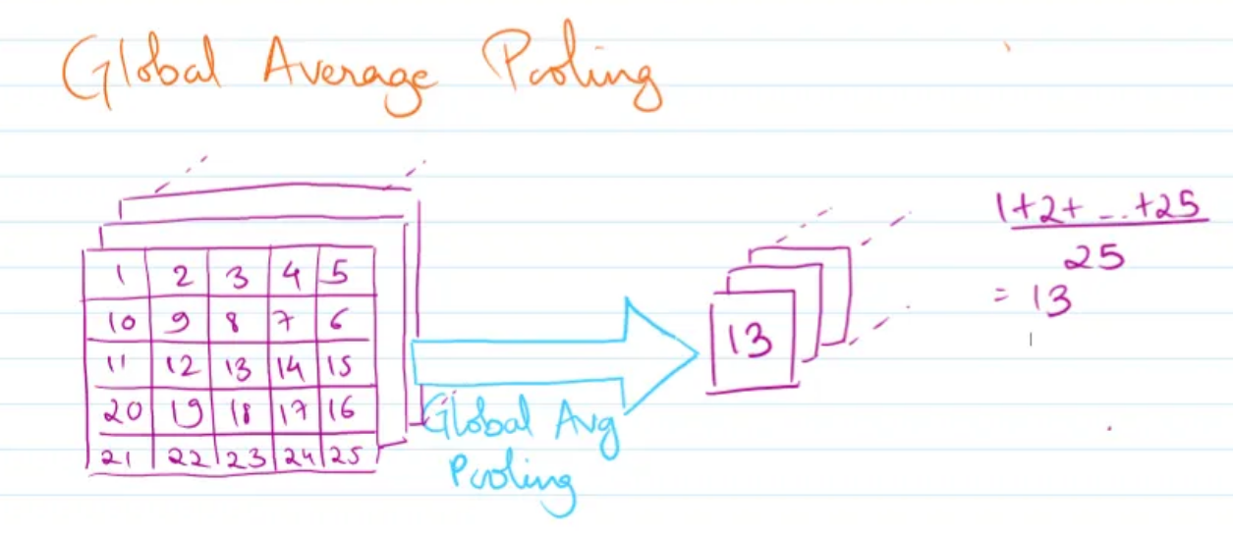
Pooling Layer
Pooling layers aim to gradually reduce the dimensionality of the representation, and thus further reduce the number of parameters and the computational complexity of the model.
It helps in controlling the model’s complexity, reducing overfitting, and improving computational efficiency by reducing the number of parameters while retaining essential information.
Types of Pooling Layers:
1. Max Pooling
2. Average Pooling
3. Global Pooling

Slide 32
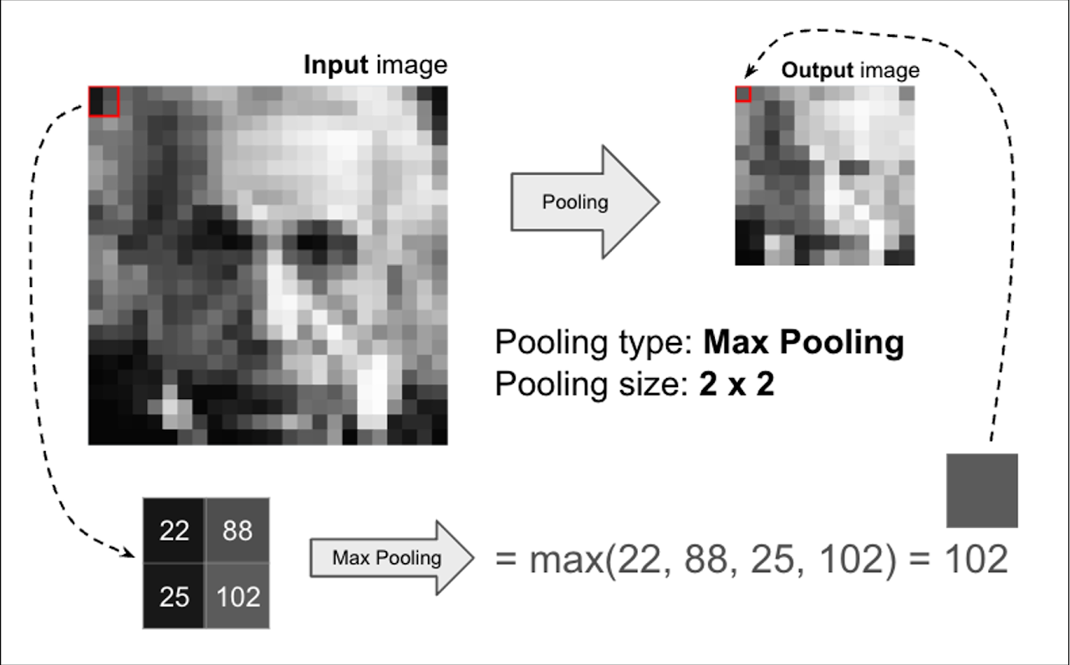

Slide 33
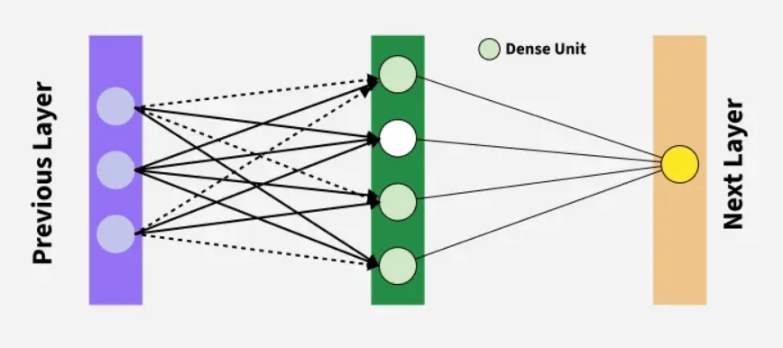
Fully-Connected Layer
The fully-connected layer contains neurons of which are directly connected to the neurons in the two adjacent layers, without being connected to any layers within them. This is analogous to way that neurons are arranged in traditional forms of ANN.

Slide 34
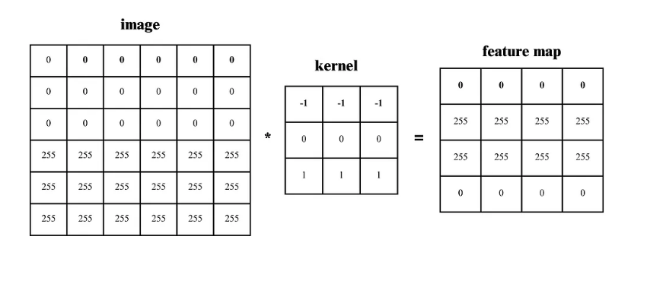
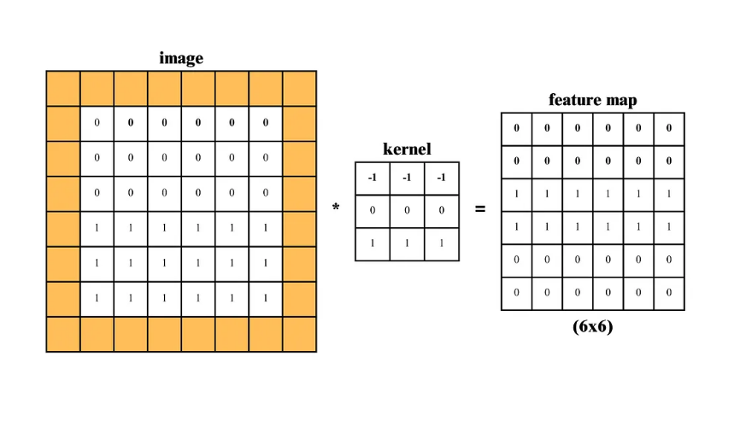
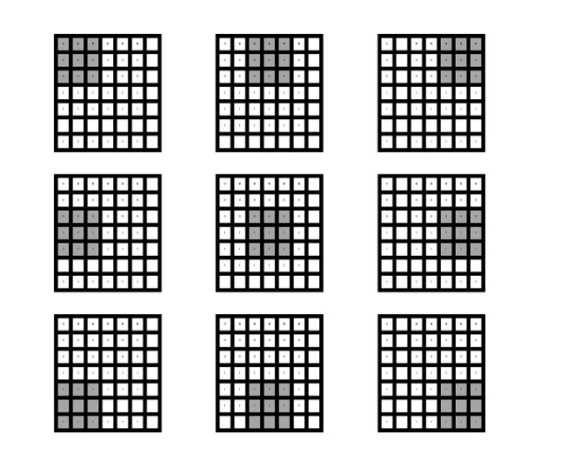
Padding and Strides
In Convolutional Neural Networks (CNNs), padding and strides are important concepts that determine how the convolution operation is applied to an input, affecting the output size and how features are extracted.
Padding refers to the process of adding extra pixels (usually zeros) around the border of the input image.
Strides refer to the number of pixels by which the filter (or kernel) moves or slides across the input image.

Slide 35
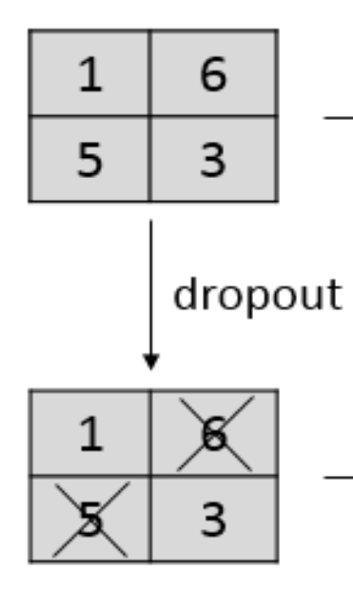
Dropout
Dropout is a regularization technique used in deep learning models, particularly Convolutional Neural Networks (CNNs), to prevent overfitting.
Overfitting occurs when a model performs well on the training data but fails to generalize to new, unseen data. Dropout addresses this issue by randomly “dropping out” (setting to zero) a fraction of neurons during training, forcing the network to learn more robust and generalizable features.
In CNNs, dropout is typically applied after fully connected (dense) layers, but it can also be used after convolutional layers. It helps prevent the model from memorizing specific features in the training data.
Common dropout rates range from 0.2 to 0.5 means that 20% to 50% of the neurons are deactivated at each training step.

Slide 36
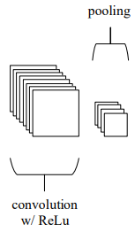
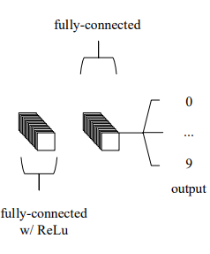
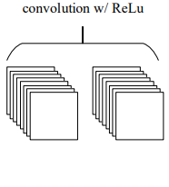



Overall Architecture

Slide 37
Training
CNNs are trained using a supervised learning approach. This means that the CNN is given a set of labeled training images. The CNN learns to map the input images to their correct labels.
The training process for a CNN involves the following steps:
Data Preparation: The training images are preprocessed to ensure that they are all in the same format and size.
Loss Function: A loss function is used to measure how well the CNN is performing on the training data. The loss function is typically calculated by taking the difference between the predicted labels and the actual labels of the training images.
Optimizer: An optimizer is used to update the weights of the CNN in order to minimize the loss function.
Backpropagation: Backpropagation is a technique used to calculate the gradients of the loss function with respect to the weights of the CNN. The gradients are then used to update the weights of the CNN using the optimizer.

Slide 38
Different CNN Models
1. LeNet: LeNet developed by Yann LeCun and his colleagues in the late 1990s was one of the first successful CNNs designed for handwritten digit recognition. It laid the foundation for modern CNNs and achieved high accuracy on the MNIST dataset which contains 70,000 images of handwritten digits (0-9).
2. AlexNet : AlexNet is a CNN architecture that was developed by Alex Krizhevsky, Ilya Sutskever and Geoffrey Hinton in 2012. It was the first CNN to win the ImageNet Large Scale Visual Recognition Challenge (ILSVRC) a major image recognition competition. It consists of several layers of convolutional and pooling layers followed by fully connected layers. The architecture includes five convolutional layers, three pooling layers and three fully connected layers.
3. Resnet: ResNet are designed for image recognition and processing tasks. They are renowned for their ability to train very deep networks without overfitting making them highly effective for complex tasks. It introduces skip connections that allow the network to learn residual functions making it easier to train deep architecture.
4. GoogleNet: GoogleNet also known as InceptionNet is renowned for achieving high accuracy in image classification while using fewer parameters and computational resources compared to other state-of-the-art CNNs. The core component of GoogleNet allows the network to learn features at different scales simultaneously to enhance performance.
5. VGG: VGGs are developed by the Visual Geometry Group at Oxford, it uses small 3x3 convolutional filters stacked in multiple layers, creating a deep and uniform structure. Popular variants like VGG-16 and VGG-19 achieved state-of-the-art performance on the ImageNet dataset demonstrating the power of depth in CNNs.

Slide 39
Applications
Image classification: CNNs are the state-of-the-art models for image classification. They can be used to classify images into different categories such as cats and dogs.
Object detection: It can be used to detect objects in images such as people, cars and buildings. They can also be used to localize objects in images which means that they can identify the location of an object in an image.
Image segmentation: It can be used to segment images which means that they can identify and label different objects in an image. This is useful for applications such as medical imaging and robotics.
Video analysis: It can be used to analyze videos such as tracking objects in a video or detecting events in a video. This is useful for applications such as video surveillance and traffic monitoring.

Slide 40
Advantages
CNNs have several advantages over traditional machine learning algorithms, including:
Automatic feature learning : CNNs can automatically learn relevant features from raw input data, which eliminates the need for manual feature engineering.
2. High accuracy : CNNs can achieve state-of-the-art performance in various image and video recognition tasks.
3. Robustness to noise: CNNs are robust to noise and distortion in the input data, which makes them highly effective in real-world applications.

Slide 41
Limitations
Despite their many advantages, CNNs also have some disadvantages, including:
High computational requirements : CNNs require significant computational resources, including high-end GPUs, to train and deploy.
2. Large amounts of data : CNNs require large amounts of labeled training data to achieve high accuracy, which can be challenging to obtain in some domains.
3. Overfitting : CNNs are prone to overfitting when the training data is limited or noisy, which can lead to poor generalization performance on new data.

Slide 42

Till now , everything looks fine
We have models for analyzing tabular data as well as image and video data
But there is a problem !!!
Here , in these models we are giving all the input data in a single time
But in many real life problems, it is not possible to give all the data in a single time
What if data is coming sequentially(Text or time series)???
Recurrent Neural Network(RNN)

Slide 43
Recurrent Neural Network(RNN)
Recurrent neural networks (RNNs) are a type of artificial neural network specifically designed to handle sequential data.
Unlike traditional neural networks where each input is independent, RNNs can access and process information from previous inputs. This makes them particularly useful for tasks that involve sequences, like text, speech, or time series data.
The quick brown fox jumps over the lazy dog.
Common types of sequential data:
Fox brown quick the jumps over lazy dog
1. Time series data
2. Natural language text
3. Speech signals

Slide 44


Slide 45


Slide 46

Types of RNN
There are 3 types of RNN architecture which are :
One to Many
Many to One
Many to Many

Slide 47

One to Many
A “one-to-many” architecture represents a scenario where the network receives a single input but generates a sequence of outputs.
Applications:
Single Input: The RNN takes in a single piece of information as input. This could be an image, a musical note, a short sentence, or any data point that serves as a starting point for the network.
Image Captioning: Based on a single image input, the RNN generates a sentence or paragraph describing the image content (multiple outputs).
Multiple Outputs: The RNN processes the input and generates a sequence of outputs over time. This sequence can vary in length depending on the specific task.
Music Generation: The RNN receives a single starting note or short melody as input and produces a sequence of musical notes forming a complete piece (multiple outputs).

Slide 48

Many to One
A “many-to-one” architecture refers to a specific type of RNN where the network processes a sequence of inputs but produces a single output.
Many Inputs: The RNN takes in a sequence of data points over time. This sequence could be words in a sentence, sensor readings over a period, or financial data points for multiple days.
Applications:
Sentiment Analysis: Given a sentence or review text (sequence of words), classify its overall sentiment (positive, negative, or neutral) as the single output.
Single Output: After processing the entire sequence, the RNN generates a single output value. This output could be a classification (positive/negative sentiment), a prediction (next value in the time series), or a summary of the information in the sequence.
Spam Detection: Analyze an email’s content (sequence of words) to determine if it’s spam (single output).

Slide 49

Many to Many
A “many-to-many” architecture describes a scenario where the network processes a sequence of inputs and generates a corresponding sequence of outputs. This means both the input and output have multiple elements processed over time steps.
Multiple Inputs: The RNN takes in a sequence of data points, similar to many-to-one RNNs. This sequence could be words in a sentence, sensor readings, or financial data points.
Multiple Outputs: The RNN generates a new sequence of data points, with a length that may or may not be the same as the input sequence.

Slide 50

Many to Many
There are two main categories of many-to-many RNNs:
Fixed Length: In this case, the number of elements in the output sequence is the same as the number of elements in the input sequence. A common application is named entity recognition (NER), where the network identifies and classifies each word in a sentence (input sequence) as a specific entity type (i.e. parts of speech) (output sequence).

Slide 51

Many to Many
2. Variable Length: Here, the output sequence can have a different length than the input sequence. This is particularly useful for tasks like machine translation, where the source sentence (input sequence) in one language might be translated into a longer or shorter sentence (output sequence) in another language.

Slide 52
Many to Many
Applications:
Machine Translation: Translate text from one language to another (e.g., English to French).
Video Captioning: Generate captions describing the content of a video (sequence of video frames as input, sequence of words as output).
Text Summarization: Summarize a long document into a shorter version with key points (sequence of sentences as input, shorter sequence of sentences as output).

Slide 53
Training
Backpropagation in RNNs, also known as Backpropagation Through Time (BPTT), is a crucial technique for training these networks. It allows them to learn and improve their performance on tasks involving sequential data.
Steps for Training:
1. Forward Pass
2. Error Calculation
3. Weight Update

Slide 54


Slide 56

After processing the entire sequence, the difference (error) between the network’s final output and the desired output for the sequence is calculated.

Slide 57


Slide 58




Slide 59
Applications
Natural Language Processing (NLP):
Language Modeling: RNNs can predict the next word in a sentence, useful for tasks like text generation and autocomplete.
Machine Translation: RNNs can be used for translation tasks, with one RNN encoding the input sentence and another decoding it in the target language.
Sentiment Analysis: RNNs can analyze text sentiment by capturing contextual information from words in a sequence.
2. Speech Recognition and Synthesis:
Speech-to-Text: RNNs are employed to convert spoken language into written text, making them the backbone of speech recognition systems.
Text-to-Speech: RNNs can generate human-like speech from text input, improving voice assistants and accessibility tools.

Slide 60
Applications
3. Time-Series Analysis and Forecasting:
Financial Forecasting: RNNs can predict stock prices, currency exchange rates, and other financial variables.
Weather Prediction: RNNs can analyze historical weather data to forecast future weather conditions.
4. Music Generation:
RNNs can generate music sequences, learning patterns from existing music compositions and producing new compositions.
5. Video Analysis and Action Recognition:
Video Understanding: RNNs can process frames in a video sequence to understand actions, objects, and activities.
Gesture Recognition: RNNs can recognize hand gestures and movements in videos for applications like sign language translation.

Slide 61
Applications
6. Robotics and Autonomous Systems:
Path Prediction: RNNs can help robots predict the paths of moving objects and plan their actions accordingly.
Gesture Control: RNNs enable natural interaction with robots through gesture recognition.
7. Language Generation and Dialogue Systems:
Chatbots: RNNs power chatbots and virtual assistants by generating coherent responses in conversations.
Storytelling: RNNs can create stories or narratives based on input prompts.

Slide 62
Limitations
Lack of Parallelism: The inherently sequential nature of RNNs limits their parallel processing capabilities, making them less efficient for deployment on certain hardware architectures.
Vanishing Gradient Problem: Traditional RNNs suffer from the vanishing gradient problem, especially in long sequences. Gradients can become extremely small as they are propagated backward through time, making it difficult for the network to learn from distant past information. This hinders the RNN’s ability to capture long-term dependencies.

Slide 63


Slide 64
Limitations
Exploding Gradient Problem: In contrast to the vanishing gradient problem, exploding gradients occur when gradients become extremely large, leading to unstable training and convergence issues. This can result in a loss function that increases rapidly and prevents the network from learning effectively.
Lack of Global Context: In very long sequences, the context from the initial steps might get diluted over time, limiting the model’s ability to capture global information. Advanced architectures like transformers have been developed to address this issue.
However, RNNs excel at analyzing recent inputs, which is perfect for short-term predictions like suggesting the next word on a mobile keyboard.

Slide 65

Then how to avoid this gradient problem for RNNs so that Long-Term Dependency can be captured….
Long Short-Term Memory(LSTM) !!!

Slide 66

Long Short-Term Memory(LSTM)
LSTMs come to the rescue to solve the vanishing gradient problem. It does so by ignoring (forgetting) useless data/information in the network. The LSTM will forget the data if there is no useful information from other inputs (prior sentence words). When new information comes, the network determines which information to be overlooked and which to be remembered.

Slide 67

LSTM Architecture
In RNNs, we have a very simple structure with a single activation function (tanh).
In LSTMs, instead of just a simple network with a single activation function, we have multiple components, giving power to the network to forget and remember information.

Slide 68


Slide 69

LSTM Architecture
LSTMs have 4 different components :
Cell state (Memory cell)
2. Forget gate
3. Input gate
4. Output gate

Slide 70

1. Cell State (Memory cell)
It is the first component of LSTM which runs through the entire LSTM unit. It kind of can be thought of as a conveyer belt.
This cell state is responsible for remembering and forgetting. This is based on the context of the input. This means that some of the previous information should be remembered while some of them should be forgotten and some of the new information should be added to the memory. The first operation (X) is the pointwise operation which is nothing but multiplying the cell state by an array of [-1, 0, 1]. The information multiplied by 0 will be forgotten by the LSTM. Another operation is (+) which is responsible to add some new information to the state.

Slide 71

2. Forget Gate
The forget LSTM gate, as the name suggests, decides what information should be forgotten. A sigmoid layer is used to make this decision. This sigmoid layer is called the “forget gate layer”.
It does a dot product of h(t-1) and x(t) and with the help of the sigmoid layer, outputs a number between 0 and 1 for each number in the cell state C(t-1). If the output is a ‘1’, it means we will keep it. A ‘0’ means to forget it completely.

Slide 72


3. Input gate
The input gate gives new information to the LSTM and decides if that new information is going to be stored in the cell state.
This has 3 parts:
A sigmoid layer decides the values to be updated. This layer is called the “input gate layer”
2. A tanh activation function layer creates a vector of new candidate values, Č(t), that could be added to the state.
3. Then we combine these 2 outputs, i(t) * Č(t), and update the cell state.

Slide 73

4. Output gate
The output of the LSTM unit depends on the new cell state.
First, a sigmoid layer decides what parts of the cell state we’re going to output. Then, a tanh layer is used on the cell state to squash the values between -1 and 1, which is finally multiplied by the sigmoid gate output.

Slide 74
LSTM Visualization

Slide 75
Training
The training process of LSTM is similar to RNNs

Slide 76
Applications
Language Modeling: Used in tasks like machine translation and text summarization. RNNs learn dependencies between words in a sequence, helping generate grammatically correct and meaningful sentences.
Speech Recognition: Used to convert spoken language into text. By learning temporal patterns in audio signals, RNNs can recognize words and map them accurately to text.
Time Series Forecasting: Used for predicting stock prices, weather and energy consumption. They learn patterns in time series data to predict future events.
Anomaly Detection: Used for detecting fraud or network intrusions. These networks can identify patterns in data that deviate drastically and flag them as potential anomalies.
Recommender Systems: In recommendation tasks like suggesting movies, music and books. They learn user behavior patterns to provide personalized suggestions.
Video Analysis: Applied in tasks like activity recognition and action classification. When combined with CNNs, RNNs help process sequential frames to understand motion and temporal patterns.

Slide 77
Advantages
Modeling long-term dependencies: LSTMs are well-suited for modeling long-term dependencies in sequential data, since they can selectively “remember” or “forget” information over time. This makes them useful for tasks like speech recognition, machine translation, and text generation.
2.Robustness to noisy data: LSTMs are more robust to noisy or missing data than other types of recurrent neural networks, since they can selectively filter out irrelevant or noisy information using the forget gate.
3.Flexibility: LSTMs can be used for a wide variety of tasks, including classification, regression, and sequence-to-sequence learning.
4.Interpretability: Since LSTMs maintain a cell state vector that represents the network’s “memory” at each time step, they can be more interpretable than other types of recurrent neural networks.

Slide 78
Limitations
Computationally expensive: LSTMs can be computationally expensive to train and evaluate, especially for long sequences or large datasets.
2.Prone to overfitting: LSTMs can be prone to overfitting on small datasets, especially if the model architecture is too complex.
3.Hyperparameter tuning: LSTMs have many hyperparameters that need to be tuned in order to achieve optimal performance, including the number of hidden units, the learning rate, and the dropout rate.
4.Data requirements: LSTMs require a large amount of training data to learn complex patterns in the data. If there is not enough data available, the model may not perform well.

Slide 79
Looks Complicated…
Is there any simplified version of LSTM???
Gated Recurrent Unit(GRU)

Slide 80

Gated Recurrent Unit(GRU)
GRU stands for Gated Recurrent Unit, which is a type of recurrent neural network (RNN) architecture that is similar to LSTM (Long Short-Term Memory).
However, GRU has a simpler architecture than LSTM, with fewer parameters, which can make it easier to train and more computationally efficient.
Overall, GRU is a popular alternative to LSTM for modeling sequential data, especially in cases where computational resources are limited or where a simpler architecture is desired.

Slide 81


Slide 82


Slide 83

1. Update gate

Slide 84

2. Reset gate

Slide 85

3. Current memory content

Slide 86

4. Final memory at current time step

Slide 87
Advantages
GRU networks are similar to Long Short-Term Memory (LSTM) networks, but with fewer parameters, making them computationally less expensive and faster to train.
GRU networks can handle long-term dependencies in sequential data by selectively remembering and forgetting previous inputs.
GRU networks have been shown to perform well on a variety of tasks, including natural language processing, speech recognition, and music generation.
GRU networks can be used for both sequence-to-sequence and sequence classification tasks.

Slide 88
Limitations
GRU networks may not perform as well as LSTMs on tasks that require modeling very long-term dependencies or complex sequential patterns.
GRU networks may be more prone to overfitting than LSTMs, especially on smaller datasets.
GRU networks require careful tuning of hyperparameters, such as the number of hidden units and learning rate, to achieve good performance.
GRU networks may not be as interpretable as other machine learning models, since the gating mechanism can make it difficult to understand how the network is making predictions.

Slide 89

Deep RNNs

Slide 90
Applications
Use when the complexity of the problem statement or task is high like machine translation or speech recognition
2.When we have large datasets as using deep RNNs on small dataset increases the chance of overfitting
3.Sufficient computational power
4. Not satisfied with the performance of simple RNNs
This same logic of stacking RNNs on top of another RNNs can be extending to LSTM and GRU and they will then be called as Deep LSTM and Deep GRU respectively
Mostly we use deep LSTM or deep GRU as in deep RNN we face the problem of exploding and vanishing gradient descent just like we faced in simple RNNs

Slide 91
Limitations
Chances of overfitting increases as the complexity of these architecture increases
2.Training time increases

Slide 92

Bidirectional RNN
A Bidirectional Recurrent Neural Network (Bi-RNN) processes sequential data in two directions simultaneously, forward and backward. This allows it to capture context from both past and future inputs, which makes Bi-RNNs especially powerful for tasks that require a deep understanding of the entire sequence.
Both the forward and backward RNNs work independently of each other, and their outputs are combined, typically by concatenation, element-wise addition, or averaging, to produce the final output at each timestep. This architecture enables the model to access context from both preceding and succeeding tokens, offering a comprehensive understanding of the sequence.

Slide 93
Application
Handwriting Recognition: By processing strokes both forward and backward, Bi-RNNs can better interpret the flow and structure of handwriting.
Text Classification: In sentiment analysis or topic classification, knowing the future words in a sentence can improve the accuracy of predictions.
Sequence Labeling: For tasks like named entity recognition (NER), part-of-speech (PoS) tagging, and dependency parsing, Bi-RNNs leverage both previous and future tokens to assign accurate labels.

Slide 94
Limitations
1. Slower to Compute:They process the data twice, once forward and once backward. It takes longer to train and run on large datasets.
2. Uses More Memory:Storing hidden states in both directions uses more memory. This can be a problem when working with long sequences or limited hardware.
3. More Complex to Build : They need careful handling of both forward and backward passes. Harder to implement correctly compared to simpler models.
4. Delay in Real-Time: They need to see the whole sequence before making a decision. Not suitable for tasks that need immediate responses, like real-time speech recognition.

Slide 95
SEQ-2-SEQ Architecture

Slide 96
Attention Mechanism

Slide 97


Transformer

Slide 98
Focus in Future
Other models of CNN , RNN , LSTM , GRUs and implement and optimize these models
Multimodal Neural Networks
Implementation of Transformer architecture
Different architectures of LLMs
GPT2 , GPT3 architecture
Vision Transformer
Applications of these models in real world

Slide 99
Thank You
"The future of artificial intelligence is not about man versus machine, but rather man with machine. Together, we can achieve unimaginable heights of innovation and progress" — Fei-Fei Li.

