Slide 1
WELCOME

Slide 2
Name : Chandradip Patil
SELF INTRODUCTION
Course :- MSC - 1st in computer science
College :- Pratap College
Amalner .
purpose :- I am excited to share with my internship work. All my present respected sir and mam
Thank you :- Thank all of you for being here let`s get start my presentation

Slide 3
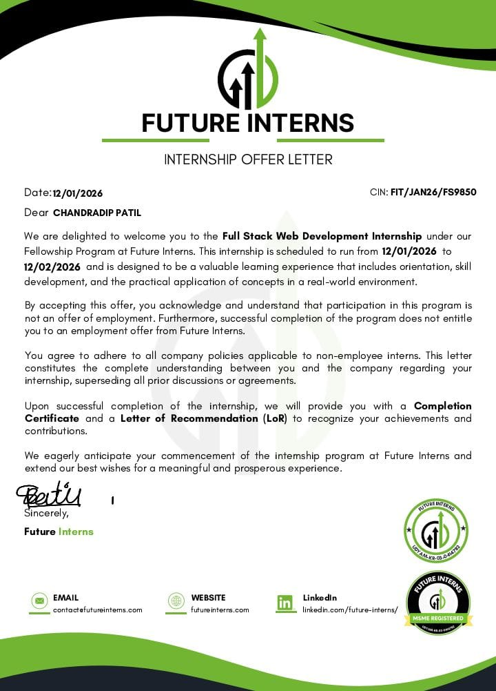

Slide 4

Self introduction
About internship
Introduction of company
Process follow for internship Task 1 and 2
CONTENT
project
Certificate

Slide 5

PROCESS FOLLOW FOR INTERNSHIP
Apply Company For Internship future interns
Receive Internship letter from future interns They give first Task (individual)
Complete first task and submit They Give Second Task
Complete Second task and Submit

Slide 6


ABOUT INTERNSHIP :
Duration - 30 days Start day –05\02\2025 & End day –
08/03/2025
Intern - Full Stack Web Development Internship
Paid or unpaid – This Internship Was Unpaid
Task I Have On Work On -
Task 1 – (Individual)
1] : Java Code Review and Error Correction
Level: Beginner
Objective: Identify, correct, and explain errors in Java code snippets to strengthen understanding of Java syntax and structure.

Slide 7

INTRODUCTION OF COMPANY
At future interns, we're on a mission to revolutionize online education by providing dynamic and interactive live training programs in cutting-edge technologies.
Future interns is at the forefront of online education, offering live training programs and courses that span the dynamic landscape of technology. Specializing in web development, data science and analytics, UI/UX designing, app development, HTML, CSS, and Java programming, we provide a comprehensive and hands-on learning experience for students and professionals alike.

Slide 8
Task 2 – Task work
1] Create a presentation on the topic
-Introduction and history of java
-OOPs in Java
Submit in pdf format

Slide 9



This are the technology are use in the project
1) JAVA SWING
2) HTML
3) CSS

Slide 10

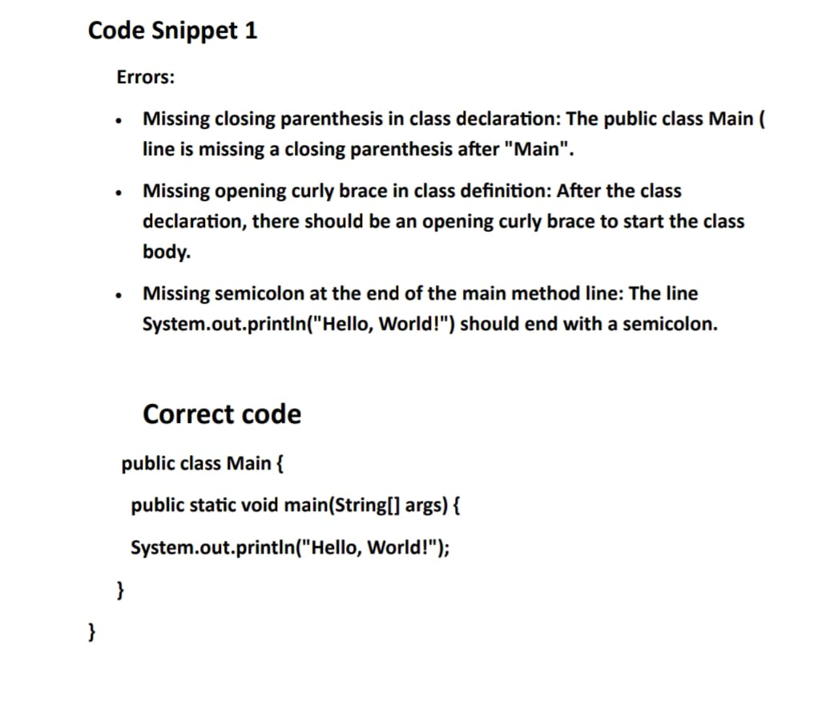
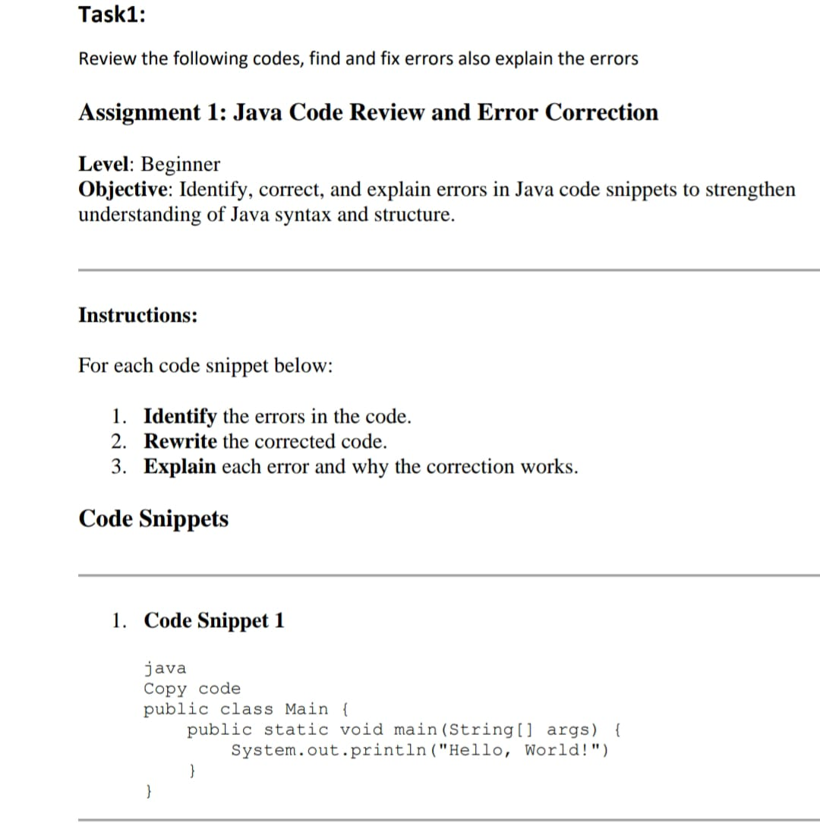
Task 1 : Java Code Review and Error Correction
1 Level: Beginner
:
Output - Hello world

Slide 11
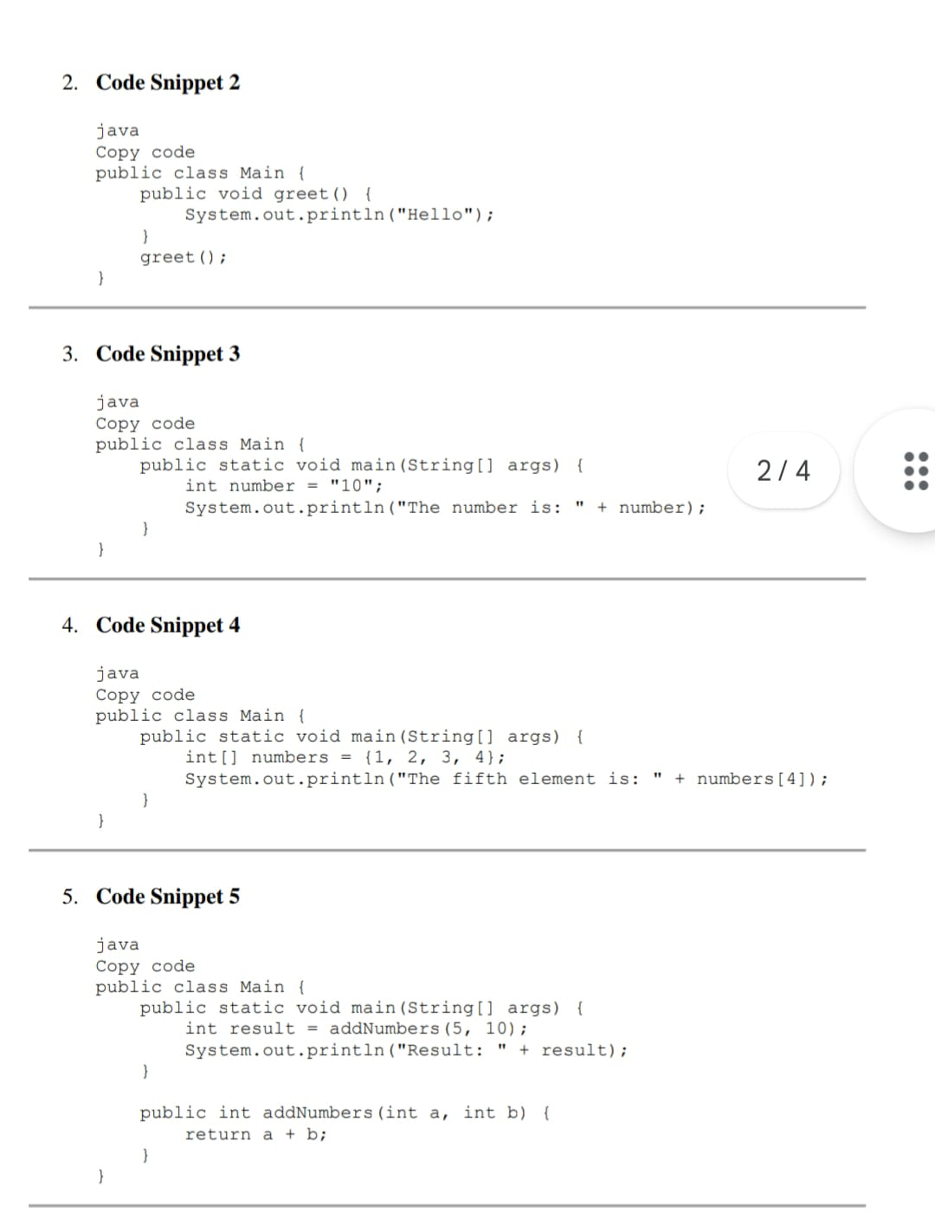

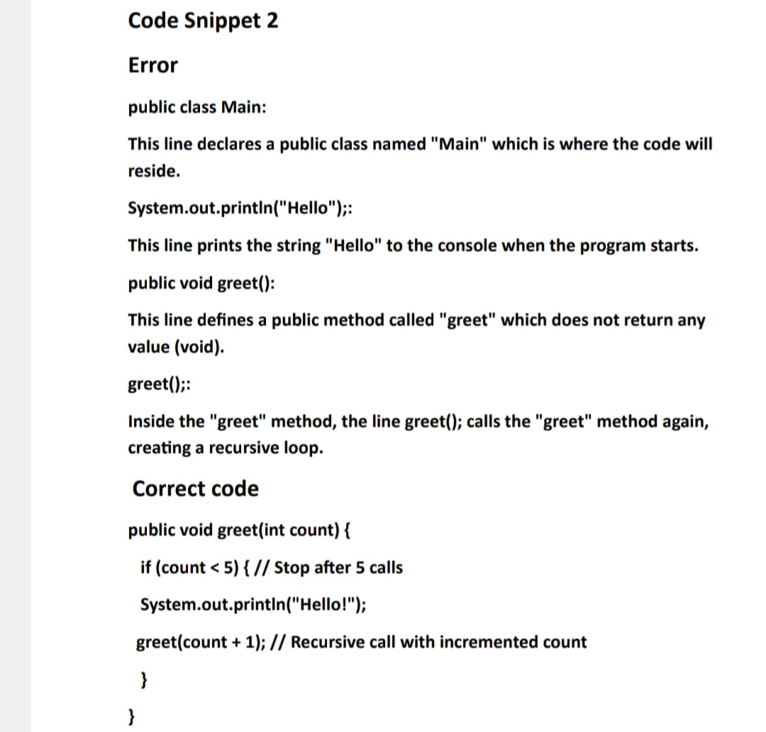

Slide 12
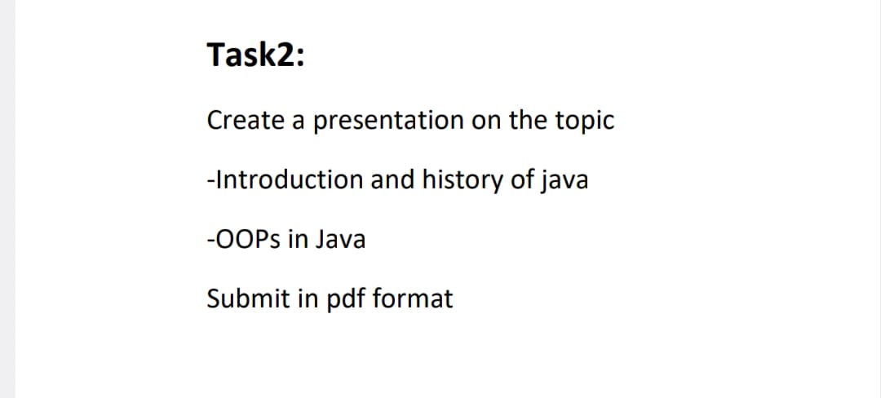

Task[2]

Slide 13
Introduction to Java
Heading: What is Java?
Content:
Java is a high-level, object-oriented programming language developed by Sun Microsystems (now owned by Oracle Corporation).
It is platform-independent, meaning Java programs can run on any device with a Java Virtual Machine (JVM).
Known for its Write Once, Run Anywhere capability. Java is widely used in enterprise applications, mobile apps (Android), and web servers.
Visuals: Java logo or an image of the "Write Once, Run Anywhere“ concept.

Slide 14
History of Java:
Heading: Evolution of Java
Content:
1991:Java was initially developed by James Gosling and Mike Sheridan at Sun Microsystems.
1995: Official release of Java 1.0 with its slogan: "Write Once, Run Anywhere“.
2004: Sun Microsystems released Java 5 (J2SE 5.0), introducing major updates like Generics, Metadata annotations, and Enhanced for-loop.
2009: Oracle acquired Sun Microsystems, and Java came under Oracle's stewardship.
Current Day: Java continues to evolve with new versions focusing on performance, security, and developer productivity.
Visuals: Timeline graphic showing key milestones of Java's history.

Slide 15
Why OOP in Java?
Modularity:
I Code is organized into classes and objects, making it easier to break down complex systems into smaller, more manageable parts.
Reusability:
OOP promotes code reusability through inheritance. Once a class is written, it can be reused in different parts of the program or in different projects.
Maintainability:
OOP allows you to modify or extend existing code with minimal impact on other parts of the programme. It's easier to debug, test, and maintain because classes and objects can be easily updated without affecting the entire program.

Slide 16

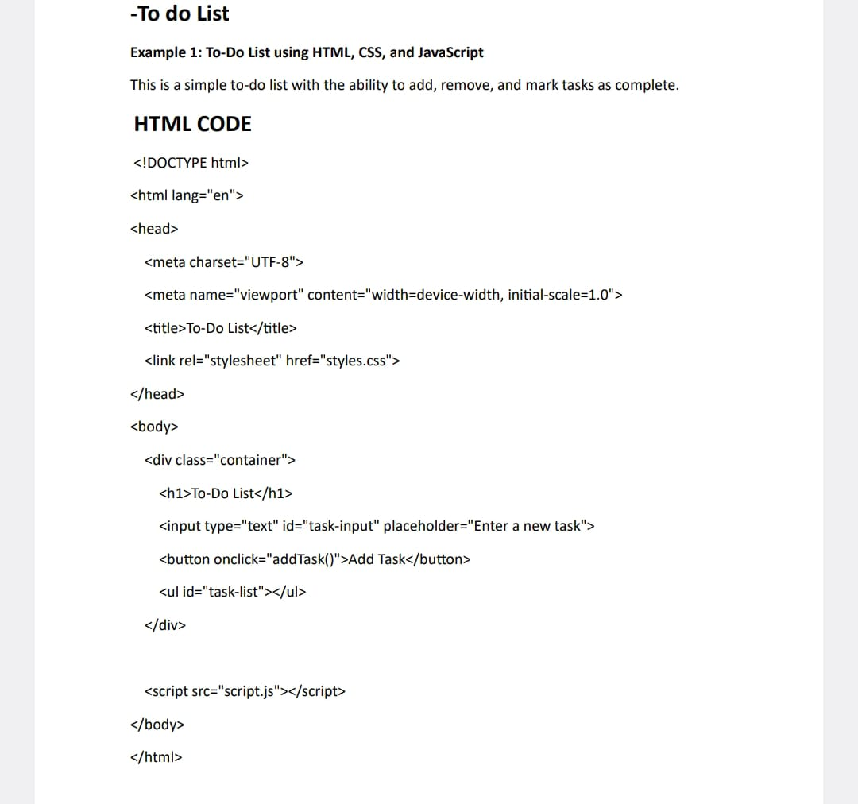
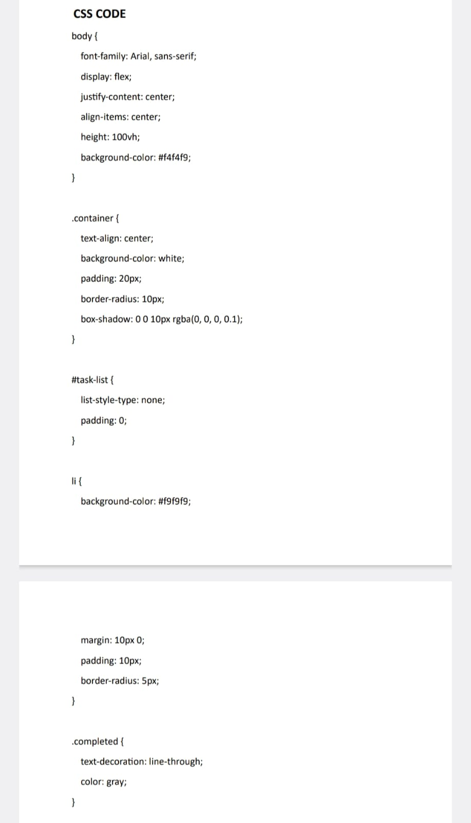
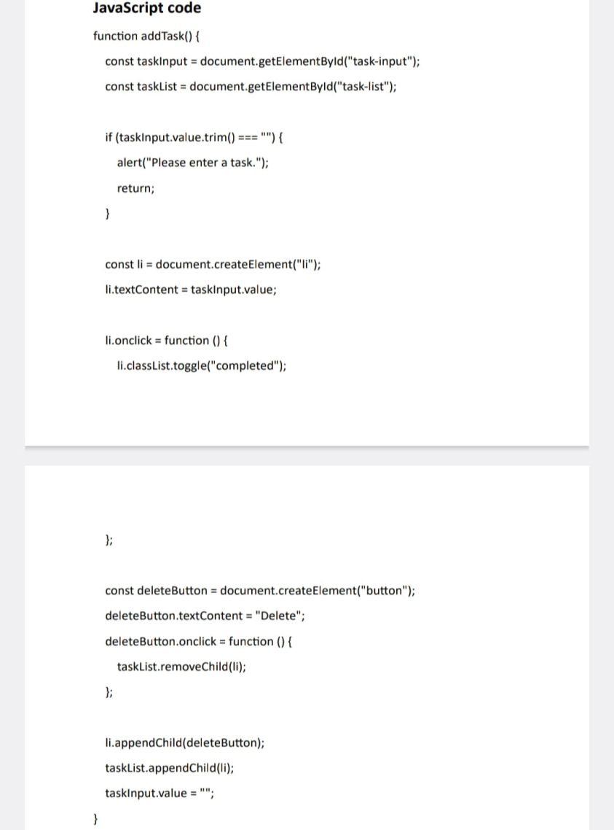
Final Project
-To do List
Example 1: To-Do List using HTML, CSS, and JavaScript

Slide 17
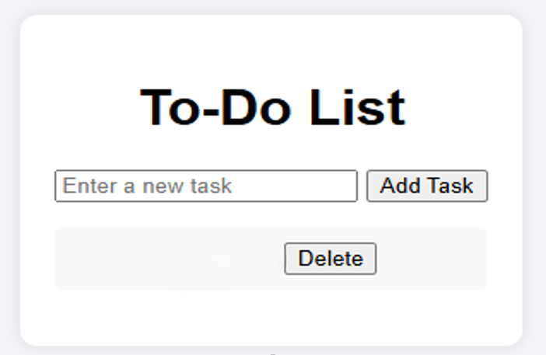
CHANDRADIP

Slide 18


