Slide 1
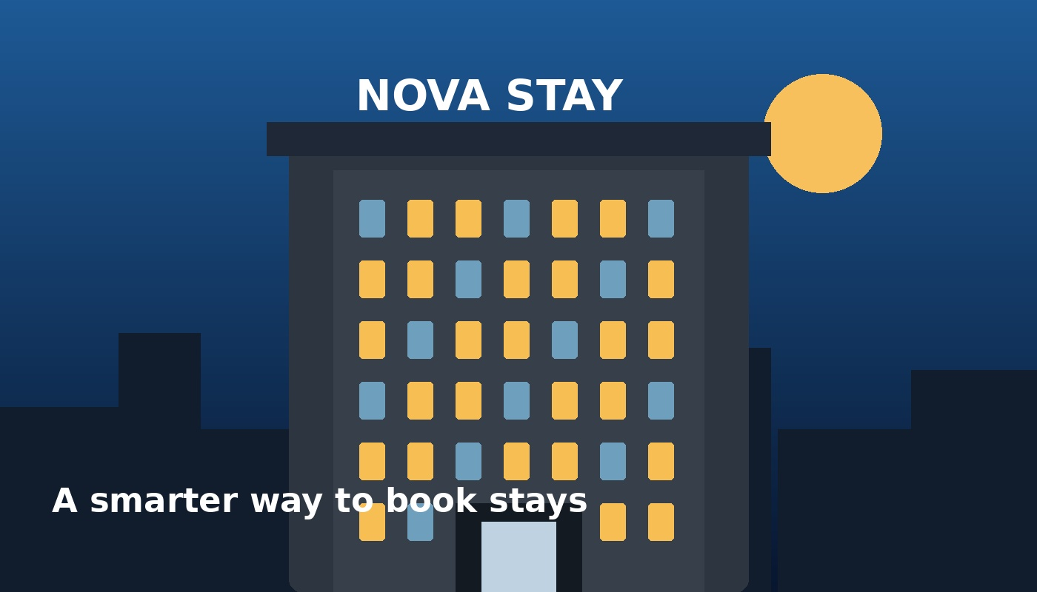
01 | BUSINESS & MARKET
1/5
StayFlow — a smarter hotel booking agency
Curated hotel bookings for US & UK travelers and small businesses — combining OTA-level choice with human service.
62.3%
$160.54
82.5%
US hotel occupancy, 2025
US ADR, 2025
London occupancy, 2025
THE BUSINESS
CUSTOMER PAIN
COMPETITIVE SET
We source, compare and book hotels for leisure travelers, corporate travelers and small group/event clients. Revenue: hotel commissions / contracted rates + transparent service fees where appropriate.
Travelers face too many options; small businesses waste time comparing rates; hotels need profitable demand. StayFlow curates the shortlist, negotiates where possible and provides human support.
Booking.com — massive OTA choice Expedia — global OTA ecosystem Agoda — strong international/mobile demand Our wedge: curated options + corporate/group support + human problem-solving.
Sources: CoStar/STR 2025 US hotel performance; Knight Frank UK Hotel Trading Performance Review 2026; competitor positioning from Booking.com, Expedia and Agoda.

Slide 2
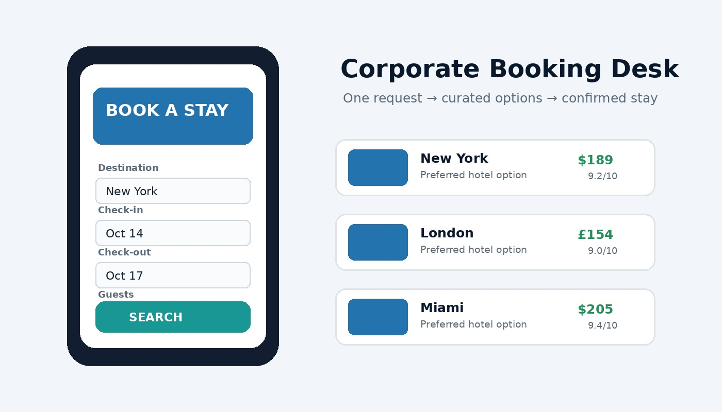
02 | STARTUP PLAN
2/5
Start with $5,000 — build supply, demand and trust
$5,000 ALLOCATION
$900 Supplier / booking technology + setup $700 Website, domain & CRM $1,000 B2B prospecting + travel ads test $1,200 Part-time sales / booking support $500 Content + creative $300 Admin / contracts / insurance buffer $400 Contingency TOTAL = $5,000
LEAN TEAM
CORE SYSTEM
Founder — sales, supplier relationships, key accounts Booking Specialist — quotes, reservations, changes Freelance Marketing/VA — prospecting, content, CRM Remote-first: no office required.
CRM + inquiry form → hotel/supplier inventory → comparison sheet/API → secure payment process → voucher → post-booking support. Control point: only sell rates and inventory we can actually confirm.
Startup budget is a proposed operating allocation. Supplier/API access and commercial terms vary by provider and must be contracted before launch.

Slide 3
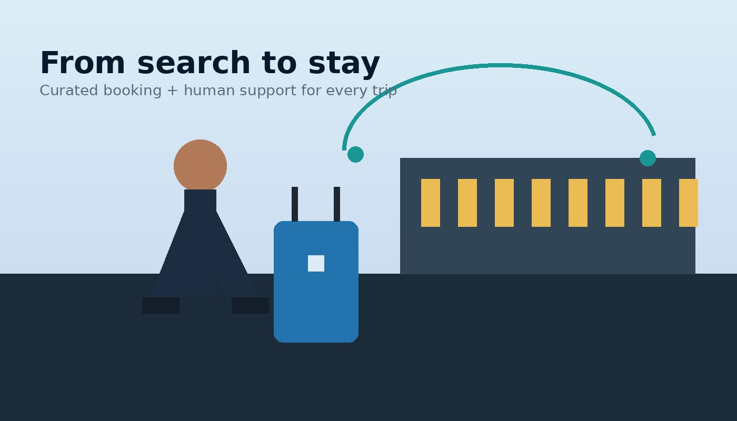
03 | SALES PLAN
3/5
First 10 customers — sell a specific outcome, not “cheap hotels”
WHO WE TARGET
1. SME owners & executive assistants 2. Relocation / project teams 3. Wedding & event planners 4. Boutique travel advisors needing overflow 5. Frequent leisure travelers seeking curated stays Start with 2–3 destinations, then expand.
ACQUISITION ENGINE
10-CUSTOMER FUNNEL
Daily: • 30–40 B2B calls • 30 personalized emails • 20 LinkedIn touches • 5 partner outreach messages Offer: “Free 3-hotel comparison + 24-hour quote.”
300 qualified prospects ↓ 60 conversations ↓ 25 quote requests ↓ 15 serious buyers ↓ 10 first customers Then ask every satisfied customer for 2 referrals and a repeat-booking date.
Acquisition funnel is an explicit planning assumption, not a market guarantee. Outreach must follow applicable email, privacy and telemarketing rules in each target market.

Slide 4
04 | MONEY PLAN
4/5
$10,000/month — build recurring room-night volume
10%
$200
400
$8,000
Illustrative gross booking margin
Illustrative ADR
Room nights / month
Booking revenue contribution
REVENUE MIX
MONTHLY EXPENSE TARGET
WHY THIS CAN SCALE
Corporate stays: 300 room nights × $200 ADR × 10% = $6,000 Group / event service: 10 bookings × $250 fee = $2,500 Premium planning / concierge: 5 × $300 = $1,500 TOTAL TARGET = $10,000/month
Booking specialist / VA — $1,500 CRM + software — $350 Marketing / outreach — $700 Payment/admin/insurance — $300 Content / creative — $250 Contingency — $400 Illustrative OPEX ≈ $3,500 Target contribution ≈ $6,500 before tax.
The unit is the room night, not a one-time customer. Win a corporate account → repeat stays → expand to more employees → add groups/events → add destinations. Track: booking conversion, average booking value, gross margin, repeat rate, cancellation rate.
Financial model is illustrative. The 10% margin assumption must be validated against actual supplier/agency contracts; hotel commission structures vary by channel and agreement.

Slide 5
05 | 90-DAY PLAN + INVESTMENT CASE
5/5
90 days: launch → prove → scale
MONTH 1 — LAUNCH
MONTH 2 — PROVE
MONTH 3 — SCALE
WEEK 1 Define niche, destinations and offer WEEK 2 Set up website, CRM, supplier relationships and booking workflow WEEK 3 Start B2B outreach + first quotes WEEK 4 Close first customers; collect testimonials KPI: 10 paying/booking customers or a clear pipeline toward them.
Focus on the channel producing the cheapest qualified bookings. Add corporate repeat-booking reminders. Build 3 referral partnerships: event planners, travel advisors, relocation firms. KPI: 20–25 active customers / repeat bookings + improving conversion.
Expand only the best-performing destinations. Add supplier inventory and automation after demand is proven. Target: 400 room nights/month + $10k monthly revenue. WHY INVEST? Low fixed overhead • recurring bookings • diversified customer segments • measurable unit economics • scalable destination expansion.
Key market context: PwC US Hospitality Directions May 2026 projects 2.9% US lodging RevPAR growth in 2026 and notes AI is changing booking behavior. CoStar/STR and Knight Frank provide 2025 performance benchmarks.

