Slide 1
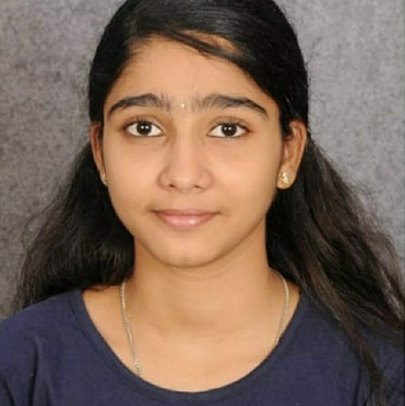



SHRI SNEHA CHANDRAGIRI
Analyst/Software Engineer
Bachelor of Engineering and Technology, Civil Engineering : 2017 - 2021
Bangalore
Skills
shri-sneha.chandragiri@capgemini.com
TECHNICAL | Dot Net, Visual Basic, C, Core Java Spring Boot, Advance Java.
DATABASE | SQL database – Oracle, MySQL No SQL database – MongoDB
UI Tech | HTML 5 & CSS 3,JavaScript and Bootstrap
Tools | Git
Add On skills | Peer learning, Github,Maven, Postman.
Additional Skills: | Project Management, Team Building, Project Management, Team Leader, Strategic/Tactical Planning, Business Analysis and Development, Excellent Communication and Interpretation skills
+91 9182347323
A4
Trained On J2EE with Angular and DOTNET
Hands on Experience in creating Traditional and Reactive application on JAVA, Spring Boot
Proficient in creating java Applications.
Hands on Experience in creating Traditional and Reactive application on visual basic
Proficient in creating visual basic Applications.
Hands on experience in developing web pages using HTML5, CSS3, Object Oriented Java script. Good understanding of Document Object Model (DOM) and DOM Functions.
Hands on experience in creating microservices with Spring boot, Post Man, Swagger API
AWS CERTIFIED with cloud practitioner
AZURE CERTIFIED with AZ-900
AGILE CERTIFIED
Certified with level 1 and level 2 Entry Developer
Bus Reservation System
(Based on Java Spring boot and Angular) (Front-end-Angular, Back-end Spring boot):- A bus reservation system is a mobile or web software solution designed to provide customers with a personalized easy-to-utilize user experience for booking and purchasing tickets online. It stores customers' personal data records, scheduled routes, frequent trips, drop points
Check out my work on GitHub & Video Profile

