Slide 1
Kotlin
Kotlin is Google’s official language for Android
Kotlin is a modern statically typed programming language that will boost productivity.
Improved app quality with Kotlin. @Nullable and @NonNull types are baked into Kotlin's type system to help you avoid NullPointerExceptions.
Kotlin is 100% interoperable with the Java programming language. Call Java-based code from Kotlin, or call Kotlin from Java-based code.
Kotlin is fully supported in Android Studio 3.0 and higher. We can create new projects with Kotlin files, convert Java language code to Kotlin, debug Kotlin code, and more.
Android KTX is a set of Kotlin extensions to make Android development with Kotlin more concise by leveraging Kotlin language features such as extension functions/properties, lambdas, named parameters, and parameter default values.

Slide 2
Jetpack is a collection of software components to make it easier to develop great Android apps.
These components follow best practices to:
- Accelerate Development
- Eliminate Boiler plate code
- Build high quality apps.

Slide 3
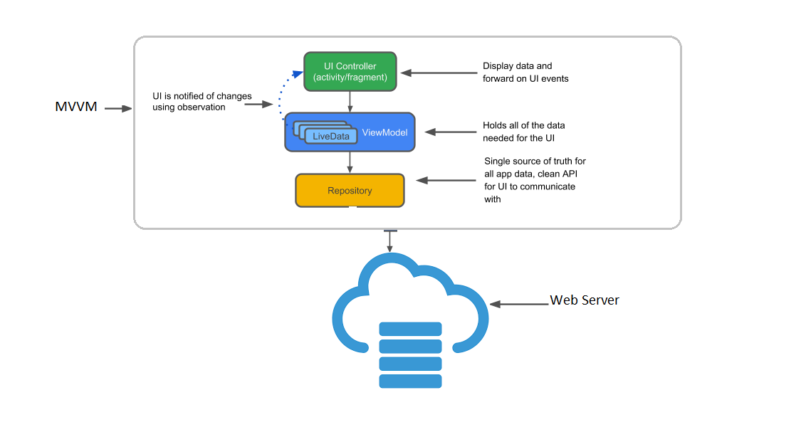

Slide 4
Jet Pack Libraries
Lifecycle Aware Components
View Model
Live Data

Slide 5
Lifecycle Aware Components
Lifecycle-aware components perform actions in response to a change in the lifecycle status of another component, such as activities and fragments.
These components help you produce better-organized, and often lighter-weight code, that is easier to maintain.
Each component whether an activity/Fragment will have lifecycle.
Each component that has lifecycle is called LifeCycleOwner.
Its lifecycle has 2 enumeration Event and state to determine the lifecycle of component.
Each event is related to a state for example
onCreate() event is related to CREATED state
onStart() event is related to STARTED state and so on.
There is a LifecycleObserver that performs actions depends on lifecycle state of Lifecycle owner.

Slide 6
View Model
Architecture Components provides ViewModel helper class for the UI controller that is responsible for preparing data for the UI.
The ViewModel class is designed to store and manage UI-related data in a lifecycle conscious way.
The ViewModel class allows data to survive configuration changes such as screen rotations.
Acts as interface between View and Model components.
Uses Live Data(Observable data) to notify view about changes.
View Model can’t inflate a layout or start an activity/fragment like view.

Slide 7
Live Data
LiveData is an observable data holder class.
LiveData is lifecycle-aware, meaning it respects the lifecycle of other app components, such as activities, fragments, or services and ensures LiveData only updates app component observers that are in an active lifecycle state.

Slide 8
Data Binding
The Data Binding Library is a support library that allows you to bind UI components in your layouts to data sources in your app using a declarative format rather than programmatically.
The expression language allows you to write expressions that connect variables to the views in the layout.
The Data Binding Library automatically generates the classes required to bind the views in the layout with your data objects.

Slide 9
Dagger2
Dependency Injection is a design pattern built on the concept of inversion of control.
In simple terms “ You don’t create objects yourself, let someone else create them for you.”
Dagger2 is a dependency injection library that was created by developers at Square.
Dagger 2 is a compile-time android dependency injection framework and uses the Java Specification Request (JSR) 330 and uses an annotation processor.

Slide 10
RX Java
Reactive Extensions (ReactiveX or RX) is a library that follows Reactive Programming principles that is compose asynchronous and event based programs by using observable sequence.
RxJava is a JVM implementation of Reactive Extensions.
RxJava is all about two key components: Observable and Observer. In addition to these, there are other things like Schedulers, Operators and Subscription.
Reactive Extensions are available in multiple languages C++ (RxCpp), C# (Rx.NET), Java (RxJava), Kotlin (RxKotlin), Android (RXAndroid),Swift (RxSwift) and lot more.
RxAndroid is specific to Android Platform with few added classes on top of RxJava. More specifically, Schedulers are introduced in RxAndroid (AndroidSchedulers.mainThread()) which plays major role in supporting multithreading concept in android applications.

Slide 11
Thank You

