Slide 1
Accessibility guidelines

Slide 2
Make apps more accessible
Android apps should aim to be usable by everyone, including people with disabilities.
Common disabilities that affect a person's use of an Android device include blindness or low vision, color blindness, deafness or impaired hearing.
Develop apps with accessibility in mind, you make the user experience better, particularly for users with these disabilities.
Make Android app more accessible means working through the subtle details of how users interact with your app and providing appropriate feedback to users based on their interactions.

Slide 3
Guide Lines:
Label UI elements
Group content
Make touch targets large
Provide adequate color contrast
Use cues other than color

Slide 4
Label UI elements
Provide useful and descriptive labels that explain the meaning and purpose of each interactive element to users.
These labels allow screen readers, such as Talk Back, to properly explain the function of a particular control to users who rely on these services.
Provide labels for elements in 2 ways:
For Static Labels:
Add an attribute android:contentDescription to the corresponding XML element within the activity's layout resource file.
For Dynamic Labels:
Set the element's label in the dynamic logic using setContentDescription() method that changes the element's appearance.
For graphical elements that are purely decorative:
set their respective android:contentDescription XML attributes to "@null"
For editable elements like EditText:
use the android:hint XML attribute for static elements and the setHint() method for dynamic elements to indicate each element's purpose.

Slide 5
Group content
You should arrange related content into groups so that accessibility services announce the content in a way that reflects its natural groupings.
Two most effective methods of grouping related content are the following:
Organize content into a single announcement
If users should treat a set of elements as a single unit of information, you can group these elements in a focusable container.
Use android: focusable="true" XML attribute to root layout
Create natural groupings
For more complex structures, such as tables, we can assign focus to one piece of the structure at a time, such as a single row.

Slide 6
Make touch targets large
Users have difficulty interacting with small touch targets on a device's screen.
Provide larger touch targets, you make it substantially easier for users to navigate your app.
Touchable area of focusable items to be a minimum of 48dp x 48dp. Larger is even better.
set the android:minWidth and android: minHeight attributes of each interactive element to 48dp or greater

Slide 7
Provide adequate color contrast
Users with low vision and those who use devices with dimmed displays can have difficulty reading information on the screen.
Provide increased contrast ratios between the foreground and background colors in your app, you make it easier for users to navigate within and between screens.
The World Wide Web Consortium (W3C) has created a set of color contrast accessibility guidelines:
For large text, 18 points or higher for regular text and 14 points or higher for bold text, use a contrast ratio of at least 3.0 to 1.
For small text, smaller than 18 points for regular text and smaller than 14 points for bold text, use a contrast ratio of at least 4.5 to 1.

Slide 8
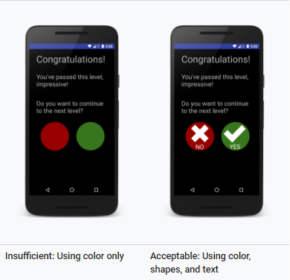
Use cues other than color
To assist users with color vision deficiencies, use cues other than color to distinguish UI elements within your app's screens.
using different shapes or sizes, providing text or visual patterns, or adding audio- or touch-based (haptic) feedback to mark the elements' differences.

Slide 9
References
For more information:
https://developer.android.com/guide/topics/ui/accessibility/

Slide 10
Thank you

