Slide 1

infopolish

Slide 2
Tired of sanitizing data ?
Outsourcing ?
Data Integrity ?

Slide 3
Current system
Accuracy
?
Manual Data sanitization
?
Efficiency
Automated systems
Cost
?
Computed outputs
Time
?
Problems ?

Slide 4
Our system
Accuracy
Automated Data sanitization
Efficiency
Speeding process
Cost
Solution to companies
Time
Solution !

Slide 5
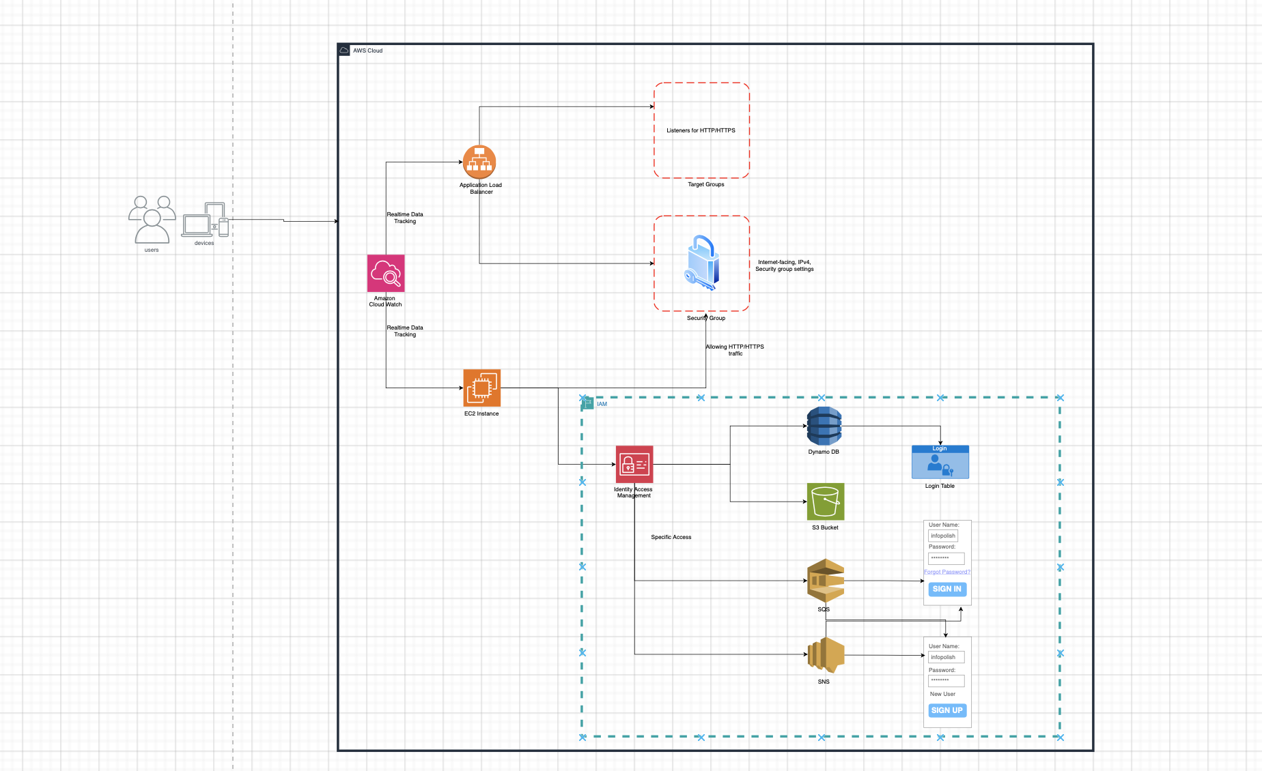
System Architecture

Slide 6
DataSets
Using Kaggle Datasets
Realistic Model Training

Slide 7
Security Considerations
Input validation and String sanitization
Error handling techniques
AWS SDK
IAM roles
CloudWatch
Penetration testing is also done which involved "Whitebox" testing.
An crawler detection system is also installed with the tag "robots.txt“

Slide 8

Limitations
It cannot support “Massive Datasets”
Cannot handle DDOS attacks
Load Balancing is limited to service availability based on cost
Pic credit: https://www.eschoolnews.com/district-management/2019/07/01/2-ways-educators-are-using-data-to-solve-problems/

Slide 9
What works best/worst
Strengths:
Automation of Data Preparation
Comprehensive approach
User Friendly Interface
Security Implementation
AWS Integration

Slide 10
What works best/worst
Weakness:
Dependency on User provided Data
Limited Scope of Models
AWS Cost
Possible Bottlenecks in Security Layers

Slide 11
Future Enhancements
Expansion of ML models
Real-Time Data processing
Enhanced Data cleaning
Customization of feature engineering
Enhanced Security implementation
Integration with Data visualization
AI assisted Decision making on Models

Slide 12
Team Members
Geyasri Vagdevi – Frontend
Joe Newman Jaya Thomas – Testing and Report
Rahul Chakali – Backend and Model development
Soundirya Murugan – Testing and Report
Sreeja Ajithkumar – Frontend and Integration
Venakatasubramanian Sanakaranarayanan – Devops and Backend

Slide 13
Questions ??

