Slide 1
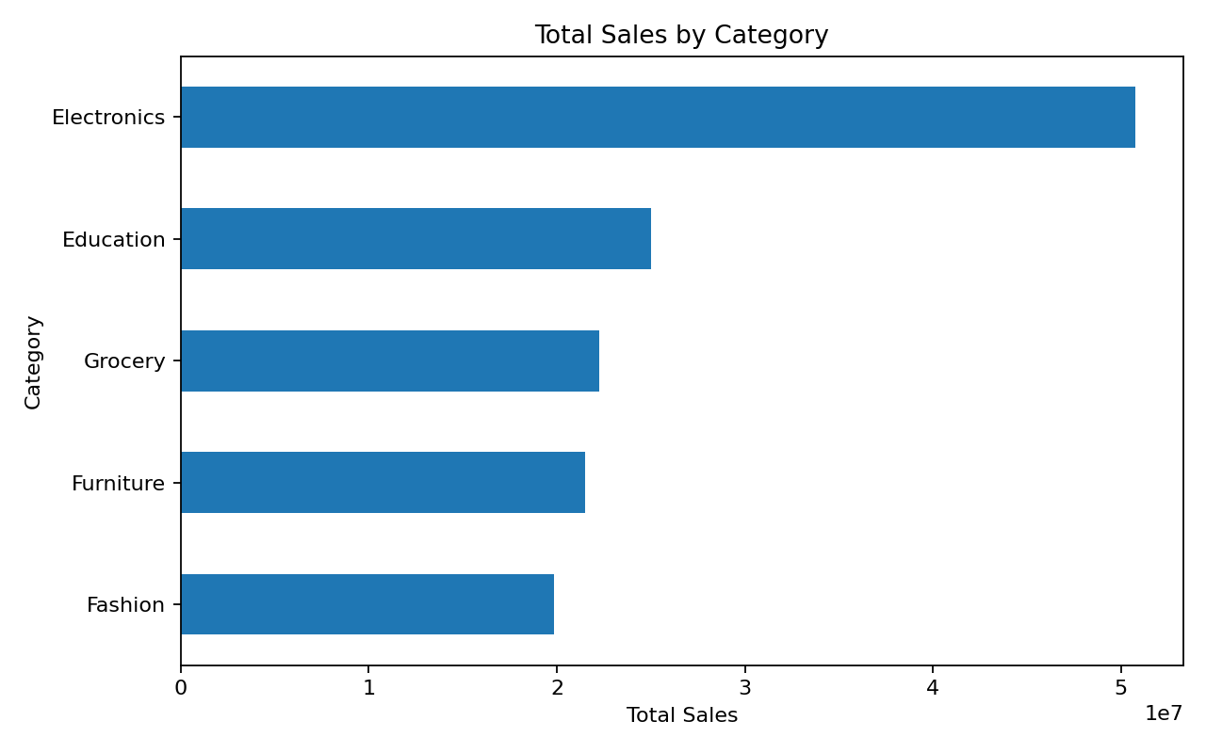
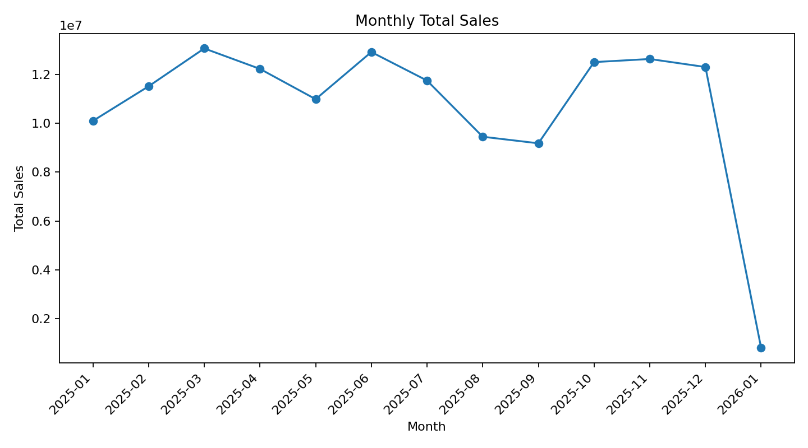
ApexPlanet Task 2 | EDA & Business Intelligence
Rows
1,000
Customers
947
Total sales
139,399,440
Missing cells
0
Top category: Electronics (50,778,582 sales units) | Top product: Laptop (25,443,009) | Top city: Patna (19,285,967)

