Slide 1
Corporate Learning System
Executive Overview | Progress, Risk, Intervention, and Compliance Tracking
Prepared by: Abnish Kumar, Chandrakanta Shahu, Alok Bhagat, Durgesh Patil

Slide 2
Executive Summary
A single operating view for learning compliance and intervention management
Centralizes employee learning progress, risk signals, interventions, and compliance reporting.
Gives leadership a fast view of workforce readiness and training compliance posture.
Supports proactive action through configurable risk rules and targeted interventions.
Built as a working proof of concept with React, NestJS, PostgreSQL, JWT auth, and seeded demo data.
Employees
Courses
237
10
Enrollments
Interventions
957
467
Corporate Learning System | Executive Overview | 2

Slide 3
Business Challenge
Manual learning governance makes risk hard to spot early
Training completion, attendance, assessments, and competency data often sit in separate workflows.
Managers need earlier visibility into at-risk learners before compliance gaps become escalations.
Manual reminders and reporting are time-consuming and inconsistent across departments.
Executives need a clear, auditable view of compliance health and intervention outcomes.
Corporate Learning System | Executive Overview | 3

Slide 4
Solution Overview
A workflow for detect, act, track, and report
1. Ingest
Attendance, assessments, competencies
2. Evaluate
Configurable risk rules
3. Intervene
Reminders, warnings, escalations
4. Report
Compliance and management reporting
Corporate Learning System | Executive Overview | 4

Slide 5
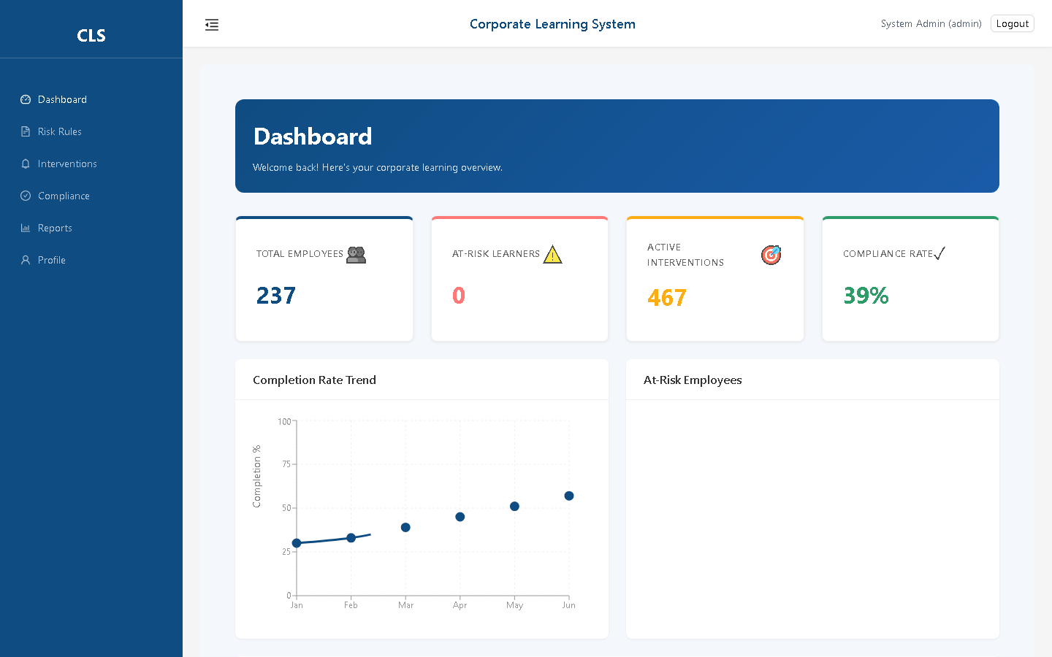
Leadership Dashboard
A live snapshot of learning progress and compliance health
Highlights employees, active interventions, and compliance rate.
Shows completion trend and recent interventions for quick operational review.
Designed for executive and manager visibility without drilling into raw data.
Corporate Learning System | Executive Overview | 5

Slide 6
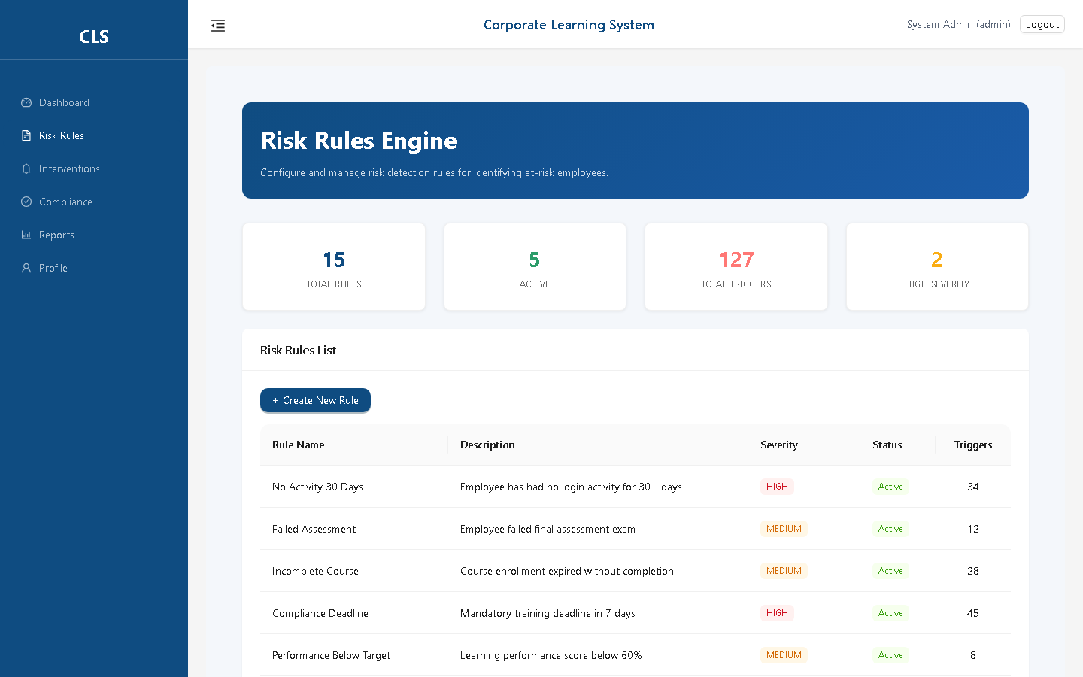
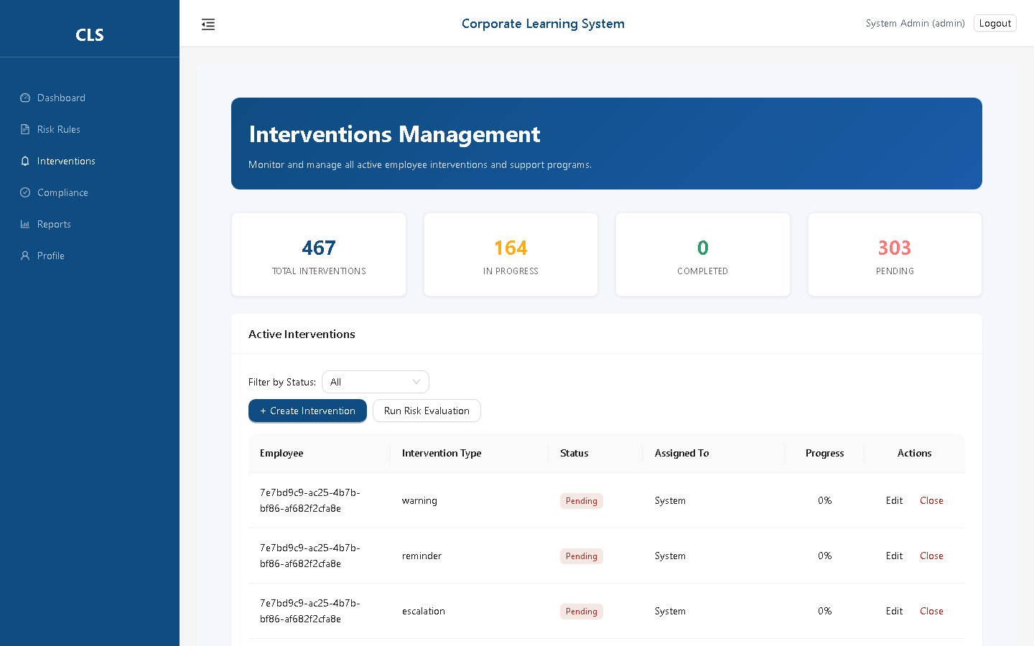
Risk Rules and Interventions
Proactive identification and response
Configurable Risk Rules
Tracked Interventions
Corporate Learning System | Executive Overview | 6

Slide 7

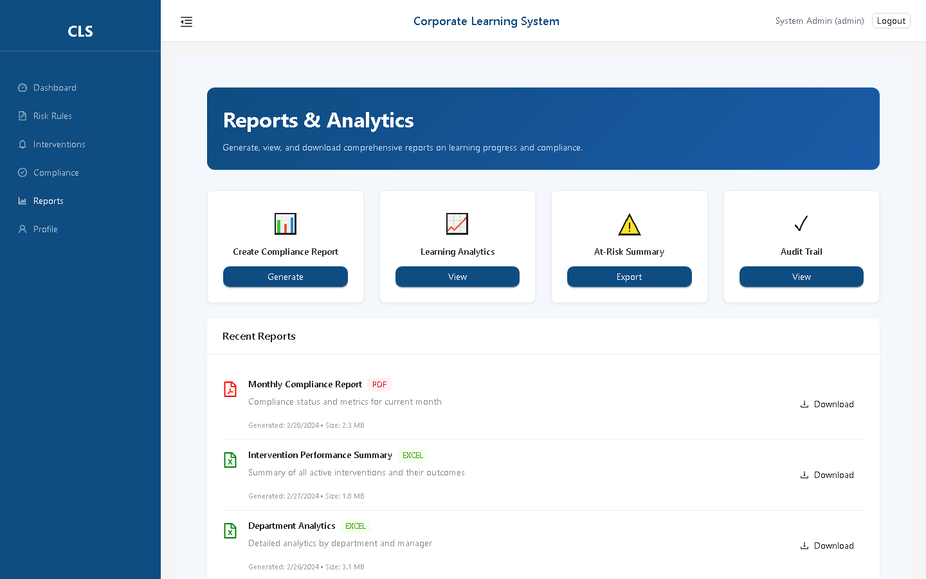
Compliance and Reporting
Management-ready outputs for governance
Compliance Review
Executive Reports
Corporate Learning System | Executive Overview | 7

Slide 8
Security and Architecture
Built on a practical, scalable web foundation
Frontend: React + TypeScript + Vite for responsive user experience.
Backend: NestJS + TypeScript API with modular controllers and services.
Database: PostgreSQL with TypeORM entities and seeded demo data.
Security: JWT authentication, role-aware guards, CORS controls, and audit logging foundation.
Deployment path: move from local POC to managed database, environment hardening, and CI/CD.
Corporate Learning System | Executive Overview | 8

Slide 9
Recommended Next Steps
Move from proof of concept to pilot-ready release
Pilot with a defined employee group and validate real-world learning workflows.
Integrate with HRIS/LMS sources for automated employee, course, and completion data.
Finalize role-based access, audit retention, and reporting approvals.
Add analytics for intervention effectiveness and compliance trend forecasting.
Prepare production deployment with backups, monitoring, secrets management, and CI/CD.
Corporate Learning System | Executive Overview | 9

Slide 10
Corporate Learning System
A practical platform for improving learning compliance, reducing operational risk, and enabling timely interventions.
Team: Abnish Kumar, Chandrakanta Shahu, Alok Bhagat, Durgesh Patil

