Slide 1
Data Storytelling & Statistical Validation
Task 4 – ApexPlanet Data Analytics Internship Presented by: CHANDRA KANTH. P

Slide 2
Objective
Analyze the sales dataset to identify business trends.
Visualize sales performance using Power BI.
Extract meaningful insights from the data.
Validate findings using a simple hypothesis.
Provide recommendations to improve business performance.

Slide 3
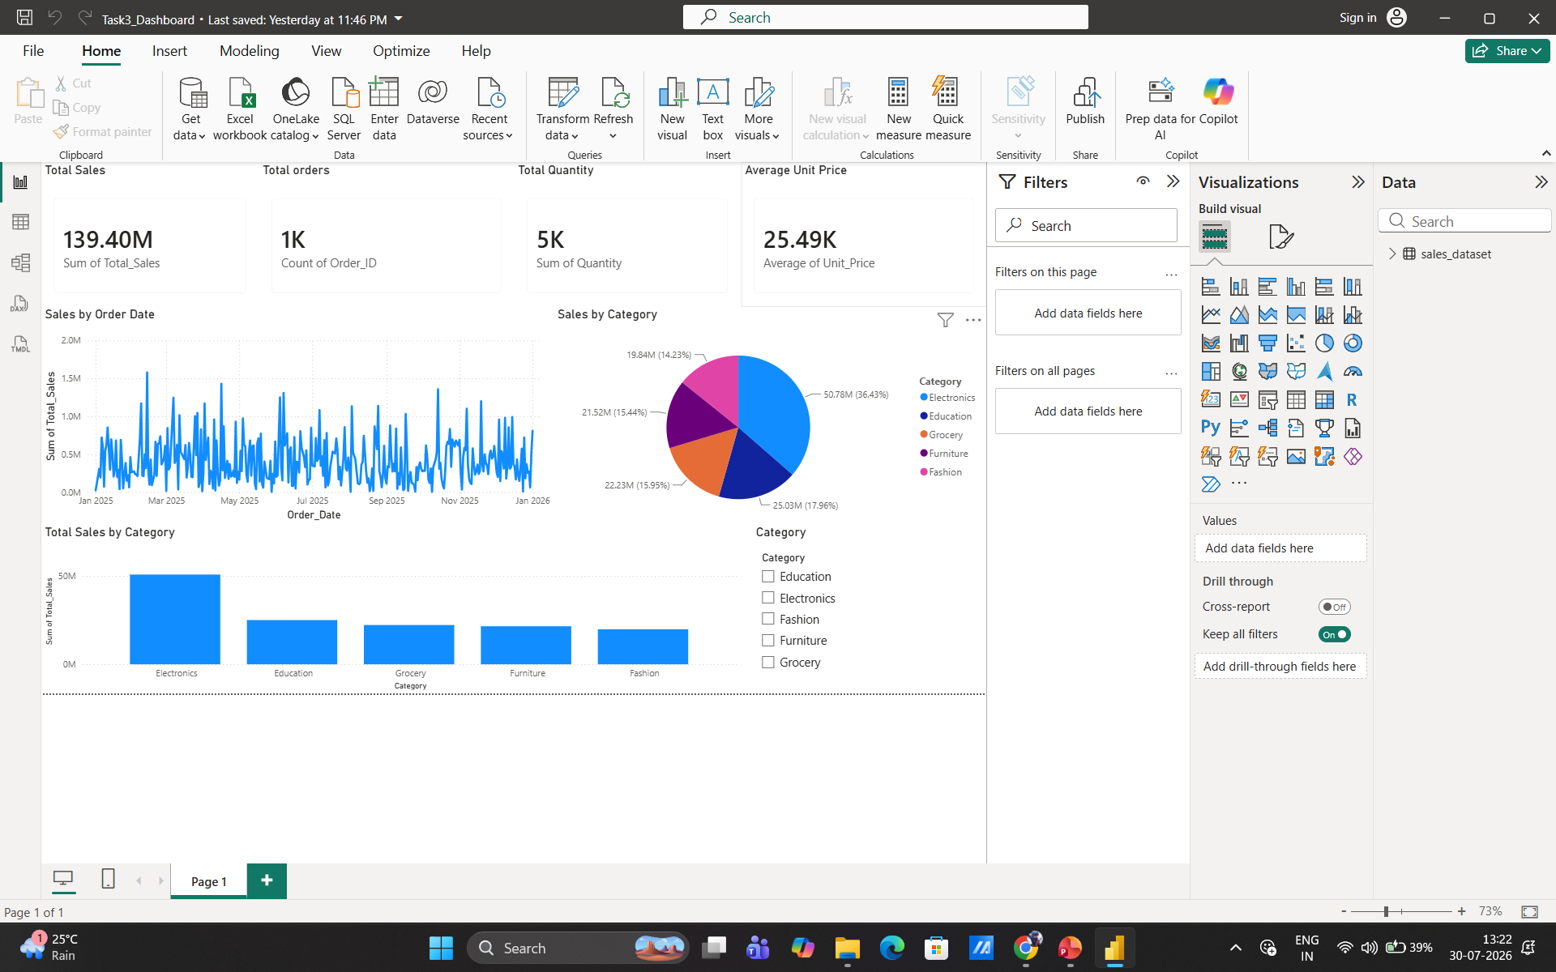
Power BI Dashboard & Key Performance Indicators (KPIs)
Key Performance Indicators
Total Sales: 139.40M
Total Orders: 1K
Total Quantity: 5K
Average Unit Price: 25.49K
Summary: The dashboard provides an overview of sales performance across different product categories and time periods.

Slide 4
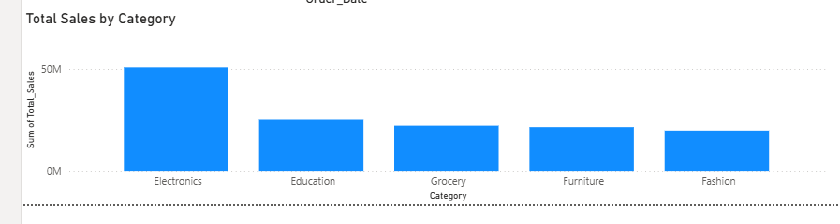
Business Insights
Electronics generated the highest sales among all categories.
Education was the second highest-performing category.
Grocery and Furniture showed moderate sales performance.
Fashion recorded the lowest sales and needs improvement.
Sales trends changed over time, indicating seasonal or customer demand patterns
Recommendations
Increase investment in the Electronics category to maximize revenue.
Improve marketing campaigns for Fashion and Furniture.
Monitor sales trends regularly to optimize inventory and promotions.

Slide 5
Hypothesis Testing
Hypothesis (H₀): Electronics is not the highest-selling category.
Alternative Hypothesis (H₁): Electronics is the highest-selling category.
Analysis:
Sales data from the Power BI dashboard was analyzed.
Electronics recorded the highest total sales among all product categories.
The dashboard supports this observation.
Result:
The alternative hypothesis (H₁) is accepted based on the dashboard analysis. Conclusion: Electronics is the best-performing category. The company should continue investing in this category while improving sales in lower-performing categories such as Fashion.

Slide 6
Conclusion & Thank You
Project Summary
Successfully analyzed the sales dataset using Power BI.
Identified key business insights using KPIs and visualizations.
Performed hypothesis testing to validate findings.
Recommended actions to improve business performance.
Key Takeaway
Electronics was the highest-performing category, while Fashion showed the greatest opportunity for improvement.
Final Message
Any Questions?
Thank You!

