Slide 1
DATA CONSULTING
Data Transformation and Integration

Slide 2
TABLE OF CONTENTS
01
02
03
Insights to input data
Process of data integration
Key take-aways from the integrated data

Slide 3


Insights to input data
01. Insight to input data
Orginal data
General information
Number of records :
21 ,906
Features / Columns :
9
1. Each model has 19 attributes as records
2. Missing values in model type

Slide 4
Insights to input data
What we know about the input data
1. Input data file is json file type
2. Input file needs to be converted to excel
3. Inconsistent naming convention
4. Missing values
5. Feature names as measuring unit.
6. Inconsistent letter cases.
7. Redundant data

Slide 5



Insights to input data
02. Process of data integration
to dataframe
Dataframe
Dataframe
Pre-processing
Normalisation
Integration
Save to excel in a local folder
Save to excel in a local folder
Save to excel in a local folder
Python script
Run the script
Combined excel spreadsheet

Slide 6
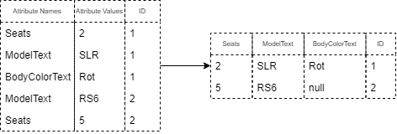
Insights to input data
Pre-processing
After reading the json file into dataframe attributes are transformed to features, this reduces the number of records to around 1000.
Dataframe and the excel files are saved as output
PRE
POST

Slide 7
Insights to input data
Normalisation
The ‘BodyColorText’ and ‘MakeText’ features of the Input Pre-processed dataframe are normalized and saved as excel file and dataframe as output
PRE
POST
ID | MakeText | BodyColorText
1 | MERCEDES-BENZ | anthrazit
10 | LAMBORGHINI | anthrazit mÃ©t.
1010 | MERCEDES-BENZ | silber mÃ©t.
53 | MERCEDES-BENZ | blau
54 | LAND ROVER | blau
55 | LAMBORGHINI | blau
550 | MERCEDES-BENZ | schwarz
551 | RENAULT | schwarz
552 | FORD | schwarz
ID | MakeText | BodyColorText
434 | BMW | Other
435 | Saab | Other
439 | Porsche | Other
44 | Mercedes-Benz | Blue
45 | Audi | Blue
50 | Audi | Blue
512 | Mercedes-Benz | Black
513 | Renault | Black
514 | Nissan | Black

Slide 8
Insights to input data
Normalisation required
Some other attributes that require normalisation
“ConditionTypeText”
Change German to English
Example : VorfÃ¼hrmodell to Used, Neu to New
“InteriorColorText”
Change German to english
Example : schwarz to Black
“DriveTypeText”
Change German to English
Example : Hinterradantrieb to Rear-wheel drive
“km”
Change the km column from data type object to float
Example :48000 to 48000.0

Slide 9
Insights to input data
Integration
Taking normalized data-frame as input, data is integrated to the copied schema of the target dataset.
unmapped features are removed,
Finally the data-frame is saved as excel file as output.
carType | color | condition | currency | drive | city | country | make | manufacture_year | mileage | mileage_unit | model | model_variant | price_on_request
Limousine | Other | Occasion |  |  | Zuzwil |  | Mercedes-Benz | 1999 | 31900 | Kilometer | E 320 | E 320 ElÃ©gance 4-Matic
Coupé | Other | Oldtimer |  |  | Zuzwil |  | Lamborghini | 1973 | 48000 | Kilometer |  | Espada GT 400 Serie 3
Coupé | Other | Occasion |  |  | Zuzwil |  | Ferrari | 2004 | 42600 | Kilometer | F360 | F360 Modena Berlinetta

Slide 10
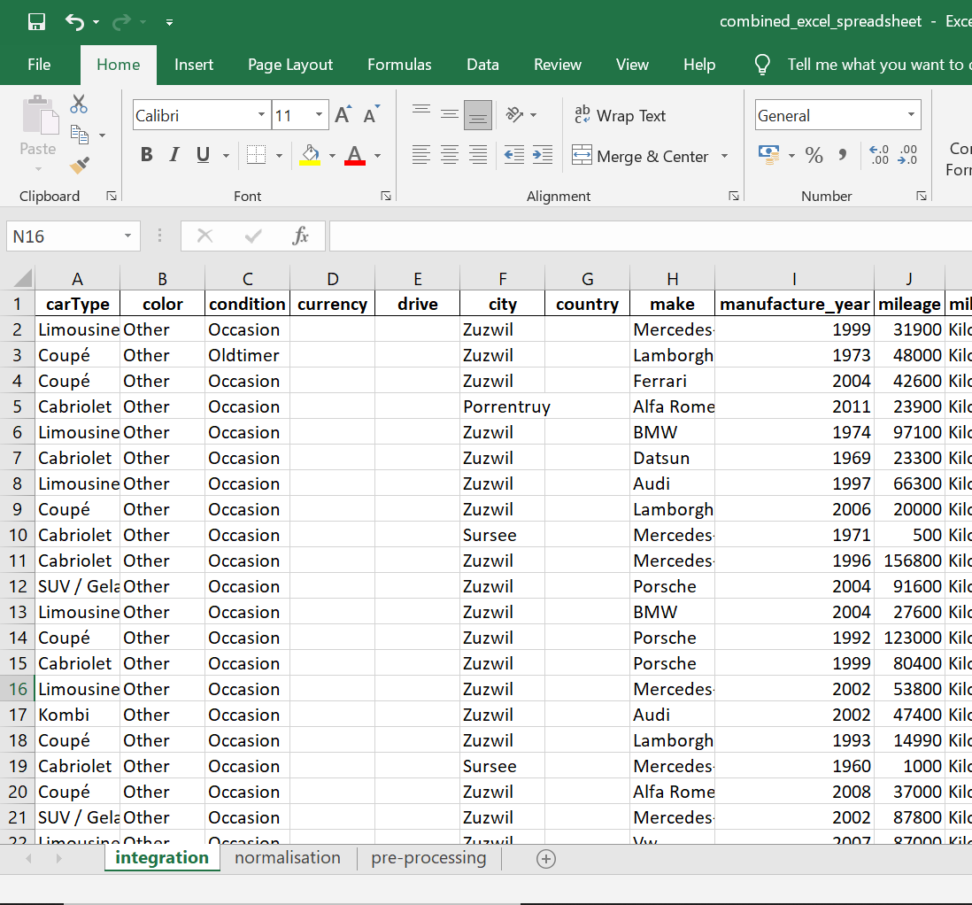
Insights to input data
Combined excel file extraction
Run the python script which searches for all the excel files in the folder and combines them into one excel spreadsheet with different tabs.

Slide 11


Insights to input data
Key take-aways from the integrated data
Key facts
Recomendation
1. Missing values
2. Output file is more clear and small
3. Consistent naming
4. Consistent letter case
5. Redundant datas are removed.
6. “km” feature in supplier data column is assumed to be mileage in target dataset
7. “mileage_unit” feature in target data filled with unit “kilometer” target dataset
8. “FirstRegYear” feature is assumed as “manufacture_year” in target dataset
9. “FirstRegMonth” feature is assumed as “manufacture_month” in target dataset
1. Avoid redundant data
2. Keep naming convention consistent
3. Consider important features like price and feul consumption
4. Try to avoid measuring units as features
5. Country and Zip can be useful to add

Slide 12
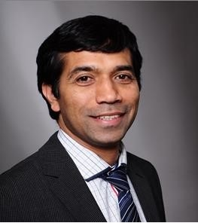


Do you have any questions?
Chandrakantha HA
ckanth_ha@yahoo.com
+49 15901286283
THANKS

