Slide 1



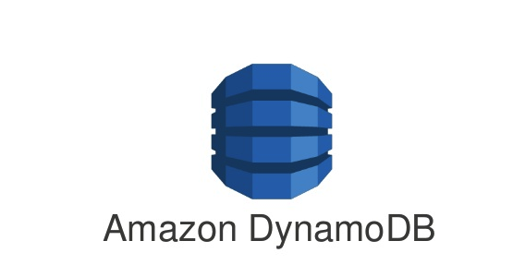

S3 to DynamoDB Data Transfer Application
Post Records On Success
Csv file posted in s3
Requests sent to sqs to process one file at a time
Send Mail Notifications On Failure
File Processed And Records Converted To DynamoDb compatible json

