Slide 1
Capstone Project - 2
Project Title: Bike Sharing Demand Prediction
Presented by:
Shubham Chandrakar

Slide 2

About the project:
In Seoul (South Africa), currently rental bikes are introduced in many urban cities for the enhancement of mobility comfort. It is important to make the rental bike available and accessible to the public at the right time as it lessens the waiting time. Eventually, providing the city with a stable supply of rental bikes becomes a major concern.
Our main aim to explore and analyse the data to understand the problem and find suitable solution as well as predict rental bike count required at each hour for the stable supply of rental bikes

Slide 3
Approach followed towards the project:
Data Wrangling
Checking duplicated row
Checking Null/Nan Values
Outlier Removal
Feature engineering
Dependent variable distribution check.
EDA on Project
Univariate analysis
Bivariate analysis
Mutivariate analysis
Correlation analysis
VIF analysis
Categorical Encoding
Building ML model and hyperparameter tuning
Linear regression model
Lasso regression model
Lasso regression model with Cross Validation
Random forest regression model
Random forest regression model with cross validation
XG Boost regression model
XG Boost regression model with cross validation

Slide 4
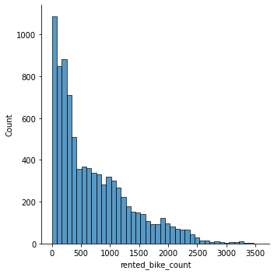
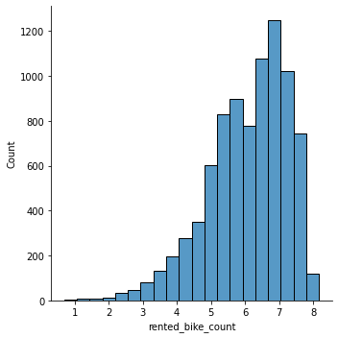
Distribution before log transformation
Observations on dependent feature:
The dependent feature is: rented_bike_count
The distribution of data is positively skewed with skewness = 1.153
There is need of log transformation or box-cox transformation
Log transformation is found to be giving more accuracy i.e 90 % to 94% approximately so log transformation is used inspite of box - cox transformation.
Distribution after log transformation

Slide 5
Distribution before log transformation
Observations on dependent feature:
The dependent feature is: rented_bike_count
The distribution of data is positively skewed with skewness = 1.153
There is need of log transformation or box-cox transformation
Log transformation is found to be giving more accuracy i.e 90 % to 94% approximately so log transformation is used inspite of box - cox transformation.
Distribution after log transformation

Slide 6




Features that affect bike demand:
Hour of the day (Hourly time period)
Time slot of the day (day,night,morning,evening)
Type of seasons
Month of the Year
Temperature

Slide 7
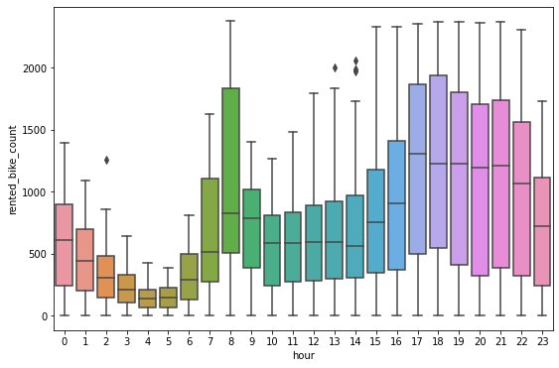
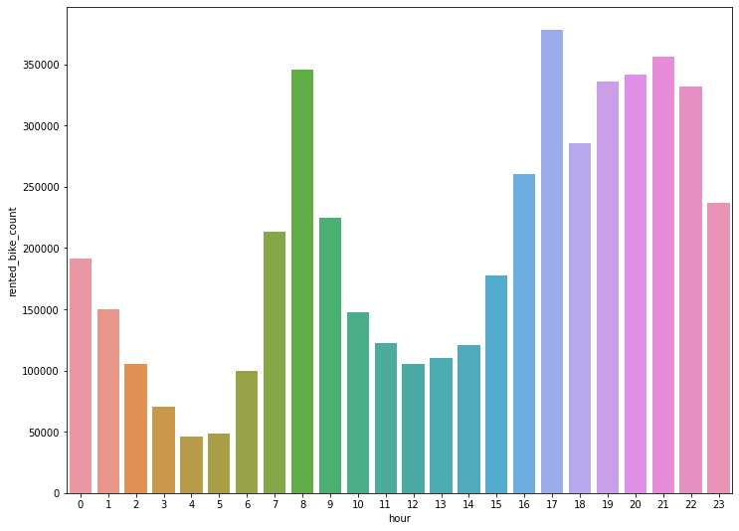
Relationship between each hour and bike demand:
It can be seen that bike demand rises after 5 AM and peaks at 8 AM, then again rises after 2 PM and peaks at 5PM then demand remain significantly above average demand 6PM and 11PM
That means in this 11 hours of a day bike demand is most.
Conclusion: The bike must be readily available at this 11 hour in a day to meet the demand
Box plot hour vs rented bike count
Box plot hour vs total rented bike count

Slide 8
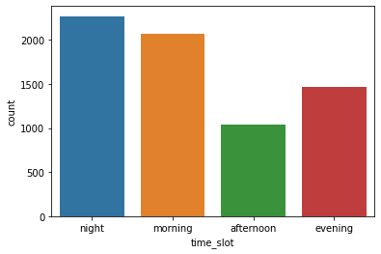
Relationship between Time slot of the day and bike demand:
We have divided 24 hours into four time slot: morning, afternoon, evening, night
Key Findings according to four time slot:
Bikes are mostly rented at night time
Second most time slot at which bike is rented.
At afternoon least no of bikes are rented
Conclusion : The availability of bike must be maintained according to demand of time slot
Count plot hour vs rented bike count

Slide 9
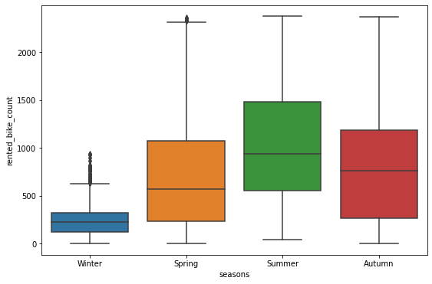
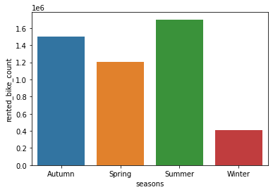
Relationship between season and rented bike demand:
It can be seen that demand of bike is in following order:
Summer > Autumn > Spring > Winter
Conclusion : The availability of bike must be maintained according to demand of seasons
Bar plot season vs rented bike count
Bar plot season vs total rented bike count

Slide 10
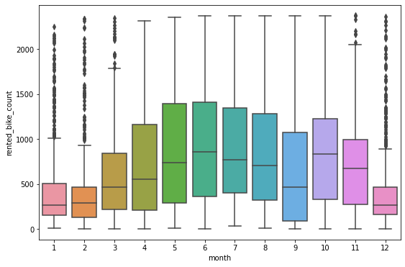
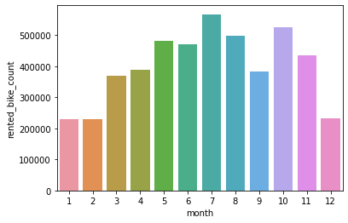
Relationship between month and rented bike demand:
Key finding related to monthly bike demand:
Rental bike demand is low on January, February and December.
Rental bike demand is very high between May to August. So this months can be considered as peak months.
Conclusion : The availability of bike must be maintained in the peak months.
Bar plot month vs rented bike count
Bar plot month vs total rented bike count

Slide 11
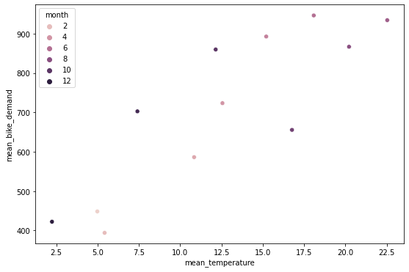
Relationship between temperature and rented bike demand:
Following are the relationship between temperature and demand of rental bike:
It can be seen that demand of bike increases with increase in temperature
When temperature is high demand for rental bike is more during evening.
When temperature is low demand for rental bike,during morning and night.
Conclusion : The demand for bike is directly proportion to temperature.
Scatter plot mean temperature vs mean rented bike count according to month

Slide 12
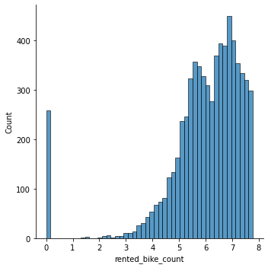
Preparation of dataset for modelling:
Some of the important steps performed were:
Separation of dependent variable and independent variable
Log transformation of dependent variable
Log transformation (94 %) giving better accuracy than Yeo Johnson transformation (83. 5%)
Distribution before log transformation
Distribution after log transformation

Slide 13
Preparation of dataset for modelling (Contd.):
Some of the important steps performed were:
Train Test split of dataset in 4:1 among test and train set
Shape of dataset consisting independent variable after split
Train set = (5472, 86)
Test Set = (1369, 86)
Shape of dataset cosisting dependent variable after split
Train set =(5472,1)
Test set = (1369,1)
Scaling of features using MinMaxScaler() .

Slide 14
Prediction of rental bike demand using various ML model (Application of models):
Linear regression model (baseline model):
Results:
Accuracy score | MSE | RMSE | Model score (train set) | Model Score(test set) | R2 Score | Adjusted R2 score
90.22% | 0.214 | 0.462 | 90.43 | 90.83 | 90.83 | 90.22

Slide 15
Prediction of rental bike demand using various ML model (Application of models):
2. Lasso Linear regression model (baseline model):
Result:
Accuracy score | MSE | RMSE | Model score (train set) | Model Score(test set) | R2 Score | Adjusted R2 score
90.24% | 0.2138 | 0.4624 | 0.9037 | 0.9085 | 0.9085 | 0.9024

Slide 16
Prediction of rental bike demand using various ML model (Application of models):
3. Lasso Linear regression model(with hyperparameter tuning):
Tuning method used = GridSearchCV
Results:
Accuracy score | MSE | RMSE | Model score (train set) | Model Score(test set) | R2 Score | Adjusted R2 score
90.24% | 0.2138 | 0.4624 | 0.9037 | 0.9085 | 0.9085 | 0.9024

Slide 17
Prediction of rental bike demand using various ML model (Application of models):
4. Random forest regression model (baseline model):
Result:
Accuracy score | MSE | RMSE | Model score (train set) | Model Score(test set) | R2 Score | Adjusted R2 score
70.22% | 0.6524 | 0.8077 | 0.7260 | 0.7209 | 0.7209 | 0.7022

Slide 18
Prediction of rental bike demand using various ML model (Application of models):
5. Random forest regression model(with hyperparameter tuning):
Tuning method used = GridSearchCV
Results:
Accuracy score | MSE | RMSE | Model score (train set) | Model Score(test set) | R2 Score | Adjusted R2 score
91.52% | 0.1859 | 0.4309 | 0.9552 | 0.9205 | 0.9205 | 0.9152

Slide 19
Prediction of rental bike demand using various ML model (Application of models):
6. XG Boost regression model (baseline model):
Result:
Accuracy score | MSE | RMSE | Model score (train set) | Model Score(test set) | R2 Score | Adjusted R2 score
94.14% | 0.1355 | 0.3681 | 0.9769 | 0.9042 | 0.9420 | 0.9414

Slide 20
Prediction of rental bike demand using various ML model (Application of models):
7. XG Boost regression model(with hyperparameter tuning):
Tuning method used = GridSearchCV
Results:
Accuracy score | MSE | RMSE | Model score (train set) | Model Score(test set) | R2 Score | Adjusted R2 score
94.14% | 0.1282 | 0.3581 | 0.9841 | 0.9451 | 0.9420 | 0.9414

Slide 21
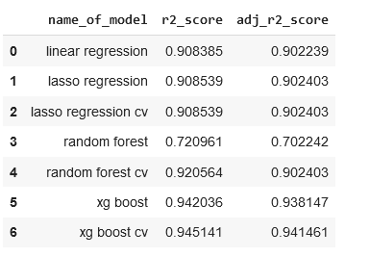
Conclusion:
It is found that demand for bike rises with rise in temperature.
At night demand for rental bike is most.
In summer season the demand for rental bike is most.
In monthly period it is seen that rental bike demand is low on January, February and December and high between may to august
It can be seen that bike demand rises after 5 AM and peaks at 8 AM, then again rises after 2 PM and peaks at 5PM then demand remain significantly above average demand 6PM and 11PM.That means in this 11 hours of a day bike demand is most.
XG boost regression model can predict rental bike demand with best accuracy of 94.14% accuracy.
Name of model with r2 score and adjusted r2 score

