Slide 1
Capstone Project - 1
Topic : Global Terrorism Analysis
Presented by:
Shubham Chandrakar

Slide 2
Aim : Explore and analyze the data to discover key findings pertaining to terrorist activities
To understand the pattern of terrorist activities we performed analysis in the following manner:
Data Importing : Importing the data into the dataframe.
Understanding the problem : We will explore and analysis the data to understand the pattern of terrorist attacks.
Cleaning the data : Removing duplicates, null/nan values.
Feature engineering : Removing,combining or creating features wherever necessary.
Identifying features: Identifying numerical and categorical variable.
Univariate analysis : Analysing each feature individually, identifying distribution and trend in data.
Multivariate analysis : Analysing two or more features together and identifying relationship,trend etc.
Conclusion : Identifying the important patterns and find possible solutions.

Slide 3
Points for discussion:
Trend of terrorism globally over the span of 1970 to 2017
Share of terrorist activity globally country wise from 1970 to 2017
Most targeted city from 1970 to 2017
Mode of Attack by used by terrorism
Type of institutional targets ,sub-target targeted by terrorist over span of 1970 to 2017
Name of top 20 target of terrorist
Type of weapon used by terrorist
Successful and unsuccessful terrorist attacks
No of identified kills, wounded and affected people each year
Most prominent type of attack in a country in span of 1970 to 2017
Type of target chosen mostly used for a country and region, type of weapon mostly used in specific country
Type of attack mostly used for city and country
Relationship between wounded, killed and affected people across span of 1970 to 2017

Slide 4
Data summary:
df : It is a dataframe that contains important and relevant information such as year, country
name,location, no of kills,wounded and affected etc.
numerical_variables : It contains numerical features names in df.
year_country_terrorism_df : It contains year, country name and no of terrorist activity happenedin that year in the country
targeted_city : It is a dataframe that contains name of city and no of times it was targeted
top_20_targeted_city: It is a dataframe that contains top 20 name of city that was targeted
attack_pattern_df : It is a dataframe that contains type of attacks and no of times the attack has happened.
institutional_target_df : It is a dataframe that contains names of institutional target and no of times it was targeted.
sub_target_df : It is a dataframe that contains name of type of sub-target and no of times it was targeted.
top_sub_target_df: It is a dataframe that contains name of top 20 type of sub-target and no of times it was targeted.
top20_name_of_target_df: It is a dataframe that contains name of top 20 individual target and no of times it was targeted.
weapon_df : it is a dataframe that contains name of type of weapon and no of times it was used.

Slide 5
Data summary (continued):
year_kills : It is a dataframe that contains value of no of identified kills in each year.
year_wounded : it is a dataframe that contains value of no of wounded people in each year.
country_attack_type : it is a dataframe that contains name of country, type of attack mostly used in a country and type of weapon mostly used in a country.
most_affected_country_attack_type : it is a dataframe that contains name of country which is most affected, type of attack mostly used in a country and type of weapon mostly used in a country.
attack_type_mode_country: it is a dataframe that contains type of attack mostly used in a country and region.
target_type_mode_country : It is a dataframe that contains type of target mostly chosen by terrorists for a given country.
weapon_type_mode_country: It is a dataframe that contains type of weapon mostly chosen by terrorists for a given country.
attack_type_mode_country : It is a dataframe that contains type of attack mostly chosen by terrorists for a given city and region.
df_wka : It is a dataframe that consists of year, no of kills,wounded and affected.

Slide 6
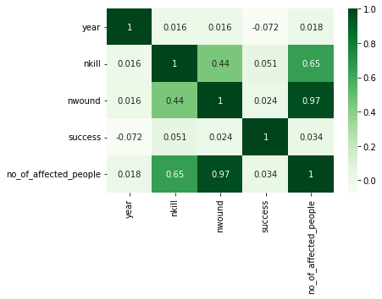
What correlation in data says ?
It a preliminary analysis of numerical data to check how much one numerical feature is correlated to other .
It is found that year has positive correlation with no of kills(nkill), no of wounded(nwound) and no of people people affected.
no of wounded has 97% correlation with no of people affected
Therefore with passed of time no of people are more affected by global terrorism
SNS HEATMAP NUMERICAL Variable
sns.heatmap(df.corr(),cmap ="Greens",annot = True)

Slide 7
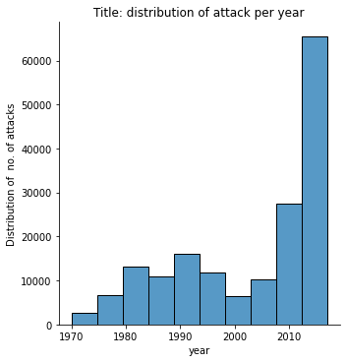
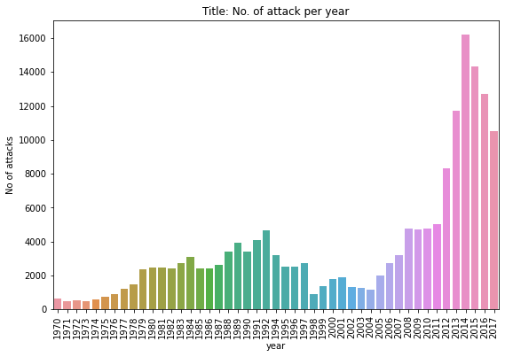
Trend of terrorism globally over the span of 1970 to 2017
Key findings:
1. Distribution of attack per year is on overall increasing trend.
2. Trend no of attack happened in following years:
* 1st peak at year 1992 around 16000 attacks happened.
* 1st low at year 1988 around 1000 attacks.
* 2nd peak at year 2001 around 1800 attacks happened.
* 2nd low at year 2004 around 1000 attacks happened.
* 3rd peak at year 2014 around 5000 attacks happened
3. After 2004 terrorism activity is rapidly rising

Slide 8
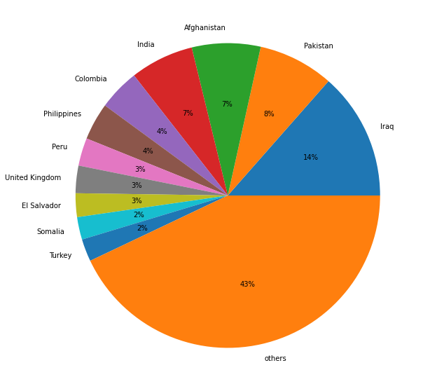
Share of terrorist activity globally country wise from 1970 to 2017
Key findings about share of terrorist activity globally country wise from 1970 to 2017 are as follows:
1. Iraq is most affected country with 14% overall share of terrorist activity globally.
2. Second most affected country is Pakistan with 8% overall share of terrorist activity globally.
3. Third most affected is Afganistanwith 7% overall share of terrorist activity globally.
4. Fourth most affected is India with 7% overall share of terrorist activity globally.
5. 11 countries inclunding above four countries share 57 % percent of terrorist activity globally and rest of 194 countries share 43 % percent of terrorist activity globally.

Slide 9
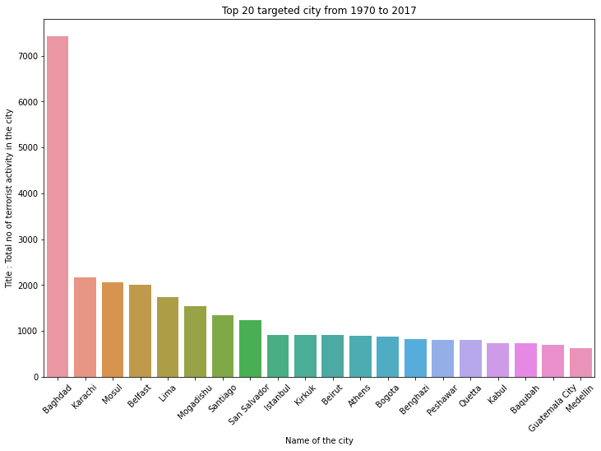
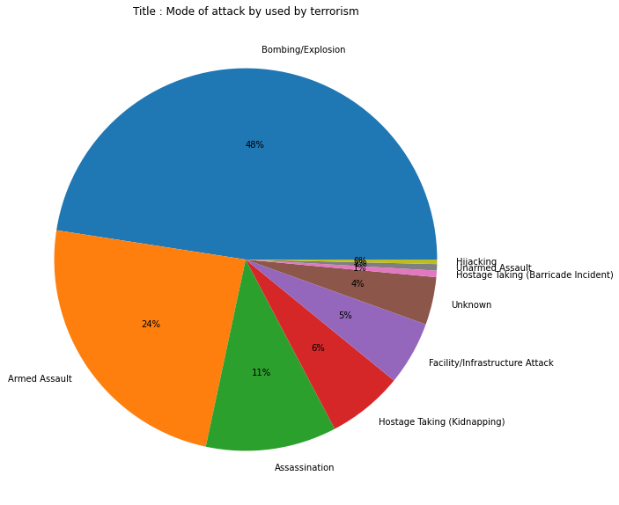
Most targeted cities from 1970 to 2017
Key findings:
1. 75% of cities had less than 2 terror acitvities
2. 90% of cities had less than 5 terror acitvities
3. Baghdad is most targeted city having 7428 terrorist activity followed by Karachi and Mosul.
Mode of Attack by used by terrorists
Key findings related to mode of attack are as follows:
1. Bombing/Explosion constitutes 48% of globally used mode of attack preferred by terrorist.
2. Armed assualt is second most preferred mode of attack, constitutes 24% of globally used mode of attack preferred by terrorist.
3. Assasination is third most preferred mode of attack, constitutes 11% of globally used mode of attack preferred by terrorist.

Slide 10
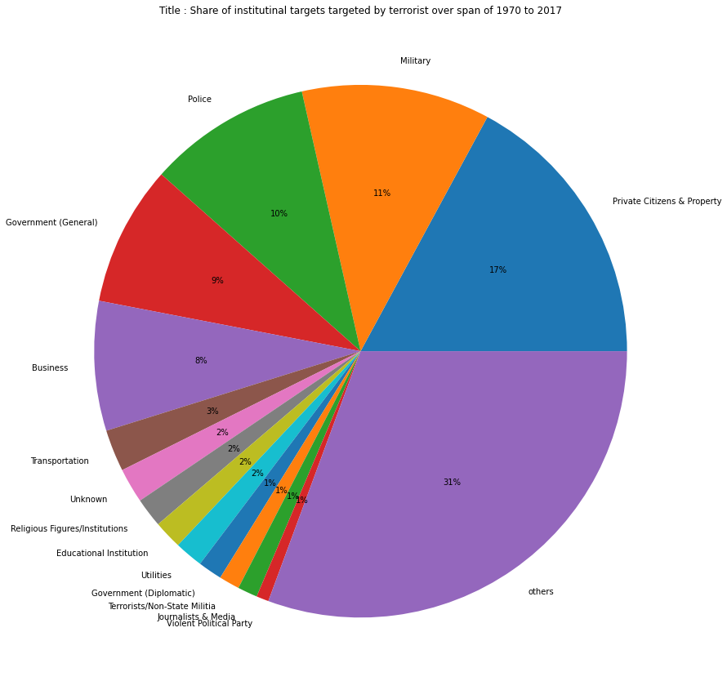
Type of institutional targets targeted by terrorist over span of 1970 to 2017
Key finding related institutional targets targeted by terrorist over span of 1970 to 2017:
Most targeted institutional target is Private Citizens & Property, it consitutes 17% of all institutional target targeted by terrorist.
Second most targeted institutional target is Military,it constitutes 11% of all institutional target targeted by terrorist.
Third most targeted institutional target is Police,it constitutes 10% of all institutional target targeted by terrorist.
Fourth most targeted institutional target is Government (General),it constitutes 9% of all institutional target targeted by terrorist.
Fifth most targeted institutional target is Business,it constitutes 8% of all institutional target targeted by terrorist.
`

Slide 11
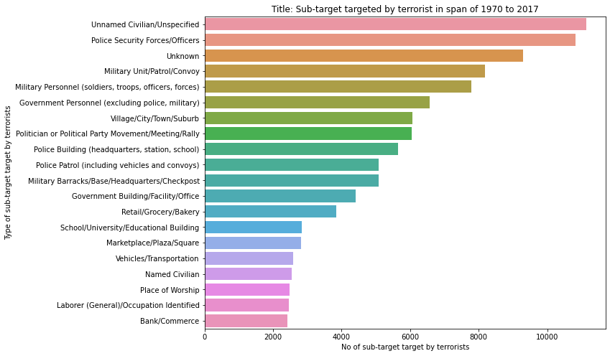
Sub-targets targeted by terrorists
Key finding related sub-targets targeted by terrorist over span of 1970 to 2017:
Most targeted sub-target is Civilians, it consitutes 11143 attacks of all sub-target targeted by terrorist.
Second most targeted sub-target is Police Security Forces/Officers,it consitutes 10820 attacks of all sub-target targeted by terrorist..
Third most targeted sub-target is Unknown,it consitutes 9285 attacks of all sub-target targeted by terrorist.
Fourth most targeted sub-target is Military Unit/Patrol/Convoy,it consitutes 9285 attacks of all sub-target targeted by terrorist.
Fifth most targeted sub-target is Military Personnel (soldiers, troops, officers, forces),it constitutes 7787 of all all sub-target targeted by terrorist.
`

Slide 12
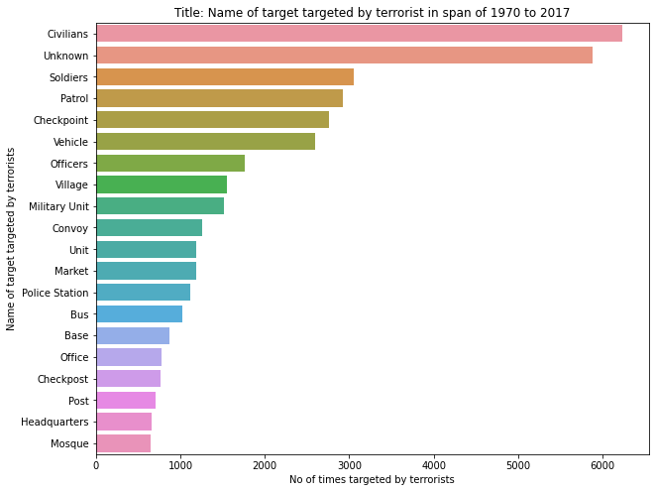
Name of Top 20 individual target of terrorist
Name of top 20 individual target of terrorists are Civilians, Unknown, Soldiers, Patrol, Checkpoint, Vehicle, Officers, Village, Military Unit, Convoy, Unit, Market, Police Station, Bus, Base, Office, Checkpost, Post, Headquarters, Mosque.
`

Slide 13
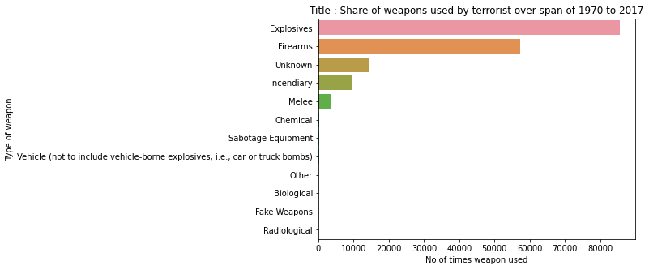
Type of weapon used by terrorist
Key findings related to type of weapon used by terrorist in terrorist attacks:
1. Most preferred type of weapon is Explosives.
2. Second Most preferred type of weapon is Firearms.
3. Third Most preferred type of weapon is Incendiary.
Other types of weapon used are: Melee, Chemical, Sabotage Equipment, Vehicle (not to include vehicle-borne explosives, i.e., car or truck bombs), Biological, Fake Weapons,Radiological.
`

Slide 14
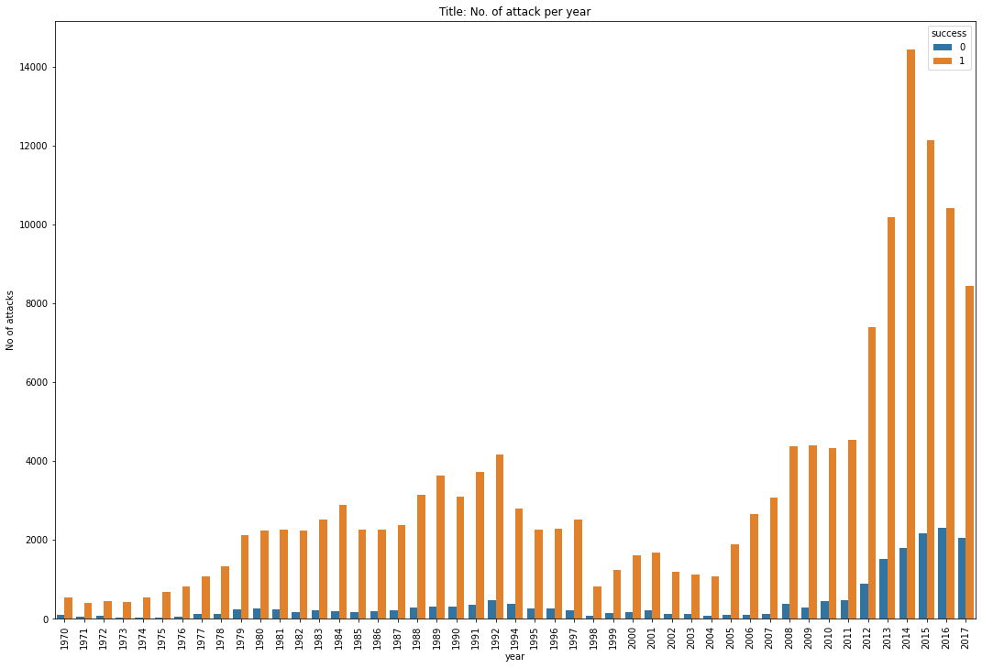
Successful terrorist attacks
Trend indicates that in any year terrorists were mostly successful.
`

Slide 15
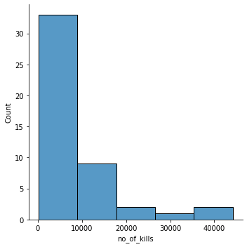
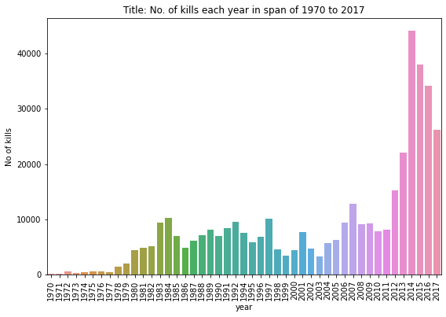
No of identified kills each year
Key findings related to no of kills:
1. No of kills are mostly around 10000 kills in any year as per distribution plot.
2. We found that after 2012 no of kills globally increased drastically and average no of kills between 2012 to 2017 is = 30,000.
3. Average no. of kills before 2012 is = 5,531.
4. Average no. of kills between 2012 to 2017 is = 29998
So there is almost five times increase in no kills over the span of 1970 to 2017
`

Slide 16
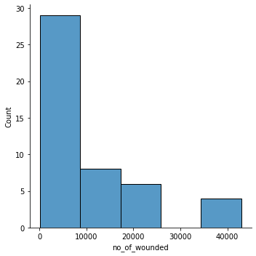
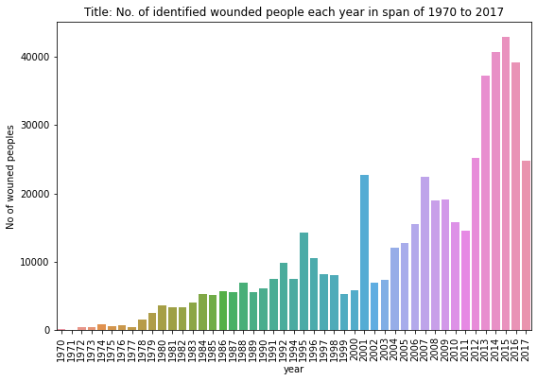
No of identified wounded peoples
Key findings related to identified wounded peoples:
1. There is rising trend in no of idenfied wounded people, similar to no of identified over the years
2. Most of the times no of wounded are less than 10000 over the span of 1970 to 2017
3. Three times no of wonded people peaked are as follows: Year 1995 = 14227 Year 2001 = 22762 Year 2015 = 42971
4. Avg no of wounded people between 1970 to 2000 is = 4748 Avg no of wounded people between 2000 to 2017 is = 15548
So similar to no of identified kills there is drastically increase in no of wounded people after Year 2000.

Slide 17
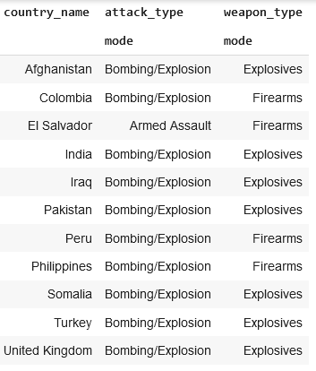
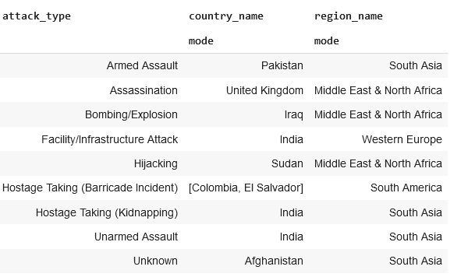
Relation between attack type, weapon type and country in a country in span of 1970 to 2017
1. Type of weapons and type of attack mostly used in most affected countries.
2. Type of attack mostly practised in a country and region

Slide 18
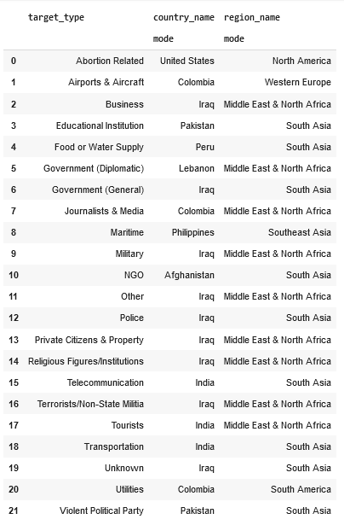
Type of target chosen mostly used for a country and region
Type of target chosen mostly used in specific country and region
This analysis shows relation between type of target, country name and region name.
This table shows type of target and corresponding country name, region name in which that specific target is mostly used.

Slide 19
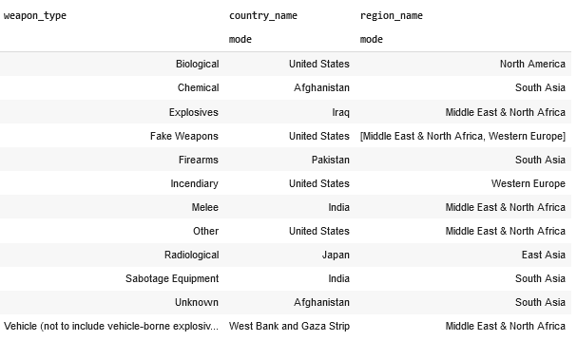
Type of weapon mostly used for specific country
Type of weapon chosen mostly used for specific country and region
This analysis shows relation between weapon type,country name and region name.
This table shows type of weapon and corresponding country name, region name in which that specific weapon is mostly used.

Slide 20
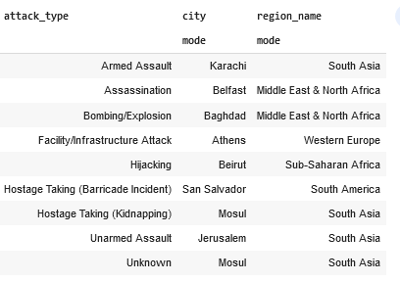
Type of attack mostly used for specific city and country
Type of attack chosen mostly used in specific city and region name
This analysis shows relation between type of attack, city and region name.
This table shows type of attack and corresponding city, region name in which that specific attack is mostly performed.

Slide 21
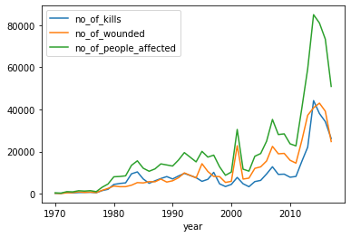
Relationship between wounded,killed and affected people across span of 1970 to 2017
Relationship between wounded,killed and affected people across span of 1970 to 2017
This analysis shows relationship between wounded,killed and affected people across span of 1970 to 2017.
No of people killed, no of people wounded and no of people affected all show positive trend in overall growth.
After 2012 no of people affected are drastically increased.

Slide 22
Conclusion:
There is rising trend in growth of global terrorist activities all over the world.
The no of people killed over span of 1970 to 2017 is constantly rising, after 2012 average no of people killed per year is increased six times
The most affected countries are Iran, Pakistan,India etc, 11 countries have share of 57% of all terrorist activities all over the world.
The most preferred attack type by terrorist is Bombing/Explosion etc.
The threat of global terrorism is rising every year. We need to curb terrorist activities globally as soon as possible. We need to stop bombing activities, trade of illegal armaments and increase security of citizens. Governments of each countries and UNSC must take necessary action to solve this global problem at a high priority level. CItizens must need to be provided with food security, education, justice, health and jobs so that they must protect themselves from terrorism and prevent any citizen to join terrorist organisation.
Thank You

