Slide 1
Capstone Project
Project Title: Health Insurance Cross sell Prediction
Presented by:
Shubham Chandrakar
Notes:
Hello

Slide 2


Problem statement:
The client is an insurance company involved in the health insurance business. The client has experience in selling health insurance. They need the help of the data science team in building a model to predict whether the policyholders (customers) from past year will also be interested in vehicle insurance provided by the company
Aim: Our aim is to explore, analyze and draw insights from the data as well as predict whether policyholders (customers) from past year will be interested in purchasing vehicle insurance policy.

Slide 3
Data pipeline
Data Wrangling :- In these step dataset is loaded, null value is treated, duplicated rows are removed, dependent variable distribution is checked, feature engineering is performed, correlation analysis is performed, outlier removal is performed.
EDA on dataset :- In these step univariate analysis in which we observed each variable individually, bivariate analysis is performed to check relation between two features.
Data processing for ML model :- First , VIF analysis is performed to remove multicollinearity. After that categorical encoding is performed. At last final tuning of data is done to finally use data efficiently for building ML model.
Building ML model: We build models after handling imbalanced data in three ways:
Building ML models over imbalanced data and performing hyperparameter tuning using Cross-Validation over baseline model.
Building ML models after oversampling data using SMOTE implementation and performing hyperparameter tuning using Cross-Validation over baseline model
Building ML models after oversampling and undersampling data using SMOTETomek implementation and performing hyperparameter tuning using Cross-Validation over baseline model

Slide 4
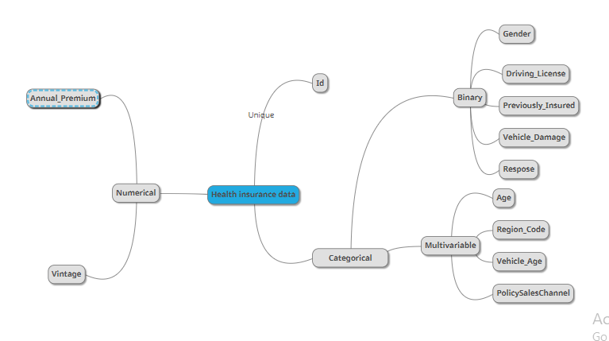
Data Summary

Slide 5
Data Summary
id : It is Unique ID for the customer
Gender : Gender of the customer i.e either male or female
Age : Age of the customer
Driving_License : If it is 0, then customer does not have, If it is 1,the customer already has DL
Region_Code : It is unique code for the region of the customer
Previously_Insured : It tell whether customer was previously insured or not ,If 1, then customer already has Vehicle Insurance. If 0,then Customer doesn't have Vehicle Insurance
Vehicle_Age : This feature contains value of age of the Vehicle
Vehicle_Damage :If value is 1,then customer got his/her vehicle damaged in the past.If value is 0, then customer didn't get his/her vehicle damaged in the past.
Annual_Premium : The amount customer needs to pay as premium in the year
PolicySalesChannel : Anonymized Code for the channel of outreaching to the customer ie. Different Agents, Over Mail, Over Phone, In Person, etc.
Vintage :It is Number of Days, Customer has been associated with the company
Response : If value is 1, then customer is interested.If 1, then customer is not interested

Slide 6
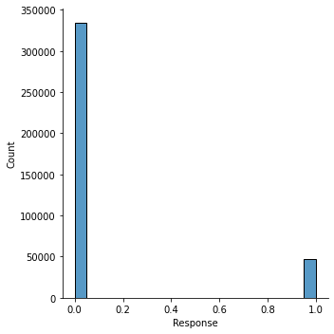
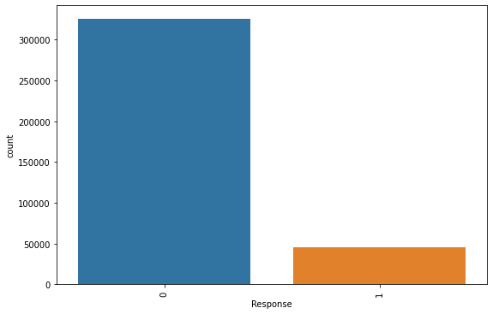
Dependent feature analysis
In this dataset out dependent feature is : Response
It is a binary feature that contain two values:
1 , if policyholder(customer) is interested
0, if policyholder(customer) is not interested in buying policy based on his/her previous purchase of health insurance
Following are observation related to dependent variable:
It is heavily imbalanced
It is categorical and binary in nature
Distribution plot of Response feature
Distribution plot of Response feature

Slide 7
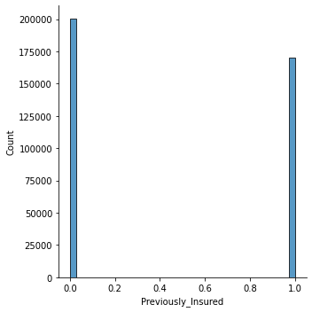
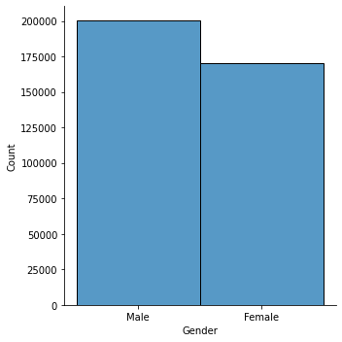
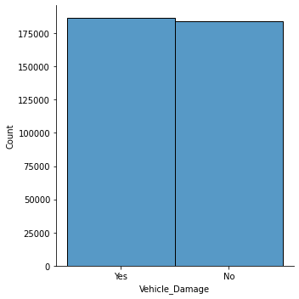
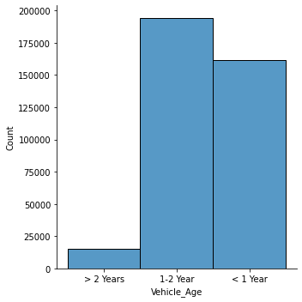
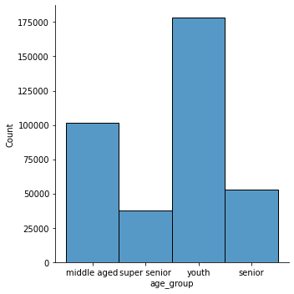
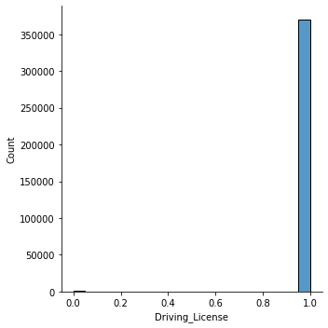
EDA : Univariate Analysis Findings
Following are the key findings:
Male customers are more than female customers.
Most of the people have driving license.
Most of the customers are in age group less than 28.
Most vehicle insured are 1-2 years old.
More than 50% people reported vehicle damage.
Most of the customers have negative response as compared to positive response.
Most of the people were not previously insured
Major customers are youth followed by middle aged.

Slide 8
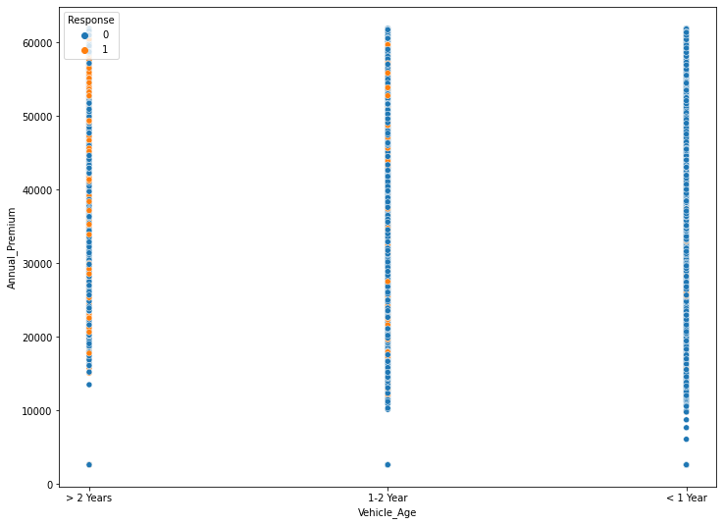
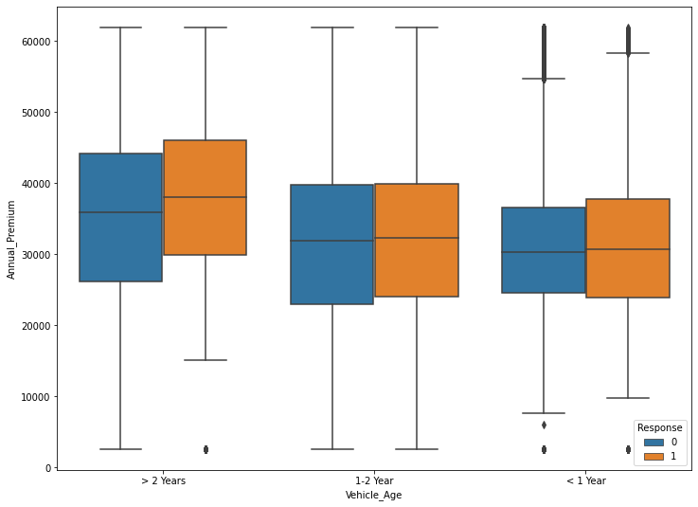
EDA : Bivariate Analysis Findings
Annual Premium depends on Vehicle Age
Key findings:
1. With age of vehicle premium increases
2. Mean annual premium is highest for vehicle older than 2 years
Conclusion: It will be more beneficial for client company to get more client with vehicle older than 2 year.

Slide 9
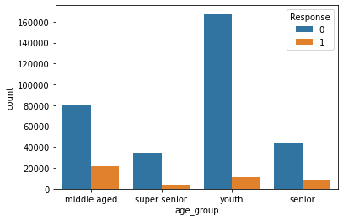
EDA : Bivariate Analysis Findings (contd.)
Age group and Response
Key findings:
Middle aged people are most responsive followed by senior.
Least responsive age group is youth
Conclusion: The client must focus more on youth as the positive responsive is low for youth age group. They must also focus towards senior and super seniors.
Youth : age <35 years
Middle aged : 50 years > age =>35 years
Senior : 50< age <62 years
Super senior : age >62 years

Slide 10
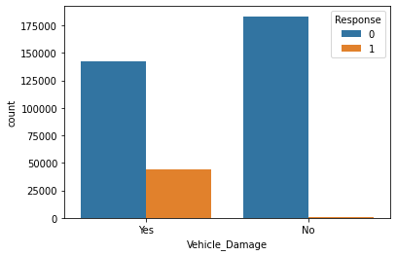
EDA : Bivariate Analysis Findings (contd.)
Vehicle damage and response
People who had vehicle damage in the past are mostly showing response in comparison to people with no vehicle damage in the past are showing negligible response.
Conclusion: The client must focus more on converting people who had no vehicle damage in the past

Slide 11
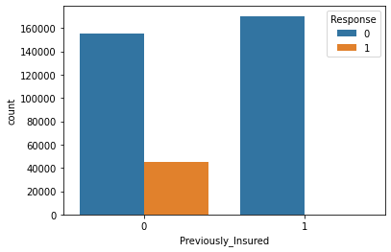
EDA : Bivariate Analysis Findings (contd.)
Previously insured and response
People who were previously insured are showing more response in comparison to people who were not previously insured.
Conclusion: Client must focus on people who are not previously insured as they are giving negligible response

Slide 12
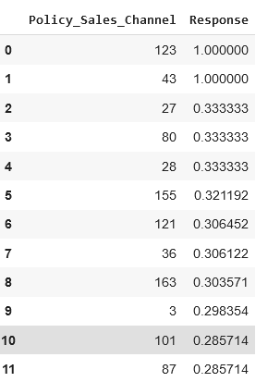
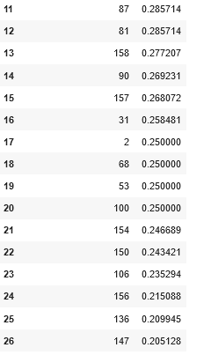
EDA : Bivariate Analysis Findings
Policy sales channel and response
Key findings:
There are 36 policy sales channel which generated no response.
There are 27 out 155 sales channel generated more than 20% positive response conversion
There are 78 out 155 sales channel generated more than 10% positive response conversion
Conclusion: Client must provide proper resources and training to the 36 policy sales channels generating zero response. They must use experience of the 78 sales channels with 10% conversion rate to improve customer.

Slide 13
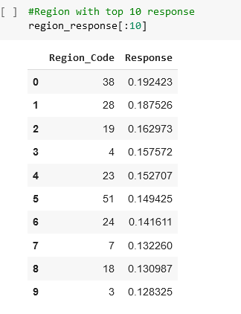
EDA : Bivariate Analysis Findings
Region code and response
Key findings:
All regions are generating more than 4% conversion
15 out of 53 region under operation generating 12% conversion in terms of positive response
Conclusion: Client must provide proper resources and training in regions where conversion rate is less than 5%. And try to expand customer base in the regions where the company has more than 12% conversion in terms of positive response

Slide 14
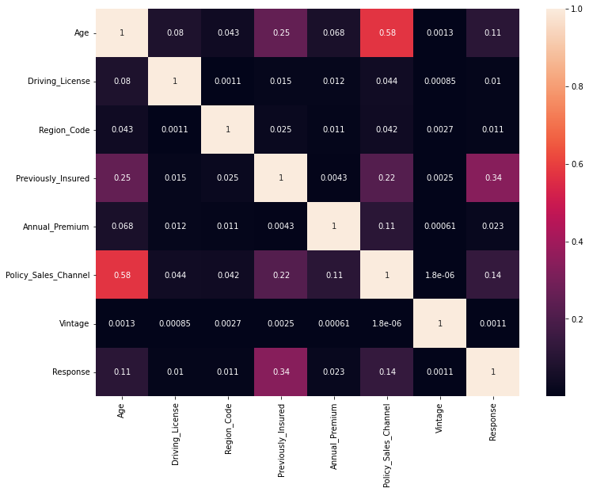
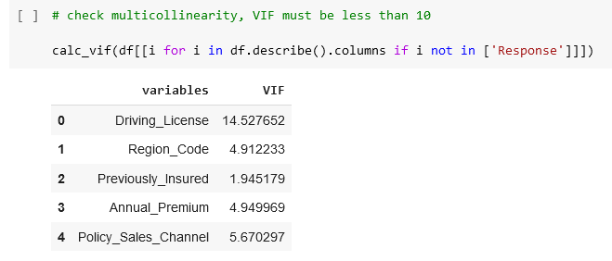
Correlation analysis and VIF analysis

Slide 15
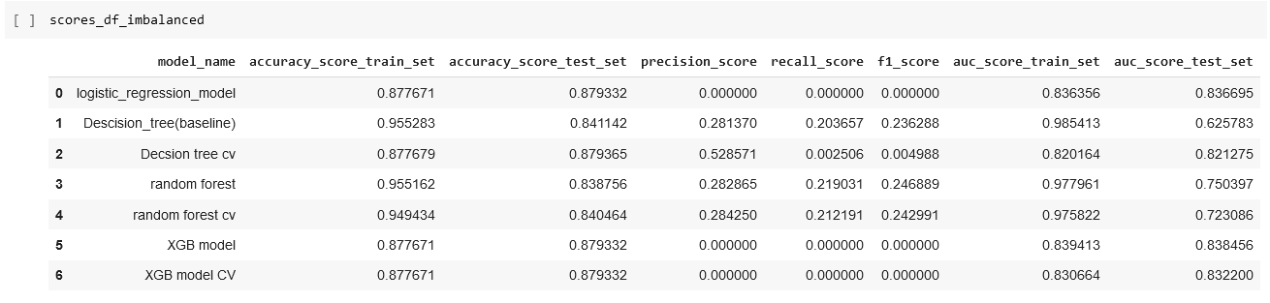
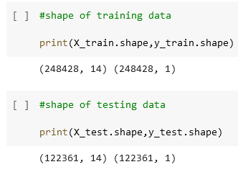
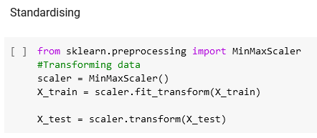
Building ML model over Imbalanced dataset
Shape of test and train set
Standardisation method: MinMaxScaler()
Type of ML model Algorithm used:
Logistic Regession Model
Random Forest Regression Model
XGBoost Regression Model
Decision tree
Observations:
All models failed to detect positive label except Random Forest classifier
Best Model for imbalanced dataset:
Random Forest Classifier (baseline) model
with parameters :
rfc_clf = RandomForestClassifier(max_features ="sqrt")

Slide 16
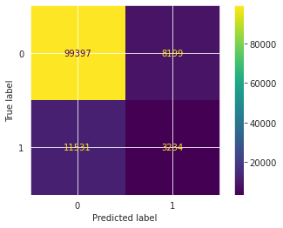
Building ML model over Imbalanced dataset
Best Model : Random Forest Classifier (baseline model)
rfc_clf = RandomForestClassifier(max_features ="sqrt" )
Conclusion: This model has very low f1 score of 24.29% so we cannot use this model.

Slide 17
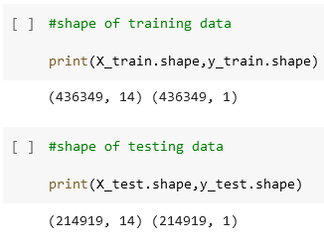
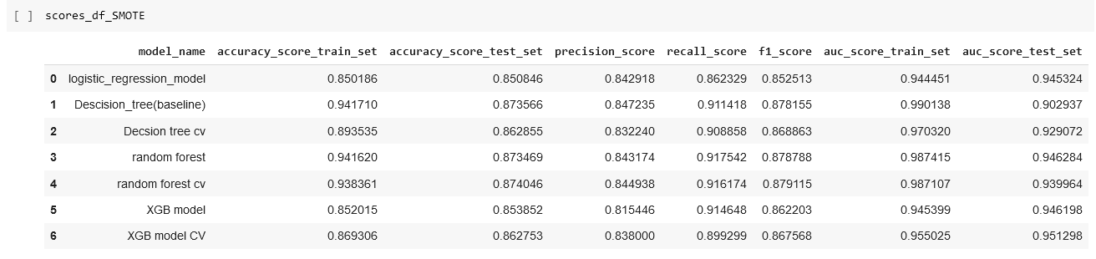
Building ML model after oversampling the unbalanced dataset using SMOTE
Shape of test and train set before SMOTE
Shape of test and train set after SMOTE
Type of ML model Algorithm used:
Logistic Regression Model
Random Forest Regression Model
XGBoost Regression Model
Decision tree Model
Standardisation method: MinMaxScaler()

Slide 18

Building ML model after oversampling the unbalanced dataset using SMOTE
Observation:
Best model with highest f1 score of 87.91%, ROC_AUC score of 93.99% on test set and 98.71% on train set is Random Forest Classifier with hyper parameter tuning using GridSearchCV
All model performed well but SMOTE implementation equalise both true label and false label.
Best model with parameter: RandomForestClassifier(max_features='sqrt', n_estimators=20,verbose = 2, cv=5)
max_features: The number of features to consider when looking for the best split
n_estimator: The number of trees in the forest
verbose : Controls the verbosity when fitting and predicting
cv: no of folds for cross-validation
Confusion matrix:
Conclusion: Here best model is Random Forest Classifier with f1 score of 87.91%, ROC_AUC score of 93.99% on test set and 98.71% on train set. But as only oversampling cannot provide best result for imbalanced data because it equalise both true and false label. This model cannot be accepted.
matrix:
[[215986 2052]
[ 10510 19880]]
[[99707 7889]
[11632 3133]]

Slide 19
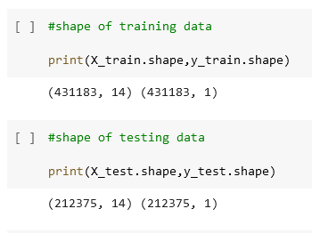
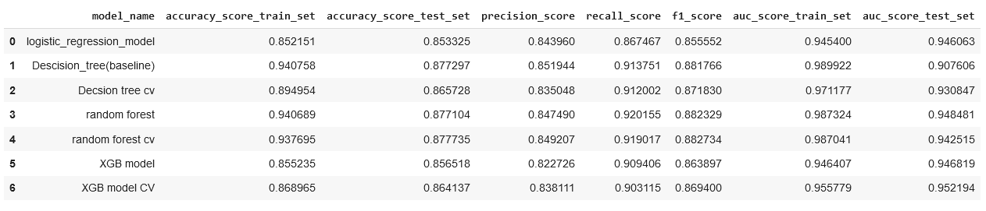
Building ML model after oversampling and undersampling together using SMOTETomek
Shape of test and train set before SMOTETomek
Shape of test and train set after SMOTETomek
Type of ML model Algorithm used:
Logistic Regression Model
Random Forest Regression Model
XGBoost Regression Model
Decision Tree Model
Standardisation method: MinMaxScaler()

Slide 20
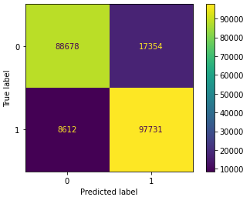
Building ML model after oversampling and undersampling together using SMOTETomek
Observation:
Best model with highest f1 score of 88.27%, ROC_AUC score of 98.70% on train set and 94.25% on test set is Random Forest Classifier with hyper parameter tuning using GridSearchCV
All model performed well as SMOTETomek implementation balance both true label and false label.
Best model with parameter: RandomForestClassifier(max_features='sqrt', n_estimators=20,verbose = 2, cv=5)
max_features: The number of features to consider when looking for the best split
n_estimator: The number of trees in the forest
verbose : Controls the verbosity when fitting and predicting
cv: no of folds for cross-validation
Confusion matrix:
Conclusion: Here best model is Random Forest Classifier with f1 score of 88.27%, ROC_AUC score of 98.70% on train set and 94.25% on test set. As oversampling and undersampling performed together can provide best result for imbalanced data because it equalise both true and false label. This model can be accepted and implemented as best model.
matrix:
[[88678 17354]
[ 8612 97731]]

Slide 21
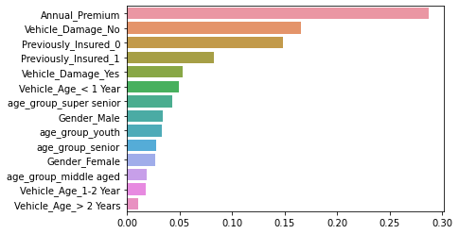
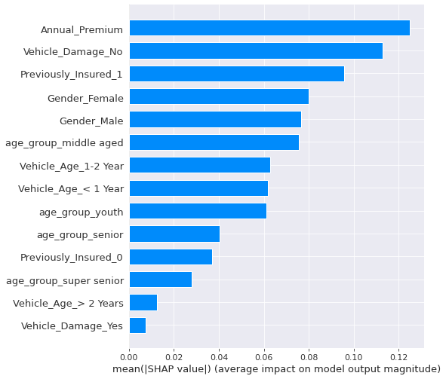
Feature importance based on best model
Best model : RandomForestClassifier(max_features='sqrt', n_estimators=20,verbose = 2, cv=5)
We have calculated feature importance for best model
SHAP : Summary plot (bar type) for first 1000 rows
Using Scikit-learn library function

Slide 22
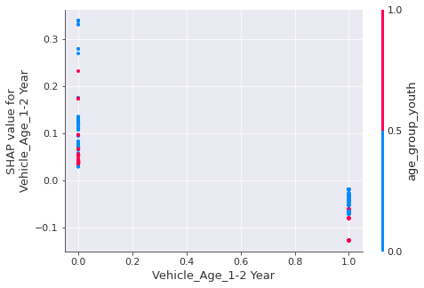
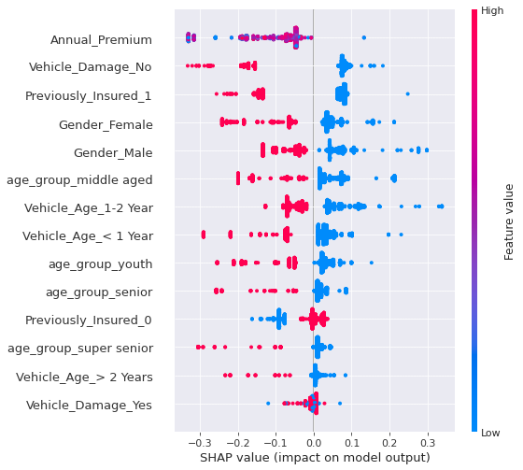
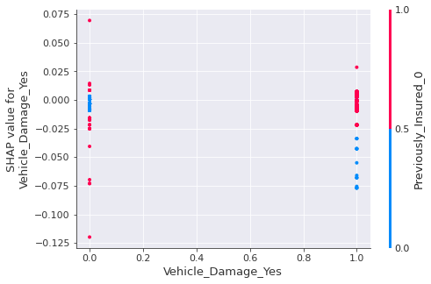
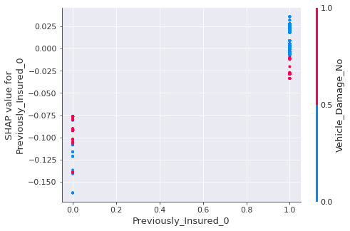
Feature importance based on best model(contd.)
Best model : RandomForestClassifier(max_features='sqrt', n_estimators=20,verbose = 2, cv=5)
We have calculated feature importance for best model
SHAP : Summary plot (dot type) for first 1000 rows
SHAP : Dependence plot for first 1000 rows

Slide 23
Conclusion
We need to target middle aged, senior people as well as focus more on converting youth into our possible customers.
Policyholders who did not had vehicle damage in the past needed to be guided more to purchase policy.
Thirty-six policy channels had generated no response,they needed to be trained robustly.
Regions generating less than 8% conversion rate must focus on increasing brand presence in their respective region.
While building ML models, SMOTETomek must be used for resampling data after that Random Forest Classification model with hyperparameter tuning as it can predict whether the policyholders (customers) from past year will also be interested in Vehicle Insurance provided by the company with 94.26 % ROC-AUC score and 88.27% f1 score.
Best model : RandomForestClassifier(max_features='sqrt', n_estimators=20,verbose = 2, cv=5)
As database is very large SHAP implementation is not feasible for this project as it takes large amount of time but feature importance can be adequately quantified based on feature importance function of scikit-learn library.
THANK YOU

