Slide 1
Capstone Project-4
Project Title: Netflix Movies and TV shows clustering
Presented by:
Shubham Chandrakar
Notes:
Hello

Slide 2
Aim of the Project:
Problem Statement:
The dataset provided to us by Flexible, a third party Netflix search engine. It consists of various features related to tv show and movie title available on netflix as of 2019. In 2019, Flexible released the report stating that the number of TV shows on Netflix has nearly tripled since 2010. While the number of movies on Netflix has been decreased by 2,000 titles.
Our aim:
To perform exploratory data analysis (EDA)understand what type of content available in which country.
To verify whether netflix is increasingly focusing on tv shows in spite of movie titles.
Perform clustering of similar content by matching text based features.
Notes:
Hello

Slide 3
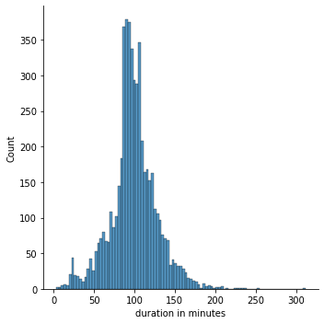
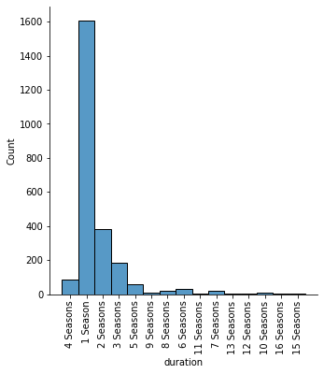
Exploratory Data Analysis (EDA): Some important findings
Duration of movies and TV series:
Key findings:
Movie length follows normal distribution.
Mean movie length is between 90 min to 110 min.
Most of the TV Series has less than 5 seasons.
Large number of the TV Series has 1 season only.
Conclusion:
Good movie length can be considered as 2 hours and A good TV-Series length can be considered as 5 seasons for becoming successful in Netflix platform
Notes:
Hello

Slide 4
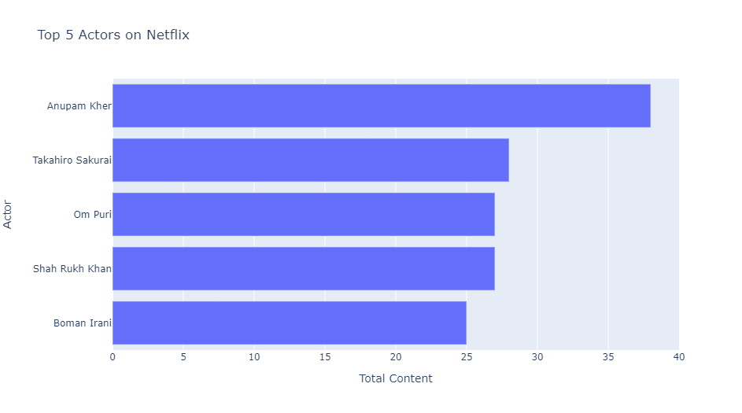
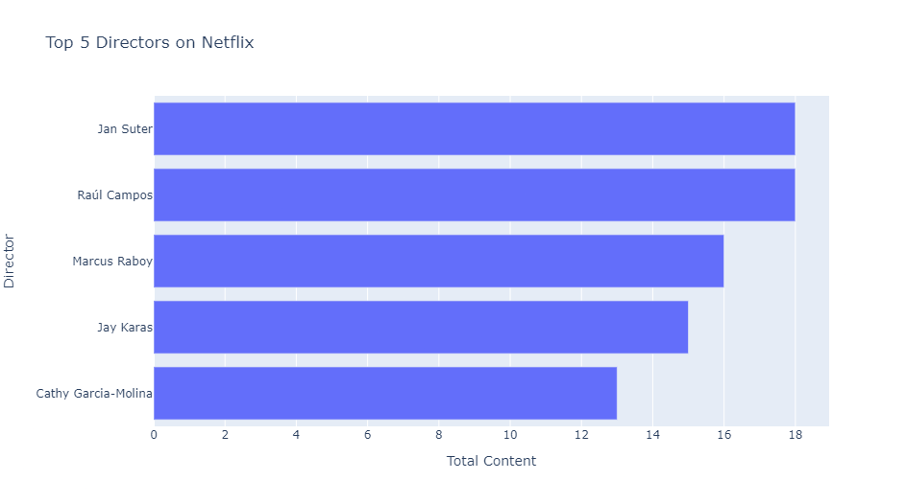


Exploratory Data Analysis (EDA): Some important findings
Top 5 director and actors in Netflix (in terms of number of title):
Key findings:
Anupam Kher acted in most titles followed by Takahiro Sakurai.
Jan Sutler directed in most titles followed by Raul Campos.
Anupam Kher
Raul Campos
Notes:
Hello

Slide 5
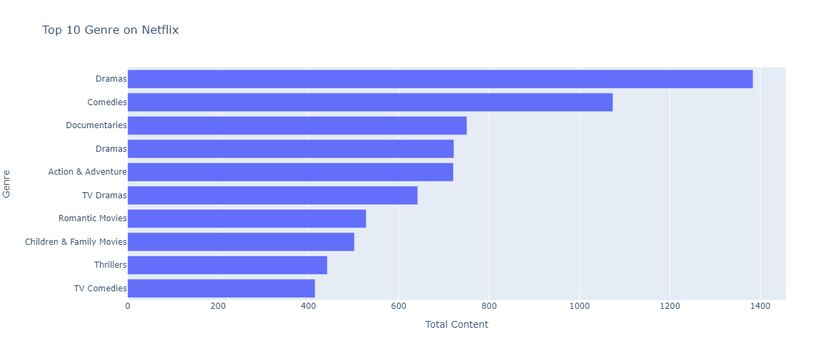
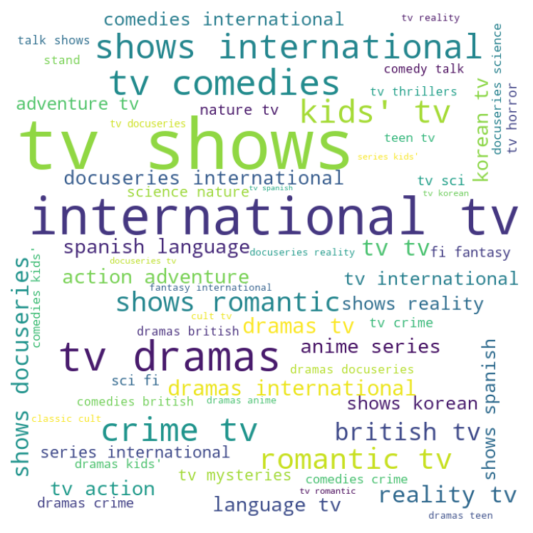
Exploratory Data Analysis (EDA): Some important findings (Contd.)
Top genres in Netflix :
Key findings:
Dramas is top genre in Netflix.
Second top genre in Netflix is Comedies.
Other top genres are Documentaries, Action and Adventures, TV Dramas and Romantic Movies.
Notes:
Hello

Slide 6
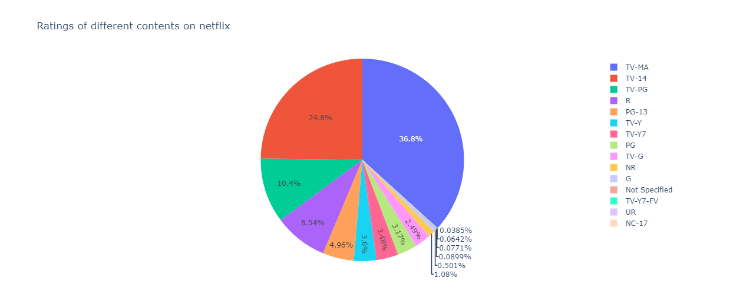
Exploratory Data Analysis (EDA): Some important findings (Contd.)
Distribution of Rated Content in Netflix :
Key findings:
36.8 % of the content is rated “TV-MA” .
24.8 % of the content is rated “TV-14” .
10.4 % of the content is rated “TV-PG” .
8.54 % of the content is rated “R”.
Notes:
Hello

Slide 7
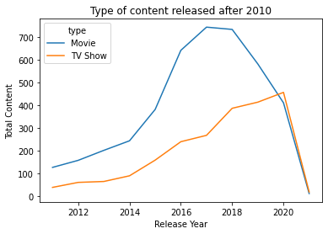
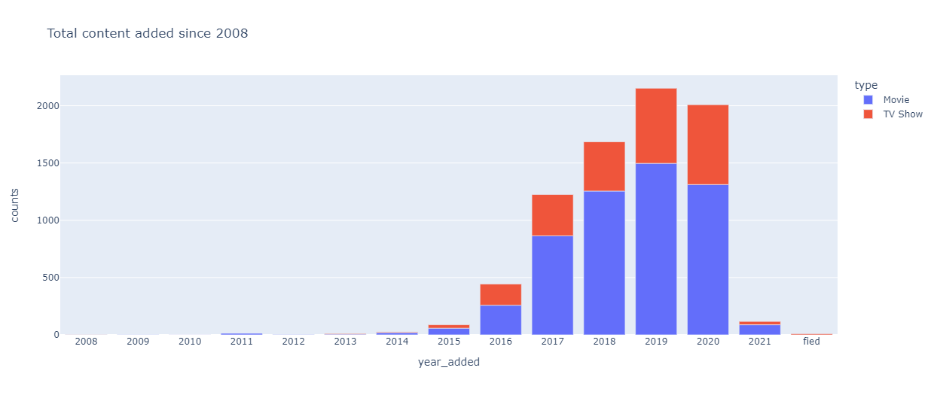
Exploratory Data Analysis (EDA): Some important findings (Contd.)
Decline in growth rate of listing of Movies from 2017 :
Key findings:
Both type of content i.e. “Movies” and “TV Series” were constantly rising till 2017
After 2017 there is decline growth rate of listing of movies.
During 2020 fall in both type of content due to Covid-19 pandemic
Conclusion:
It can be seen that TV Series are more popular after 2017
Notes:
Hello

Slide 8
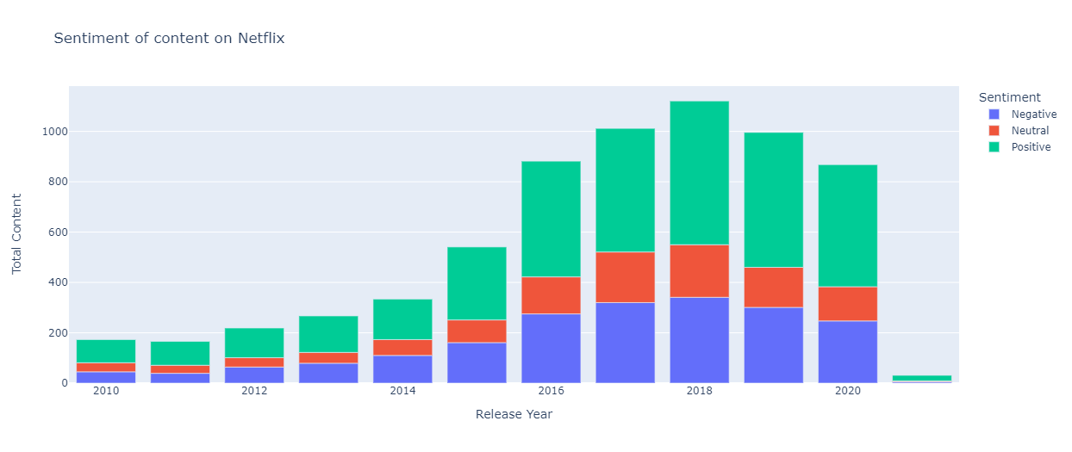
Exploratory Data Analysis (EDA): Some important findings (Contd.)
Sentiment analysis of content :
Key findings:
Most of the content ever produced is “Positive Sentiment”.
Very less number of the content ever produced is “Negative Sentiment”.
Conclusion:
It can be seen that “Positive Content” are more popular.
Notes:
Hello

Slide 9
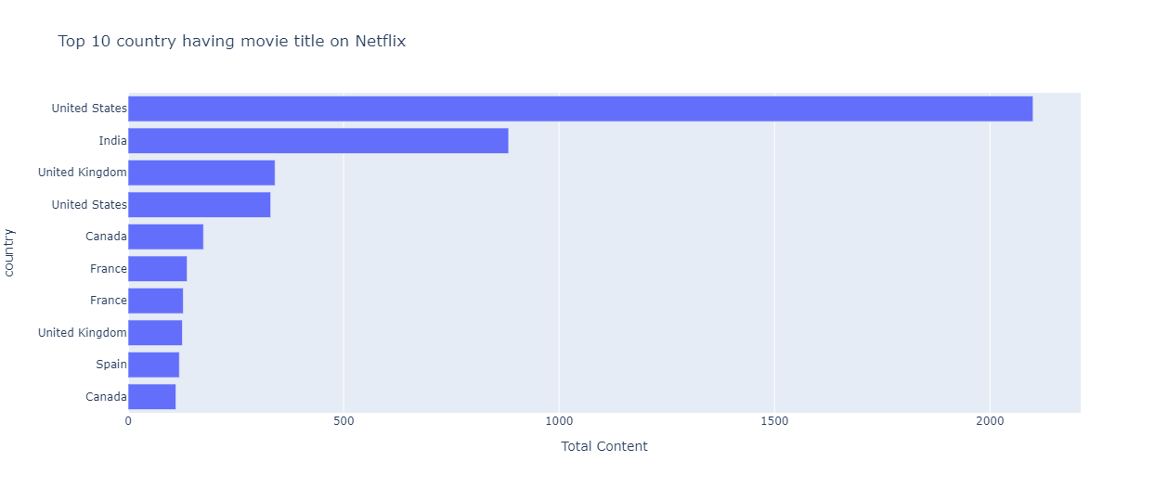


Exploratory Data Analysis (EDA): Some important findings (Contd.)
Top Movie producer countries :
Key findings:
Most of the movie title ever produced by USA
Second most movie title ever produced by India
Other top producer countries UK, Canada, France and Spain respectively
Conclusion:
It can be seen that USA, India, UK, Canada, France and Spain has good market for producers.
USA(United States of America)
India
Notes:
Hello

Slide 10
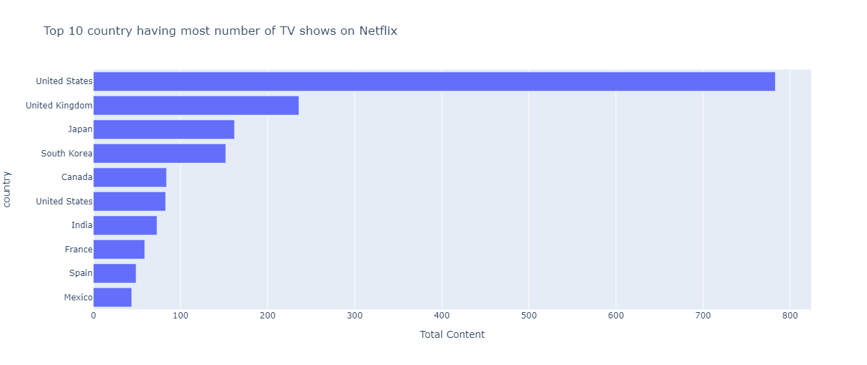

Exploratory Data Analysis (EDA): Some important findings (Contd.)
Top TV-Series producer countries :
Key findings:
Most of the TV-series title ever produced by USA
Second most TV-series title ever produced by UK
Other top producer countries Japan, South Korea and Canada respectively
Conclusion:
It can be seen that USA, UK, Japan, South Korea and Canada has good market for TV-series producers.
USA(United States of America)
United Kingdom of Great Britain and Northern Ireland (UK)
Notes:
Hello

Slide 11
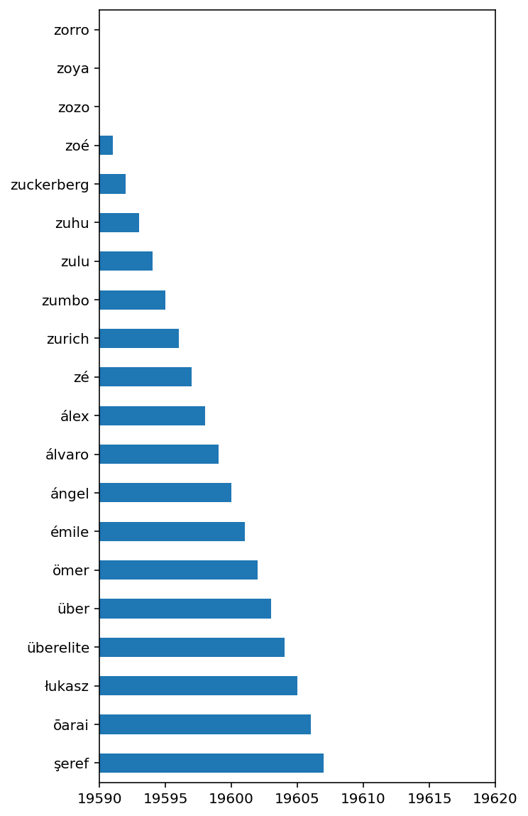
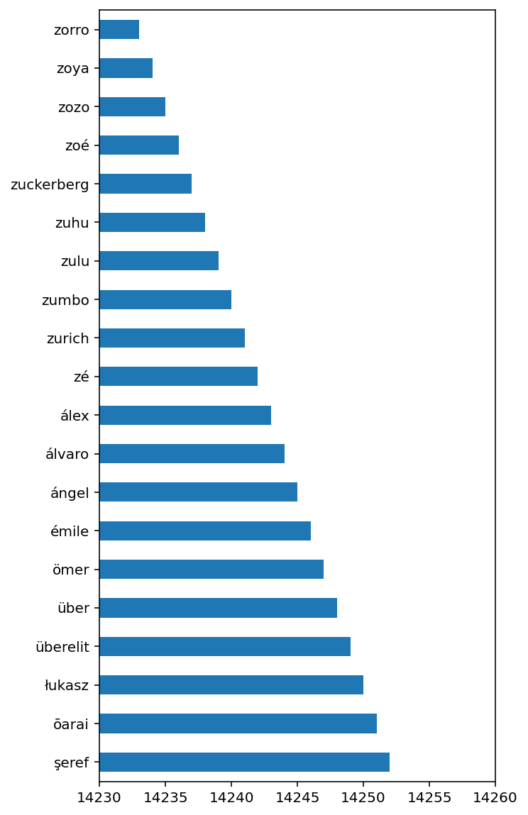

Data Preparation for clustering: Steps followed for data preparation
Steps followed for Data Preparation:
Following steps were performed:
Removal of punctuation.
Removal of stop - words.
Visualisation of Word cloud in description column.
Stemming is performed
Checking top words before stemming.
Checking top words after stemming.
Top Words before Stemming
Top Words after Stemming
Notes:
Hello

Slide 12
Topic modeling and Building clustering models.
Steps followed for topic modeling :
Following steps for topic modeling:
Data preprocessing (vectorization) using CountVectorizer().
Building Latent Dirichlet Allocation(LDA) model for clustering.
Building K-Means clustering model for clustering.
Building Hierarchical clustering model for clustering.
Notes:
Hello

Slide 13
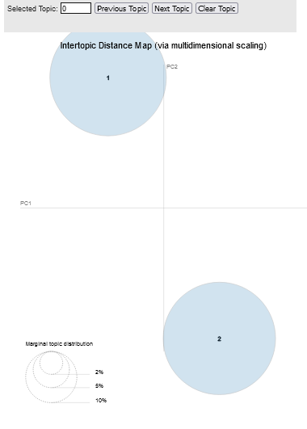
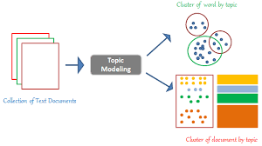
Latent Dirichlet Allocation (LDA) model
Observation on LDA models :
After cross-validation using GridSearchCV, It is found that optimum no of clusters is 2
Best log likelihood Score for the LDA model -242625.54
LDA model Perplexity on train data 3355.1382527834458
Visualization of no of clusters using LDA models.
Notes:
Hello

Slide 14
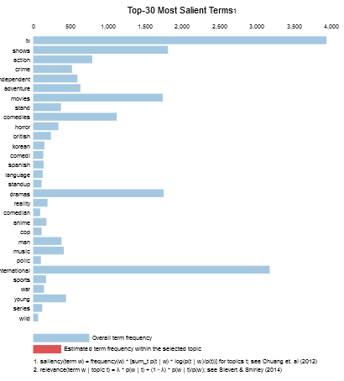
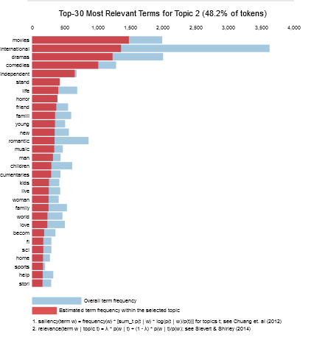
Latent Dirichlet Allocation (LDA) model (contd.)
Topics on 1st cluster
Topics on 2nd cluster
Notes:
Hello

Slide 15
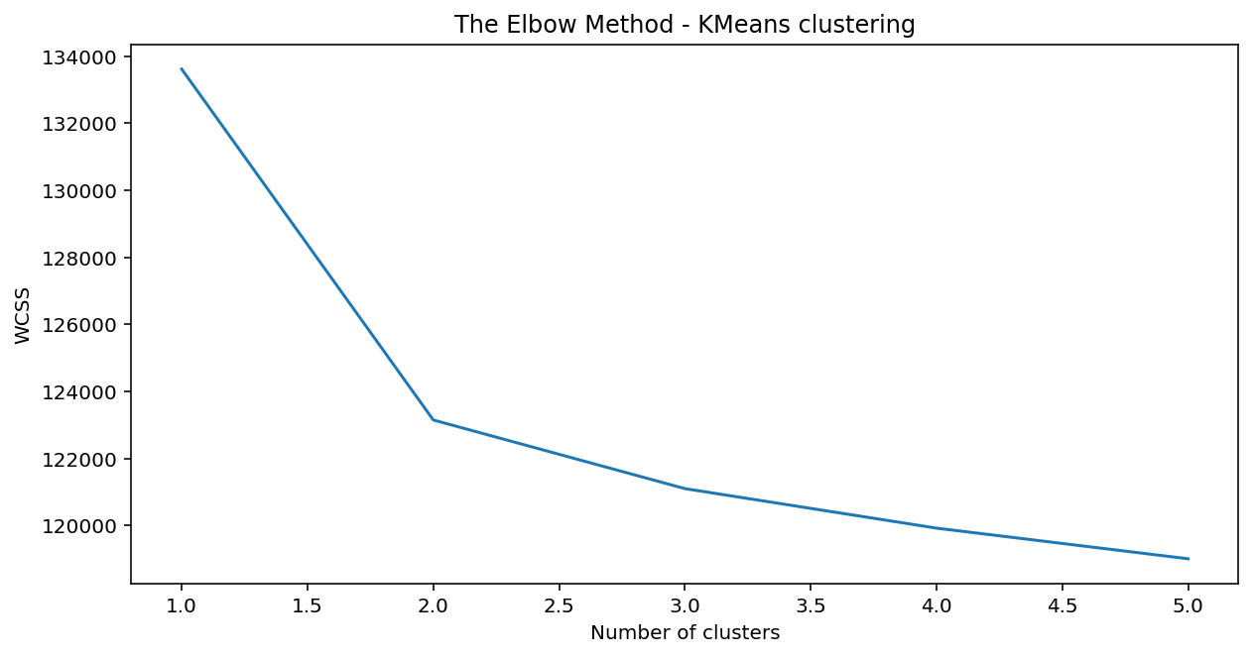
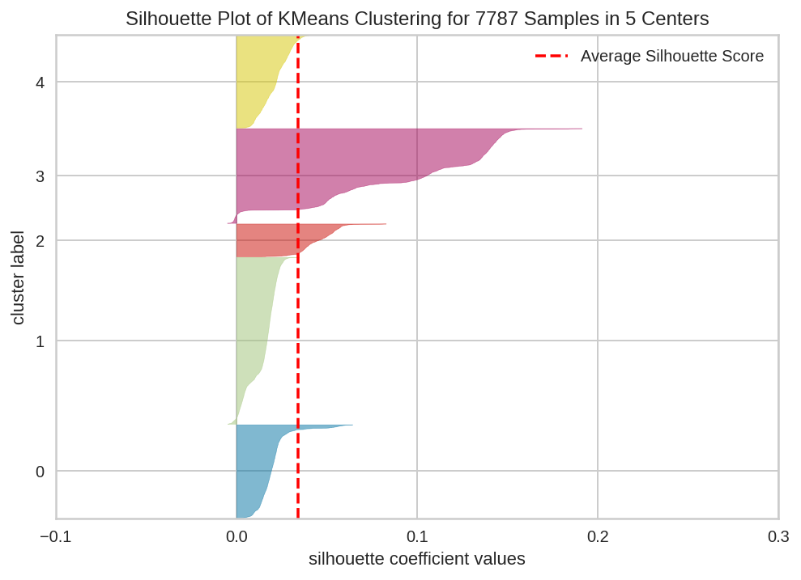
K-Means Clustering model
Observation on K-Means Clustering models :
Using Elbow method, It is found that optimum no of clusters is 3.
Using Silhouette analysis, it is found that optimum number of cluster is 3.
So using K-Means clustering model best model is
kmeans = KMeans (n_clusters=3)
Notes:
Hello

Slide 16
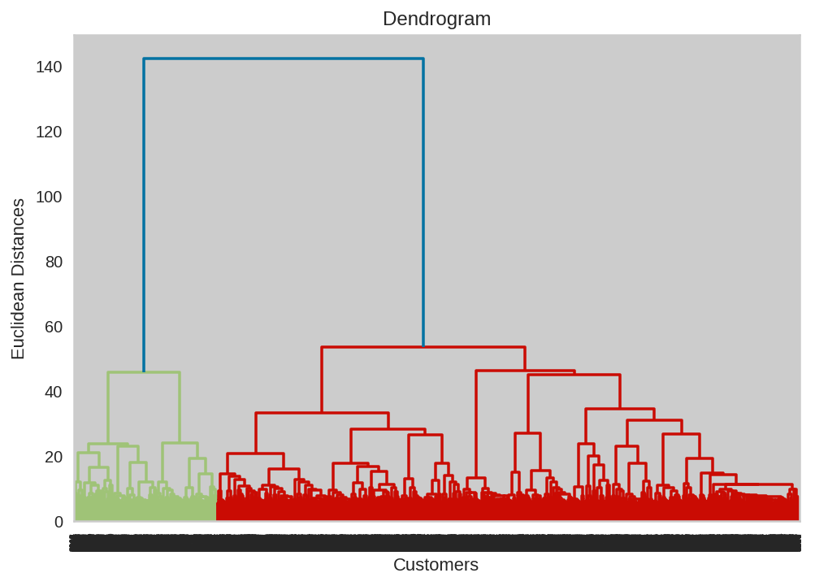
Hierarchical Clustering model
Observation on Hierarchical Clustering models :
Using Dendrogram, It is found that optimum no of clusters is 8.
The Hierarchical clustering model best model is
hc = AgglomerativeClustering(n_clusters = 8, affinity = 'euclidean', linkage = 'ward')
Notes:
Hello

Slide 17
Conclusion
It is found out that after 2017 there is decline in growth of new movie titles after 2017.
Top 5 countries with the most movies on Netflix are the USA,India,UK, Canada and France.
Top 5 countries with the most TV shows are the USA, UK, Japan, South Korea and Canada.
As we performed topic modeling, LDA gives better results as data contains multiple topics. We can say that LDA with optimal number of clusters i.e. 2 is the best model.
THANK YOU
Notes:
Hello

