Slide 1
Using Matrix Exponential to Solve System of Differential Equations

Slide 2

Exponential Function
The function e^{x} is called exponential function.
It’s value can be obtained by following series.
It is a converging series.

Slide 3

Matrix Exponential: Definition
The function e^{A} where A is a square matrix is called matrix exponential function.
It’s value can be obtained by following series.
It is also a converging series.

Slide 4
Matrix Exponential: But why ?
The function e^{x} is intuitive and straightforward.
But not the matrix exponential.
What is the use of this definition ?
It helps in solving system of linear differential equations.

Slide 5
Prerequisites

Slide 6
Eigenvalue and Eigenvector
Eigenvalue and eigenvector are some of the most important properties of a matrix.
A vector x is said to be an eigenvector of matrix A, if there exists a scalar ƛ such that Ax = ƛx. ƛ is called the corresponding eigenvalue.

Slide 7


Slide 9
Eigenvalue and Eigenvector
Some properties of eigenvalues and eigenvectors.
If Ax = λx then A^{n} x = λ^{n} x i.e., the eigenvectors of the powers of the same matrix remain unchanged while the eigenvalues change in an exponential manner.
If Ax = λx then (A + cI)x = (λ + c)x

Slide 10
2. Diagonalization of a Matrix
In many practical applications of linear algebra, we want to convert a matrix into a diagonal matrix(if possible).
Because these matrices are easy to process for computers.
Example.
Power of a diagonal matrix is just power of its diagonal elements
Determinant of diagonal matrix is just product of diagonal elements

Slide 11
2. Diagonalization of a Matrix: How ?
A matrix A is diagonalizable if there exists an invertible matrix P and a diagonal matrix D such that A = PD⁻¹P.

Slide 12
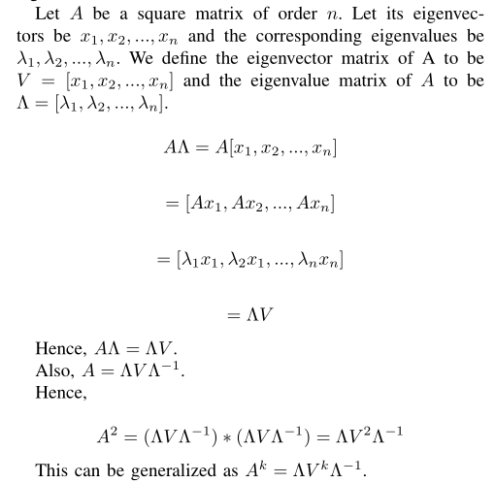

Slide 13
3. Power of a Matrix
Consider the vector u_{k + 1} which is related to matrix A by the equation,
u_{k + 1} = Au_{k}. Such equation appears frequently when solving system of linear differential equations.
Calculating u_{k} = A^{k}u₀ is straightforward but tedious as it involves calculating power of matrix.
Not practical to do this for large k.

Slide 14

3. Power of a Matrix: better approach ?
If A has n independent eigenvectors then, they form a basis.
Vector u can be written as a linear combination of those eigenvectors.

Slide 15
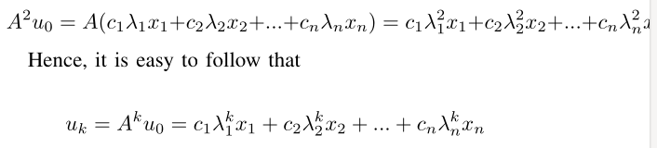
3. Power of a Matrix: better approach ?
Then Au₀ can be written as,

Slide 16
Ready for Matrix Exponential!

Slide 17
Matrix Exponential
At first glance, the matrix exponential seems a vague.
But it is accepted as a definition unlike the e^{x} series which is a theorem.
e^{at} is a solution to the differential equation y’ = ay.
We can extend this concept into a system of linear differential equations using matrix exponential.
Ex. If we have n linear differential equations of type y’ = ay where y and y’ are vectors then its solution can be given as y(t) = e^{At}y(0).

Slide 18
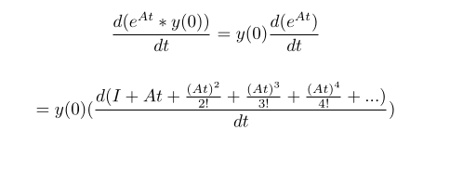
Matrix Exponential
We can verify that the given solution is correct by substituting it into original equation.

Slide 19
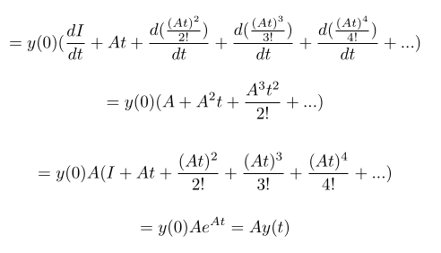
Matrix Exponential

Slide 20
Application of Matrix Exponential : Solving System of Differential Equations
See paper for solved example.

Slide 21
Application
Presented by Dablu Chauhan
Machine learning
Eigenvalue and eigenvector are probably one of the most important concepts in linear algebra.
From machine learning to quantum computing, many problems can be solved by finding the eigenvalue and eigenvectors of a matrix.
PCA is a very popular classical dimensionality reduction technique which uses this concept to compress your data by reducing its dimensionality since curse of dimensionality has been very critical issue in classical Computer Vision to deal with images and even in Machine Learning, features with high dimensionality increase model capacity which in turn requires a large amount of data to train
It is a method that uses simple matrix operations and statistics to calculate a projection of the original data into the same number or fewer dimensions.

Slide 22
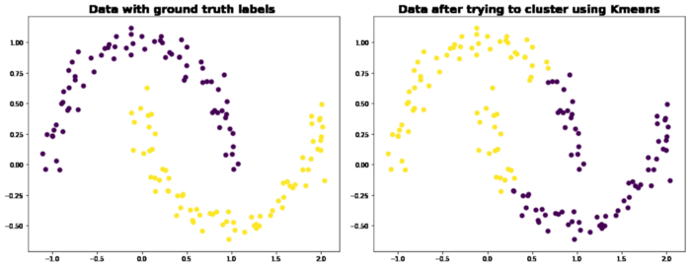
Spectral Clustering
K-Means is the most popular algorithm for clustering but it has several issues associated with it such as dependence upon cluster initialization and dimensionality of features

Slide 23
2)Vibrations
Vibrations are widely used in mechanical engineering; civil engineering, communication engineering, and automobile engineering.
The axial motion of bar, beam vibrations, buckling of a beam bar, a stereo system of car, aerodynamics, etc. The continuous cyclic motion of an equilibrium point is called vibration.
Engineers try to avoid it due to damaging effects caused by cyclic forces created by cyclic motions, unwanted sounds, and wasting of energy.
The mass-spring-damper model, one of the basic concepts of vibrations uses eigenvalues to calculate frequency and mode shape for vibrations. The natural frequency of the bridge is the eigenvalue of the smallest magnitude of a system that models the bridge.

Slide 24
3) Oil companies frequently use eigenvalue analysis to explore land for oil:
Oil, dirt, and other substances all give rise to linear systems which have different eigenvalues, so eigenvalue analysis can give a good indication of where oil reserves are located. Oil companies place probes around a site to pick up the waves that result from a huge truck used to vibrate the ground. The waves are changed as they pass through the different substances in the ground. The analysis of these waves directs the oil companies to possible drilling sites.

Slide 25
Presentation Contributors
Chandrakishor Singh: slide 1-20
Dablu Chauhan: slide 21-24
References
1. Yann Le Cun, Ido Kanter, and Sara A. Solla, “Eigenvalues of covariance matrices: Application to neural-network learning”, Phys. Rev. Lett., Vol. 66, 1991.
2. W Thomson, “Theory of vibration with applications”, Upper Saddle River, NJ: Prentice-Hall, 1998.
3. Introduction to Linear Algebra, 5th Edition - MIT Mathematics
4.https://towardsdatascience.com/the-essence-of-eigenvalues-and-eigenvectors-in-machine-learning-f28c4727f56f

