Slide 1
Operating Systems
Processes
Jagpreet Singh
Asst. Prof. IIIT Allahabad
Thanks to Prof. Torsten Hoefler (ETH Zurich)
for the original slides

Slide 2
Course Outline
02.08.: OS Introduction
09.08.: OS Structure and System calls
16.08.: Processes
23.08.: Scheduling
30.08.: Threads
06.09.: Synchronization
13.09.: Deadlocks
C1 Review Test
27.09.: Memory Management
04.10.: Demand Paging
11.10.: File System Abstractions
01.11.: File System Implementations
08.11.: Disk Management
C2 Review Test
C3 Review Test
2

Slide 3
Process concept
Q: What is the relation between a process and a program?
A process is the execution of a program with restricted rights.
Virtual machine, of sorts
On older systems:
Single dedicated processor
Single address space
System calls for OS functions
In software:
computer system = (kernel + processes)

Slide 4
Process ingredients
Virtual processor
Address space
Registers
Instruction pointer / program counter
Program text (object code)
Program data (static, heap, stack)
OS “stuff”:
Open files, sockets, CPU share,
Security rights, etc.

Slide 5











Process address space
7FFFFFFF
Stack
Stack dynamic variables,
Function parameters
Dynamic memory
allocation
BSS
Data
Text
Global, static variables
00000000
Executable program Code
a nice article using gdb to learn about process address space

Slide 6
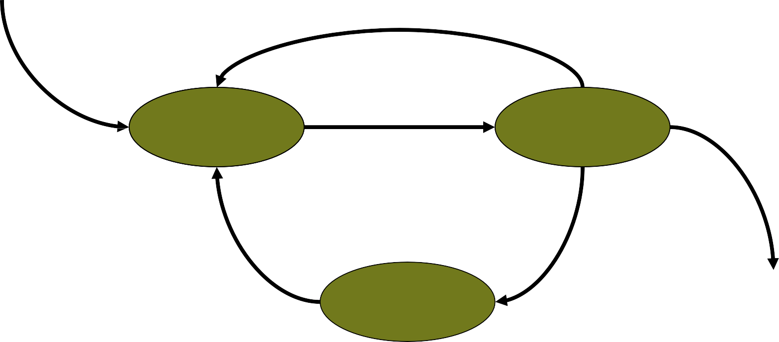





Process lifecycle
created
preemption
runnable
(ready)
running
dispatch
I/O completes
I/O operation
blocked
(waiting)
terminated

Slide 7
Multiplexing
OS time-division multiplexes processes
Or space-division on multiprocessors
Each process has a Process Control Block (PCB)
In-kernel data structure
Holds all virtual processor state
Identifier and/or name
Registers
Memory used, pointer to page table Files and sockets open, etc.

Slide 8




Process control block
(other kernel data structures)
Process address space
Stack
kernel memory
BSS
Data
Text
Process
Control
Block

Slide 9










Process switching
Process A
Kernel
Process B
[Process A executes]
Save state to PCB(A)
Time
[Kernel executes]
Restore from PCB(B)
[Process B executes]
Save state to PCB(B)
[Kernel executes]
Restore from PCB(A)
[Process A executes]

Slide 10
Process Creation

Slide 11
Process creation
Bootstrapping problem. Need:
Code to run
Memory to run it in
Basic I/O set up (so you can talk to it)
Way to refer to the process
Typically, “spawn” system call takes enough arguments to
construct, from scratch, a new process.

Slide 12







Process creation on Windows
Did it work?
BOOL CreateProcess(
in_opt inout_opt in_opt in_opt
in in
in_opt
in_opt in
out
);
LPCTSTR LPTSTR
ApplicationName, CommandLine,
What to run?
LPSECURITY_ATTRIBUTES ProcessAttributes, LPSECURITY_ATTRIBUTES ThreadAttributes,
What rights will it have?
BOOL DWORD LPVOID LPCTSTR
LPSTARTUPINFO
InheritHandles, CreationFlags, Environment, CurrentDirectory, StartupInfo,
What will it see when it starts up?
LPPROCESS_INFORMATION ProcessInformation
The result
Moral: the parameter space is large!

Slide 13
Unix fork()and exec()
Dramatically simplifies creating processes:
fork(): creates “child” copy of calling process
exec(): replaces text of calling process with a new program
There is no “CreateProcess(...)”.
Unix is entirely constructed as a family tree of such processes.

Slide 14
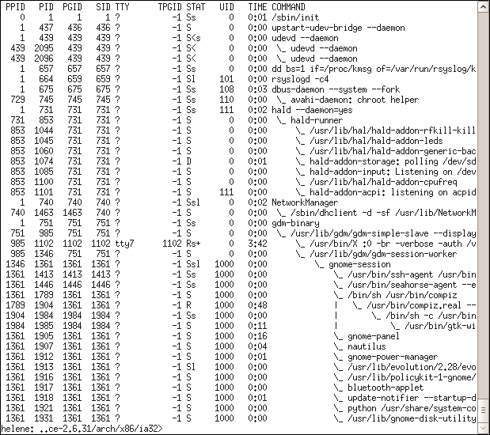



Unix as a process tree
Exercise: work out how to do this on your favorite Unix or Linux machine…

Slide 15






Fork in action
pid_t p = fork();
if ( p < 0 ) {
// Error… exit(-1);
} else if ( p == 0 ) {
// We’re in the child
execlp(“/bin/ls”, “ls”, NULL);
} else {
// We’re a parent.
// p is the pid of the child wait(NULL);
exit(0);
}
Return code from fork() tells you
whether you’re in the parent or child (cf. setjmp())
Child process can’t actually be cleaned up until parent “waits” for it.

Slide 16



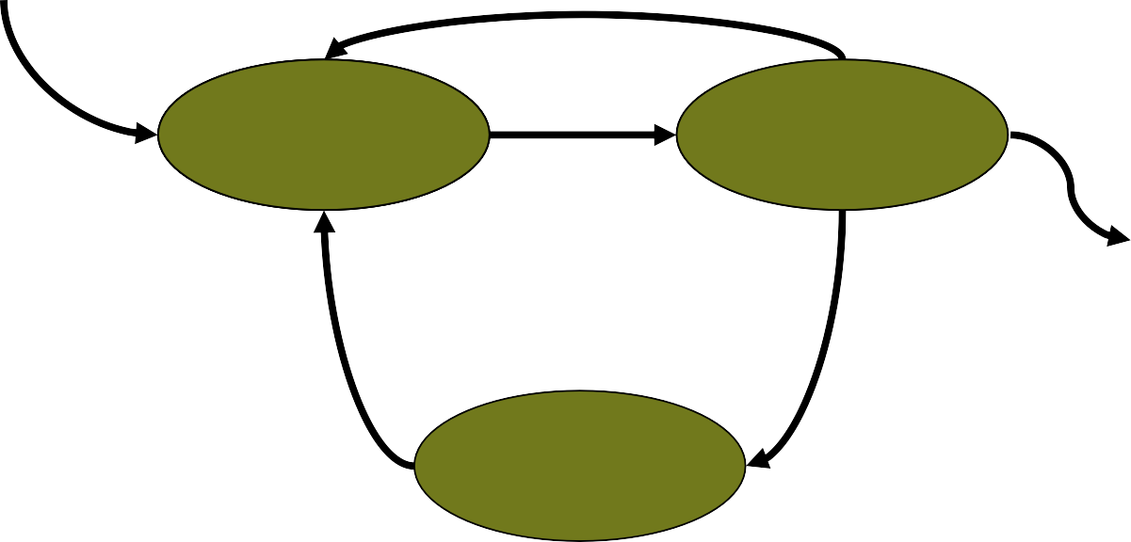

Process state diagram for Unix
preemption
forked
It really is called a Zombie
runnable
(ready)
running
dispatch
“undead”
I/O completes
I/O operation
blocked (waiting)
parent
calls wait()
dead (and gone)

Slide 17
Kernel Threads

Slide 18
How do threads fit in?
It depends…
Types of threads:
Kernel threads
One-to-one user-space threads
Many-to-one
Many-to-many
Do NOT confuse this with hardware threads/SMT/Hyperthreading
In these, the CPU offers more physical resources for threads!

Slide 19
Kernel threads
Kernels can (and some do) implement threads
Multiple execution contexts inside the kernel
Much as in a JVM
Says nothing about user space
Context switch still required to/from user process
First, how many stacks are there in the kernel?

Slide 20






Process switching
[Process A executes]
Save state to PCB(A)
Time
What’s happening here?
A thread?
[Kernel executes]
Restore from PCB(B)
[Process B executes]
Save state to PCB(B)
[Kernel executes]
Restore from PCB(A)
[Process A executes]

Slide 21
Kernel architecture
Basic Question: How many kernel stacks?
Unix 6th edition has a kernel stack per process
Arguably complicates design
Q. On which stack does the thread scheduler run?
A. On the first thread (#1)
⇒ Every context switch is actually two!
Linux et al. replicate this, and try to optimize it.
Others (e.g., Barrelfish) have only one kernel stack per CPU
Kernel must be purely event driven: no long-running kernel tasks
More efficient, less code, harder to program (some say).

Slide 22























Process switching revisited
Process A Kernel stack A
Kernel stack B
Process B
Kernel stack 0
Save to PCB(A)
Decide to switch process
For a kernel with multiple kernel stacks
Pick process to run
Switch to Kernel stack B
With cleverness, can sometimes run scheduler on current process’ kernel stack.
Restore PCB(B)

Slide 23
System calls in more detail
We can now say in more detail what happens during a system call
Precise details are very dependent on OS and hardware
Linux has 3 different ways to do this for 32-bit x86 alone!
Linux:
Good old int 0x80 or 0x2e (software interrupt, syscall number in EAX)
Set up registers and call handler
Fast system calls (sysenter/sysexit, >Pentium II)
CPU sets up registers automatically
http://www.int80h.org/ ☺
37

Slide 24
Performing a system call
In user space:
Marshall the arguments somewhere safe
Saves registers
Loads system call number
Executes SYSCALL instruction (or SYSENTER, or INT 0x80, or..)
And?

Slide 25
System calls in the kernel
Kernel entered at fixed address
Privileged mode is set
Need to call the right function and return, so:
Save user stack pointer and return address
– In the Process Control Block
Load SP for this process’ kernel stack
Create a C stack frame on the kernel stack
Look up the syscall number in a jump table
Call the function (e.g., read(), getpid(), open(), etc.)

Slide 26
Returning in the kernel
When function returns:
Load the user space stack pointer
Adjust the return address to point to:
Return path in user space back from the call, OR Loop to retry system call if necessary
Execute “syscall return” instruction
Result is execution back in user space, on user stack
Alternatively, can do this to a different process…

Slide 27
User-space threads

Slide 28
From now on assume:
Previous example was Unix 6th Edition:
Which had no threads per se, only processes
i.e., Process ↔ Kernel stack
From now on, we’ll assume:
Multiple kernel threads per CPU
Efficient kernel context switching
How do we implement user-visible threads?

Slide 29
What are the options?
Implement threads within a process (one kernel thread)
Multiple kernel threads in a process
Some combination of the above
and other more unusual cases we won’t talk about…

Slide 30
Many-to-one threads
Early “thread libraries”
Green threads (original Java VM)
GNU Portable Threads
Standard student exercise: implement them!
Sometimes called “pure user-level threads”
aka. lightweight threads, tasks (differences in control)
No kernel support required
Also (confusingly) “Lightweight Processes”

Slide 31







Many-to-one threads
User
Kernel
CPU 0
CPU 1

Slide 32
















Address space layout for user level threads
Thread 1 stack
Stack
Thread 3 stack
Thread 2 stack
BSS
Data
Text
Just allocate on the heap
BSS
Data
Text

Slide 33
One-to-one user threads
Every user thread is/has a kernel thread.
Equivalent to:
multiple processes sharing an address space
Except that “process” now refers to a group of threads
Most modern OS threads packages:
Linux, Solaris, Windows XP, MacOSX, etc.

Slide 34
One-to-one user threads
User
Kernel
CPU 0
CPU 1

Slide 35




One-to-one user threads
Thread 1 stack
Stack
Thread 2 stack
Thread 3 stack
BSS
Data
Text
BSS
Data
Text

Slide 36
Comparison
User-level threads
Cheap to create and
destroy
Fast to context switch
Can block entire process
Not just on system calls
One-to-one threads
Memory usage (kernel
stack)
Slow to switch
Easier to schedule
Nicely handles blocking

Slide 37
Many-to-many threads
Multiplex user-level threads over several kernel-level threads
Only way to go for a multiprocessor
I.e., pretty much everything these days
Can “pin” user thread to kernel thread for performance/predictability
Thread migration costs are “interesting”…

Slide 38
Many-to-many threads
User
Kernel
CPU 0
CPU 1

Slide 39
Next week
Synchronization:
How to implement those useful primitives
Interprocess communication
How processes communicate
Scheduling:
Now we can pick a new process/thread to run, how do we decide which
one?

