Slide 1
Operating Systems
Threads
Jagpreet Singh
Asst. Prof. IIIT Allahabad

Slide 2
Course Outline
02.08.: OS Introduction
09.08.: OS Structure and System calls
16.08.: Processes
28.08.: Scheduling
04.09.: Threads
11.09.: Synchronization
C1 Review Test
25.09.: Deadlocks
__.09.: Memory Management
__.10.: Demand Paging
__.10.: File System Abstractions
__.11.: File System Implementations
__.11.: Disk Management
C2 Review Test
C3 Review Test
2

Slide 3
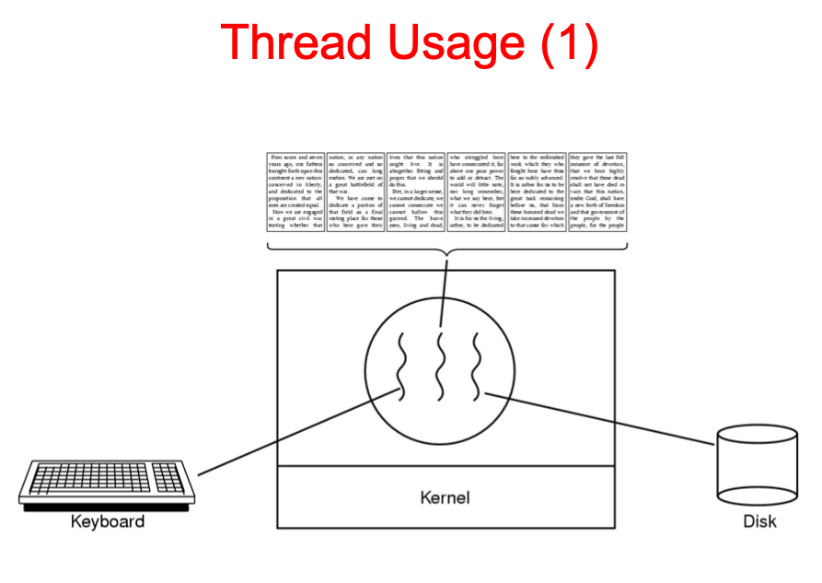

Slide 4
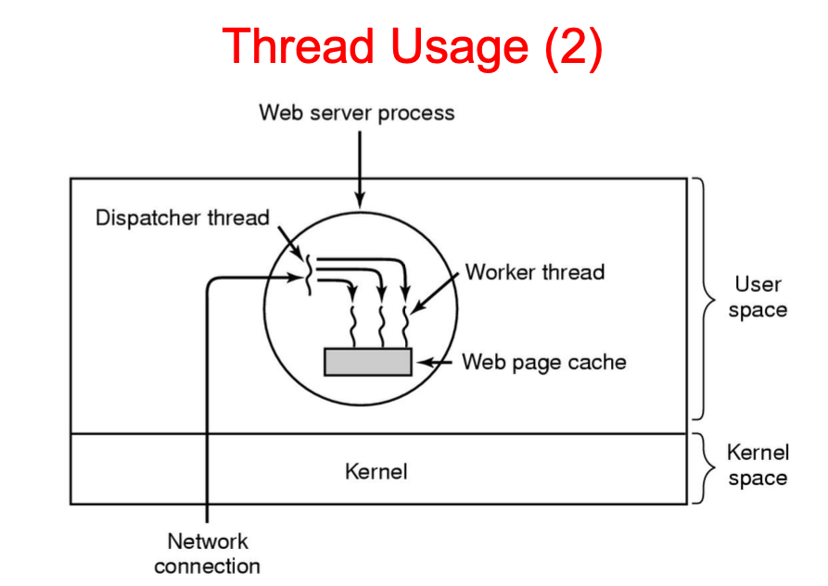

Slide 5
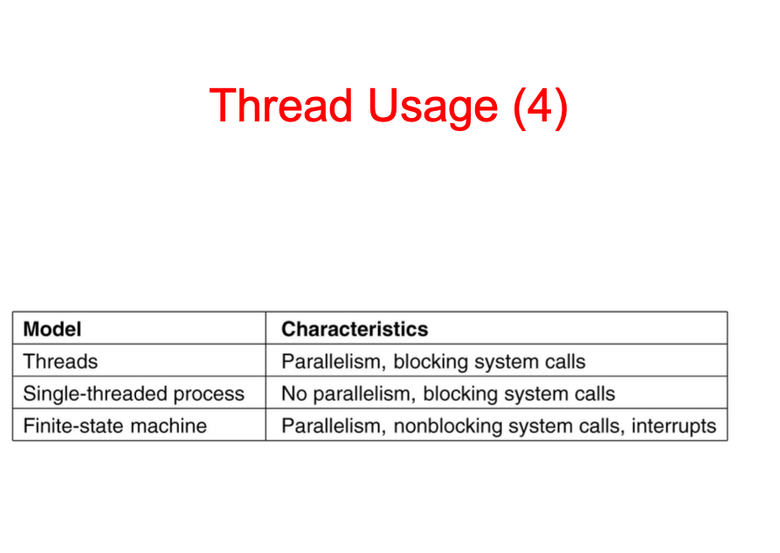

Slide 6
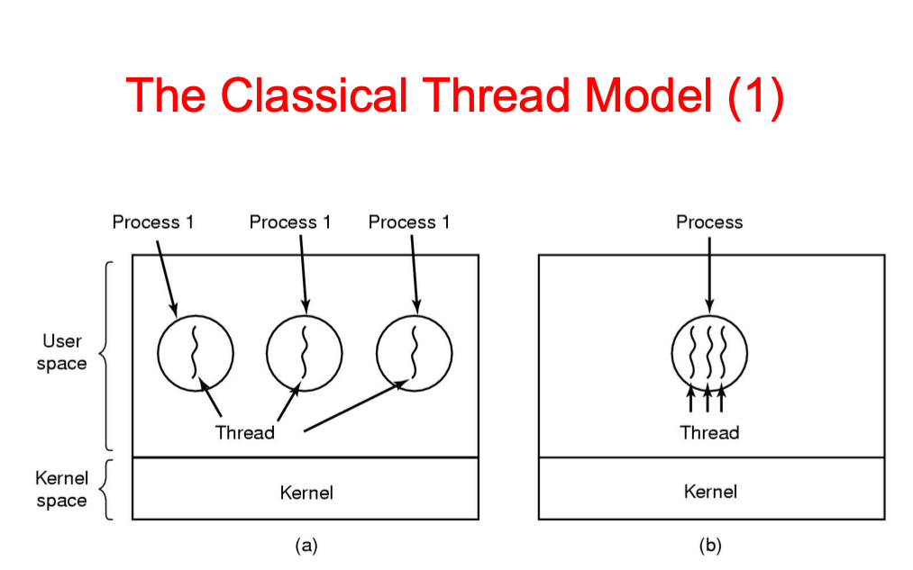

Slide 7
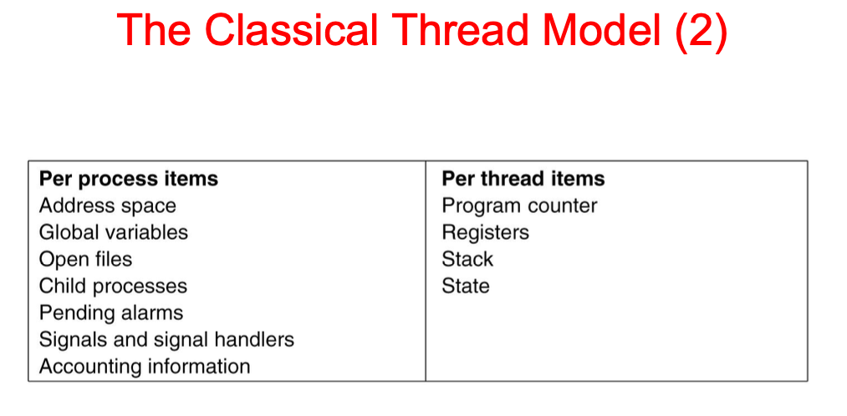

Slide 8
What are the options?
Implement threads within a process (one kernel thread)
Multiple kernel threads in a process
Some combination of the above
and other more unusual cases we won’t talk about…
8

Slide 9
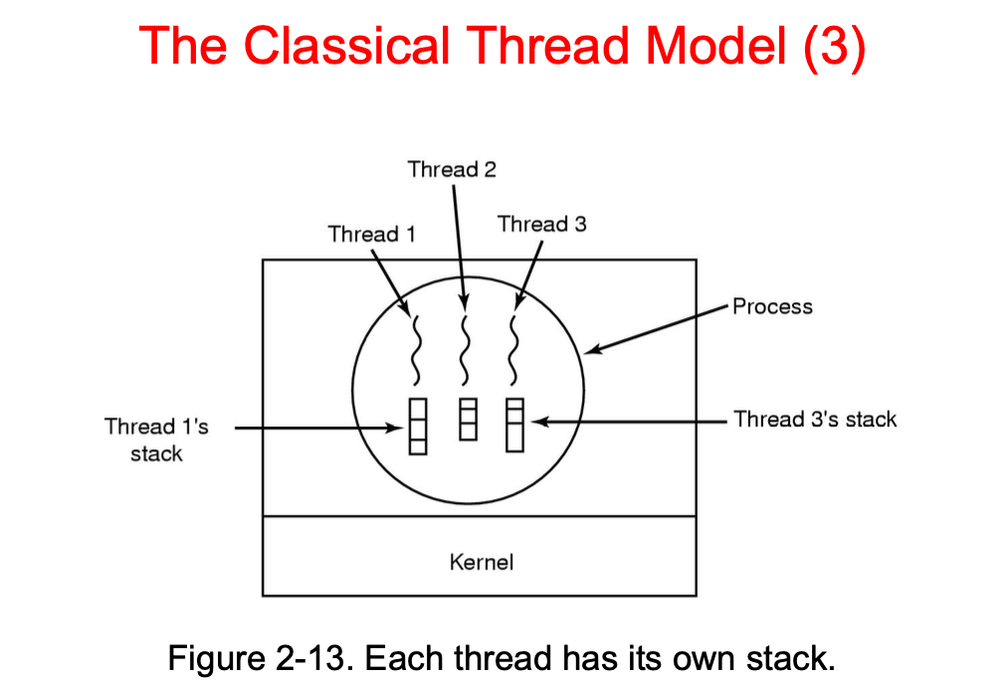

Slide 10
Many-to-one threads
Early “thread libraries”
Green threads (original Java VM)
GNU Portable Threads
Standard student exercise: implement them!
Sometimes called “pure user-level threads”
aka. lightweight threads, tasks (differences in control)
No kernel support required
Also (confusingly) “Lightweight Processes”
10

Slide 11







Many-to-one threads
User
Kernel
CPU 0
CPU 1
11

Slide 12




























Address space layout for user level threads
Thread 1 stack
Stack
Thread 3 stack
Thread 2 stack
BSS
Data
Text
Just allocate on the heap
BSS
Data
Text
12

Slide 13
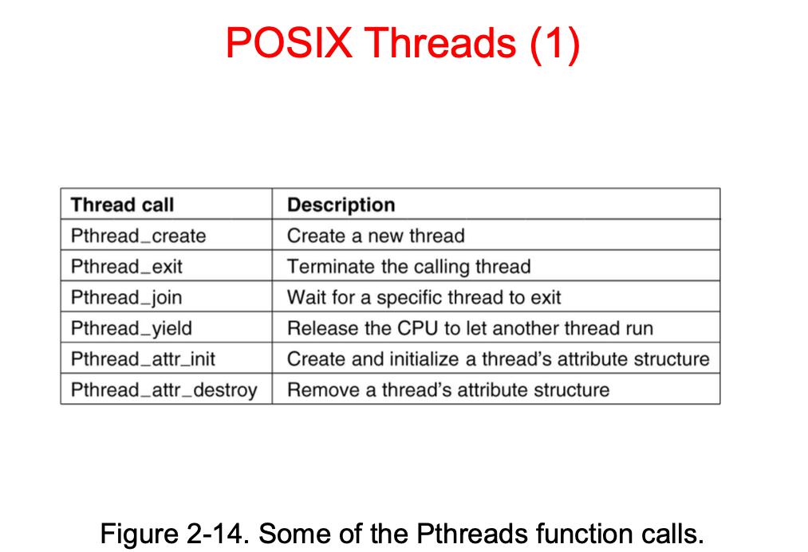

Slide 14
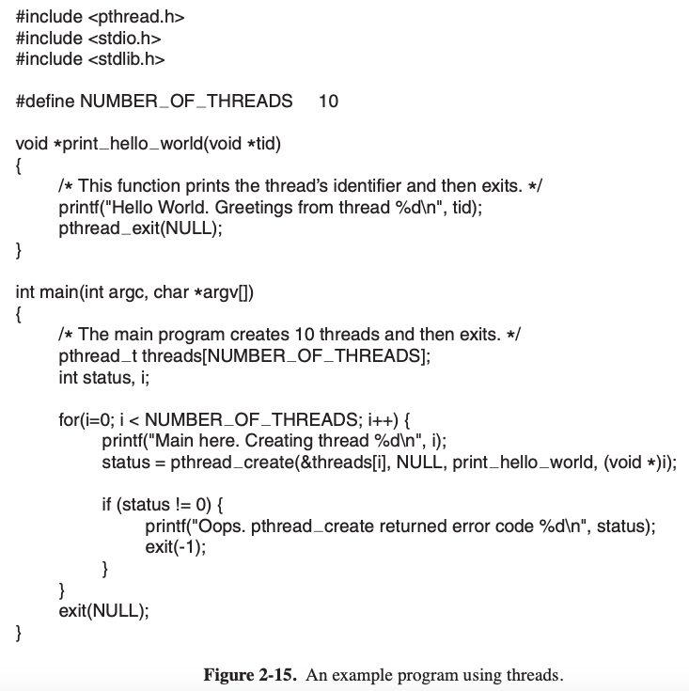

Slide 15
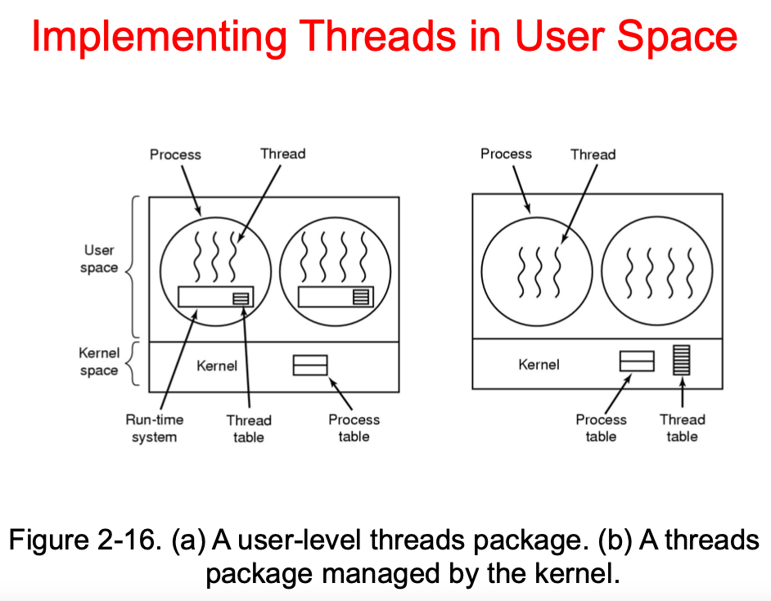

Slide 16
One-to-one user threads
Every user thread is/has a kernel thread.
Equivalent to:
multiple processes sharing an address space
Except that “process” now refers to a group of threads
Most modern OS threads packages:
Linux, Solaris, Windows XP, MacOSX, etc.
16

Slide 17
One-to-one user threads
User
Kernel
CPU 0
CPU 1
17

Slide 18




One-to-one user threads
Thread 1 stack
Stack
Thread 2 stack
Thread 3 stack
BSS
Data
Text
BSS
Data
Text
18

Slide 19
Comparison
User-level threads
Cheap to create and
destroy
Fast to context switch
Can block entire process
Not just on system calls
One-to-one threads
Memory usage (kernel
stack)
Slow to switch
Easier to schedule
Nicely handles blocking
19

Slide 20
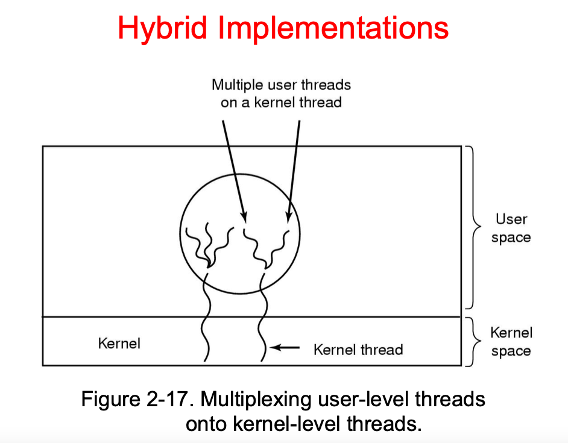

Slide 21
Many-to-many threads
Multiplex user-level threads over several kernel-level threads
Only way to go for a multiprocessor
I.e., pretty much everything these days
Can “pin” user thread to kernel thread for performance/predictability
Thread migration costs are “interesting”…
21

Slide 22
Many-to-many threads
User
Kernel
CPU 0
CPU 1
22

Slide 23
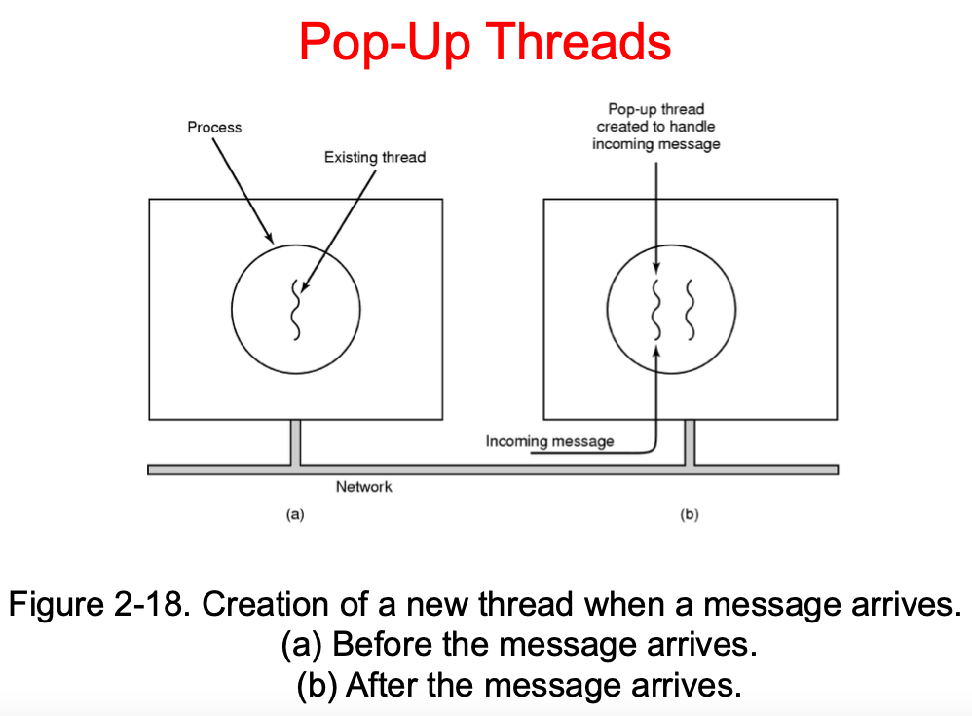

Slide 24
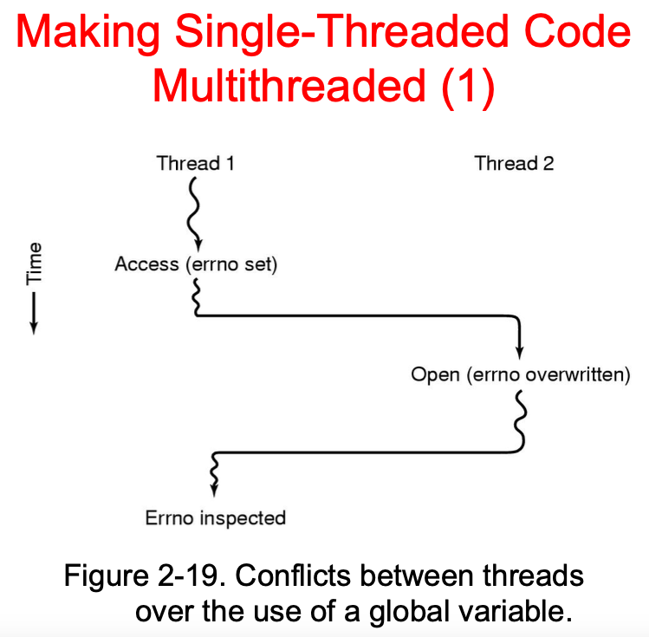

Slide 25
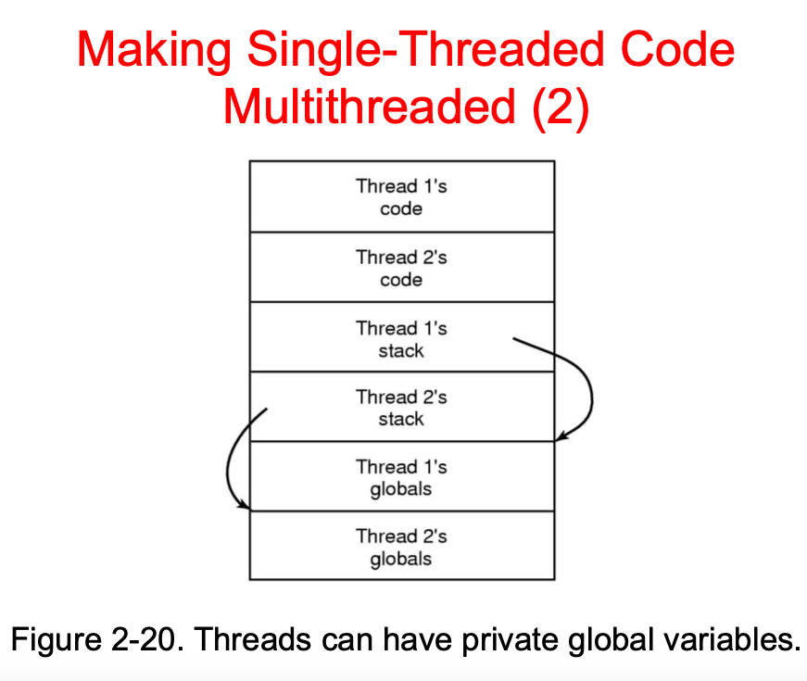

Slide 26
Next week
Synchronization:
How to implement those useful primitives
Interprocess communication
How processes communicate
26

