Slide 1
Evaluation

Slide 2
Evaluation
The major goal of IR is to search document relevant to a user query.
The evaluation of the performance of IR systems relies on the notion of relevance.
What constitute relevance ?

Slide 3
Relevance
Relevance is subjective in nature i.e. it depends upon a specific user’s judgment.
Given a query, the same document may be judged as relevant by one user and non-relevant by another user. Only the user can tell the true relevance.
however not possible to measure this “true relevance”
Most of the evaluation of IR systems so far has been done on document test collections with known relevance judgments.

Slide 4
Another issue with relevance is the degree of relevance.
Traditionally, relevance has been visualized as a binary concept i.e. a document is judged either as relevant or not relevant whereas relevance is a continuous function (a document may exactly what the user want or it may be closely related)

Slide 5
Why System Evaluation?
There are many retrieval models/ algorithms/ systems, which one is the best?
What is the best component for:
  Ranking function (dot-product, cosine, …)
  Term selection (stop word removal, stemming…)
  Term weighting (TF, TF-IDF,…)
How far down the ranked list will a user need to look to find some/all relevant documents?

Slide 6
Evaluation of IR Systems
The evaluation of IR system is the process of assessing how well a system meets the information needs of its users (Voorhees, 2001).
Criteria's for evaluation
-Coverage of the collection
-Time lag
- Presentation format
- User effort
- Precision
- Recall

Slide 7
Of these criteria, recall and precision have most frequently been applied in measuring information retrieval.
Both these criteria are related with the effectiveness aspect of IR system i.e. its ability to retrieve relevant documents in response to user query.

Slide 8
Effectiveness is purely a measure of the ability of the system to satisfy user in terms of the relevance of documents retrieved
Aspects of effectiveness include:
- whether the documents being returned are relevant to the user
-whether they are presented in the order of relevance
- whether a significant number of relevant documents in the collection are being returned to the user etc

Slide 9
Evaluation of IR Systems
The IR evaluation models can be broadly classified as system driven model and user-centered model.
System driven model focus on measuring how well the system can rank documents
user–centered evaluation model attempt to measure the user’s satisfaction with the system.
Notes:
the time that elapses between submission of the query and getting back the response
: the effort made by the user in obtaining answers to her queries
: the proportion of retrieved documents which are relevant
: the proportion of relevant documents that are retrieved.

Slide 10
Effectiveness measures
The most commonly used measures of effectiveness are precision and recall. These measures are based on relevance judgments.

Slide 11
Evaluation of IR Systems
Traditional goal of IR is to retrieve all and only the relevant documents in response to a query
All is measured by recall: the proportion of relevant documents in the collection which are retrieved i.e. P(retrieved|relevant)
Only is measured by precision: the proportion of retrieved documents which are relevant
Notes:
Both these criteria are related with the effectiveness aspect of IR system i.e. its ability to retrieve relevant documents in response to user query.

Slide 12
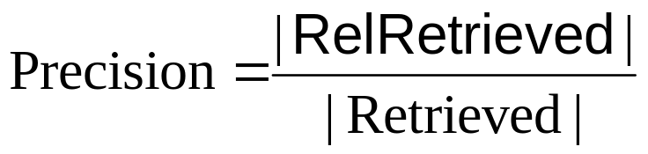

Precision vs. Recall
All docs
Retrieved
RelRetrieved
Relevant

Slide 13
These definitions of precision and recall are based on binary relevance judgment, which means that every retrievable item is recognizably “relevant”, or recognizably “not relevant”.
Hence, for every search result all retrievable documents will be either
(i) relevant or non-relevant and
(ii) retrieved or not retrieved.

Slide 14
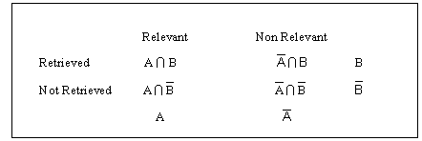
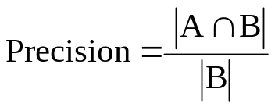
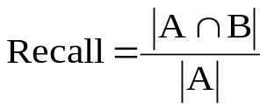
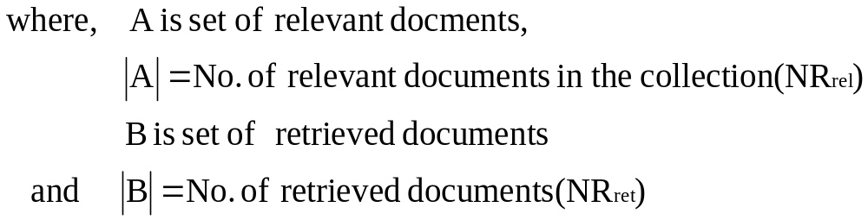

Slide 15
Trade-off between Recall and Precision
Returns relevant documents but
misses many useful ones too
The ideal
1
Precision
0
1
Recall
Returns most relevant
documents but includes
lots of junk
Notes:
There exists a trade-off between precision and recall, even though a high value of both at the same time is desirable. The trade-off is shown in figure 8.14. Precision is high at low recall values. As recall increases precision degrades. The ideal case of perfect retrieval requires all relevant documents be retrieved before the first non-relevant document is retrieved. This is shown in figure by the line parallel to x-axis having a precision of 1.0 at all recall point. Recall is an additive process. Once highest recall (1.0) is achieved, it remains 1.0 for any subsequent document retrieved. We can always achieve 100% recall by retrieving all documents in the collection, but this defeats the mere intent of an information retrieval system.

Slide 16
Test collection approach
The total number of relevant documents in a collection must be known in order for recall to be calculated.
To provide a framework of evaluation of IR systems, a number of test collections have been developed (Cranfield, TREC etc.).
These document collections are accompanied by a set of queries and relevance judgments.
Notes:
relevant documents in a collection must be known in order for recall to be calculated. The amount of effort and time required on behalf of user makes this almost impossible in most of the actual operating environment.
These test collections made it possible for IR researchers efficiently evaluate their experimental approaches, and to compare the effectiveness of their system with that of others.

Slide 17
IR test collections
Collection Number of documents Number of queries
Cranfield 1400 225
CACM 3204 64
CISI 1460 112
LISA 6004 35
TIME 423 83
ADI 82 35
MEDLINE 1033 30
TREC-1 742,611 100
___________________________________________________________

Slide 18
Fixed Recall Levels
One way to evaluate is to look at average precision at fixed recall levels
  Provides the information needed for precision/recall graphs
Notes:
In order to evaluate the performance of IR system recall and precision are almost always used together. One measure is to calculate precision at a particular cutoff. Typical cutoffs are 5 documents, 10 documents, 15 documents etc.

Slide 19
Document Cutoff Levels
Another way to evaluate:
  Fix the number of documents retrieved at several levels:
    top 5
    top 10
    top 20
    top 50
    top 100
  Measure precision at each of these levels
  Take (weighted) average over results
focuses on how well the system ranks the first k documents.

Slide 20
Computing Recall/Precision Points
For a given query, produce the ranked list of retrievals.
Mark each document in the ranked list that is relevant according to the gold standard.
Compute a recall/precision pair for each position in the ranked list that contains a relevant document.

Slide 21
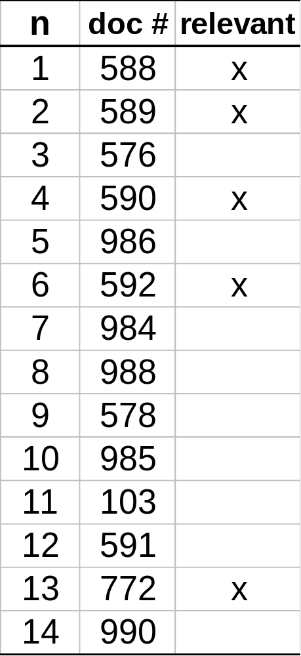
Computing Recall/Precision Points: An Example
Let total # of relevant docs = 6
Check each new recall point:
R=1/6=0.167; P=1/1=1
R=2/6=0.333; P=2/2=1
R=3/6=0.5; P=3/4=0.75
R=4/6=0.667; P=4/6=0.667
Missing one
relevant document.
Never reach
100% recall
R=5/6=0.833; p=5/13=0.38

Slide 22
Interpolating a Recall/Precision Curve
Interpolate a precision value for each standard recall level:
  r_{j} ∈{0.0, 0.1, 0.2, 0.3, 0.4, 0.5, 0.6, 0.7, 0.8, 0.9, 1.0}
  r₀ = 0.0, r₁ = 0.1, …, r₁₀=1.0
The interpolated precision at the j-th standard recall level is the maximum known precision at any recall level greater than or equal to j-th level.

Slide 23
Example: Interpolated Precision
Precision at observed recall points:
Recall Precision
0.25 1.0
0.4 0.67
0.55 0.8
0.8 0.6
1.0 0.5
The interpolated precision :
0.0 1.0
0.1 1.0
0.2 1.0
0.3 0.8
0.4 0.8
0.5 0.8
0.6 0.6
0.7 0.6
0.8 0.6
0.9 0.5
1.0 0.5
Interpolated average precision = 0.745

Slide 24
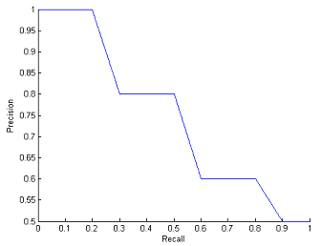
Recall-Precision graph

Slide 25
Average Recall/Precision Curve
Compute average precision at each standard recall level across all queries.
Plot average precision/recall curves to evaluate overall system performance on a document/query corpus.

Slide 26
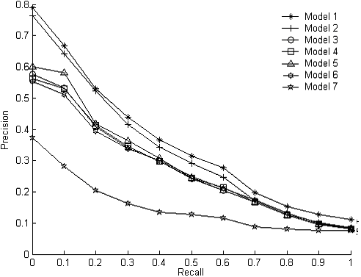
Average Recall/Precision Curve
Model
1. doc = “atn”, query = “ntc”
2. doc = “atn”, query = “atc”
3. doc = “atc”, query = “atc”
4. doc = “atc”, query = “ntc”
5. doc = “ntc”, query = “ntc”
6. doc = “ltc”, query = “ltc”
7. doc = “nnn”, query= “nnn”

Slide 27
1.000000 1.000000 1.000000 0.250000 0.250000 0.150000 0.150000 0.060606 0.016611 0.016611 0.016611
1.000000 1.000000 0.333333 0.333333 0.022727 0.022727 0.030075 0.026042 0.026042 0.026042 0.026042
1.000000 0.068966 0.081081 0.031250 0.024155 0.020115 0.022663 0.023377 0.021692 0.010138 0.010138
0.111111 0.111111 0.166667 0.085714 0.078431 0.078431 0.087719 0.086957 0.063636 0.034335 0.034335
1.000000 1.000000 1.000000 1.000000 0.200000 0.200000 0.200000 0.029703 0.029703 0.029703 0.029703
1.000000 1.000000 0.636364 0.142857 0.142857 0.135922 0.100000 0.055866 0.024974 0.014123 0.014123

Slide 28
Problems with Precision/Recall
Can’t know true recall value
  except in small collections
Precision/Recall are related
  A combined measure sometimes more appropriate
Assumes batch mode
  Interactive IR is important and has different criteria for successful searches
Assumes a strict rank ordering matters.

Slide 29
Other measures: R-Precision
R-Precision is the precision after R documents have been retrieved, where R is the number of relevant documents for a topic.
  It de-emphasizes exact ranking of the retrieved relevant documents.
  The average is simply the mean R-Precision for individual topics in the run.

Slide 30
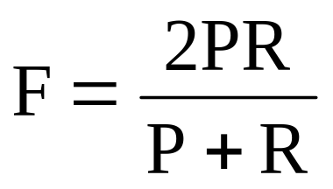
Other measures: F-measure
F-measure takes into account both precision and recall. It is defined as harmonic mean of recall and precision.
Compared to arithmetic mean both need to be high for harmonic mean to be high.
Notes:
Jane Reid, “A Task-Oriented Non-Interactive Evaluation Methodology for Information Retrieval Systems”, Information Retrieval, 2, 115–129, 2000

Slide 31
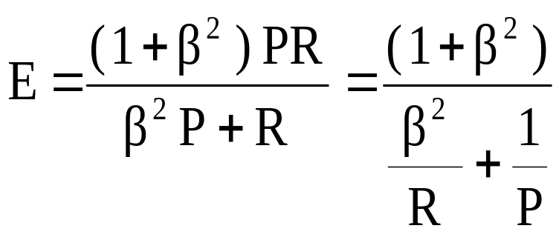
E-measure
E-measure is a variant of F-measure that allows weighting emphasis on precision over recall. It is defined as:
Value of β controls the trade-off between precision and recall.
Setting β to 1, gives equal weight to precision and recall (E = F)
β>1 weight precision more whereas β<1 gives more weight to recall.

Slide 32
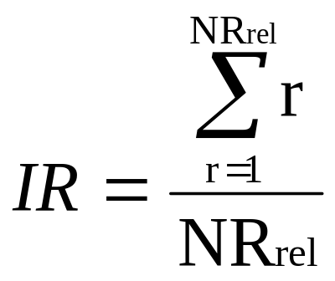
Normalized recall
Normalized recall measures how close is the set of the retrieved document to an ideal retrieval in which the most relevant NR_{rel} documents appear in first NR_{rel} positions.
If relevant documents are ranked 1,2,3, … then Ideal rank (IR) is given by

Slide 33
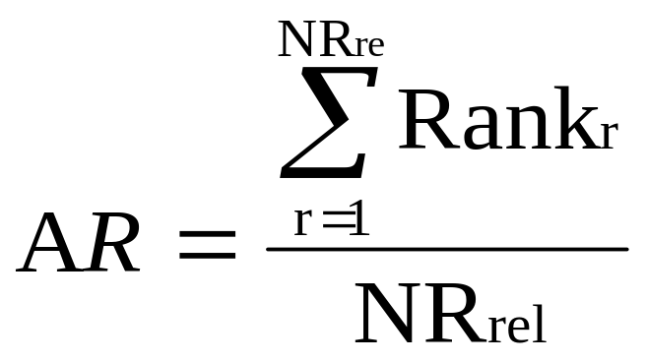
Let the average rank (AR) over the set of relevant documents retrieved by the system be:
Rank_{r} represents the rank of the r^{th} relevant document

Slide 34
The difference between AR and IR, given by AR-IR, represents a measure of the effectiveness of the system.
This difference ranges from 0 (for the perfect retrieval ) to (N-NR_{rel}) for worst case retrieval

Slide 35
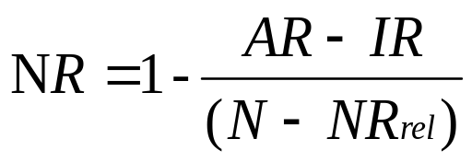
The expression AR-IR can be normalized by dividing it by (N-NR_{rel}) and then by subtracting the result from 1, we get the normalized recall (NR) given by:
This measure ranges from 1 for the best case to 0 for the worst case.

Slide 36
Evaluation Problems
Realistic IR is interactive; traditional IR methods and measures are based on non-interactive situations
Evaluating interactive IR requires human subjects (no gold standard or benchmarks)
[Ref.: See Borlund, 2000 & 2003; Borlund & Ingwersen, 1997 for IIR evaluation]

