Slide 1
XML Indexing and Search

Slide 2
Native XML Database
Uses XML document as logical unit
Should support
  Elements
  Attributes
Contrast with
  DB modified for XML
  Generic IR system modified for XML

Slide 3
Semi structured Retrieval
XML documents are semi structured.
Can be viewed as an ordered, labeled tree:
leaf nodes containing text
internal nodes define the roles of the leaf nodes in the document.
the labeled internal nodes encode either the structure of the document (title, act, and scene) or metadata functions (author).

Slide 4
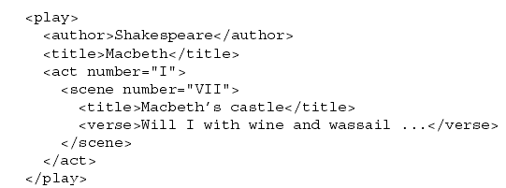

Slide 5
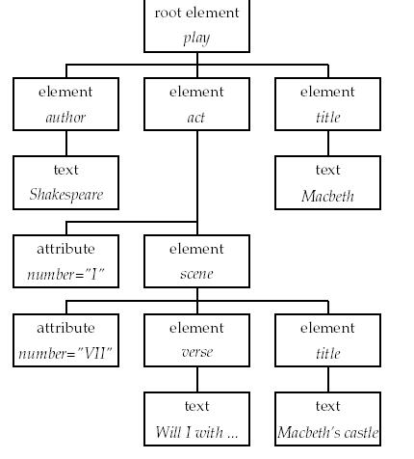

Slide 6
The nodes of the tree are XML elements and are written with an opening and closing tag.
An element can have one or more XML attributes.
XML documents are processed and accessed through XML Document Object Model or DOM.
DOM represents elements, attributes and text within elements as nodes in a tree.

Slide 7
XPath is the standard for paths in XML (referred as Context)
Ex:
act/scene -selects all scene elements whose parent is an act element.
play//scene selects all scene elements occurring in a play element.
/play/title
/play//title
/scene/title selects no elements.

Slide 8
XML Indexing and Search
Most native XML databases have taken a DB approach
  Exact match
  Evaluate path expressions
  No IR type relevance ranking
Only a few that focus on relevance ranking

Slide 9
Data vs. Text-centric XML
Data-centric XML: used for messaging between enterprise applications
  Mainly a recasting of relational data
Content-centric XML: used for annotating content
  Rich in text
  Demands good integration of text retrieval functionality
  E.g., find me the ISBN #s of Books with at least three Chapters discussing cocoa production, ranked by Price

Slide 10
IR XML Challenge 1: Term Statistics
There is no document unit in XML
How do we compute tf and idf?
Global tf/idf over all text context is useless
Indexing granularity

Slide 11
IR XML Challenge 2: Fragments
IR systems don’t store content (only index)
Need to go to document for retrieving/displaying fragment
  E.g., give me the Abstracts of Papers on existentialism
  Where do you retrieve the Abstract from?
Easier in DB framework

Slide 12
IR XML Challenges 3: Schemas
Ideally:
  There is one schema
  User understands schema
In practice: rare
  Many schemas
  Schemas not known in advance
  Schemas change
  Users don’t understand schemas
Need to identify similar elements in different schemas
  Example: employee

Slide 13
IR XML Challenges 4: UI
Help user find relevant nodes in schema
  Author, editor, contributor, “from:”/sender
What is the query language you expose to the user?
  Specific XML query language? No.
  Forms? Parametric search?
  A textbox?
In general: design layer between XML and user

Slide 14
IR XML Challenges 5: using a DB
Why you don’t want to use a DB
  Spelling correction
  Mid-word wildcards
  Contains vs “is about”
  DB has no notion of ordering
  Relevance ranking

Slide 15
XIRQL

Slide 16
XIRQL
University of Dortmund
  Goal: open source XML search engine
Motivation
  “Returnable” fragments are special
    E.g., don’t return a <bold> some text </bold> fragment
  Structured Document Retrieval Principle
  Empower users who don’t know the schema
    Enable search for any person no matter how schema encodes the data
    Don’t worry about attribute/element

Slide 17
Atomic Units
Specified in schema
Only atomic units can be returned as result of search (unless unit specified)
Tf.idf weighting is applied to atomic units

Slide 18
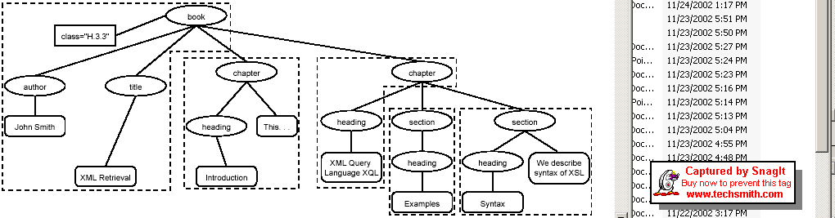
XIRQL Indexing

Slide 19
Structured Document Retrieval Principle
A system should always retrieve the most specific part of a document answering a query.
Example query: xql
Document:
  <chapter> 0.3 XQL
  <section> 0.5 example </section>
  <section> 0.8 XQL 0.7 syntax </section>
  </chapter>
Return section, not chapter

Slide 20
motivates a retrieval strategy that returns the smallest unit that contains the information
hard to implement this principle algorithmically.

Slide 21
Text-Centric XML Retrieval

Slide 22
Text-centric XML retrieval
Documents marked up as XML
  E.g., assembly manuals, journal issues …
Queries are user information needs
  E.g., give me the Section (element) of the document that tells me how to change a brake light
Different from well-structured XML queries where you tightly specify what you’re looking for.

Slide 23
Vector spaces and XML
Vector spaces – tried+tested framework for keyword retrieval
  Other “bag of words” applications in text: classification, clustering …
For text-centric XML retrieval, can we make use of vector space ideas?
Challenge: capture the structure of an XML document in the vector space.

Slide 24
Vector spaces and XML
For instance, distinguish between the following two cases
Book
Book
Title
Author
Title
Author
The Pearly
Gates
Microsoft
Bill Gates
Bill Wulf

Slide 25
Content-rich XML: representation
Book
Book
Title
Author
Title
Author
Microsoft
Bill
Gates
Pearly
Bill
Wulf
The
Gates
Lexicon terms.

Slide 26
Encoding the Gates differently
What are the axes of the vector space?
In text retrieval, there would be a single axis for Gates
Here we must separate out the two occurrences, under Author and Title
Thus, axes must represent not only terms, but something about their position in an XML tree

Slide 27
Queries
Before addressing this, let us consider the kinds of queries we want to handle
Book
Book
Title
Author
Title
Gates
Bill
Microsoft

Slide 28
Query types
The preceding examples can be viewed as sub-trees of the document
But what about?
(Gates somewhere underneath Book)
Book
Gates

Slide 29
Subtrees and structure
Consider all subtrees of the document that include at least one lexicon term:
Microsoft
Bill
Gates
Book
e.g.
Title
Author
Author
Title
Author
Microsoft
Bill
Gates
Book
Book
…
Microsoft
Bill
Gates
Title
Author
Microsoft
Bill
Gates

Slide 30
Structural terms
Call each of the resulting subtrees a structural term
Note that structural terms might occur multiple times in a document
Create one axis in the vector space for each distinct structural term
Weights based on frequencies for number of occurrences (just as we had tf)
All the usual issues with terms (stemming? Case folding?) remain

Slide 31
Example of tf weighting
Play
Play
Play
Play
Play
Act
Act
Act
Act
Act
To be or not to be
to
be
or
not
Here the structural terms containing to or be would have more weight than those that don’t

Slide 32
Down-weighting
For the doc on the left: in a structural term rooted at the node Play, shouldn’t Hamlet have a higher tf weight than Yorick?
Idea: multiply tf contribution of a term to a node k levels up by γ^{k}, for some γ < 1.
Play
Title
Act
Hamlet
Scene
Alas poor Yorick

Slide 33
Down-weighting example, γ=0.8
For the doc on the previous slide, the tf of
  Hamlet is multiplied by 0.8
  Yorick is multiplied by 0.64
in any structural term rooted at Play.

Slide 34
The number of structural terms
Can be huge!
Impractical to build a vector space index with so many dimensions

Slide 35
Structural terms: docs+queries
The notion of structural terms is independent of any schema/DTD for the XML documents
Well-suited to a heterogeneous collection of XML documents
Each document becomes a vector in the space of structural terms
A query tree can likewise be factored into structural terms
  And represented as a vector
  Allows weighting portions of the query

Slide 36
Example query
0.6
0.4
Book
Title
Author
0.6
0.4
Title
Author
Gates
Bill
Book
Book
Gates
Bill
0.6
0.4
Title
Author
…
Gates
Bill

Slide 37
Weight propagation
The assignment of the weights 0.6 and 0.4 in the previous example to subtrees was simplistic
  Can be more sophisticated
  Think of it as generated by an application, not necessarily an end-user
Queries, documents become normalized vectors
Retrieval score computation “just” a matter of cosine similarity computation

Slide 38
Restrict structural terms?
Depending on the application, we may restrict the structural terms
E.g., may never want to return a Title node, only Book or Play nodes
So don’t enumerate/index/retrieve/score structural terms rooted at some nodes

Slide 39
The catch remains
This is all very promising, but …
How big is this vector space?
Can be exponentially large in the size of the document
Cannot hope to build such an index
And in any case, still fails to answer queries like
Book
(somewhere underneath)
Gates

Slide 40
Two solutions
Query-time materialization of axes
Restrict the kinds of subtrees to a manageable set

Slide 41
Query-time materialization
Instead of enumerating all structural terms of all docs (and the query), enumerate only for the query
  The latter is hopefully a small set
Now, we’re reduced to checking which structural term(s) from the query match a subtree of any document
This is tree pattern matching: given a text tree and a pattern tree, find matches
  Except we have many text trees
  Our trees are labeled and weighted

Slide 42

Example
Here we seek a doc with Hamlet in the title
On finding the match we compute the cosine similarity score
After all matches are found, rank by sorting
Text =
Play
Title
Act
Scene
Hamlet
Alas poor Yorick
Query =
Title
Hamlet

Slide 43
(Still infeasible)
A doc with Yorick somewhere in it:
Query =
Will get to it …
Title
Yorick

Slide 44
Restricting the subtrees
Enumerating all structural terms (subtrees) is prohibitive, for indexing
  Most subtrees may never be used in processing any query
Can we get away with indexing a restricted class of subtrees
  Ideally – focus on subtrees likely to arise in queries

Slide 45
JuruXML (IBM Haifa)
Only paths including a lexicon term
In this example there are only 14 (why?) such paths
Thus we have 14 structural terms in the index
Play
Title
Act
Hamlet
Scene
To be or not to be

Slide 46
Variations
Book
Could have used other subtrees – e.g., all subtrees with two siblings under a node
Which subtrees get used: depends on the likely queries in the application
Could be specified at index time – area with little research so far
Title
Author
Microsoft
Bill
Gates
2 terms
Book
Title
Author
Microsoft
Bill
Gates

Slide 47
Descendants
Return to the descendant examples:
Book
Book
vs.
Author
Author
Bill
Gates
FirstName
LastName
Bill
Gates
No known DTD.
Query seeks Gates under Author.

Slide 48
Handling descendants in the vector space
Devise a match function that yields a score in [0,1] between structural terms
E.g., when the structural terms are paths, measure overlap
The greater the overlap, the higher the match score
  Can adjust match for where the overlap occurs
Book
Book
Book
Author
vs.
Author
in
LastName
Bill
Bill
Bill

Slide 49
How do we use this in retrieval?
First enumerate structural terms in the query
Measure each for match against the dictionary of structural terms
  Just like a postings lookup, except not Boolean (does the term exist)
  Instead, produce a score that says “80% close to this structural term”, etc.
Then, retrieve docs with that structural term, compute cosine similarities, etc.

Slide 50
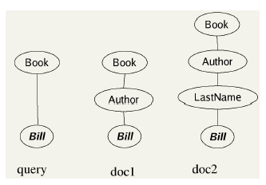

Figure cr(q, d1) = 3/4 = 0.75 and cr(q, d2) = 3/5 = 0.6.

Slide 51

context resemblance similarity
V is the vocabulary of (non-structural) terms;
C is the set of all contexts (paths) occurring in the collection and the queries; and weight(d, t, ck) is the weight of term t in context ck in document d.

Slide 52
Example of a retrieval step
Query ST
Index
ST1
Doc1 (0.7)
Doc4 (0.3)
Doc9 (0.2)
Match
=0.6
ST5
Doc3 (1.0)
Doc6 (0.8)
Doc9 (0.6)
ST = Structural Term
Now rank the Doc’s by cosine similarity;
e.g., Doc9 scores 0.578.

Slide 53
ST in the query occurs as ST1 in the index and has a match coefficient of 0.6 with a second term ST5 in the index.
highest ranking document is Doc9 with a similarity of 1.0× 0.2+0.6×0.6 = 0.56.
Query weights are assumed to be 1.0.

Slide 54
Indexing and search in JuruXML.
Indexing
For each indexing unit i:
Compute structural terms for i
Construct index
Search
Compute structural terms for query
For each structural term t:
Find matching structural terms in dictionary
For each matching structural term t′:
Compute matching weight cr(t, t′)
Search inverted index with computed terms and weights
Return ranked list

Slide 55
Closing technicalities
But what exactly is a Doc?
In a sense, an entire corpus can be viewed as an XML document
Corpus
Doc1
Doc2
Doc3
Doc4

Slide 56
What are the Doc’s in the index?
Anything we are prepared to return as an answer
Could be nodes, some of their children …

Slide 57
What are queries we can’t handle using vector spaces?
Find figures that describe the Corba architecture and the paragraphs that refer to those figures
  Requires JOIN between 2 tables
Retrieve the titles of articles published in the Special Feature section of the journal IEEE Micro
  Depends on order of sibling nodes.

Slide 58
Can we do IDF?
Yes, but doesn’t make sense to do it corpus-wide
Can do it, for instance, within all text under a certain element name say Chapter
Yields a tf-idf weight for each lexicon term under an element
Issues: how do we propagate contributions to higher level nodes.

Slide 59
Example
Say Gates has high IDF under the Author element
How should it be tf-idf weighted for the Book element?
Should we use the idf for Gates in Author or that in Book?
Book
Author
Bill
Gates

Slide 60
INEX: a benchmark for text-centric XML retrieval

Slide 61
INEX(INitiative for the Evaluation of XML retrieval)
Benchmark for the evaluation of XML retrieval
  Analog of TREC (recall CS276A)
Consists of:
  Set of XML documents
  Collection of retrieval tasks

Slide 62
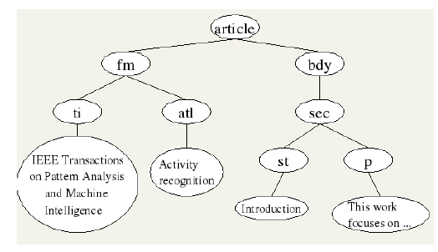
Schema of INEX Document
Fm – front matter, ti – title, atl- article title,

Slide 63
There are two types of queries, called topics, in INEX:
content-only or CO topics and
content-and-structure or CAS topics.

Slide 64
Content only queries
Standard IR queries but we retrieve document component
Content and Structure (CAS) Queries
Put on constraints on which type of components are retrieved
e.g. “sections of an article in … about ….”

Slide 65
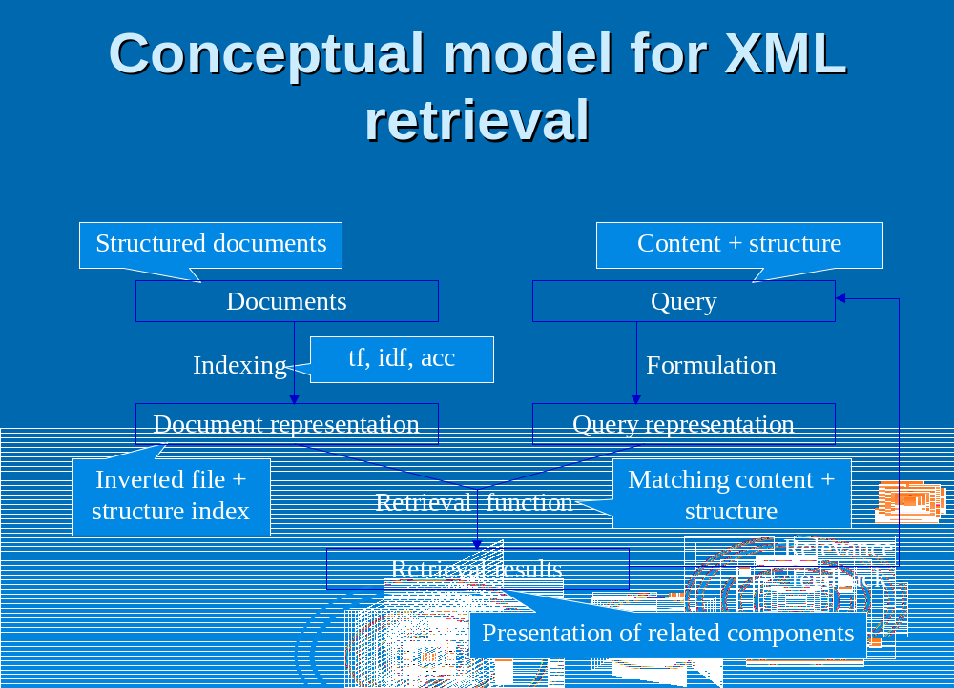

Slide 66
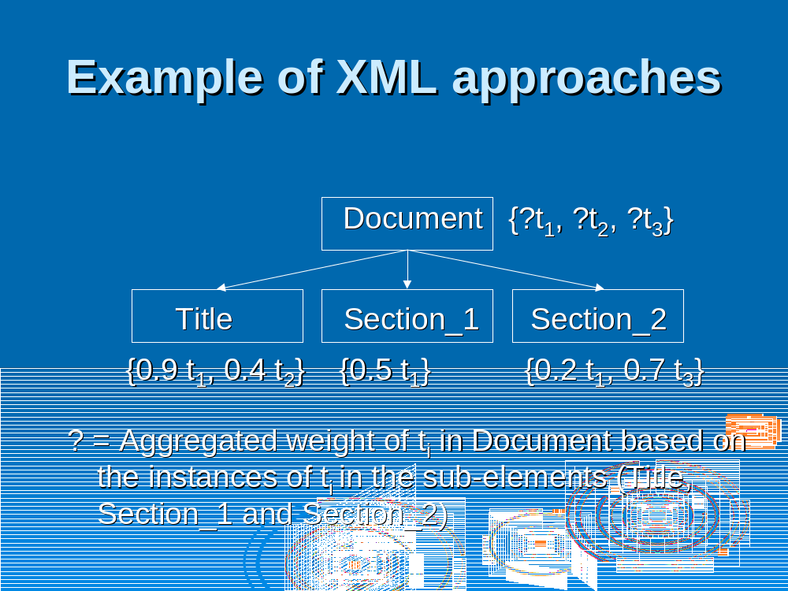

Slide 67
INEX
Each engine indexes docs
Engine team converts retrieval tasks into queries
  In XML query language understood by engine
In response, the engine retrieves not docs, but elements within docs
  Engine ranks retrieved elements

Slide 68
INEX assessment
For each query, each retrieved element is human-assessed on two measures:
  Topical Relevance – how relevant is the retrieved element
  Component Coverage – is the retrieved element too specific, too general, or just right
    E.g., if the query seeks a definition of the Fast Fourier Transform, do I get the equation (too specific), the chapter containing the definition (too general) or the definition itself
These assessments are turned into composite precision/recall measures

Slide 69
The component coverage dimension evaluates whether the element retrieved is “structurally” correct, i.e., neither too low nor too high in the tree.
The topical relevance dimension also has four levels: highly relevant (3)fairly relevant (2) marginally relevant (1) and irrelevant (0).

Slide 70
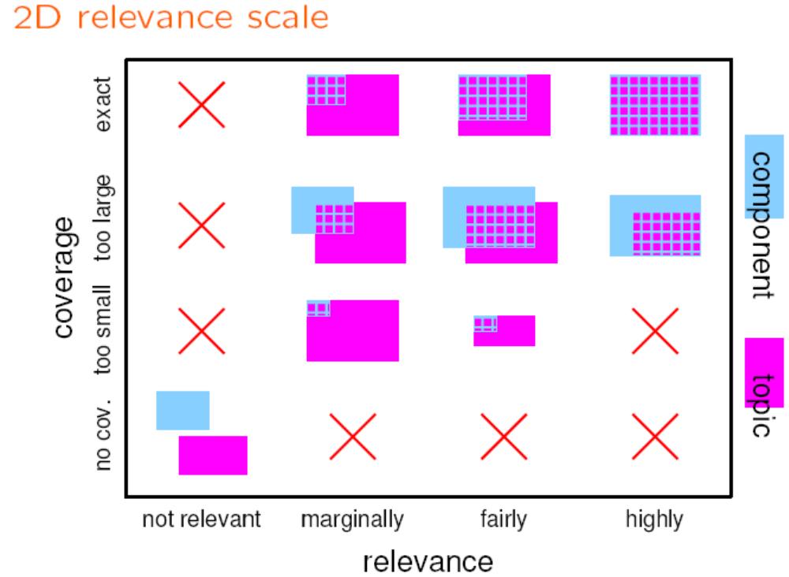

Slide 71
INEX corpus
12,107 articles from IEEE Computer Society publications
494 Megabytes
Average article:1,532 XML nodes
  Average node depth = 6.9

Slide 72
INEX topics
Each topic is an information need, one of two kinds:
  Content Only (CO) – free text queries
  Content and Structure (CAS) – explicit structural constraints, e.g., containment conditions.

Slide 73
Sample INEX CO topic
<Title> computational biology </Title>
<Keywords> computational biology, bioinformatics, genome, genomics, proteomics, sequencing, protein folding </Keywords>
<Description> Challenges that arise, and approaches being explored, in the interdisciplinary field of computational biology</Description>
<Narrative> To be relevant, a document/component must either talk in general terms about the opportunities at the intersection of computer science and biology, or describe a particular problem and the ways it is being attacked. </Narrative>

Slide 74
INEX assessment
Each engine formulates the topic as a query
  E.g., use the keywords listed in the topic.
Engine retrieves one or more elements and ranks them.
Human evaluators assign to each retrieved element relevance and coverage scores.

Slide 75
Assessments
Relevance assessed on a scale from Irrelevant (scoring 0) to Highly Relevant (scoring 3)
Coverage assessed on a scale with four levels:
  No Coverage (N: the query topic does not match anything in the element
  Too Large (The topic is only a minor theme of the element retrieved)
  Too Small (S: the element is too small to provide the information required)
  Exact (E).
So every element returned by each engine has ratings from {0,1,2,3} × {N,S,L,E}

Slide 76
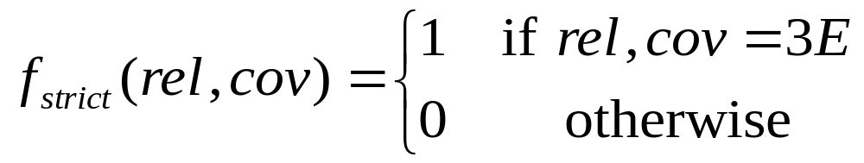
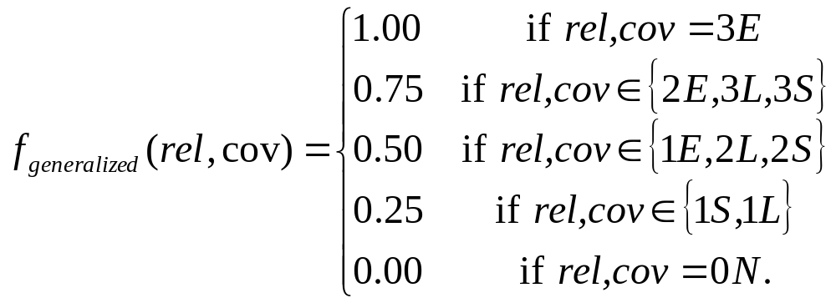
Combining the assessments
Define scores:

Slide 77
The f-values
Scalar measure of goodness of a retrieved elements
Can compute f-values for varying numbers of retrieved elements 10, 20 … etc.
  Means for comparing engines.

Slide 78
From raw f-values to … ?
INEX provides a method for turning these into precision-recall curves
“Standard” issue: only elements returned by some participant engine are assessed

