Slide 1
CS276
Information Retrieval and Web Search
Lecture 11: Probabilistic Information Retrieval

Slide 2
Recap of the last lecture
Improving search results
  Especially for high recall. E.g., searching for aircraft so it matches with plane; thermodynamic with heat
Options for improving results…
  Global methods
    Query expansion
      Thesauri
      Automatic thesaurus generation
    Global indirect relevance feedback
  Local methods
    Relevance feedback
    Pseudo relevance feedback
Notes:
The examples in the first bullet refer to the Cranfield data set which we have used as a programming exercise.

Slide 3
Probabilistic relevance feedback
Rather than reweighting in a vector space…
If user has told us some relevant and some irrelevant documents, then we can proceed to build a probabilistic classifier, such as a Naive Bayes model:
  P(t_{k}|R) = |D_{rk}| / |D_{r}|
  P(t_{k}|NR) = |D_{nrk}| / |D_{nr}|
    t_{k} is a term; D_{r} is the set of known relevant documents; D_{rk} is the subset that contain t_{k}; D_{nr} is the set of known irrelevant documents; D_{nrk} is the subset that contain t_{k}.

Slide 4
Why probabilities in IR?
User
Information Need
Query
Representation
Understanding
of user need is
uncertain
How to match?
Document
Representation
Uncertain guess of
whether document has relevant content
Documents
In traditional IR systems, matching between each document and
query is attempted in a semantically imprecise space of index terms.
Probabilities provide a principled foundation for uncertain reasoning.
Can we use probabilities to quantify our uncertainties?

Slide 5
Probabilistic IR topics
Classical probabilistic retrieval model
  Probability ranking principle, etc.
(Naïve) Bayesian Text Categorization
Bayesian networks for text retrieval
Language model approach to IR
  An important emphasis in recent work
Probabilistic methods are one of the oldest but also one of the currently hottest topics in IR.
  Traditionally: neat ideas, but they’ve never won on performance. It may be different now.

Slide 6
The document ranking problem
We have a collection of documents
User issues a query
A list of documents needs to be returned
Ranking method is core of an IR system:
  In what order do we present documents to the user?
  We want the “best” document to be first, second best second, etc….
Idea: Rank by probability of relevance of the document w.r.t. information need
  P(relevant|document_{i}, query)

Slide 7
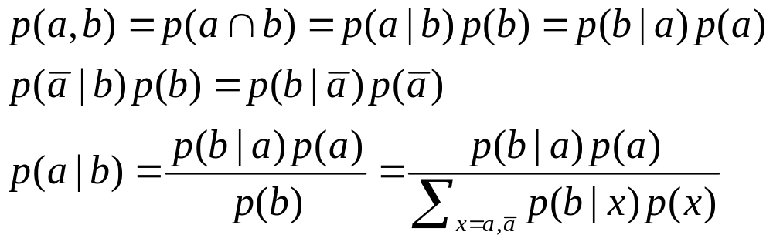
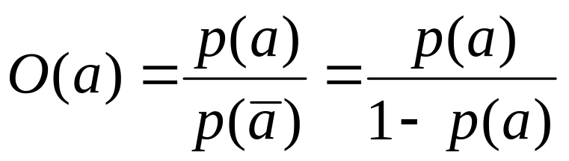
Recall a few probability basics
For events a and b:
Bayes’ Rule
Odds:
Prior
Posterior

Slide 8
The Probability Ranking Principle
“If a reference retrieval system's response to each request is a ranking of the documents in the collection in order of decreasing probability of relevance to the user who submitted the request, where the probabilities are estimated as accurately as possible on the basis of whatever data have been made available to the system for this purpose, the overall effectiveness of the system to its user will be the best that is obtainable on the basis of those data.”
    [1960s/1970s] S. Robertson, W.S. Cooper, M.E. Maron; van Rijsbergen (1979:113); Manning & Schütze (1999:538)

Slide 9
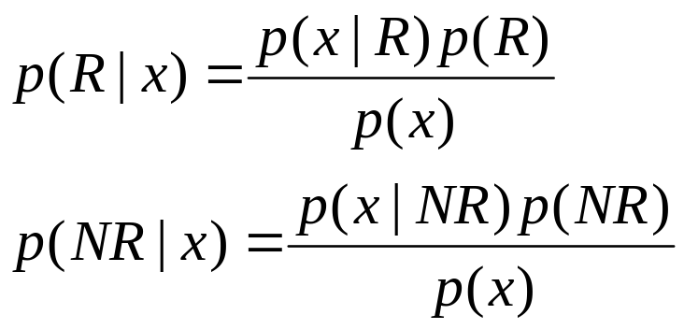

Probability Ranking Principle
Let x be a document in the collection.
Let R represent relevance of a document w.r.t. given (fixed)
query and let NR represent non-relevance.
R={0,1} vs. NR/R
Need to find p(R|x) - probability that a document x is relevant.
p(R),p(NR) - prior probability
of retrieving a (non) relevant
document
p(x|R), p(x|NR) - probability that if a relevant (non-relevant)
document is retrieved, it is x.

Slide 10
Probability Ranking Principle (PRP)
Simple case: no selection costs or other utility concerns that would differentially weight errors
Bayes’ Optimal Decision Rule
  x is relevant iff p(R|x) > p(NR|x)
PRP in action: Rank all documents by p(R|x)
Theorem:
  Using the PRP is optimal, in that it minimizes the loss (Bayes risk) under 1/0 loss
  Provable if all probabilities correct, etc. [e.g., Ripley 1996]

Slide 11
Probability Ranking Principle
More complex case: retrieval costs.
  Let d be a document
  C - cost of retrieval of relevant document
  C’ - cost of retrieval of non-relevant document
Probability Ranking Principle: if
for all d’ not yet retrieved, then d is the next document to be retrieved
We won’t further consider loss/utility from now on

Slide 12
Probability Ranking Principle
How do we compute all those probabilities?
  Do not know exact probabilities, have to use estimates
  Binary Independence Retrieval (BIR) – which we discuss later today – is the simplest model
Questionable assumptions
  “Relevance” of each document is independent of relevance of other documents.
    Really, it’s bad to keep on returning duplicates
  Boolean model of relevance
  That one has a single step information need
    Seeing a range of results might let user refine query

Slide 13
Probabilistic Retrieval Strategy
Estimate how terms contribute to relevance
  How do things like tf, idf, and length influence your judgments about document relevance?
    One answer is the Okapi formulae (S. Robertson)
Combine to find document relevance probability
Order documents by decreasing probability
Notes:
In addition to the “document independence assumption” on previous slide, we have a “term independence assumption”: terms’ contributions to relevance are treated as independent events.
Okapi is one particular way of estimating probability given tf, df, and length.

Slide 14
Probabilistic Ranking
Basic concept:
"For a given query, if we know some documents that are relevant, terms that occur in those documents should be given greater weighting in searching for other relevant documents.
By making assumptions about the distribution of terms and applying Bayes Theorem, it is possible to derive weights theoretically."
Van Rijsbergen

Slide 15
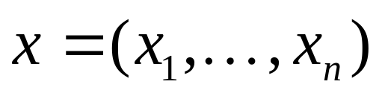
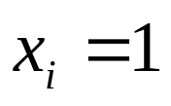
Binary Independence Model
Traditionally used in conjunction with PRP
“Binary” = Boolean: documents are represented as binary incidence vectors of terms (cf. lecture 1):
  iff term i is present in document x.
“Independence”: terms occur in documents independently
Different documents can be modeled as same vector
Bernoulli Naive Bayes model (cf. text categorization!)

Slide 16
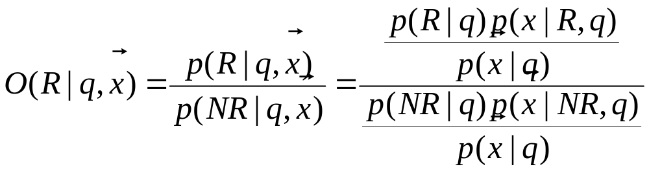
Binary Independence Model
Queries: binary term incidence vectors
Given query q,
  for each document d need to compute p(R|q,d).
  replace with computing p(R|q,x) where x is binary term incidence vector representing d Interested only in ranking
Will use odds and Bayes’ Rule:

Slide 17
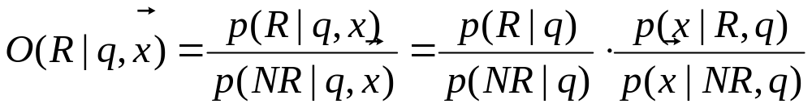
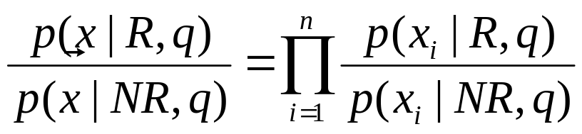
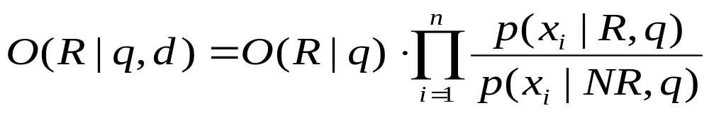
Binary Independence Model
Constant for a given query
Needs estimation
Using Independence Assumption:
So :

Slide 18
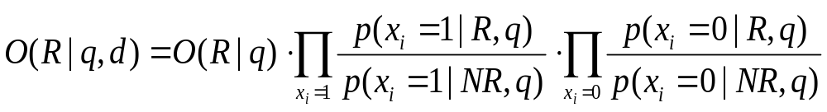



Binary Independence Model
Since x_{i} is either 0 or 1:
Let
Assume, for all terms not occurring in the query (q_{i}=0)
This can be
changed (e.g., in
relevance feedback)
Then...

Slide 19
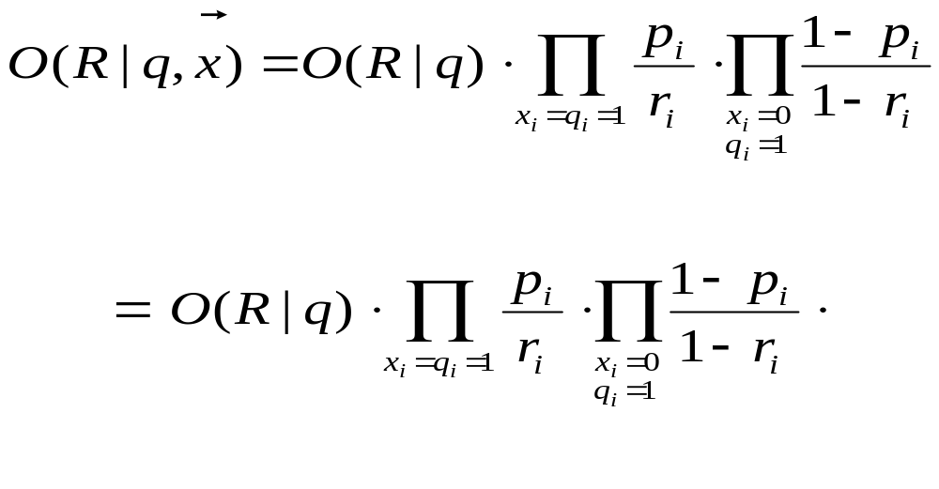
Binary Independence Model
All matching terms
Non-matching query terms
All matching terms

Slide 20
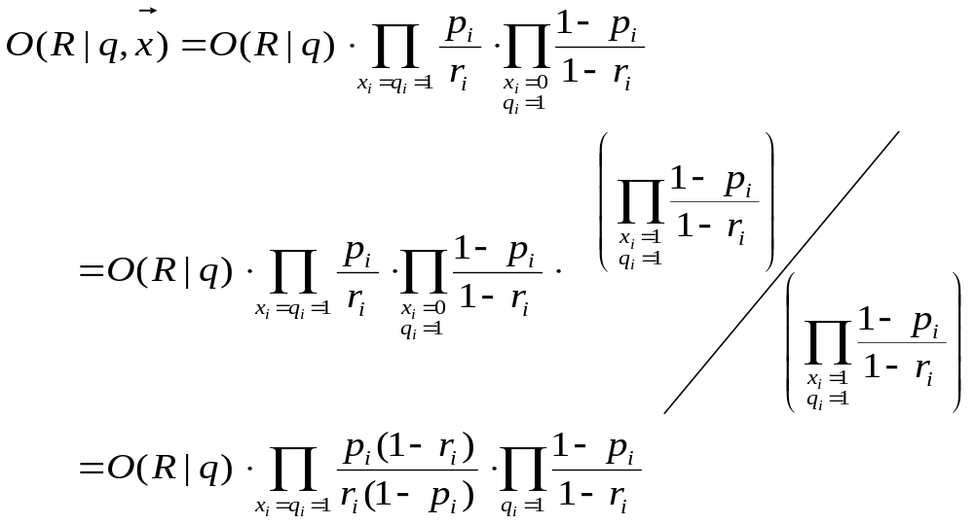
All query terms

Slide 21
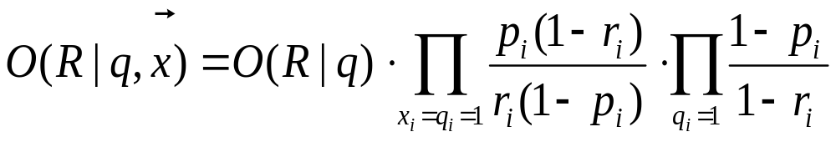
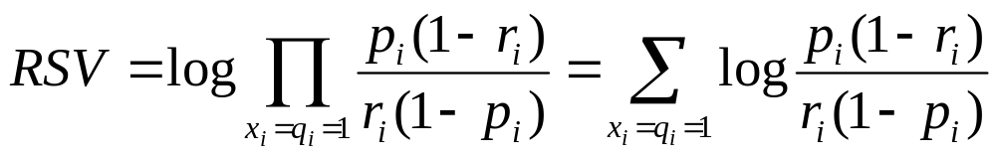
Binary Independence Model
Constant for
each query
Only quantity to be estimated
for rankings
Retrieval Status Value:

Slide 22
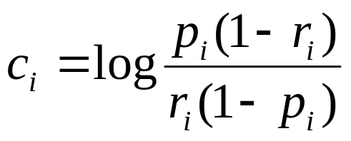
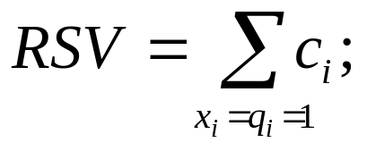
Binary Independence Model
All boils down to computing RSV.
So, how do we compute ci’s from our data ?
Notes:
Used to say: Linear Discriminant Function, because it is a linear function in terms of log probabilities, but maybe that’s too far afield for here, and is better discussed later

Slide 23
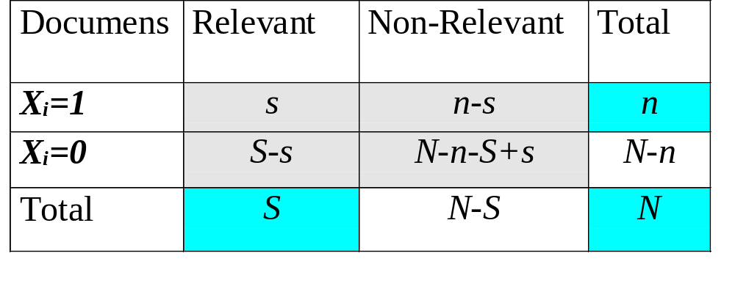
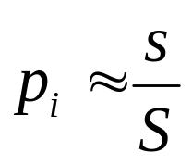
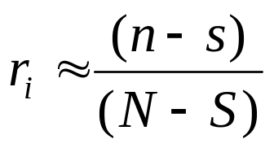
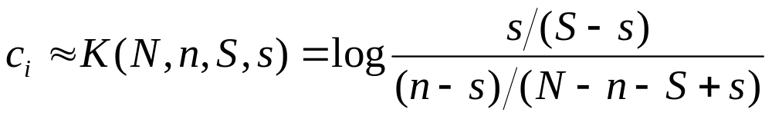
Binary Independence Model
Estimating RSV coefficients.
For each term i look at this table of document counts:
Estimates:
For now,
assume no
zero terms.
More next
lecture.
Notes:
Prabhakar wanted the add 0.5 explained. Here or elsewhere?
Log odds ratio. Add 0.5 to every expression

Slide 24
Estimation – key challenge
If non-relevant documents are approximated by the whole collection, then r_{i} (prob. of occurrence in non-relevant documents for query) is n/N and
  log (1– r_{i})/r_{i} = log (N– n)/n ≈ log N/n = IDF!
p_{i} (probability of occurrence in relevant documents) can be estimated in various ways:
  from relevant documents if know some
    Relevance weighting can be used in feedback loop
  constant (Croft and Harper combination match) – then just get idf weighting of terms
  proportional to prob. of occurrence in collection
    more accurately, to log of this (Greiff, SIGIR 1998)

Slide 25
Iteratively estimating p_{i}
Assume that p_{i} constant over all x_{i} in query
  p_{i} = 0.5 (even odds) for any given doc
Determine guess of relevant document set:
  V is fixed size set of highest ranked documents on this model (note: now a bit like tf.idf!)
We need to improve our guesses for p_{i} and r_{i}, so
  Use distribution of x_{i} in docs in V. Let V_{i} be set of documents containing x_{i}
    p_{i} = |V_{i}| / |V|
  Assume if not retrieved then not relevant
    r_{i} = (n_{i} – |V_{i}|) / (N – |V|)
Go to 2. until converges then return ranking

Slide 26
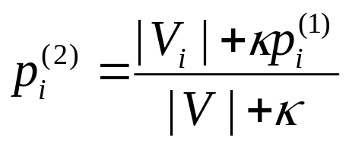
Probabilistic Relevance Feedback
Guess a preliminary probabilistic description of R and use it to retrieve a first set of documents V, as above.
Interact with the user to refine the description: learn some definite members of R and NR
Reestimate p_{i} and r_{i} on the basis of these
  Or can combine new information with original guess (use Bayesian prior):
Repeat, thus generating a succession of approximations to R.
κ is
prior
weight
Notes:
explicit Bayesian smoothing with a prior

Slide 27
PRP and BIR
Getting reasonable approximations of probabilities is possible.
Requires restrictive assumptions:
  term independence
  terms not in query don’t affect the outcome
  boolean representation of documents/queries/relevance
  document relevance values are independent
Some of these assumptions can be removed
Problem: either require partial relevance information or only can derive somewhat inferior term weights

Slide 28
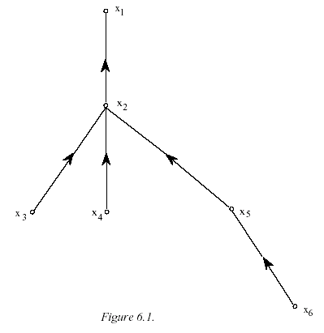
Removing term independence
In general, index terms aren’t independent
Dependencies can be complex
van Rijsbergen (1979) proposed model of simple tree dependencies
  Exactly Friedman and Goldszmidt’s Tree Augmented Naive Bayes (AAAI 13, 1996)
Each term dependent on one other
In 1970s, estimation problems held back success of this model

Slide 29
Food for thought
Think through the differences between standard tf.idf and the probabilistic retrieval model in the first iteration
Think through the differences between vector space (pseudo) relevance feedback and probabilistic (pseudo) relevance feedback

Slide 30
Good and Bad News
Standard Vector Space Model
  Empirical for the most part; success measured by results
  Few properties provable
Probabilistic Model Advantages
  Based on a firm theoretical foundation
  Theoretically justified optimal ranking scheme
Disadvantages
  Making the initial guess to get V
  Binary word-in-doc weights (not using term frequencies)
  Independence of terms (can be alleviated)
  Amount of computation
  Has never worked convincingly better in practice

Slide 31
Bayesian Networks for Text Retrieval (Turtle and Croft 1990)
Standard probabilistic model assumes you can’t estimate P(R|D,Q)
  Instead assume independence and use P(D|R)
But maybe you can with a Bayesian network*
What is a Bayesian network?
  A directed acyclic graph
  Nodes
    Events or Variables
      Assume values.
      For our purposes, all Boolean
  Links
    model direct dependencies between nodes
Notes:
But note that this is a pseudo difference, since it will also internally use independences and inversions just like the standard model, but more flexibly

Slide 32
Bayesian Networks
a,b,c - propositions (events).
Bayesian networks model causal relations between events
Inference in Bayesian Nets:
  Given probability distributions
  for roots and conditional
  probabilities can compute
  apriori probability of any instance
  Fixing assumptions (e.g., b
  was observed) will cause
  recomputation of probabilities
p(b)
a
b
p(a)
Conditional
dependence
c
p(c|ab) for all values
for a,b,c
For more information see:
R.G. Cowell, A.P. Dawid, S.L. Lauritzen, and D.J. Spiegelhalter.
1999. Probabilistic Networks and Expert Systems. Springer Verlag.
J. Pearl. 1988. Probabilistic Reasoning in Intelligent Systems:
Networks of Plausible Inference. Morgan-Kaufman.

Slide 33
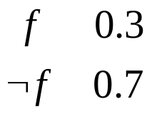
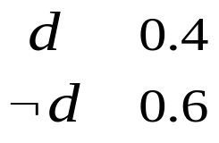
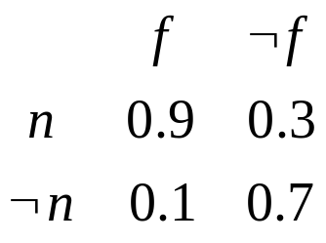
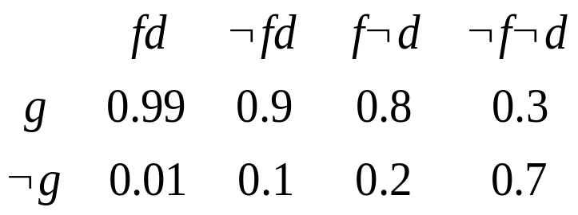
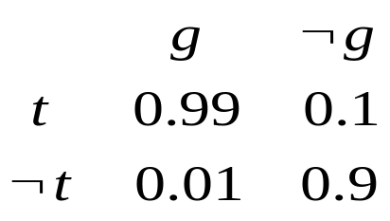
Toy Example
Finals
(f)
Project Due
(d)
No Sleep
(n)
Gloom
(g)
Triple Latte
(t)

Slide 34
Independence Assumptions
Finals
(f)
Project Due
(d)
Independence assumption:
P(t|g, f)=P(t|g)
Joint probability
P(f d n g t)
=P(f) P(d) P(n|f) P(g|f d) P(t|g)
No Sleep
(n)
Gloom
(g)
Triple Latte
(t)

Slide 35
Chained inference
Evidence - a node takes on some value
Inference
  Compute belief (probabilities) of other nodes
    conditioned on the known evidence
  Two kinds of inference: Diagnostic and Predictive
Computational complexity
  General network: NP-hard
    Tree-like networks are easily tractable
    Much other work on efficient exact and approximate Bayesian network inference
      Clever dynamic programming
      Approximate inference (“loopy belief propagation”)

Slide 36
Model for Text Retrieval
Goal
  Given a user’s information need (evidence), find probability a doc satisfies need
Retrieval model
  Model docs in a document network
  Model information need in a query network

Slide 37
Bayesian Nets for IR: Idea
Document Network
d1
d2
di -documents
dn
Large, but
Compute once for each
document collection
ti - document representations
ri - “concepts”
t1
t2
tn
r1
r2
rk
r3
ci - query concepts
Small, compute once for
every query
c1
c2
cm
qi - high-level concepts
q2
q1
Query Network
I
I - goal node

Slide 38
Bayesian Nets for IR
Construct Document Network (once !)
For each query
  Construct best Query Network
  Attach it to Document Network
  Find subset of d_{i}’s which maximizes the probability value of node I (best subset).
  Retrieve these d_{i}’s as the answer to query.

Slide 39
Bayesian nets for text retrieval
d₁
Documents
d₂
Document
Network
r₁
r₂
r₃
Terms/Concepts
c₁
c₂
c₃
Concepts
Query
Network
q₁
q₂
Query operators
(AND/OR/NOT)
i
Information need

Slide 40
Link matrices and probabilities
Prior doc probability P(d) = 1/n
P(r|d)
  within-document term frequency
  tf × idf - based
P(c|r)
  1-to-1
  thesaurus
P(q|c): canonical forms of query operators
  Always use things like AND and NOT – never store a full CPT*
  *conditional probability table

Slide 41
Example: “reason trouble –two”
Hamlet
Macbeth
Document
Network
reason
trouble
double
reason
trouble
two
Query
Network
OR
NOT
User query

Slide 42
Extensions
Prior probs don’t have to be 1/n.
“User information need” doesn’t have to be a query - can be words typed, in docs read, any combination …
Phrases, inter-document links
Link matrices can be modified over time.
  User feedback.
  The promise of “personalization”

Slide 43
Computational details
Document network built at indexing time
Query network built/scored at query time
Representation:
  Link matrices from docs to any single term are like the postings entry for that term
  Canonical link matrices are efficient to store and compute
Attach evidence only at roots of network
  Can do single pass from roots to leaves

Slide 44
Bayes Nets in IR
Flexible ways of combining term weights, which can generalize previous approaches
  Boolean model
  Binary independence model
  Probabilistic models with weaker assumptions
Efficient large-scale implementation
  InQuery text retrieval system from U Mass
    Turtle and Croft (1990) [Commercial version defunct?]
Need approximations to avoid intractable inference
Need to estimate all the probabilities by some means (whether more or less ad hoc)
Much new Bayes net technology yet to be applied?

Slide 45
Resources
S. E. Robertson and K. Spärck Jones. 1976. Relevance Weighting of Search Terms. Journal of the American Society for Information Sciences 27(3): 129–146.
C. J. van Rijsbergen. 1979. Information Retrieval. 2nd ed. London: Butterworths, chapter 6. [Most details of math] http://www.dcs.gla.ac.uk/Keith/Preface.html
N. Fuhr. 1992. Probabilistic Models in Information Retrieval. The Computer Journal, 35(3),243–255. [Easiest read, with BNs]
F. Crestani, M. Lalmas, C. J. van Rijsbergen, and I. Campbell. 1998. Is This Document Relevant? ... Probably: A Survey of Probabilistic Models in Information Retrieval. ACM Computing Surveys 30(4): 528–552.
http://www.acm.org/pubs/citations/journals/surveys/1998-30-4/p528-crestani/
[Adds very little material that isn’t in van Rijsbergen or Fuhr ]

Slide 46
Resources
H.R. Turtle and W.B. Croft. 1990. Inference Networks for Document Retrieval. Proc. ACM SIGIR: 1-24.
E. Charniak. Bayesian nets without tears. AI Magazine 12(4): 50-63 (1991). http://www.aaai.org/Library/Magazine/Vol12/12-04/vol12-04.html
D. Heckerman. 1995. A Tutorial on Learning with Bayesian Networks. Microsoft Technical Report MSR-TR-95-06
http://www.research.microsoft.com/~heckerman/
N. Fuhr. 2000. Probabilistic Datalog: Implementing Logical Information Retrieval for Advanced Applications. Journal of the American Society for Information Science 51(2): 95–110.
R. K. Belew. 2001. Finding Out About: A Cognitive Perspective on Search Engine Technology and the WWW. Cambridge UP 2001.
MIR 2.5.4, 2.8

