Slide 1
CS276
Information Retrieval and Web Search
Lecture 12: Naïve BayesText Classification

Slide 2
Probabilistic relevance feedback
Recall this idea:
Rather than reweighting in a vector space…
If user has told us some relevant and some irrelevant documents, then we can proceed to build a probabilistic classifier, such as the Naive Bayes model we will look at today:
  P(t_{k}|R) = |D_{rk}| / |D_{r}|
  P(t_{k}|NR) = |D_{nrk}| / |D_{nr}|
    t_{k} is a term; D_{r} is the set of known relevant documents; D_{rk} is the subset that contain t_{k}; D_{nr} is the set of known irrelevant documents; D_{nrk} is the subset that contain t_{k}.

Slide 3
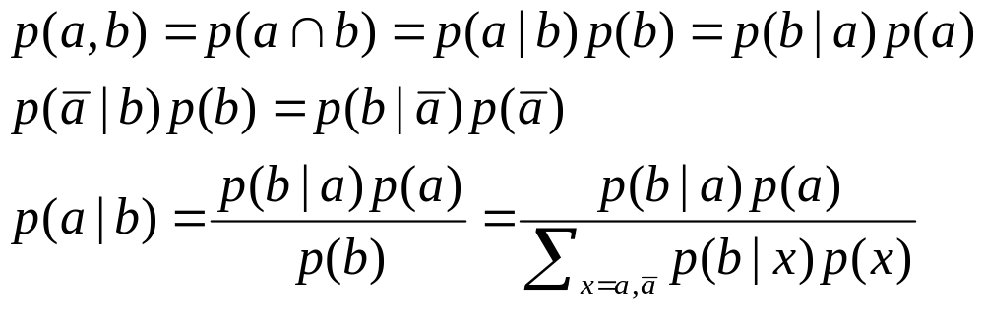
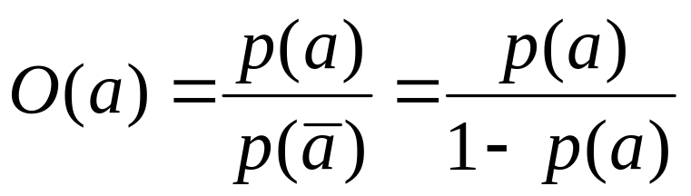
Recall a few probability basics
For events a and b:
Bayes’ Rule
Odds:
Prior
Posterior

Slide 4
Text classification:
Naïve Bayes Text Classification
Today:
  Introduction to Text Classification
  Probabilistic Language Models
  Naïve Bayes text categorization

Slide 5
Is this spam?
From: "" <takworlld@hotmail.com>
Subject: real estate is the only way... gem oalvgkay
Anyone can buy real estate with no money down
Stop paying rent TODAY !
There is no need to spend hundreds or even thousands for similar courses
I am 22 years old and I have already purchased 6 properties using the
methods outlined in this truly INCREDIBLE ebook.
Change your life NOW !
=================================================
Click Below to order:
http://www.wholesaledaily.com/sales/nmd.htm
=================================================

Slide 6
Categorization/Classification
Given:
  A description of an instance, x∈X, where X is the instance language or instance space.
    Issue: how to represent text documents.
  A fixed set of categories:
  C = {c₁, c₂,…, c_{n}}
Determine:
  The category of x: c(x)∈C, where c(x) is a categorization function whose domain is X and whose range is C.
    We want to know how to build categorization functions (“classifiers”).

Slide 7
Document Classification
“planning
language
proof
intelligence”
Test
Data:
(AI)
(Programming)
(HCI)
Classes:
ML
Planning
Semantics
Garb.Coll.
Multimedia
GUI
Training
Data:
learning
intelligence
algorithm
reinforcement
network...
planning
temporal
reasoning
plan
language...
programming
semantics
language
proof...
garbage
collection
memory
optimization
region...
...
...
(Note: in real life there is often a hierarchy, not present in the above problem statement; and you get papers on ML approaches to Garb. Coll.)

Slide 8
Text Categorization Examples
Assign labels to each document or web-page:
Labels are most often topics such as Yahoo-categories
e.g., "finance," "sports," "news>world>asia>business"
Labels may be genres
e.g., "editorials" "movie-reviews" "news“
Labels may be opinion
e.g., “like”, “hate”, “neutral”
Labels may be domain-specific binary
e.g., "interesting-to-me" : "not-interesting-to-me”
e.g., “spam” : “not-spam”
e.g., “contains adult language” :“doesn’t”

Slide 9
Classification Methods (1)
Manual classification
  Used by Yahoo!, Looksmart, about.com, ODP, Medline
  Very accurate when job is done by experts
  Consistent when the problem size and team is small
  Difficult and expensive to scale

Slide 10
Classification Methods (2)
Automatic document classification
  Hand-coded rule-based systems
    One technique used by CS dept’s spam filter, Reuters, CIA, Verity, …
    E.g., assign category if document contains a given boolean combination of words
    Standing queries: Commercial systems have complex query languages (everything in IR query languages + accumulators)
    Accuracy is often very high if a rule has been carefully refined over time by a subject expert
    Building and maintaining these rules is expensive

Slide 11
Classification Methods (3)
Supervised learning of a document-label assignment function
  Many systems partly rely on machine learning (Autonomy, MSN, Verity, Enkata, Yahoo!, …)
    k-Nearest Neighbors (simple, powerful)
    Naive Bayes (simple, common method)
    Support-vector machines (new, more powerful)
    … plus many other methods
    No free lunch: requires hand-classified training data
    But data can be built up (and refined) by amateurs
Note that many commercial systems use a mixture of methods

Slide 12
Bayesian Methods
Our focus this lecture
Learning and classification methods based on probability theory.
Bayes theorem plays a critical role in probabilistic learning and classification.
Build a generative model that approximates how data is produced
Uses prior probability of each category given no information about an item.
Categorization produces a posterior probability distribution over the possible categories given a description of an item.

Slide 13
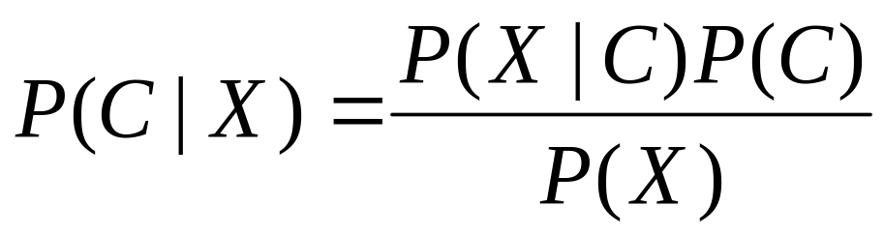
Bayes’ Rule

Slide 14
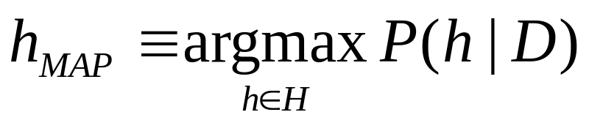
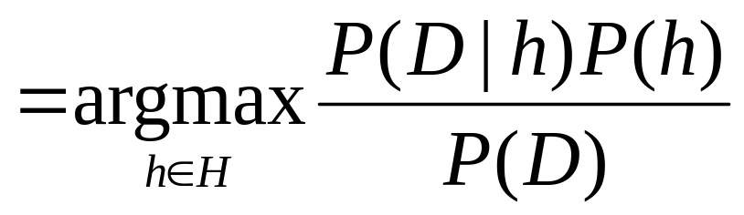
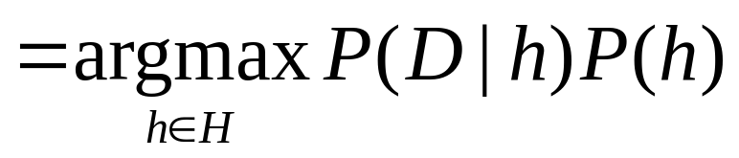
Maximum a posteriori Hypothesis
As P(D) is
constant

Slide 15
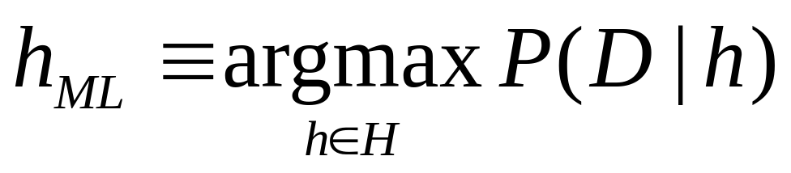
Maximum likelihood Hypothesis
If all hypotheses are a priori equally likely, we only
need to consider the P(D|h) term:

Slide 16
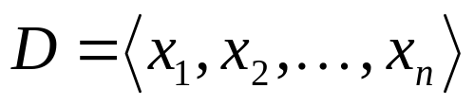
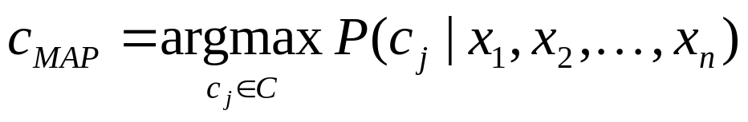
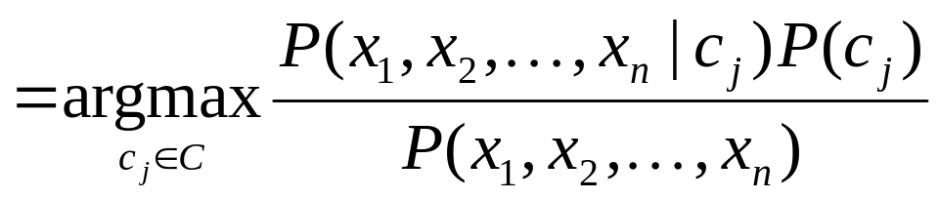
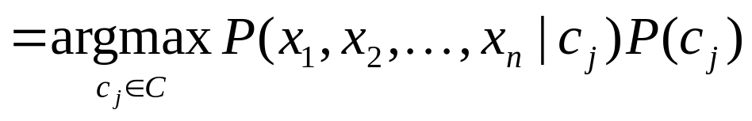
Naive Bayes Classifiers
Task: Classify a new instance D based on a tuple of attribute values into one of the classes c_{j} ∈ C

Slide 17
Naïve Bayes Classifier:
Naïve Bayes Assumption
P(c_{j})
  Can be estimated from the frequency of classes in the training examples.
P(x₁,x₂,…,x_{n}|c_{j})
  O(|X|^{n}•|C|) parameters
  Could only be estimated if a very, very large number of training examples was available.
Naïve Bayes Conditional Independence Assumption:
Assume that the probability of observing the conjunction of attributes is equal to the product of the individual probabilities P(x_{i}|c_{j}).

Slide 18
The Naïve Bayes Classifier
Flu
X₁
X₂
X₃
X₄
X₅
runnynose
sinus
cough
fever
muscle-ache
Conditional Independence Assumption: features detect term presence and are independent of each other given the class:
This model is appropriate for binary variables
  Multivariate binomial model

Slide 19
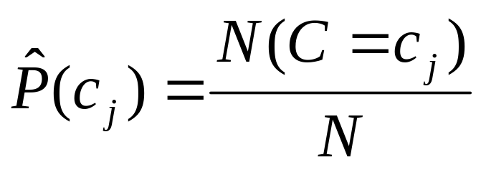
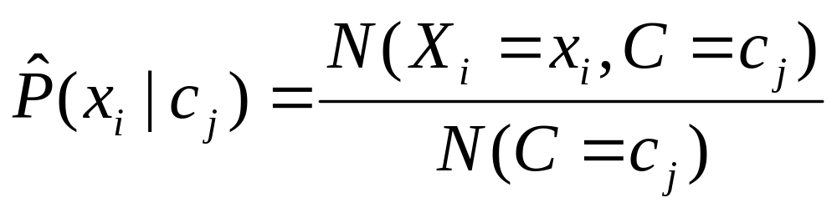
Learning the Model
C
X₁
X₂
X₃
X₄
X₅
X₆
First attempt: maximum likelihood estimates
  simply use the frequencies in the data

Slide 20
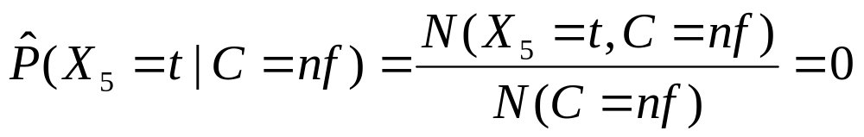
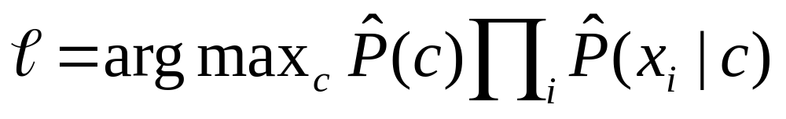
Problem with Max Likelihood
Flu
X₁
X₂
X₃
X₄
X₅
runnynose
sinus
cough
fever
muscle-ache
What if we have seen no training cases where patient had no flu and muscle aches?
Zero probabilities cannot be conditioned away, no matter the other evidence!

Slide 21
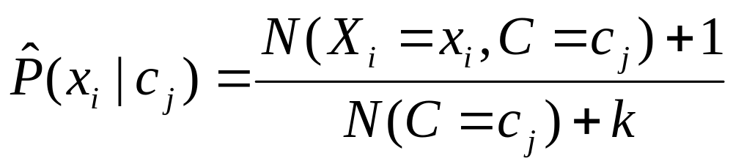
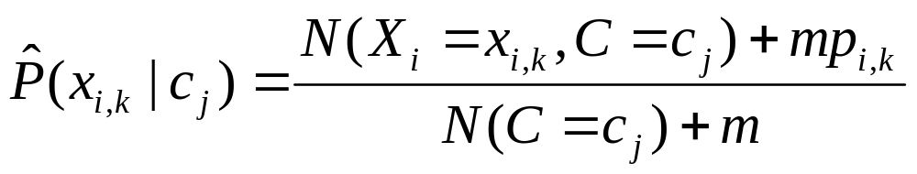
Smoothing to Avoid Overfitting
# of values of X_{i}
overall fraction in data where X_{i}=x_{i,k}
Somewhat more subtle version
extent of
“smoothing”

Slide 22
Stochastic Language Models
Models probability of generating strings (each word in turn) in the language (commonly all strings over ∑). E.g., unigram model
Model M
0.2 the
0.1 a
0.01 man
0.01 woman
0.03 said
0.02 likes
…
the
man
likes
the
woman
0.2
0.01
0.02
0.2
0.01
multiply
P(s | M) = 0.00000008

Slide 23
Stochastic Language Models
Model probability of generating any string
Model M1
Model M2
0.2 the
0.0001 class
0.03 sayst
0.02 pleaseth
0.1 yon
0.01 maiden
0.0001 woman
0.2 the
0.01 class
0.0001 sayst
0.0001 pleaseth
0.0001 yon
0.0005 maiden
0.01 woman
the
class
pleaseth
yon
maiden
0.2
0.01
0.0001
0.0001
0.0005
0.2
0.0001
0.02
0.1
0.01
P(s|M2) > P(s|M1)

Slide 24
Unigram and higher-order models
Unigram Language Models
Bigram (generally, n-gram) Language Models
Other Language Models
  Grammar-based models (PCFGs), etc.
    Probably not the first thing to try in IR
P ( )
= P ( )
P ( | )
P ( | )
P ( | )
Easy.
Effective!
P ( ) P ( ) P ( ) P ( )
P ( ) P ( | ) P ( | ) P ( | )

Slide 25
Naïve Bayes via a class conditional language model = multinomial NB
Cat
w₁
w₂
w₃
w₄
w₅
w₆
Effectively, the probability of each class is done as a class-specific unigram language model

Slide 26
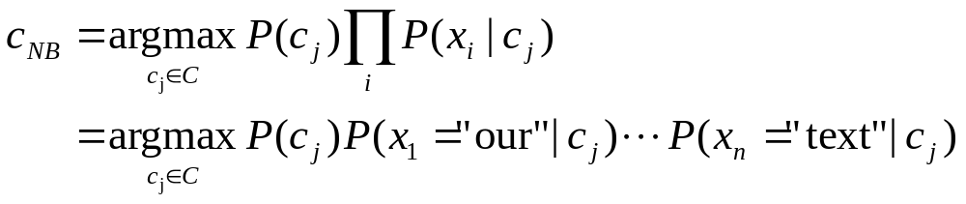
Using Multinomial Naive Bayes Classifiers to Classify Text: Basic method
Attributes are text positions, values are words.
Still too many possibilities
Assume that classification is independent of the positions of the words
  Use same parameters for each position
  Result is bag of words model (over tokens not types)

Slide 27
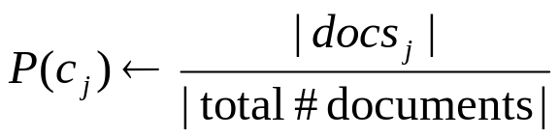
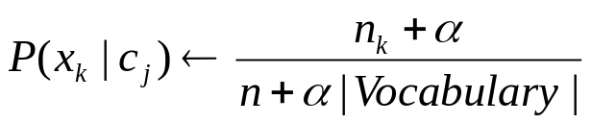
Naïve Bayes: Learning
From training corpus, extract Vocabulary
Calculate required P(c_{j}) and P(x_{k} | c_{j}) terms
  For each c_{j} in C do
    docs_{j} ← subset of documents for which the target class is c_{j}
    Text_{j} ← single document containing all docs_{j}
    for each word x_{k} in Vocabulary
      n_{k} ← number of occurrences of x_{k} in Text_{j}

Slide 28
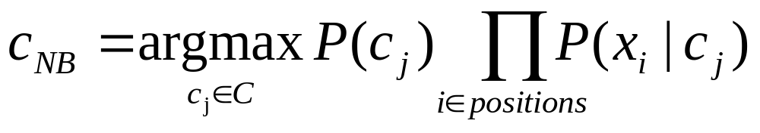
Naïve Bayes: Classifying
positions ← all word positions in current document which contain tokens found in Vocabulary
Return c_{NB}, where

Slide 29
Naive Bayes: Time Complexity
Training Time: O(|D|L_{d} + |C||V|)) where L_{d} is the average length of a document in D.
  Assumes V and all D_{i} , n_{i}, and n_{ij} pre-computed in O(|D|L_{d}) time during one pass through all of the data.
  Generally just O(|D|L_{d}) since usually |C||V| < |D|L_{d}
Test Time: O(|C| L_{t}) where L_{t} is the average length of a test document.
Very efficient overall, linearly proportional to the time needed to just read in all the data.
Why?

Slide 30
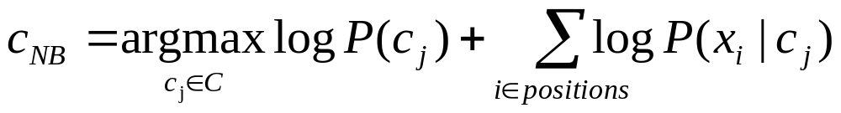
Underflow Prevention
Multiplying lots of probabilities, which are between 0 and 1 by definition, can result in floating-point underflow.
Since log(xy) = log(x) + log(y), it is better to perform all computations by summing logs of probabilities rather than multiplying probabilities.
Class with highest final un-normalized log probability score is still the most probable.

Slide 31
Note: Two Models
Model 1: Multivariate binomial
  One feature X_{w} for each word in dictionary
  X_{w} = true in document d if w appears in d
  Naive Bayes assumption:
    Given the document’s topic, appearance of one word in the document tells us nothing about chances that another word appears
This is the model used in the binary independence model in classic probabilistic relevance feedback in hand-classified data (Maron in IR was a very early user of NB)

Slide 32
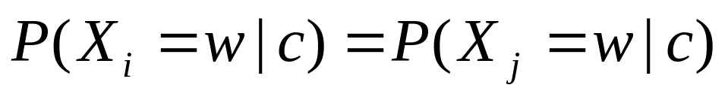
Two Models
Model 2: Multinomial = Class conditional unigram
  One feature X_{i} for each word pos in document
    feature’s values are all words in dictionary
  Value of X_{i} is the word in position i
  Naïve Bayes assumption:
    Given the document’s topic, word in one position in the document tells us nothing about words in other positions
  Second assumption:
    Word appearance does not depend on position
    Just have one multinomial feature predicting all words
for all positions i,j, word w, and class c

Slide 33
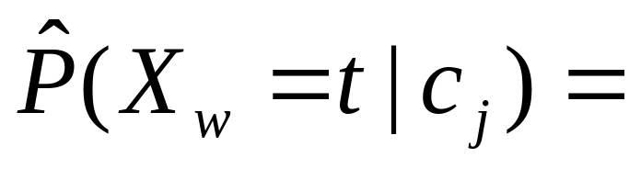
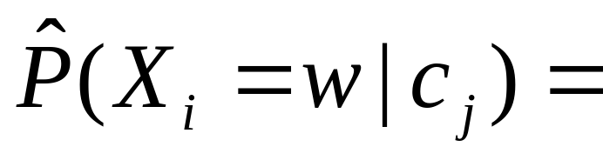
Parameter estimation
Binomial model:
Multinomial model:
  Can create a mega-document for topic j by concatenating all documents in this topic
  Use frequency of w in mega-document
fraction of documents of topic c_{j}
in which word w appears
fraction of times in which
word w appears
across all documents of topic c_{j}

Slide 34
Classification
Multinomial vs Multivariate binomial?
  Multinomial is in general better
    See results figures later

Slide 35
NB example
Given: 4 documents
  D1 (sports): China soccer
  D2 (sports): Japan baseball
  D3 (politics): China trade
  D4 (politics): Japan Japan exports
Classify:
  D5: soccer
  D6: Japan
Use
    Add-one smoothing
  Multinomial model
  Multivariate binomial model

Slide 36
Feature Selection: Why?
Text collections have a large number of features
  10,000 – 1,000,000 unique words … and more
May make using a particular classifier feasible
  Some classifiers can’t deal with 100,000 of features
Reduces training time
  Training time for some methods is quadratic or worse in the number of features
Can improve generalization (performance)
  Eliminates noise features
  Avoids overfitting

Slide 37
Feature selection: how?
Two idea:
  Hypothesis testing statistics:
    Are we confident that the value of one categorical variable is associated with the value of another
    Chi-square test
  Information theory:
    How much information does the value of one categorical variable give you about the value of another
    Mutual information
They’re similar, but χ² measures confidence in association, (based on available statistics), while MI measures extent of association (assuming perfect knowledge of probabilities)

Slide 38
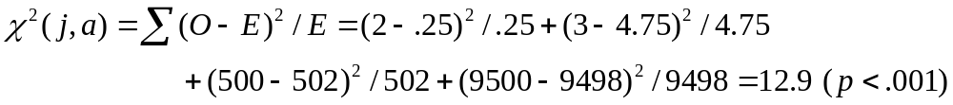
χ² statistic (CHI)
χ2 is interested in (fo – fe)²/fe summed over all table entries: is the observed number what you’d expect given the marginals?
The null hypothesis is rejected with confidence .999,
since 12.9 > 10.83 (the value for .999 confidence).
Term = jaguar
Term ≠ jaguar
expected: f_{e}
Class = auto
2
(0.25)
500
(502)
Class ≠ auto
3
(4.75)
9500
(9498)
observed: f_{o}

Slide 39

χ² statistic (CHI)
There is a simpler formula for 2x2 χ²:
A = #(t,c)
C = #(¬t,c)
B = #(t,¬c)
D = #(¬t, ¬c)
N = A + B + C + D
Value for complete independence of term and category?

Slide 40
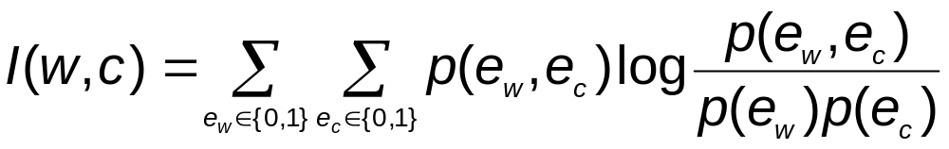
Feature selection via Mutual Information
In training set, choose k words which best discriminate (give most info on) the categories.
The Mutual Information between a word, class is:
  For each word w and each category c

Slide 41
Feature selection via MI (contd.)
For each category we build a list of k most discriminating terms.
For example (on 20 Newsgroups):
  sci.electronics: circuit, voltage, amp, ground, copy, battery, electronics, cooling, …
  rec.autos: car, cars, engine, ford, dealer, mustang, oil, collision, autos, tires, toyota, …
Greedy: does not account for correlations between terms
Why?

Slide 42
Feature Selection
Mutual Information
  Clear information-theoretic interpretation
  May select rare uninformative terms
Chi-square
  Statistical foundation
  May select very slightly informative frequent terms that are not very useful for classification
Just use the commonest terms?
  No particular foundation
  In practice, this is often 90% as good

Slide 43
Feature selection for NB
In general feature selection is necessary for binomial NB.
Otherwise you suffer from noise, multi-counting
“Feature selection” really means something different for multinomial NB. It means dictionary truncation
  The multinomial NB model only has 1 feature
This “feature selection” normally isn’t needed for multinomial NB, but may help a fraction with quantities that are badly estimated

Slide 44
Evaluating Categorization
Evaluation must be done on test data that are independent of the training data (usually a disjoint set of instances).
Classification accuracy: c/n where n is the total number of test instances and c is the number of test instances correctly classified by the system.
Results can vary based on sampling error due to different training and test sets.
Average results over multiple training and test sets (splits of the overall data) for the best results.

Slide 45
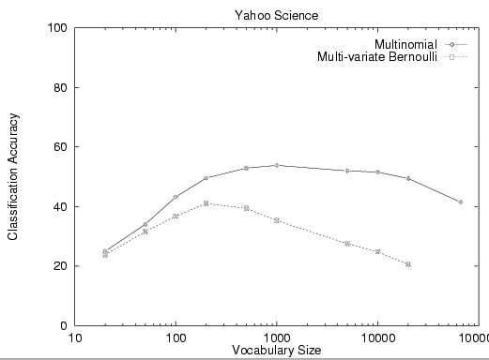
Example: AutoYahoo!
Classify 13,589 Yahoo! webpages in “Science” subtree into 95 different topics (hierarchy depth 2)

Slide 46
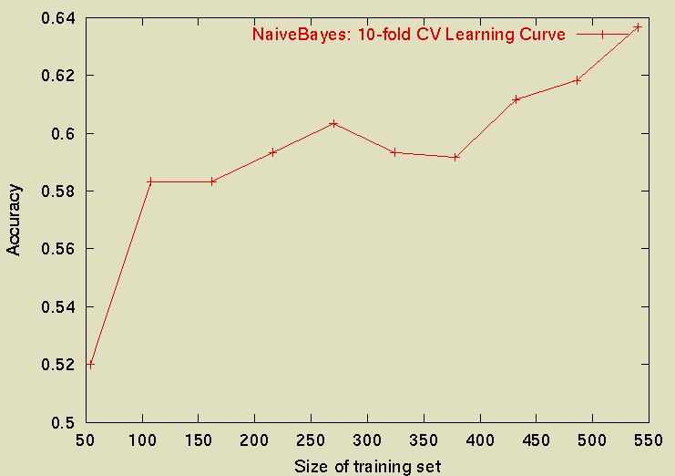
Sample Learning Curve
(Yahoo Science Data): need more!

Slide 47
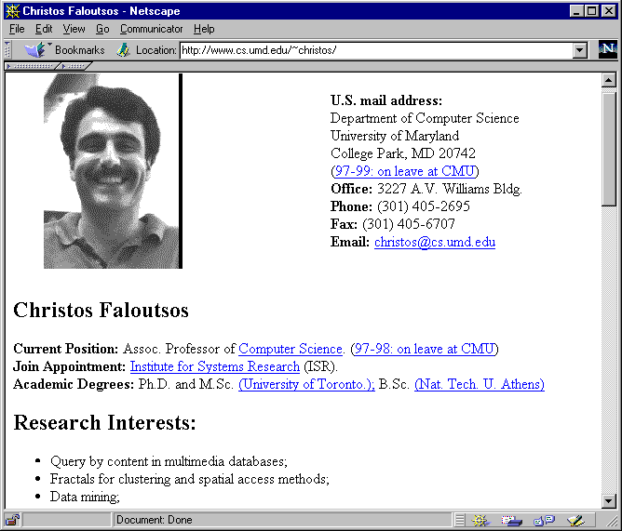
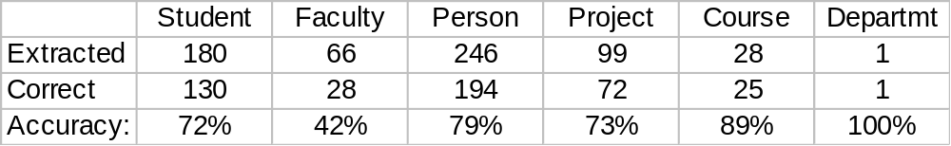
WebKB Experiment
Classify webpages from CS departments into:
  student, faculty, course,project
Train on ~5,000 hand-labeled web pages
  Cornell, Washington, U.Texas, Wisconsin
Crawl and classify a new site (CMU)
Results:

Slide 48
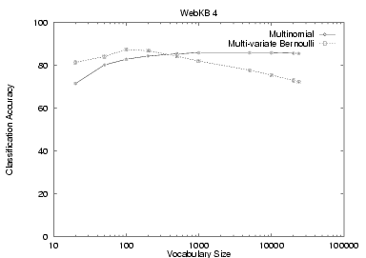
NB Model Comparison

Slide 49
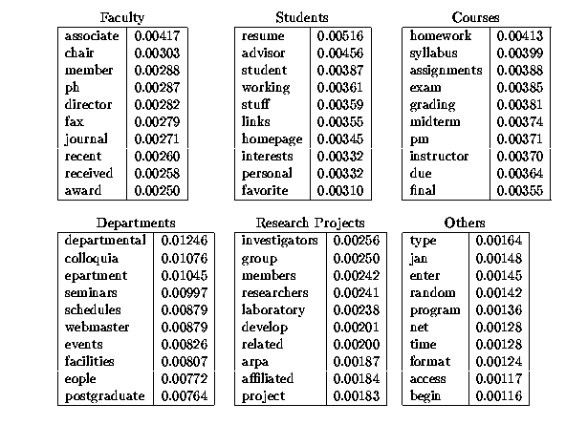

Slide 50
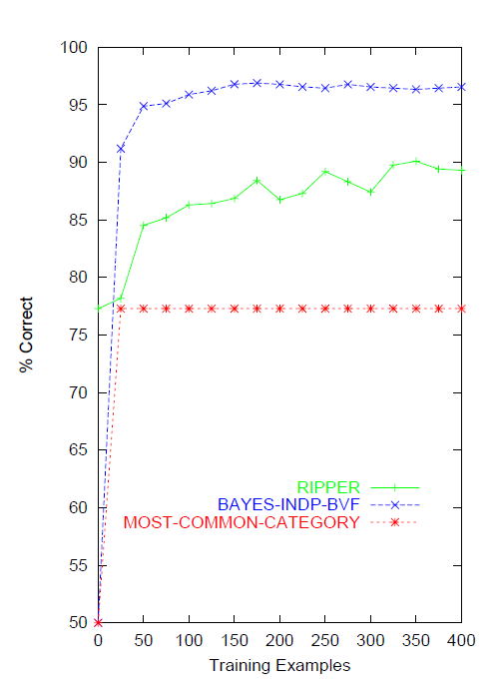
Naïve Bayes on spam email

Slide 51
SpamAssassin
Naïve Bayes has found a home for spam filtering
  Graham’s A Plan for Spam
    And its mutant offspring...
  Naive Bayes-like classifier with weird parameter estimation
  Widely used in spam filters
    Classic Naive Bayes superior when appropriately used
    According to David D. Lewis
Many email filters use NB classifiers
  But also many other things: black hole lists, etc.

Slide 52
Violation of NB Assumptions
Conditional independence
“Positional independence”
Examples?

Slide 53
Naïve Bayes Posterior Probabilities
Classification results of naïve Bayes (the class with maximum posterior probability) are usually fairly accurate.
However, due to the inadequacy of the conditional independence assumption, the actual posterior-probability numerical estimates are not.
  Output probabilities are generally very close to 0 or 1.

Slide 54
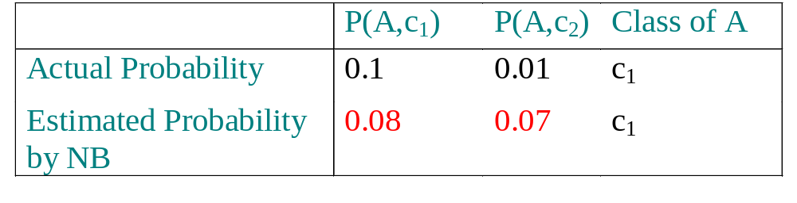
When does Naive Bayes work?
Sometimes NB performs well even if the Conditional Independence assumptions are badly violated.
Classification is about predicting the correct class label and NOT about accurately estimating probabilities.
Assume two classes c₁ and c₂. A new case A arrives.
NB will classify A to c₁ if:
P(A, c₁)>P(A, c₂)
Besides the big error in estimating the probabilities the classification is still correct.
Correct estimation ⇒ accurate prediction
but NOT
accurate prediction ⇒ Correct estimation

Slide 55
Naive Bayes is Not So Naive
Naïve Bayes: First and Second place in KDD-CUP 97 competition, among 16 (then) state of the art algorithms
  Goal: Financial services industry direct mail response prediction model: Predict if the recipient of mail will actually respond to the advertisement – 750,000 records.
Robust to Irrelevant Features
  Irrelevant Features cancel each other without affecting results
  Instead Decision Trees can heavily suffer from this.
Very good in domains with many equally important features
  Decision Trees suffer from fragmentation in such cases – especially if little data
A good dependable baseline for text classification (but not the best)!
Optimal if the Independence Assumptions hold: If assumed independence is correct, then it is the Bayes Optimal Classifier for problem
Very Fast: Learning with one pass over the data; testing linear in the number of attributes, and document collection size
Low Storage requirements

Slide 56
Resources
IIR 13
Fabrizio Sebastiani. Machine Learning in Automated Text Categorization. ACM Computing Surveys, 34(1):1-47, 2002.
Andrew McCallum and Kamal Nigam. A Comparison of Event Models for Naive Bayes Text Classification. In AAAI/ICML-98 Workshop on Learning for Text Categorization, pp. 41-48.
Tom Mitchell, Machine Learning. McGraw-Hill, 1997.
  Clear simple explanation
Yiming Yang & Xin Liu, A re-examination of text categorization methods. Proceedings of SIGIR, 1999.

