Slide 1

DEPARTMENT OF COMPUTER SCIENCE AND ENGINEERING
WASTE SEGRATION GUIDE
PROJECT STUDENT M.CHANDRA KOUSHIK(43111065)

Slide 2
AGENDA
Abstract
Existing system
Proposed system
Advantages
Disadvantages
Hardware requirements
Software requirements
Modules
Module description
Sample output(screenshot)
Conclusion

Slide 3
ABSTRACT
Waste management has become a growing global concern due to rapid urbanization and population growth, resulting in increased waste generation and environmental pollution. The Waste Segregation Guide, developed using HTML, CSS, Java, and Spring Boot, is a web-based interactive platform that educates users on proper waste segregation and disposal. It classifies waste into biodegradable, non-biodegradable, recyclable, and hazardous categories, helping individuals make environmentally responsible choices. With its user-friendly interface and strong backend support, the system promotes awareness and participation in sustainable practices. Aligned with Sustainable Development Goals (SDG 11 and SDG 12), the project contributes to building sustainable cities and encouraging responsible consumption. In the future, it can be enhanced with AI-based image recognition and IoT-enabled smart bins, making waste management more efficient and technology-driven.

Slide 4
EXISTING SYSTEM
Current waste management practices rely heavily on manual segregation, which is inefficient and poses health risks to sanitation workers. The public lacks sufficient awareness about proper disposal and segregation techniques, leading to widespread issues such as soil and water pollution, foul odours, and the emission of harmful greenhouse gases. Improper handling of waste, especially plastic and hazardous materials, further worsens environmental and health conditions in urban as well as rural areas.Existing online tools or mobile applications mainly focus on aspects like waste collection, tracking, or complaint registration. Thus, the existing system lacks interactivity, awareness-building, and efficient guidance for everyday waste management, highlighting the need for a more integrated, technology-driven solution that encourages active user participation and sustainable practices.

Slide 5
PROPOSED SYSTEM
The proposed system introduces a Waste Segregation Guide — a web-based application designed to simplify waste management through the integration of education and technology.
Users can easily explore various waste categories, understand proper disposal methods, and search for specific household or industrial items to learn how they should be handled responsibly. The platform also provides informative resources, tips, and awareness modules to encourage sustainable waste practices among users. An interactive and user-friendly interface makes navigation simple for all age groups.
In the future, the system can be enhanced with AI-based waste recognition, IoT-enabled smart bins, and real-time data analytics to further improve efficiency and support smarter, technology-driven waste management solutions.

Slide 6
ADVANTAGES
Encourages environmental awareness and user participation.
Simple, intuitive interface suitable for all age groups.
Provides real-time guidance on waste classification.
Secure data management through Spring Boot and MySQL.
Scalable and adaptable for future technological enhancements.
Supports Sustainable Development Goals (SDG 11 & 12).
Reduces manual effort and improves overall waste management efficiency.

Slide 7
DIS-ADVANTAGES
Internet connection required for full functionality.
No automatic waste recognition (manual input required).
Depends on regular content updates from the admin.
Limited to educational and awareness-based functionalities in its current form.
Real-time integration with municipal systems is not yet implemented.
These limitations will be addressed in future updates through AI automation

Slide 8
HARDWARE REQUIREMENTS
Processor: Dual Core / Intel i3 or higher
RAM: Minimum 4 GB (Recommended 8 GB for development)
Storage: 250 GB HDD or higher
Display: Standard 15-inch monitor or larger
Input Devices: Keyboard, Mouse
Connectivity: Reliable Internet Connection
Purpose: These basic requirements ensure smooth deployment, testing, and operation of the system in a typical web environment.

Slide 9
SOFTWARE REQUIREMENTS
Frontend: HTML, CSS, JavaScript
Backend: Java, Spring Boot Framework
Database: MySQL
Server: Apache Tomcat
IDE: Eclipse IDE / IntelliJ IDEA
Version Control: GitHub for source management
Testing Tools: Postman (for API testing)
Operating System: Windows / Linux / macOS
This combination provides a complete full-stack solution ensuring flexibility, performance, and security.

Slide 10
MODULES
The system is divided into multiple modules for clarity and efficiency:
User Module – Registration, login, and personalized access.
Waste Classification Module – Categorizes and explains waste types.
Search Module – Allows users to find specific items and disposal methods.
Admin Module – For content and data management.
Feedback Module – To collect user inputs and suggestions.
Educational & Awareness Module – Provides visual guides and resources.

Slide 11
MODULES DESCRIPTION
Module 1: User Management
This module manages user registration and authentication.
Users can create accounts and log in securely.
Credentials are encrypted for data protection using Spring Security.
Maintains user activity logs and preferences.
Admin has authority to manage or remove users if necessary.
It forms the foundation for personalized experiences and secure access control.

Slide 12
MODULES DESCRIPTION
Module 2: Waste Classification
This is the core of the system.
Categorizes waste into biodegradable, non-biodegradable, recyclable, and hazardous.
Provides examples for each type with disposal tips.
Displays color-coded visuals to enhance learning.
Helps users make quick and informed decisions about daily waste.
It acts as an educational tool to strengthen sustainable habits.

Slide 13
MODULES DESCRIPTION
Module 3: Search Functionality
Allows users to search for any item (e.g., plastic bottle, food waste, batteries).
Displays classification, disposal methods, and recycling information.
Reduces confusion regarding mixed waste materials.
Enhances interactivity and engagement of the system.
This feature makes the system practical and user-focused.

Slide 14
MODULES DESCRIPTION
Module 4: Admin Panel
Admins have full access to system data and user management.
Can add, update, or delete waste items and related content.
Reviews feedback and resolves reported issues.
Monitors website performance and ensures accurate data.
This ensures the system remains updated, secure, and relevant over time.

Slide 15
MODULES DESCRIPTION
Module 5: Feedback System
Enables users to submit suggestions, queries, or complaints.
Feedback is stored in the database for admin review.
Helps identify issues, gather improvement ideas, and increase user satisfaction.
Promotes user involvement in system growth and accuracy.
This module maintains communication between users and administrators

Slide 16
MODULES DESCRIPTION
Module 6: Awareness and Educational Tools
Provides infographics, videos, and color-coded charts.
Educates users about the effects of improper waste disposal.
Promotes a culture of sustainability and environmental care.
Useful for schools, NGOs, and awareness campaigns.
It transforms the platform into an informative and impactful guide.

Slide 17
SAMPLE OUTPUT
Home page displays categorized waste with images.
Search box provides instant waste classification results.
Admin dashboard manages users, categories, and feedback.
The clean layout and responsive design ensure easy navigation across all devices.
Results showed fast performance, secure login, and accurate data management.
Users found it helpful for understanding and practicing waste segregation.
The system successfully increases awareness about responsible waste handling.
The application was tested for functionality, responsiveness, and usability.

Slide 18
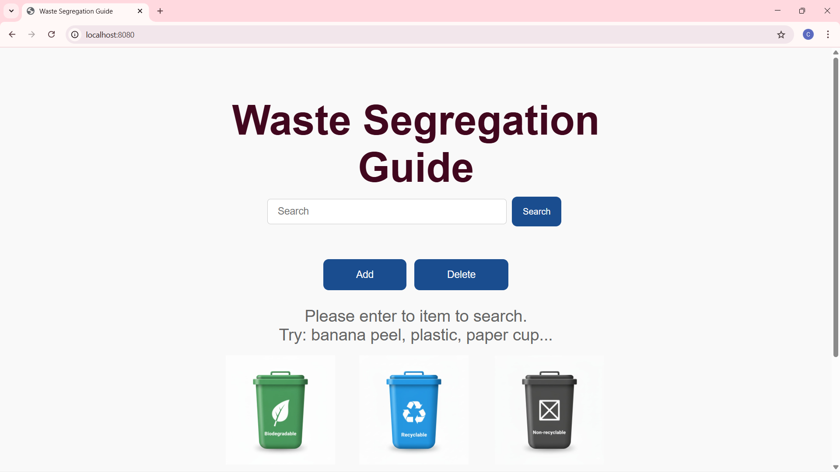
SAMPLE OUTPUT (SCREENSHOTS)

Slide 19
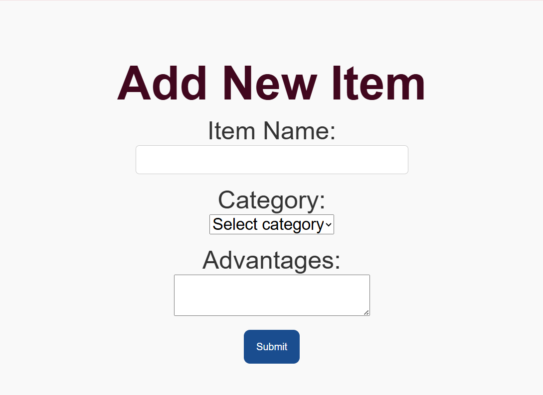
SAMPLE OUTPUT (SCREENSHOTS)

Slide 20
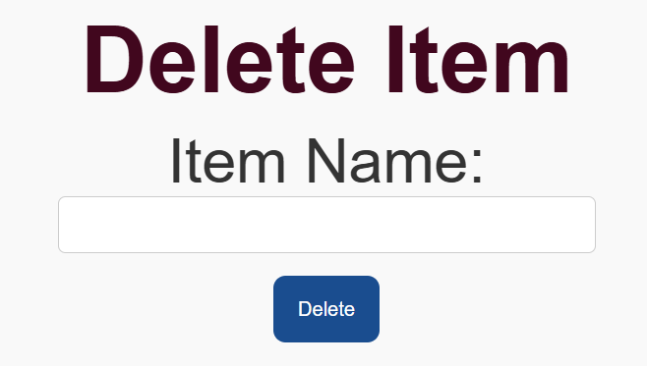
SAMPLE OUTPUT (SCREENSHOTS)

Slide 21
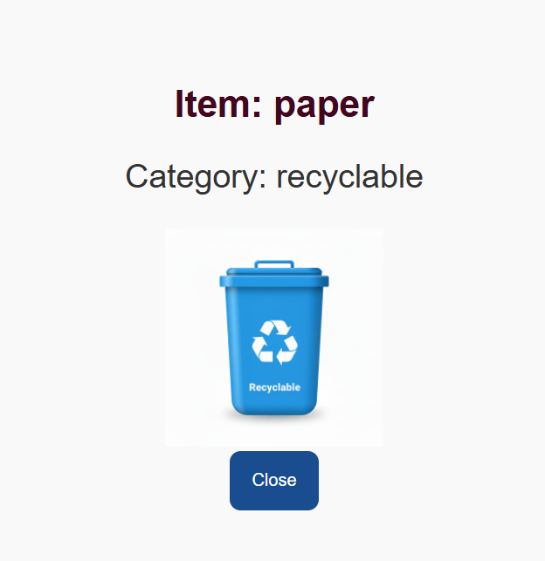
SAMPLE OUTPUT (SCREENSHOTS)

Slide 22
CONCLUSION
The Waste Segregation Management System effectively bridges the gap between awareness and action in waste management. It provides a simple yet powerful web-based platform that promotes environmental responsibility.
Key Outcomes:
Promotes digital learning about waste segregation.
Helps individuals and institutions adopt sustainable habits.
Demonstrates the potential of Java Full Stack development for social good.
Future Enhancements:
Integrating AI-based waste image classification.
Introducing IoT-enabled smart bins for automatic sorting.
Developing a mobile app version for greater accessibility.
By combining technology and awareness, the system contributes significantly toward a cleaner and more sustainable future.

