Slide 1
PRESENTATION OF GIT
TOPIC’S
GIT Repository | GIT Commit
GIT Status | GIT Checkout
GIT Files | GIT merge
GIT add . | GIT Issue fixed
GIT Branch | GIT Diff

Slide 2
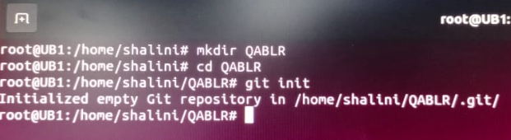
GIT Repository:
mkdir Repository_name
example: mkdir QABLR
Step1: Create a Repository name called QABLR and use git init command to create a empty Repository. The git folder is create under a directory with subdirectories. Repository get initialized the process of other files starts beigns.

Slide 3
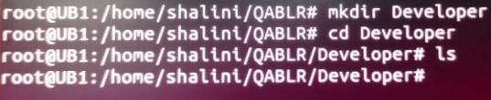
mkdir foldername
example: mkdir Developer
Step2: Create a new folder name called Developer under Repository path.
Step3: Create 2Test files under Developer path.
Developer
add.txt
sub.txt

Slide 4
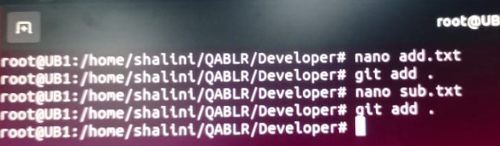
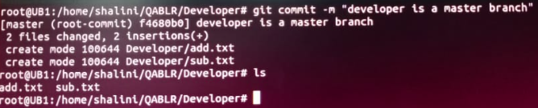
DEVELOPER: nano add.txt / nano sub.txt
aad.txt = a+b
sub.txt = c-d
Step4: use git commits –m command to changes a repository. Git commit use to create a master branch and it is a new or separate branch version of the main Repository.
git commit –m “developer is a master branch”

Slide 5

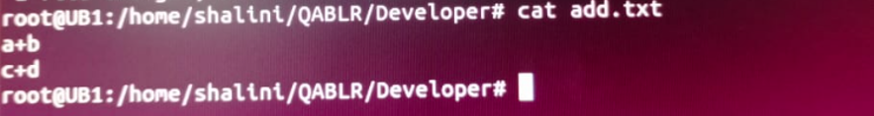
git branch add1
Step5: The git checkout command used to navigate between the branches created by git branch and Switching branches to straightforward operation.
git checkout add1
Step6: make changes for add.txt file

Slide 6
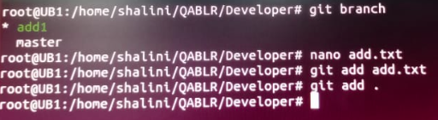
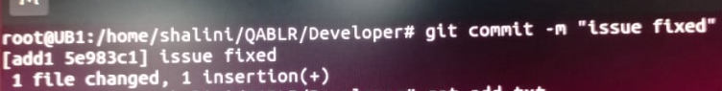
Step7: use below commands to list current branch and add changes in the working branch file of staging area.
git branch
nano add.txt
git add .
Step8:
git commit –m “issue fixed”

Slide 7
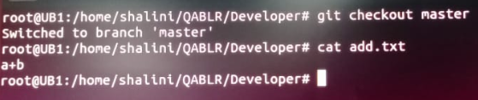
Step9:
using checkout command to see the difference of master branch file add.txt and new branch file add.txt
git checkout master
Git checkout add1

Slide 8
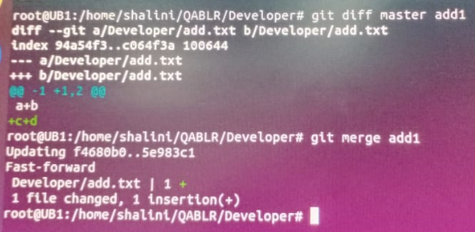
Step10: git diff can be used to compare the changes between different entities. Entities can be files, commits, or branches.
git diff master add1
Step11: The current branch master to the target branch add1.They combines using the command.
git merge add1

Slide 9

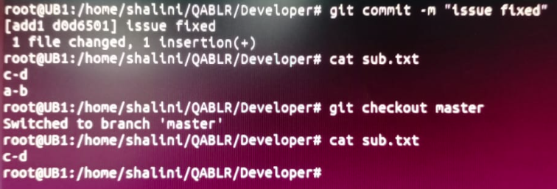
Step12: make changes for add.txt file
git commit –m “issue fixed”
git checkout master

Slide 10
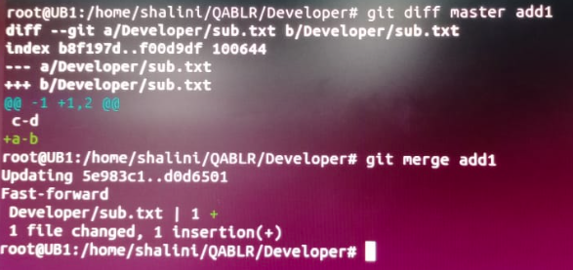
Step13: git diff can be used to compare the changes between different entities. The current master branch to the target branch add1.They combines using the command.
git diff master add1
git merge add1

