Slide 1

PRODWID
TEAM TIME VARIANCE AUTHORITY

Slide 2
What problem are we solving
Distractions due to social media
You dont have your schedule right in front of you as soon as you sit down to work
Overwhelming huge tasks cause procrastination

Slide 3

Our solution
USP : Project Scheduling – Helps break down huge projects into smaller achievable tasks
Enabling productivity by making planning and scheduling easier and effective
A Widget that includes Task list, Pomodoro Timer, Do not disturb mode etc.

Slide 4
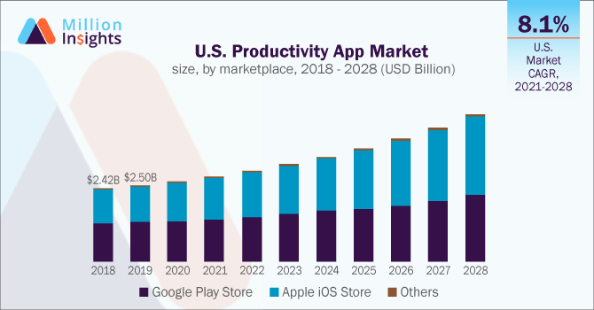
Market for productivity apps
Market size was valued at USD 8.14 billion in 2020
User Demographic of 18 –24
Top Players include:
Notion
EverNote
MicrosoftToDo
ToDoIst
Notes:
The global productivity app market size was valued at USD 8.14 billion in 2020 and is expected to grow at a compound annual growth rate (CAGR) of 9.1% from 2021 to 2028. This can be credited to the rising demand for visual interface-based productivity apps across the globe

Slide 5
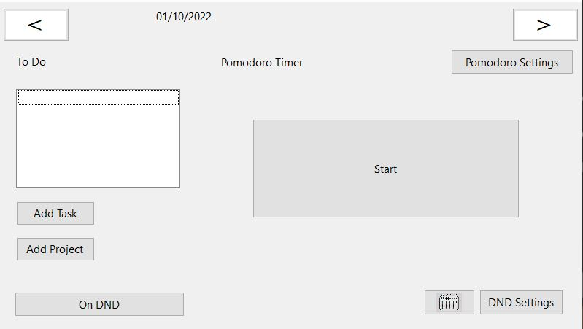
Current Version/ Prototype

Slide 6
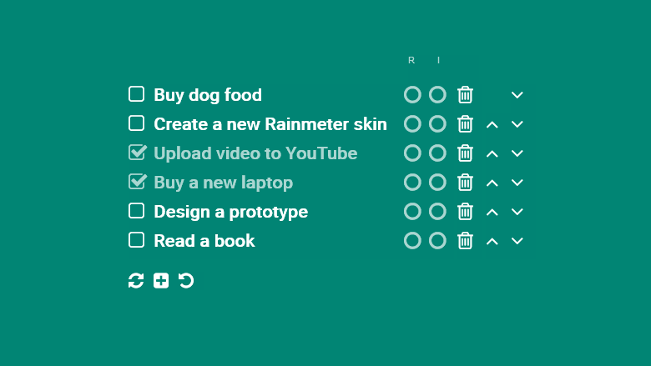

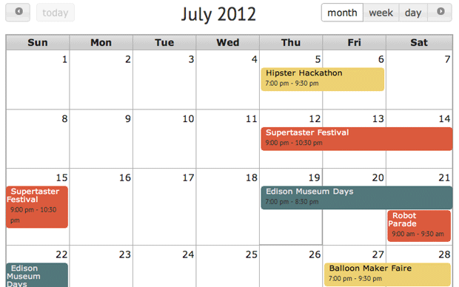

Future Vision

