Slide 1
K.K.COLLAGE OF ENGINEERING & MANAGEMENT
Project Presentation on
(Online Voting System)
Submitted by-
Chandramani kumari
Sanjana sahu

Slide 2
OUTLINES
Introduction
Problem Statement
System Architecture
Technology Use
Live Demo
Advantage
Limitation
Conclusion

Slide 3
introduction
“ONLINE VOTING SYSTEM” is a web based application in which voter can use his/her voting right online without any difficulty. He \she has to fill a registration form to register himself\herself. All the entries is checked by the DATABASE which has already all information about the voter. If all the entries are correct then a USER ID and PASSWORD is given to the voter , by using that ID and PASSWORD he\she can use his\her vote. If condition are wrong then entry will be discarded

Slide 4
Problem Statement
Now-a-days people find very less time to cast the vote .And there are several issues where India, democratic country is unable to get polling of 100%.In order to make voting easy and secure , online voting system
helpful. Voter has to register first and then login .Voter is authenticated and then proceed to voting page . Voter cast the vote and logout. One can view the results at any instance of time .

Slide 5
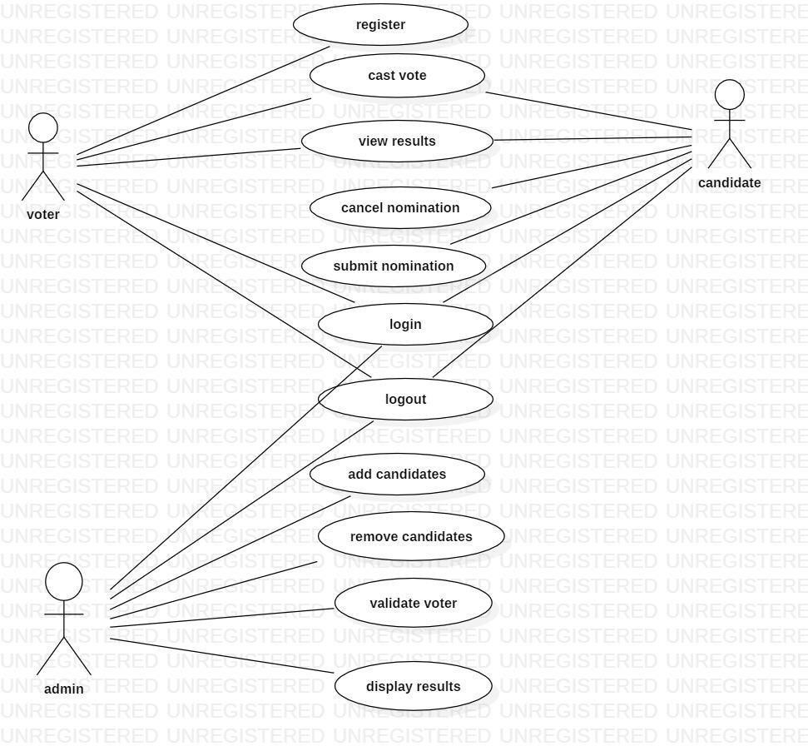
System Architecture

Slide 6
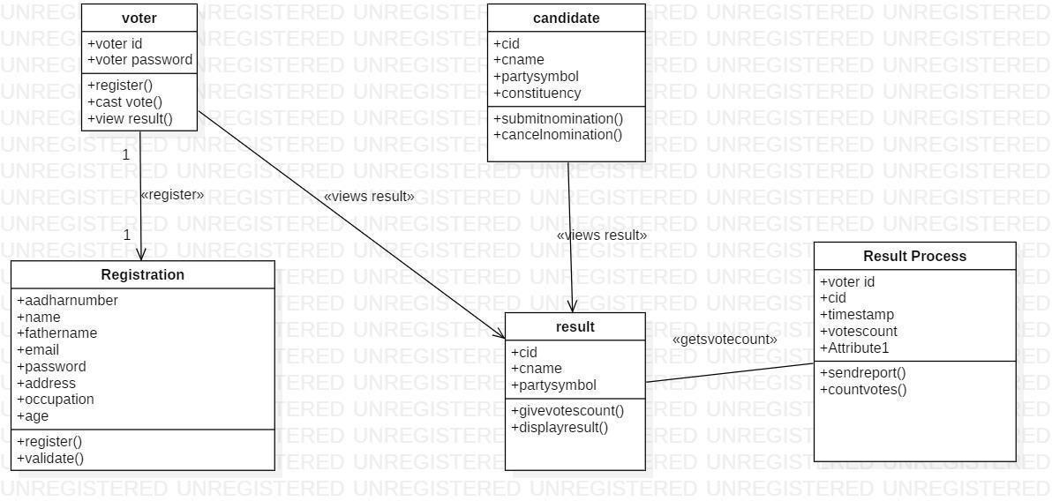
CLASS DIAGRAM

Slide 7
TECHNOLOGY USED
Front-end:
HTML
CSS
PHP
JAVASCRIPT
Back-end:
PHP
MYSQL

Slide 8
LIVE DEMO

Slide 9
ADVANTAGE
Increased Accessibility and Convenience: Voters can cast their ballots from any location with internet access, using a computer, tablet, or smartphone. This is particularly beneficial for people with disabilities, citizens living abroad or in remote areas, and those who are sick or busy, as it eliminates the need to travel to a physical polling station and wait in lines.
Higher Voter Turnout and Engagement: The convenience and flexibility of remote voting reduce barriers to participation, which can lead to a substantial increase in voter turnout, especially among younger, more tech-savvy demographics.
Cost and Time Efficiency: Online voting significantly reduces the expenses associated with traditional elections, such as printing and transporting paper ballots, renting polling locations, and hiring large numbers of manual counting staff. The automatic counting process also saves considerable time, allowing for the rapid reporting of election results, often instantly after polls close.

Slide 10
ADVANTAGE
Enhanced Accuracy and Reduced Errors: By automating the vote counting process, online systems minimize the risk of human errors such as miscounts or lost ballots. The systems can also provide immediate feedback to voters, detecting potential problems
like over-voting (selecting too many candidates).
Improved Security and Auditability (with proper implementation): Reputable online voting platforms employ robust security measures, including advanced encryption, multi-factor authentication, and unique voter identification, to protect voter data and ensure the integrity of the vote. Many systems offer detailed audit trails, allowing administrators to verify that the process was fair and results were not manipulated.
Environmental Benefits: Eliminating the extensive use of paper ballots and reducing transportation needs for both voters and election materials contributes to environmental sustainability.

Slide 11
LIMITATION
We are developing a website for casting the vote online. While casting the vote the most important thing is security. We are providing security through the OTP authentication . OTP also provides strong security but it would be more secure if we use fingerprint detection and cornea detection and map it with the aadhar database details.

Slide 12
CONCLUSION

