Slide 1
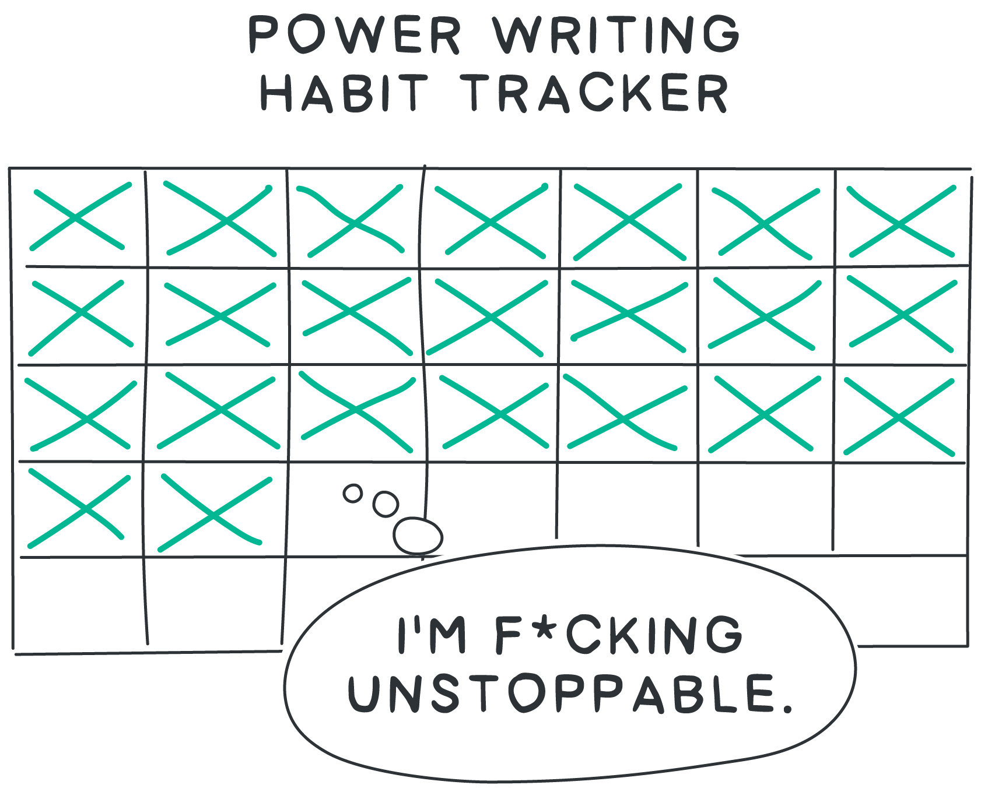
Habits of a Power Writer
Aka how to get good at this stuff.

Slide 2
How do I get better at writing?
Practicing
Noticing

Slide 3
PRACTICING.
That’s obvious.

Slide 4
But...
Writing original content is exhausting… how do you practice?

Slide 5
Learning writing is like learning guitar.

Slide 6
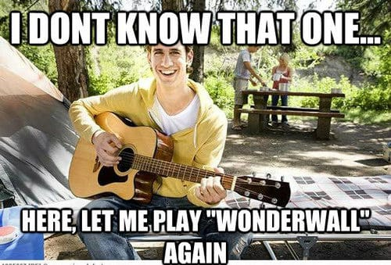

Slide 7
Learn to cook? Follow recipes
Learn guitar? Play popular songs
Learn to draw? Start by tracing
Learn to write? Copy great writing

Slide 8
It’s called:
“copywork”

Slide 9


Slide 10
Hunter S. Thompson used to re-write the Great Gatsby before he wrote his books.
Ben Franklin loved The Spectator. So he re-wrote it to improve his writing.
Naval talks about reading “The Day You Became a Better Writer” before writing.

Slide 11
My Go-To for Copywork
For short business writing:
The Day You Became A Better Writer
Frank Slootman’s memo
We don’t sell saddles here
If I want to be loose, charming, charismatic
The Boron Letters - (all of them)
How to use words to get people to do what you want them to do - sam parr
If i want to write something thoughtful, about life:
How to get Rich without Getting Lucky - Naval
What you’ll wish you’d known - paul graham

Slide 12
Pick 1.
Read it.
Rewrite it.

Slide 13
It’s weird but it works.

Slide 14
Ok got it. Practicing… next...Noticing.

Slide 15
Noticing Test
What do you mean..

Slide 16
You want to start keeping an eye out for effective writing.
Then stashing what you see, for future use.

Slide 17
Your stash is called a
swipe file

Slide 18
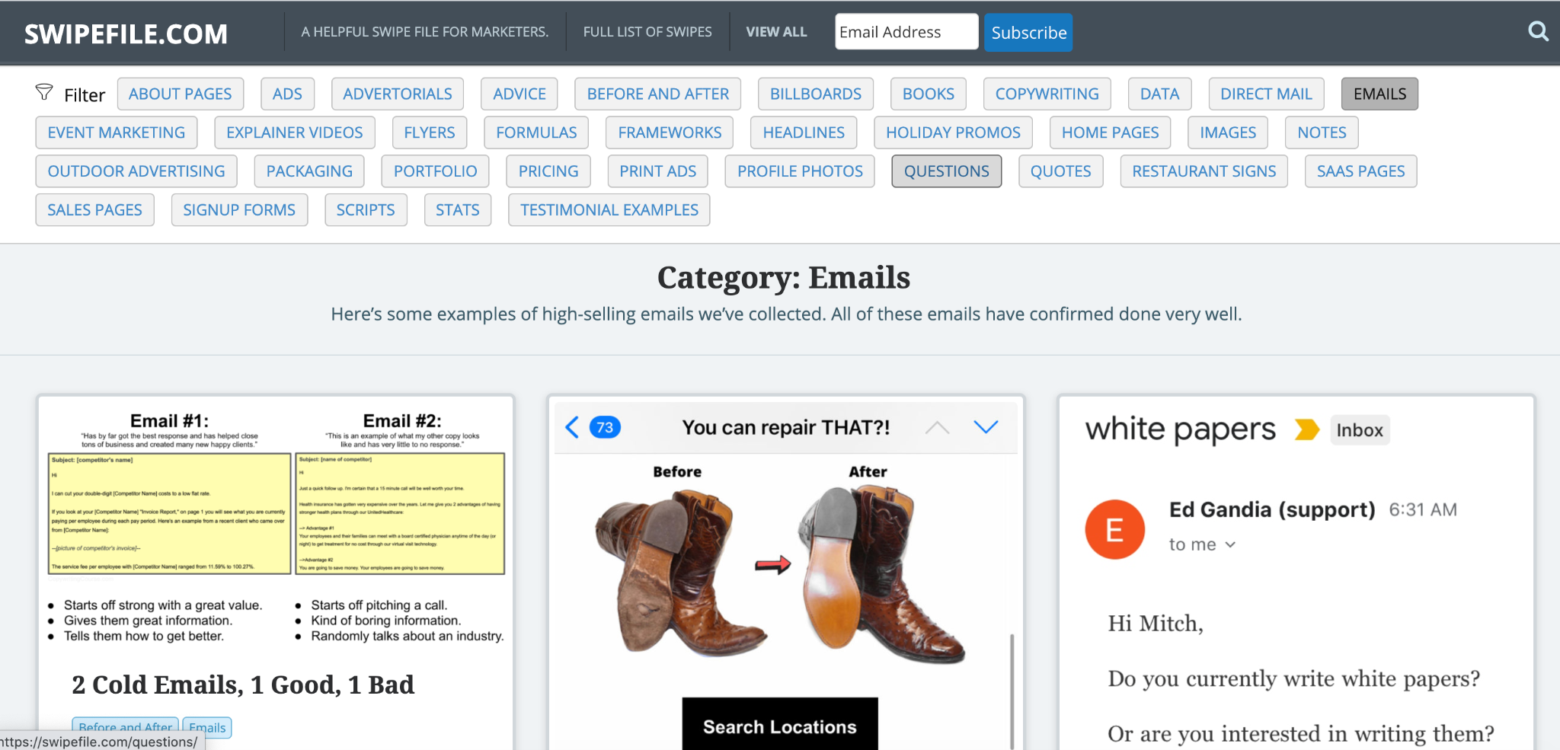
A fancy one - from my friend neville (swipefile.com)

Slide 19
My swipe files
Openers
Closers
Transition words
Phrases / analogies
Diagrams
Hero Images
Great facebook ads

Slide 20
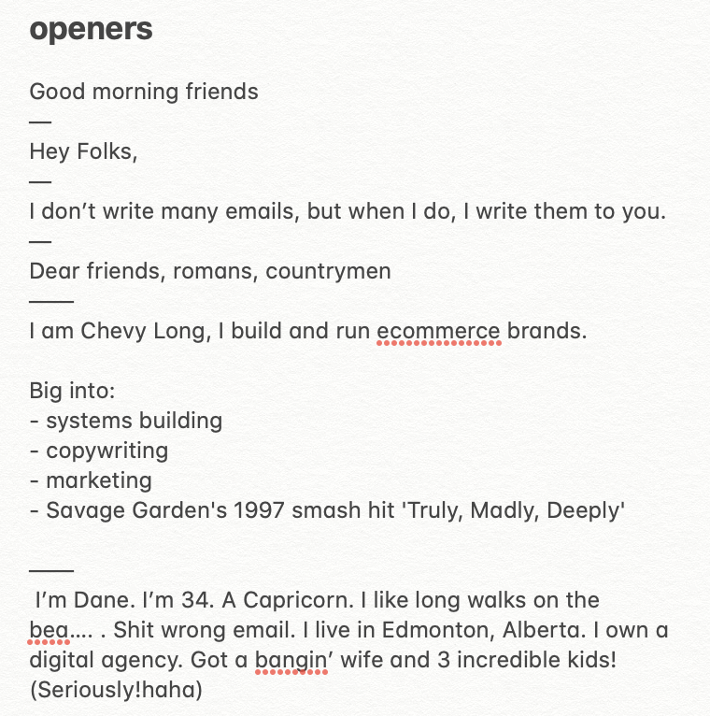
My Openers Swipe

Slide 21
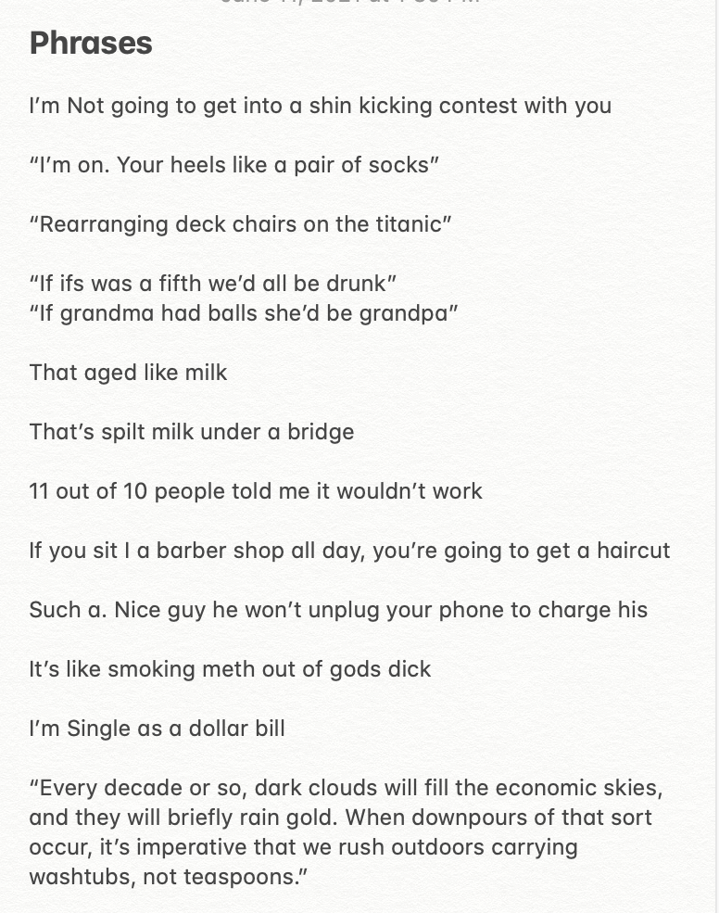
My “Fun Phrases” Swipe

Slide 22
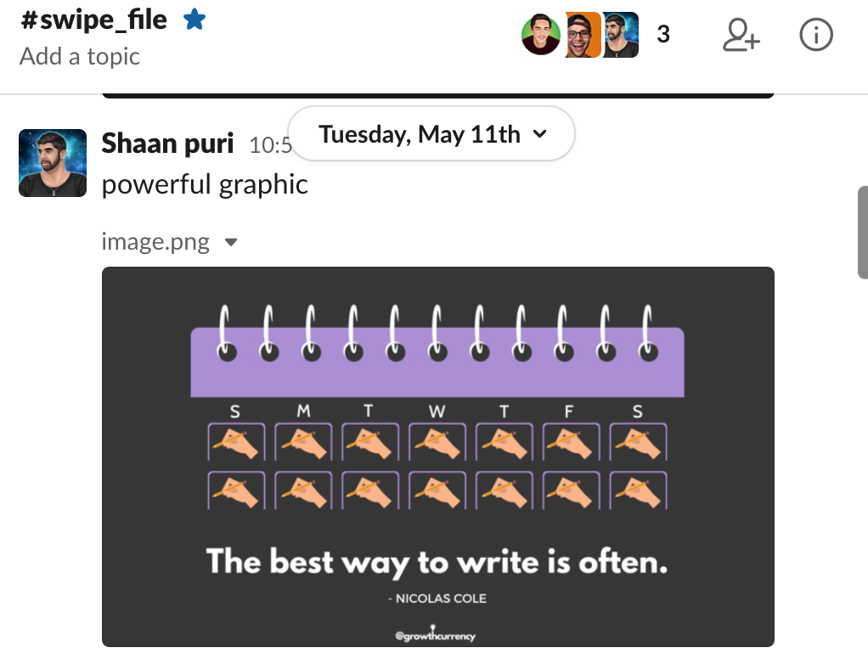
Doesn’t need to be fancy. I use slack & notes app.

Slide 23



Make Your Swipe File
And add these 3
Ad Swipe
Headline Swipe
Hero Image Swipe

Slide 24
OK.. what writing process do you recommend?

Slide 25
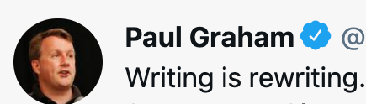
http://byronm.com/13sentences.html

Slide 26
Tools I Use
Hemingway App - gives you tips as you write (eg. don’t use fancy words)
HypeFury - the tool I use for writing twitter threads
Other than that … google docs.

Slide 27
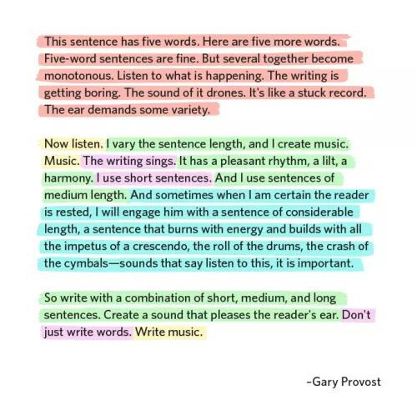
Writing Hacks
←- great writing sings. Try re-writing your posts using this paragraph structure.

Slide 28
How long should it be?
Shouldn’t it be short?
6/36 SHAANPURI.COM POWER WRITING COURSE

Slide 29
It’s not about making it “as short as can be”. It’s about making it “as long as it is interesting”
Short
Loooong
If I drive around, I sometimes notice the houses and buildings all around. There are also pieces of farm land that are very large. Houses can be built from different kinds of materials. The most common types are brick, wood, and vinyl or synthetic siding. Houses have lawns that need to be tended. Lawns need to be mowed regularly. Most people use riding lawnmowers to do this. You can also use a push mower. These come in two varieties: gas-powered and manual
This is short, but uninteresting. I finished reading, but I won’t do anything.
7/36 SHAANPURI.COM POWER WRITING COURSE

Slide 30
It’s not about making it “as short as can be”. It’s about making it “as long as it is interesting”
Interesting Long
Let’s make one thing perfectly clear. You’re reading these words because I want you to.
It’s like I’m casting a spell. The spell makes you slowly keep reading more and more.
Not because you’re forced to, but because you want to. You’re intrigued.
Would you like to learn the spell? So you can get people to hang onto every word you write?
7/36 SHAANPURI.COM POWER WRITING COURSE

Slide 31
7 Power Writing Hacks
#1 - Write at 5th - 8th grade reading level #2 - Don’t use adverbs (things that end in -ly)
#3 - Put the subject first in a sentence (“the boy hit the ball” instead of “the ball was hit by the boy”)
#4 - Use visual language (eg. “we’re going to build a huge wall at the border” vs. “improve national border security”)
#5 - rhymes and alliteration work. Feel free to rhyme anytime.
#6 - keep it personal (“I” or “you” not “we” or “one”)
#7 - Spend 20%+ of your time on the first line, last line, and formatting (readability for mobile)
BONUS: Don’t write like you write. Write like you talk. When in doubt. Talk out loud first...THEN write what sounded good!

Slide 32
summary:
The fastest way to get good is copywork
Create a swipefile to stash great things you find
Great writing is re-writing
Remember my 7 hacks for power writing

Slide 33
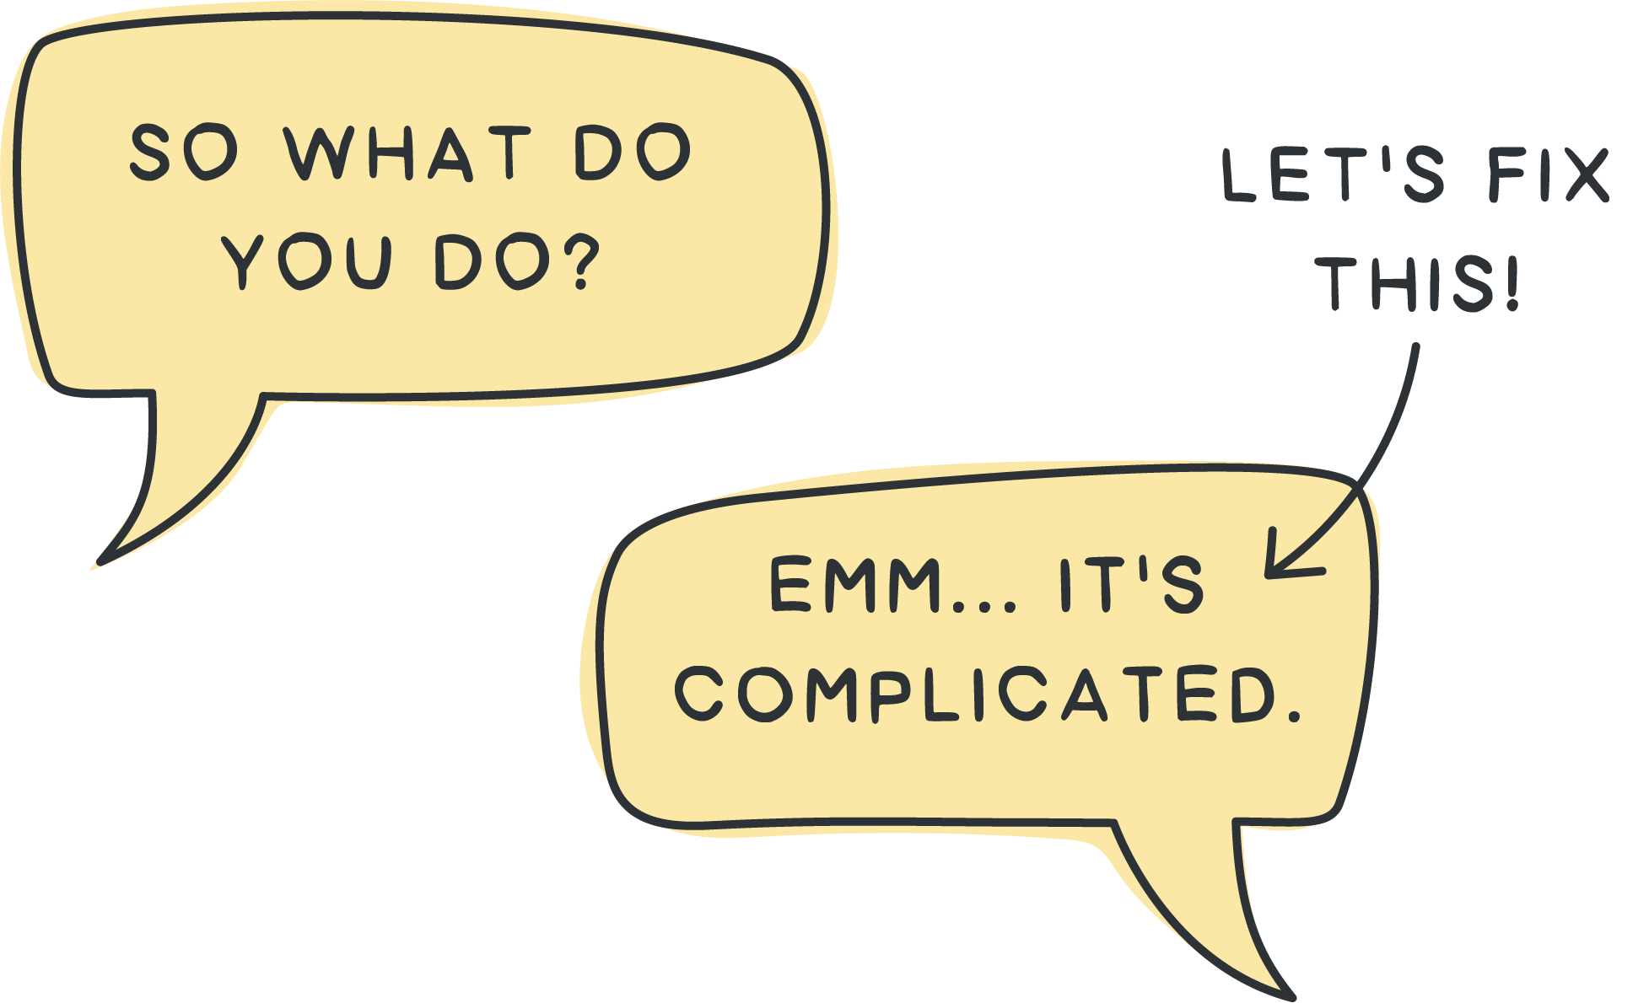
Describing what you do
By Shaan Puri
POWER WRITING COURSE

Slide 34
POWER WRITING COURSE

Slide 35
You should be able to explain:
What the company does
Who it’s for
Why it’s needed
In plain jane english.
8/36 SHAANPURI.COM POWER WRITING COURSE

Slide 36
Who wants some action? I need a founder/ceo volunteer
9/36 SHAANPURI.COM POWER WRITING COURSE

Slide 37
I’m an investor, you have 45 seconds to tell me about your company. GO!
9/36 SHAANPURI.COM POWER WRITING COURSE

Slide 38
notes:
I’m building a company that helps you invest in commercial real estate for $100
8
You know how creating videos is expensive, time consuming and sucks. We help bring the video production in house while still handling the editing outsourced for far less time and money
5
I work at a big automotive company, and i’m responsible for making sure your car gets outta the snow if it’s stuck
7
I’m brian i’m the CFO of the division of bloomberg, its the electronic trading division. Its undergoing hyper growth right now. Really cool.
4
2/36 SHAANPURI.COM POWER WRITING COURSE

Slide 39
notes:
I help people find love. I own a video speed dating company. And we do courses for singles as well
7
2/36 SHAANPURI.COM POWER WRITING COURSE

Slide 40
notes:
I’m building a company that helps you invest in commercial real estate for $100
Most people think real estate is a good investment. But they feel like they don’t have the money, time or expertise to do it .
We are an app that lets you invest in commercial real estate for as little as $100 at a time
So you can get passive income coming in every month from real estate you own - without ever lifting a finger.
2/36 SHAANPURI.COM POWER WRITING COURSE

Slide 41
notes:
I’m brian i’m the CFO of the division of bloomberg, its the electronic trading division. Its undergoing hyper growth right now. Really cool.
Most CEOs are great at product & vision, but struggle with things like pricing, forecasting, and keeping an eye on the books
So they hired me to focus on that
So that they can keep growing the customer base, and sleep easy at night knowing that the numbers are taken care of
2/36 SHAANPURI.COM POWER WRITING COURSE

Slide 42

Most people suck at this.
2/36 SHAANPURI.COM POWER WRITING COURSE

Slide 43
Try It!
Write a 45 second description:
What does your company do?
Post it into the #showyourwork channel in slack
(Doesn’t matter if you’re a solo freelancer or work at a 50,000 person company)
9/36 SHAANPURI.COM POWER WRITING COURSE

Slide 44
Hero slide of pitch deck
Landing page
Twitter bio
Slogan
(fundamental description)

Slide 45
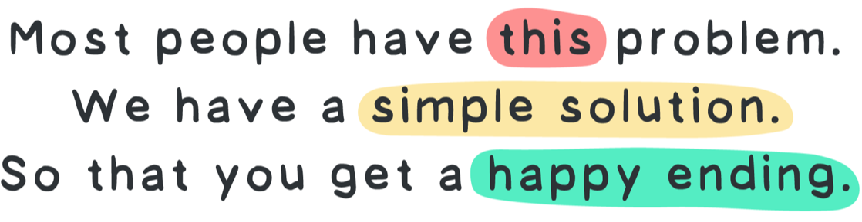
11/36 SHAANPURI.COM POWER WRITING COURSE
Don’t worry! The storybrand formula can help

Slide 46
Start with the problem
Most people struggle with _____
Most _____ hate doing
Most _____ are tired of..
Most people worry about _____
Most teachers hate ______ Most teenagers are stuck _____
Most new parents feel _____
etc..

Slide 47
Example problem statements
14/36 SHAANPURI.COM POWER WRITING COURSE
“Most people work all their life but have no idea if they’ve saved up enough to retire” - Financial advisor

Slide 48
Example problem statements
14/36 SHAANPURI.COM POWER WRITING COURSE
“Most dog owners don’t know what the heck their dog food is made of” - Dog food brand

Slide 49
Problem statement tips
15/36 SHAANPURI.COM POWER WRITING COURSE
Try using “most people” or “most [job title]” or “the average person”
If possible, name your customer (eg. “most teachers”)
The problem should be one that they nod & agree with.
Focus on what they feel not what you judge about them (eg. “feel worried”, “feel stressed”, “struggle with”, “are tired of”)

Slide 50
Now… a simple solution
That’s why we made a 3 step formula for _____
We created a 1-click way to _____
So we created a store that _____

Slide 51
Example solution statements
16/36 SHAANPURI.COM POWER WRITING COURSE
“The average tech person spends 3+hours a day, just trying to keep up with email, so we built a blazing fast client for gmail that lets you get through your email in half the time”

Slide 52
Paint a picture of the happy ending
`
What happens after they use your solution?
(hint - it’s the opposite of the problem)

Slide 53
Complicated == jargon, hard to understand
Simple == easy to understand, less words, but may not get me to care.
MOST PEOPLE THINK THE GOAL IS TO GO FROM “COMPLICATED” TO “SIMPLE”
8/36 SHAANPURI.COM POWER WRITING COURSE

Slide 54
Power == is about getting people to “give a shit”
About what your company does
8/36 SHAANPURI.COM POWER WRITING COURSE

Slide 55
Secret to getting them to “give a shit”
They don’t give a shit about your company
They give a shit about themselves.
8/36 SHAANPURI.COM POWER WRITING COURSE

Slide 56
EXAMPLE
“Learn the fundamental techniques and psychology of effective power writing”
“A writing course”
Most people have ideas in their head, but feel stressed trying to write them out clearly. This is a 10 day crash course in business writing. So your writing turns into a lean mean crisp writing machine.
8/36 SHAANPURI.COM POWER WRITING COURSE

Slide 57
2 millimeter shifts.
Change the focus from “your company” to “the customer”
“Describe their problem, then your solution”
“Cut out all the fancy, industry words” (would your mom
Understand this??
8/36 SHAANPURI.COM POWER WRITING COURSE

Slide 58

Complicated
8/36 SHAANPURI.COM POWER WRITING COURSE

Slide 59
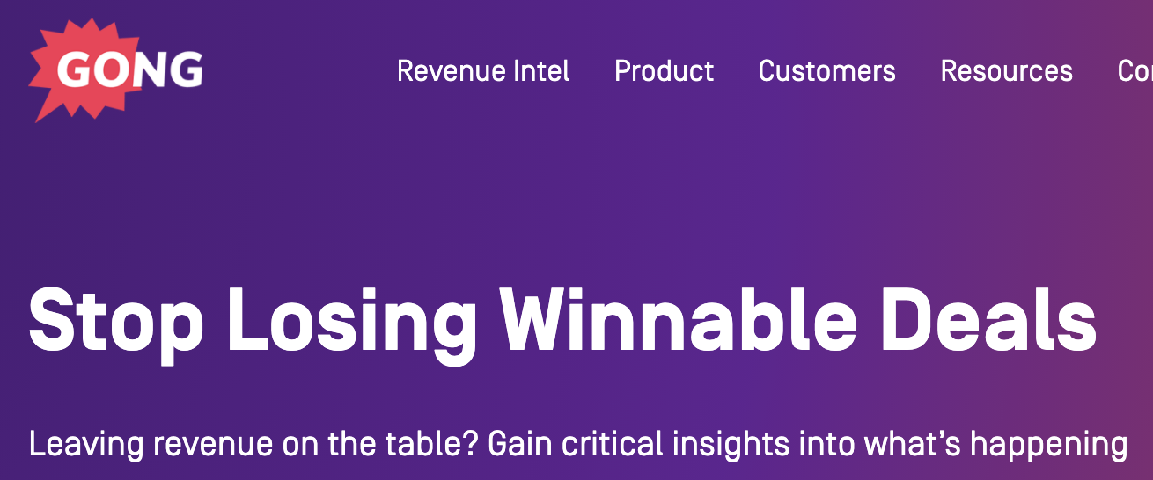
Complicated
powerful
8/36 SHAANPURI.COM POWER WRITING COURSE

Slide 60
Let’s try again.
`
8/36 SHAANPURI.COM POWER WRITING COURSE

Slide 61
notes:
2/36 SHAANPURI.COM POWER WRITING COURSE

Slide 62
notes:
2/36 SHAANPURI.COM POWER WRITING COURSE

Slide 63
Most people struggle to find the right words
that’s why we use a simple 3 step framework.
So you can be confident next time someone asks “what do you do?”
.
5/36 SHAANPURI.COM POWER WRITING COURSE

Slide 64
Example problem statements
14/36 SHAANPURI.COM POWER WRITING COURSE
“The average person spends 3+hours a day, just trying to keep up with email” - Superhuman

Slide 65
Example solution statements
16/36 SHAANPURI.COM POWER WRITING COURSE
“Most dog owners don’t know what the heck their dog food is made out of…
so we make dog food from normal ingredients, that even a human can eat”

Slide 66
Summary
18/36 SHAANPURI.COM POWER WRITING COURSE
Most people suck at explaining what their company does
The 3-step storybrand formula helps
Start with the problem the customer would agree with
Then pitch your simple solution
Paint a picture of the happy ending (problem is gone)

