Slide 1
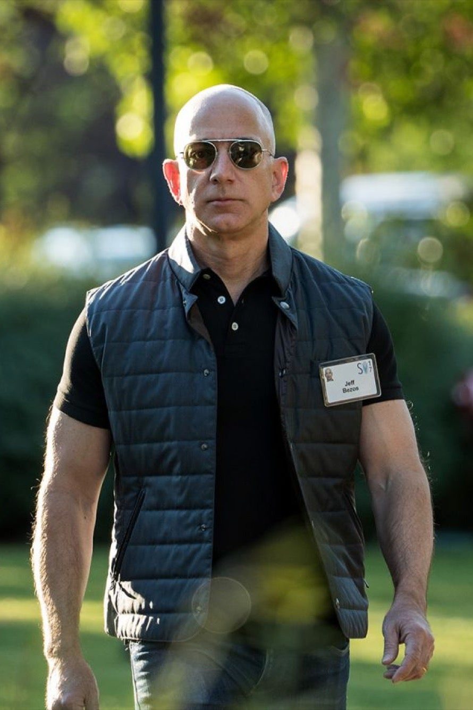
SESSION 6
Writing like
Jeff Bezos
(aka using writing inside a company)
By Shaan Puri
POWER WRITING COURSE

Slide 2
Writing is nature’s way of showing you how sloppy your thinking is. Clear writing is clear thinking”
Do you want to be known as a clear writer? NO! A clear thinker

Slide 3
The Promise:
By the end of the hour you will: 1. Have a solid framework for writing business updates to your boss/investors
2. Spin up your first “internal newsletter”

Slide 4
Let’s do it.
In the next 10 mins, draft a quick monthly update to your boss/investor for your company or project.

Slide 5
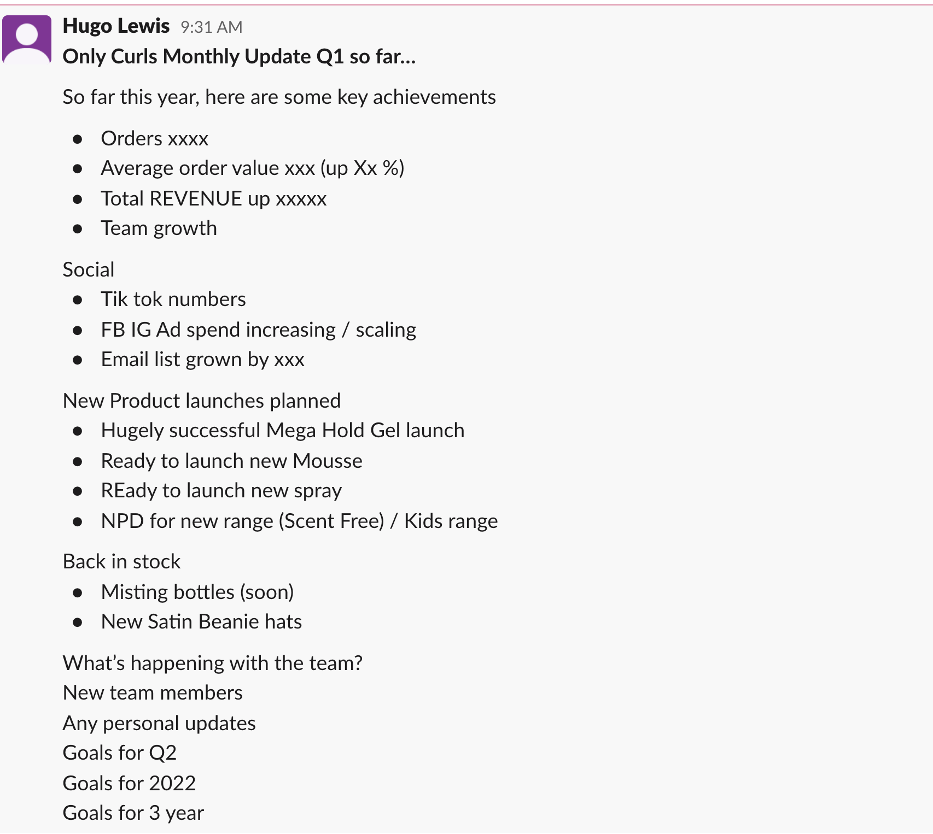
Example:
Hugo says: * dry
* looks backwards, not forward?
Audience says:
Tell me what to think about this
Add in what that lets us do aka the “so what”
Color code and bold → improve readability
Tell the story

Slide 6
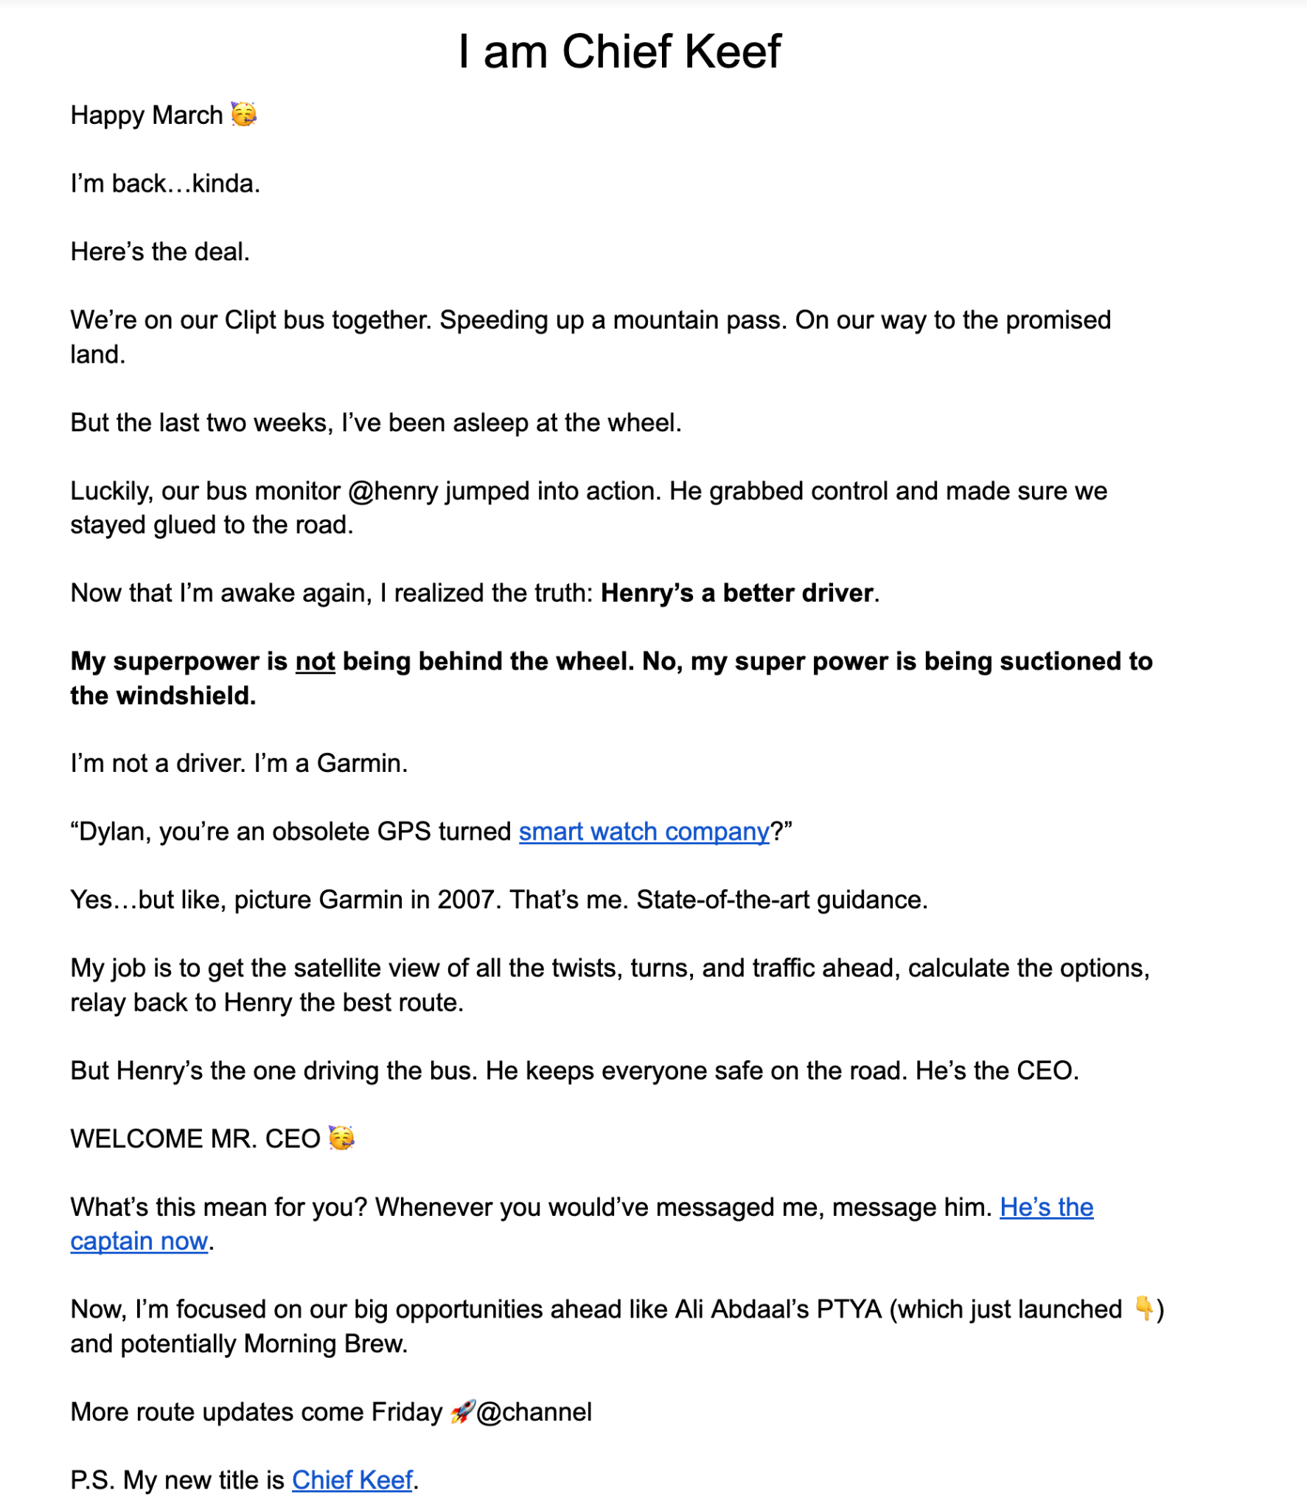
Example:
Audience feedback:
Good:
Honest
Fun to read
Writes like he talks
Bad/Room for improvement:
Presented too much like a comedy
Long to get to the point
Not sure what my takeaway is and what this means for me

Slide 7
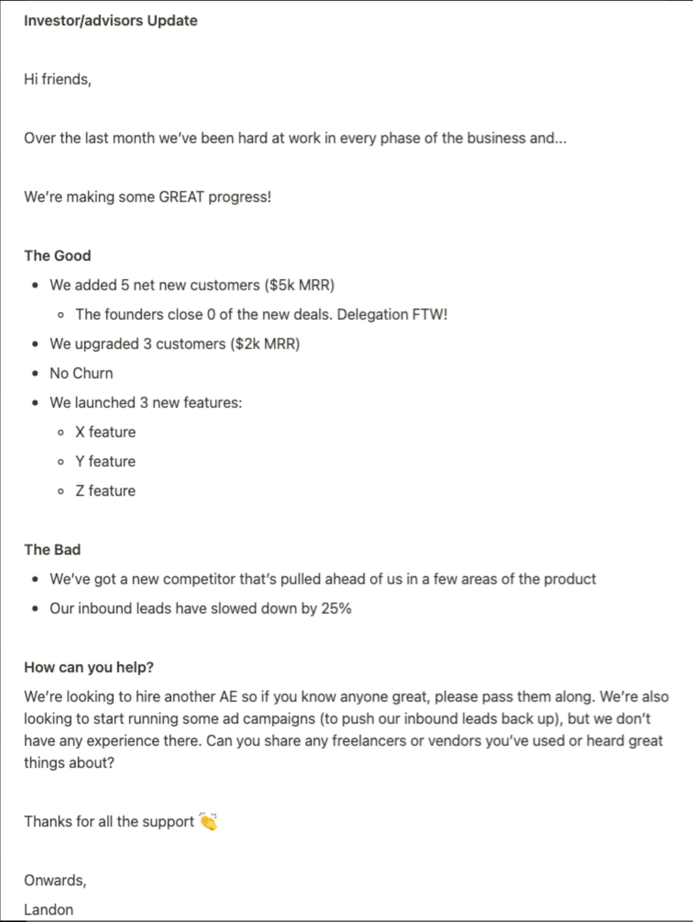
Example:
Landon:
Good:
Framing -> told them what to think
Split up good and bad news
Good ask in the email
Could be better:
Why? Why are sales going up? Is a plan working?
You told me what happened but not why

Slide 8
Common Mistakes I see
Forget to ask - what does the reader care about?
Dump, here’s all the shit we did instead of how it’s going
Missing an ask
Only sharing good news

Slide 9
The WHAT → WHY → SO WHAT Framework
What happened? (answer the question of how it’s going)
Why did it happen?
So What are we going to do about it?

Slide 10
Example.
What
Why
So What
this was an AWESOME month. Revenue was XX this month, up by Y%. Normally, as a brit, I don’t get too excited. But I make exceptions for huge months like this :)
Sales went up because – we’ve had massive growth on our social media, which led to more new customers. Instagram is up Xx, and Tiktok is up YY - thanks to the new agency we hired who is crushing it.
Going forward, here’s what I need from you!
Let’s double down on social. It’s working. I just mailed you a new iphone (yep, everyone) to help you make content each day. Here’s my guide to making great content (link)
My ask of you → this friday, everyone submit a piece of content into the “content” channel on slack. And i’m giving away a prize to the winner!

Slide 11
Why write updates?
Live in powerful peoples head, rent free
Create room for serendipity
For yourself to take a step back outta the weeds
Builds trust over time

Slide 12
Who Gets These?
you
team
boss/investor
Friends of the House
Public

Slide 13
OK - now re-write your update using the WHAT WHY SO WHAT structure.
Share as a reply in #showyourwork

Slide 14
re-write

Slide 15
Part II
One of my career hacks…
How to stand-out instead of being just another cog in the machine.

Slide 16
Scenario… you write a newsletter but only have 10 subscribers
Was it worth it?
Waste of time?
Embarrassing?

Slide 17
Depends. Which 10 people?
Elon Musk?
Mother Teresa?
The guy who created capri-sun?

Slide 18
Internal Newsletters
(massively underrated)

Slide 19
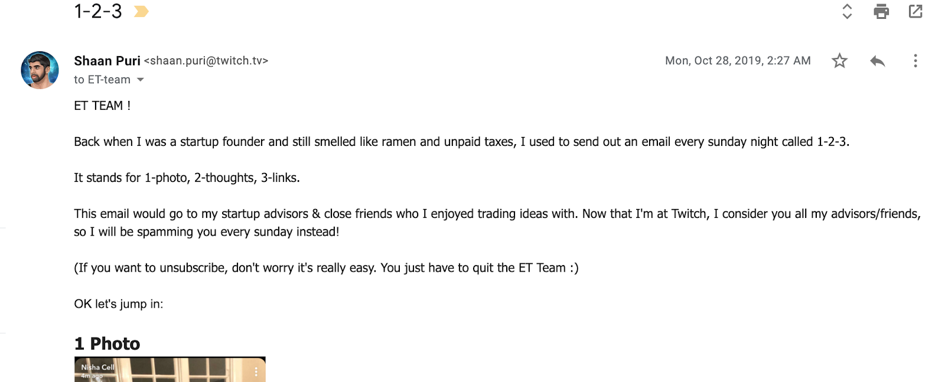
My internal newsletter

Slide 20
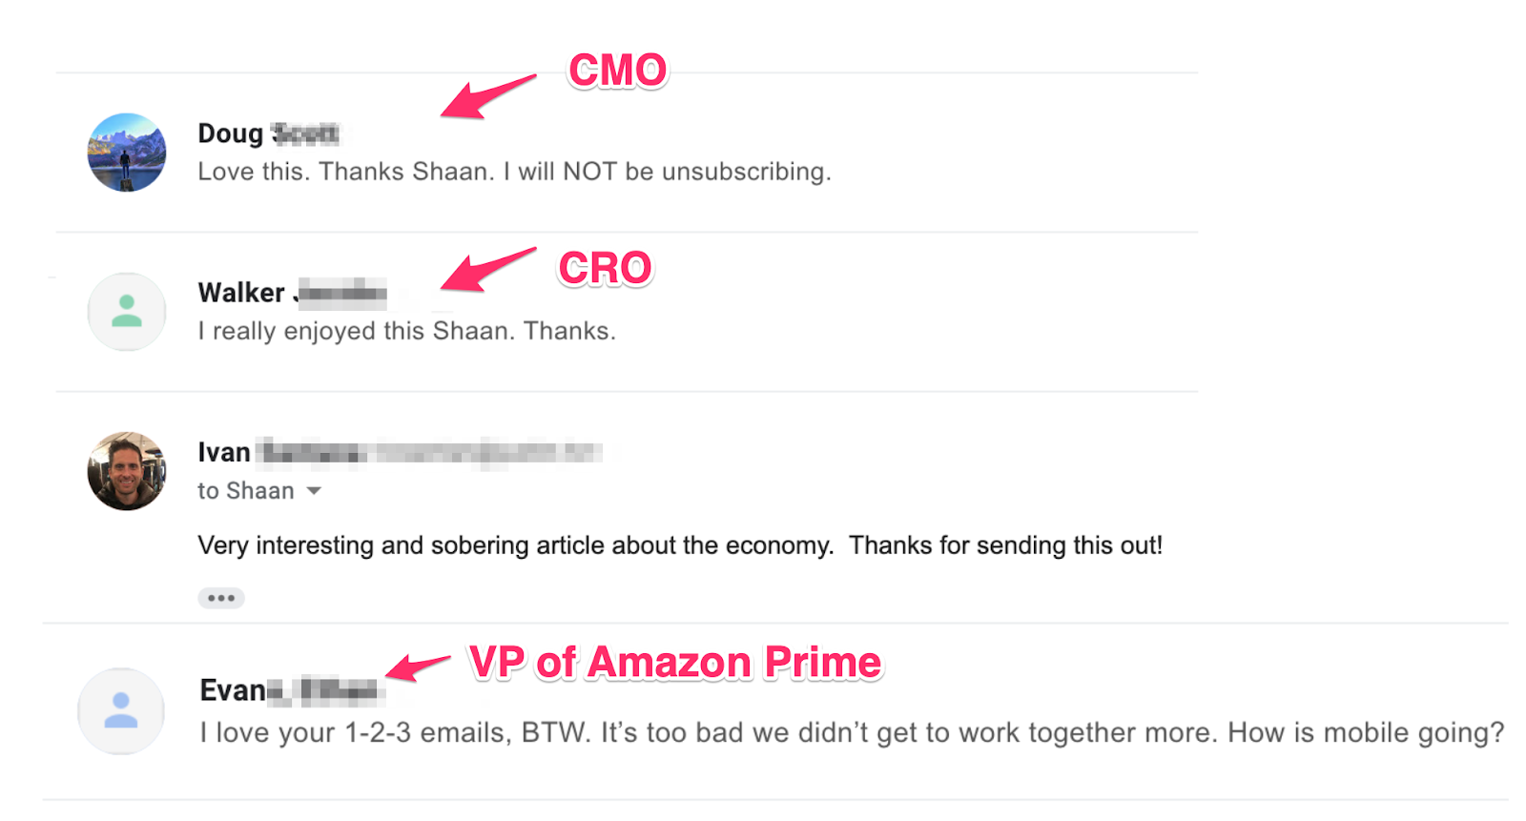
4 readers > 40,000 readers

Slide 21
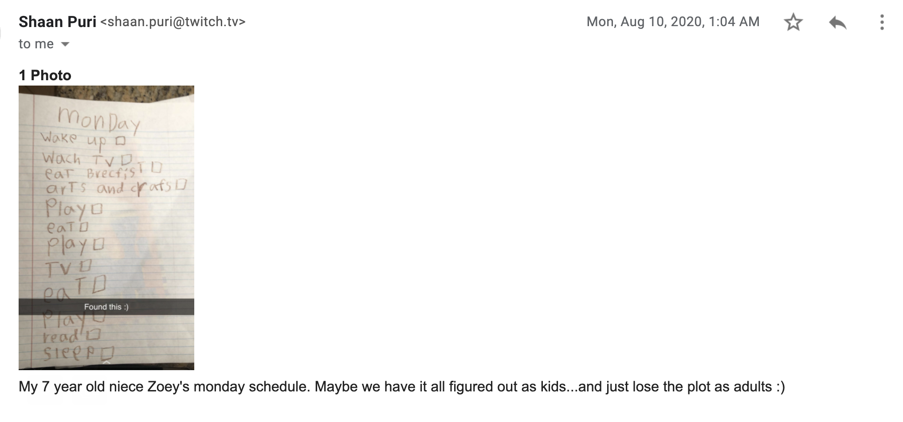
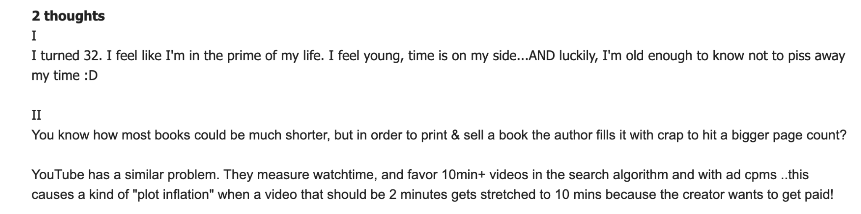

Slide 22
What did I do?
Every sunday, wrote an email.
Created a format. Mine was 1-2-3 (1 photo, 2 thoughts, 3 links) Opt-in all my favorite people in the company. After 3 sends, said reply if you wanna stay on. Skip the ladder.

Slide 23
SUMMARY
The What, Why, So What communication pattern for company updates
2. How to use an internal newsletter to build your brand inside a big company instead of just being another cog in the machine.
OK, you don’t write like Jeff Bezos.
But you did learn 2 actionable things that will make you a 2x+ better writer inside your company. Are you going to use them?

Slide 24
A No-Holds-Barred Review
“My brutally honest review of @shaanvp power writing course..”
What session was your favorite?
Session #1 - Cold emails that actually get replies
Session #2 - Power Writing Habits + Pitching your brand without stumbling and fumbling
Session #3 - Viral Writing
Session #4 - How to Write Amazing Headlines
Session #5 - Writing Landing Pages That Convert
Session #6 - Writing Like Jeff Bezos (What I Learned at Amazon)

Slide 25
Looking Back
Look at your ‘before and after’. See the transformation you’ve experienced in:
Cold Emails
Viral Writing
Pitching Yourself
Headlines
Landing Pages
Investor Updates/ Internal Newsletter
Now use this weekend to connect with people you didn’t get to during the course.

