Slide 1


DEPARTMENT OF ECE · AI / ML · NETWORK INTELLIGENCE · A.Y. 2026-27
Temporal Fusion Transformer–Based Multi-KPI Forecasting for Open RAN
Forecasting network conditions early to support proactive control
Presented by
Under the guidance of
B. Chandra Nikhilesh | 2520040091
M. Sujeeth Reddy | 2520040025
N. Sai Charan | 2520040021
<Guide Name>
<Designation, Department>
Student prototype · Simulated KPI data · 3-hour forecast horizon

Slide 2



Problem Statement
Why forecast network KPIs before taking action?
Dynamic traffic
Reactive response
Connected KPIs
User demand changes over time. Busy periods increase radio-resource use and delay.
If operators react only after congestion appears, users may already experience poor service.
Throughput, latency, packet loss and radio-resource use change together, so forecasting one KPI alone misses part of the picture.
Project goal: Predict several future KPIs and flag possible overload early, so action can be taken before users are affected.
TFT Multi-KPI Forecasting for Open RAN | 2 / 10

Slide 3







Objectives and Project Scope
A forecasting prototype, not a live network controller
Forecast 5 KPIs over the next 3 hours
Included now
Python pipeline, simulated dataset, forecasting dashboard and threshold-based alerts.
Use 12 h of history sampled every 15 min
Not included yet
Show P10 / P50 / P90 to communicate uncertainty
No live operator feed, live radio measurements or automatic RIC / xApp control.
Compare forecasts with thresholds and show warning levels
Next stage
Prepare for validation with real 4G / 5G measurements
Validate on documented real data, then test safe control recommendations.
TFT Multi-KPI Forecasting for Open RAN | 3 / 10

Slide 4







Data: KPIs and Dataset Preparation
KPI = Key Performance Indicator, a measurement of network behaviour
Throughput
Mbps · data delivered per second
Latency
ms · time for data to travel
Packet loss
% · packets that fail to arrive
PRB utilization
% · radio capacity in use
Active UEs
number of active user devices
Timestamp
orders records in time
How the dataset is produced
1 Python script
src/generate_data.py
2 CSV file
data/oran_kpis.csv
3 Records
1,600 rows · 15-min steps
4 Model input
Time-ordered KPI history
Limitation: the CSV is generated by our Python script. It is simulated data, not confirmed live telecom measurements. Future work: validate with a documented public RAN dataset.
TFT Multi-KPI Forecasting for Open RAN | 4 / 10

Slide 5

Methodology: Temporal Fusion Transformer
Input history → learn temporal patterns → predict future ranges
Past observed
5 KPIs · last 48 steps (12 h)
Variable Selection
LSTM Encoder–Decoder
Multi-Head Attention
Quantile Output
Known future
Timestamps of the next 12 steps
Learns which inputs matter
Local temporal patterns
Long-range dependencies
P10 / P50 / P90 for 5 KPIs
Static
Series / cell identifier
Gated residual layers connect the blocks and skip parts that are not needed.
Why TFT?
Why quantiles?
Designed for multi-horizon time-series forecasting; combines recurrent temporal learning with attention and handles several KPIs together.
P50 is the central forecast. P10–P90 shows a range, and P90 supports cautious threshold checks.
TFT Multi-KPI Forecasting for Open RAN | 5 / 10

Slide 6





Project Workflow & Implementation
From simulated KPIs to a forecasting dashboard with load warnings
Historical data
Pre-processing
TFT model
Forecast
Dashboard
48 steps · 12 h
Order and scale values
Learn temporal and KPI patterns
12 steps ahead · 3 h
Charts, tables and alerts
Overload detection logic
Demo thresholds
1 Forecast
Predict future PRB utilization and latency, including P90.
KPI | Moderate | High
PRB utilization | ≥ 75 % | ≥ 90 %
Latency | ≥ 30 ms | ≥ 40 ms
2 Compare
Check the P90 forecast against warning thresholds.
3 Warn
Show a load warning so the operator can investigate early.
Demonstration values, not 4G/5G standards. An alert means risk, not proof of overload.
TFT Multi-KPI Forecasting for Open RAN | 6 / 10

Slide 7
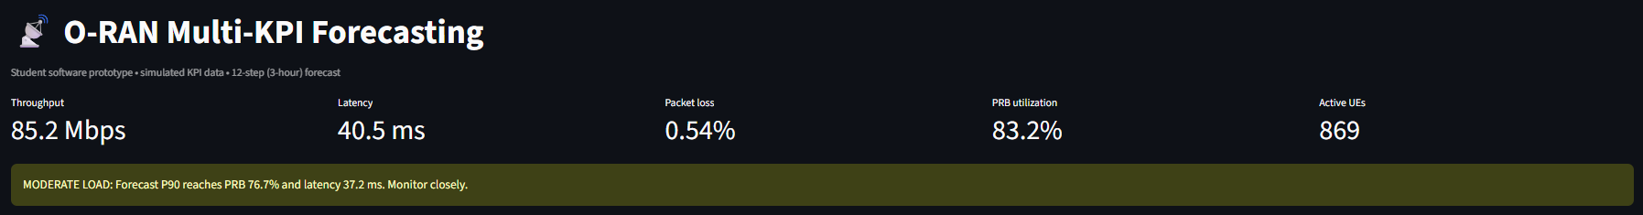
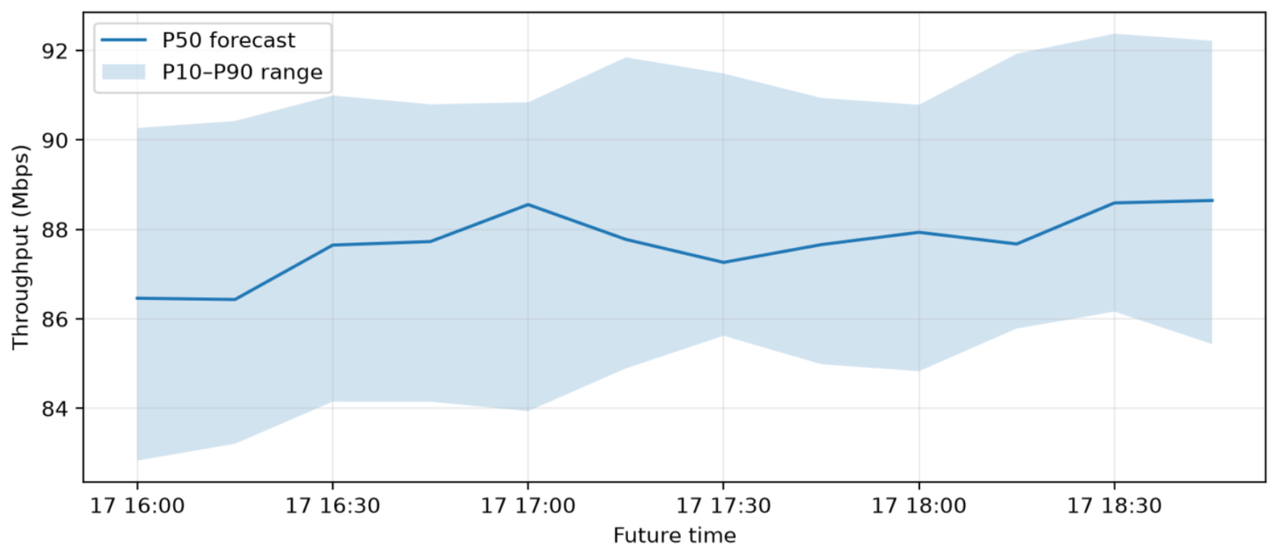
Results: Forecasting Dashboard
Prototype output on simulated data · forecast issued 17 Sep 2026, 16:00
Live view: latest KPIs (15:45) and the automatic load warning
What the dashboard tells us
Recent load is high: PRB 82–93 % and latency 38–51 ms between 13:30 and 15:45.
Throughput P50 is expected to rise slightly, from 86.5 to 88.6 Mbps.
P90 reaches PRB 76.7 % and latency 37.2 ms, above the moderate thresholds but below the high ones.
Result: a MODERATE LOAD warning (monitor closely).
Throughput forecast, 16:00–18:45: P50 line with P10–P90 band
TFT Multi-KPI Forecasting for Open RAN | 7 / 10

Slide 8
Results: 3-Hour Multi-KPI Forecast
P10 / P50 / P90 for every KPI, 12 steps of 15 minutes each
Time | Thr. P50 (Mbps) | Lat. P50 (ms) | Loss P50 (%) | PRB P90 (%) | UEs P50
16:30 | 87.65 | 34.12 | 0.319 | 75.83 | 764
17:00 | 88.56 | 33.83 | 0.296 | 73.54 | 754
17:30 | 87.26 | 33.56 | 0.318 | 73.59 | 729
18:00 | 87.94 | 32.74 | 0.279 | 71.09 | 703
18:45 | 88.65 | 31.83 | 0.213 | 67.32 | 650
−7.7 pts
PRB P50 falls from 72.4 % to 64.7 %
−2.3 ms
Latency P50 falls from 34.1 to 31.8 ms
Forecast values copied from the dashboard's forecast table
Insight: load is expected to ease after the busy period, but P90 stays near 75 % until about 17:15.
−15 %
Active UEs P50 fall from 764 to 650
TFT Multi-KPI Forecasting for Open RAN | 8 / 10

Slide 9




Evaluation, Progress & Remaining Work
Results are interpreted in the context of simulated data
Baseline comparison
Compare TFT with persistence and LSTM
Error metrics
MAE and RMSE: lower is better
Uncertainty
How often actual values fall in P10–P90
Completed
Remaining
Simulated KPI data generation (1,600 records)
TFT multi-KPI forecasts with P10 / P50 / P90
Dashboard with KPI cards, charts and tables
Threshold-based load warnings
Validate on a documented public RAN dataset
Repeatable evaluation: MAE, RMSE and coverage vs baselines
Tune the model and measure warning lead time
Test safe control recommendations (RIC / xApp)
TFT Multi-KPI Forecasting for Open RAN | 9 / 10

Slide 10
Conclusion & Future Work
Forecasts five KPIs up to 3 hours ahead from a 12-hour input window.
Shows P10 / P50 / P90 ranges and flags possible high load early.
The current prototype uses Python-generated simulated data.
Next: validate on real RAN data, tune the model and evaluate warning lead time.
Selected references
1. Lim, B. et al. (2021). Temporal Fusion Transformers for interpretable multi-horizon time series forecasting. Int. J. of Forecasting.
2. VERGE / CTTC, OAI RAN KPM dataset: github.com/VERGE-PROJECT/OAI_RAN_KPM_dataset
3. O-RAN Software Community, RIC application docs: docs.o-ran-sc.org
Thank You
Questions & discussion

