Slide 1
Molecular Orbital Theory & Chemical Reactions
Knowledge of molecular orbital diagrams, and the shapes of molecular orbitals, can be used to accurately explain and predict chemical reactivity.
Frontier Molecular Orbital (FMO) Theory/Approximation
Chemical reactions take place using the Frontier orbitals.
Frontier means a border area, between two things (often, between 2 countries). In this case, we are interested in the MOs at the border between occupied and empty.
The frontier MOs (FMOs) are called the HOMO and LUMO orbitals. HOMO is the Highest Occupied MO, the highest-energy MO that has electrons in it. LUMO is the Lowest Unoccupied MO, the lowest-energy MO that doesn't have any electrons in it.

Slide 2
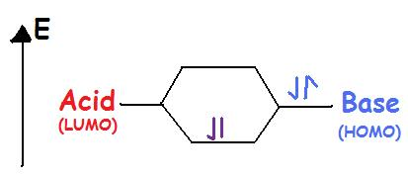
Frontier Molecular Orbital (FMO) Theory/Approximation
Chemical reactions take place using the Frontier orbitals, the HOMO and LUMO.
For example, the highest occupied molecular orbitals (HOMO) of a nucleophile or Lewis base can react with the lowest unoccupied molecular orbital (LUMO) of an electrophile or Lewis acid.
Figure 2: Lewis Acids have vacant orbitals so they are in a lower energy level. While Lewis bases have lone pair electrons to share and thus occupy a higher energy level.

Slide 3
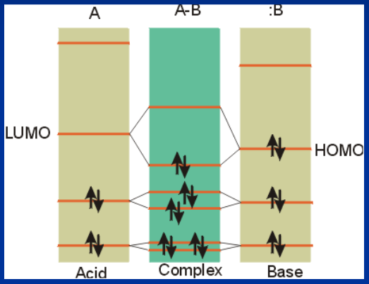
Lewis Acids & Bases: The LUMO and HOMO are called frontier orbitals.
If there is a net lowering of energy, the adduct is stable.

Slide 4
Frontier Molecular Orbital (FMO) Theory/Approximation
Filled/Vacant Interactions and HOMO/LUMO Interactions.
We already understand that when two AO’s interact, as in the prototype case of the hydrogen molecule, two MO’s are formed, and if two paired electrons are available to enter the bonding MO (BMO), strong bonding results.
The requirement for two electrons can be satisfied by having two electrons in one AO (this would be a hydride anion) and zero in the other (a proton), or by having two hydrogen atoms, each with one electron, with the electrons having opposite spin.
An analogous situation arises when any two orbitals interact, even if the orbitals are MO’s, although the bonding which results may be much weaker than in the case of molecule formation from atoms. We have already seen that essentially all molecules (simple or complex) have filled bonding BMO’s and vacant antibonding MO’s.

Slide 5
If two molecules come into contact, there is therefore always a possibility of bonding interactions between the two, since each molecule has filled MO’s and vacant MO’s.
These interactions would result in “supermolecule” formation or complexation, in which the new MO’s are delocalized over the entire complex.
In the case of interactions between molecules, the bonding interactions are sometimes modest and may be negated by repulsive nonbonding interactions between the molecules and the unfavorable entropy effect of combining two molecules into one complex molecule.
In other cases, relatively stable complexes (e.g., pi complexes) may be formed. An interaction between a filled and a vacant MO can potentially result in a stabilizing interaction because the filled orbital will be stabilized and the vacant one destabilized and two electrons are present, so that only the stabilized MO is occupied. These interactions will be referred to as filled/vacant interactions or F/V interactions.

Slide 6
Note that interactions between two filled MO’s can also result in the formation of delocalized MO’s, but there will be no net stabilization because both the stabilized and destabilized four-electron are doubly occupied (the four-electron situation).
Similarly, the interactions between two vacant MO’s obviously results in no stabilization, although delocalized virtual MO’s may result.
Importantly, although any of the potentially many F/V interactions may be stabilizing, the HOMO/LUMO interactions are virtually always the most important ones, because the interaction energy depends upon the energy difference between the F and V MO’s. In the case of the HOMO/LUMO interaction, this energy difference is obviously the smallest. The energy difference between a given HOMO and the corresponding LUMO of the other molecule is sometimes termed the “HOMO-LUMO gap”.
The approximation in which only the HOMO/LUMO interaction is considered (among all of the possible F/V interactions) is called the Frontier Orbital (or FO) approximation.

Slide 7
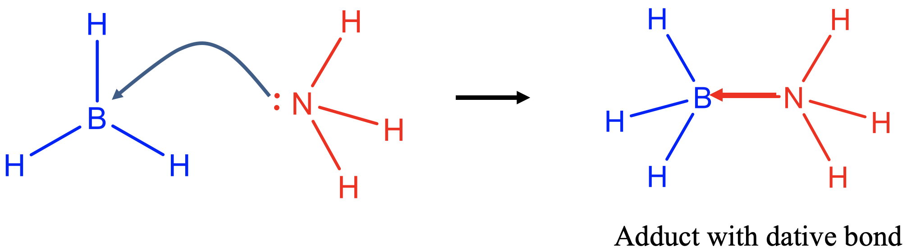
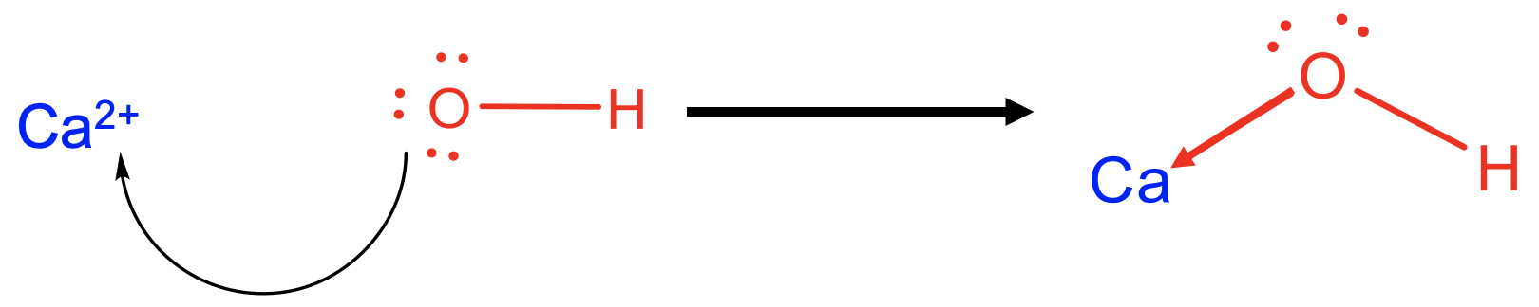
A Lewis acid is defined as an electron pair acceptor (electrophile).
A Lewis base is defined as an electron pair donor (nucleophile).
An example of a Lewis acid is BH₃, and an example for a Lewis base is NH₃.
What happens in a Lewis-acid base reaction?
The Lewis base donates an electron pair to form a covalent bond with the Lewis acid (Fig. 4.1.2). A covalent bond formed in a Lewis acid-base reaction is usually called a dative bond because both electrons in the covalent bond come from a single partner. In a "conventional" covalent bond both partners contribute one electron to the covalent bond. There is however no fundamental difference between a “conventional” covalent bond and a dative covalent bond, it is just a matter of perspective. To indicate a dative bond one can draw an arrow pointing from the donor to the acceptor atom, instead of just a line. The reaction product of a Lewis acid-base reaction is called an adduct.
As mentioned previously, the Lewis acid-base concept is quite general and can explain the bonding in quite different compounds. It includes the Broensted acid-base concept, meaning that any Broensted acid is also a Lewis acid, and any Broensted base is also a Lewis base. However, the reverse is not true. Not every Lewis acid is a Broensted acid, and not every Lewis base is a Broensted base.
The Lewis acid-base concept also explains bonding in coordination compounds, and the formation of coordination compounds from metal ions and ligands. The ligand is the Lewis base and the metal ion is the Lewis acid, the coordination compound is the Lewis acid-base adduct. The bond between the metal ion and ligand is a dative bond pointing from the ligand to the metal.
The Lewis acid-base concept can even be used to explain bonding in ionic crystals. In this case the anion would be the donor and the cation the acceptor.
Figure 4.1.2 Acid-base reaction between NH₃ and BH₃

Slide 8
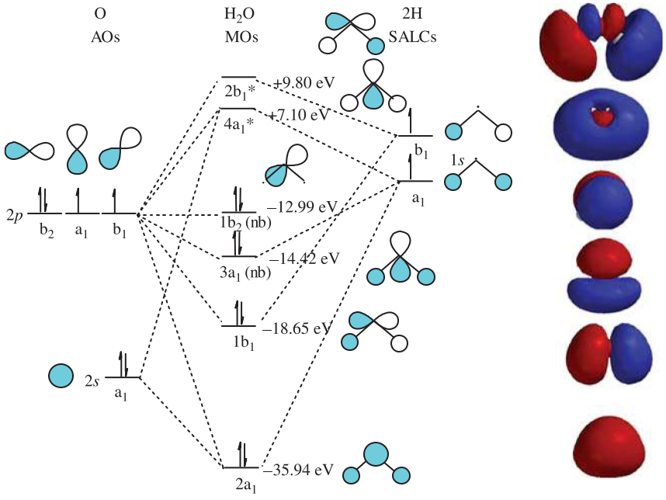
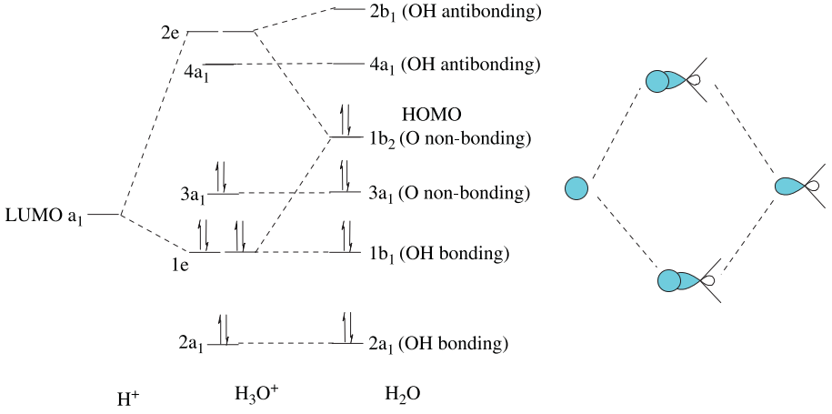
FRONTIER MOLECULAR ORBITAL THEORY: Lewis acid-base reactions
With the advent of inexpensive molecular modeling software, the FMO deﬁnition of acids and bases has become increasingly popular. According to this deﬁnition, an acid reacts via its LUMO, whereas a base reacts using its HOMO.
In the MO diagram for H₂O, the HOMO is the 1b₂ nonbonding MO derived from a 2p AO on the oxygen atom.
When H₂O reacts with a proton to form the hydronium ion, H₃O⁺, the 1b₂ HOMO on H₂O will form a bonding and antibonding combination with the 1s LUMO on H⁺, as shown in Figure 14.8.
FIGURE 14.8 Acid—base interaction diagram for H₃O⁺, showing how the LUMO on H⁺ and HOMO on H₂O interact to form a bonding and antibonding pair of MOs in H₃O⁺.
FIGURE 14.7
One-electron MO diagram for H₂O.

Slide 9
The new bonding MO (shown at right in the diagram) is isoenergetic with the 1b₁ MO in H₂O (they each have a single nodal plane); thus, the two form a degenerate e MO in H₃O⁺.
The overall effect of the interaction diagram is to lower the energy of the 1b₂ (nonbonding) orbital as it becomes an e bonding MO in H₃O⁺. Thus, the reaction H₂O + H⁺ —> H₃O⁺ is favored by enthalpy even though it is entropically unfavorable.

Slide 10
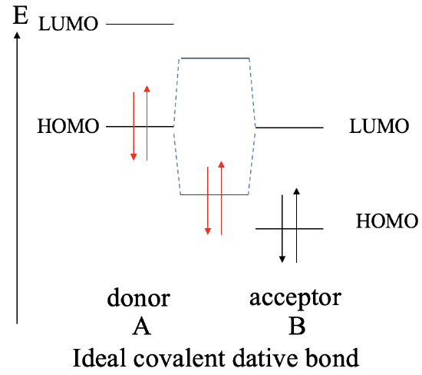
Bonding in Lewis Acid-Base Adducts:
Case I : HOMO of donor A and the LUMO of acceptor B with the same energy
The greatest covalent interaction between two orbitals it is achieved when both orbitals have the same energy. We learned this previously when we discussed the energy criterion. The same holds for dative bonds. The more similar the energies of the donor HOMO and the LUMO acceptor, the greater the covalent interaction. Ideally, the energies are exactly same. In this case we form a perfect covalent bond with the electrons equally shared between the donor and the acceptor. We can graphically illustrate this in an MO diagram the following way (Fig. 4.1.9). Let us assume a molecule A that acts as a donor
and a molecule B that acts as an acceptor. The donor A has a
HOMO and a LUMO that have a certain energy. The acceptor
molecule B also has a HOMO and a LUMO with the LUMO
having the same energy as the HOMO of A. The molecule B
will also have HOMO which is energetically below that LUMO.
Because their identical energies the combination of the
HOMO of A with the LUMO of B leads to a bonding MO and
an anti-bonding MO with equally shared electron density.
Both MOs have equidistant energy from the HOMO of A and
the LUMO of B. The electrons coming from the HOMO of A
will be in the bonding MO. They will be equally shared, and
the dative bond is an ideal covalent bond.
Figure 4.1.9 Covalent interaction between the HOMO of donor A and the LUMO of acceptor B with the same energy

Slide 11
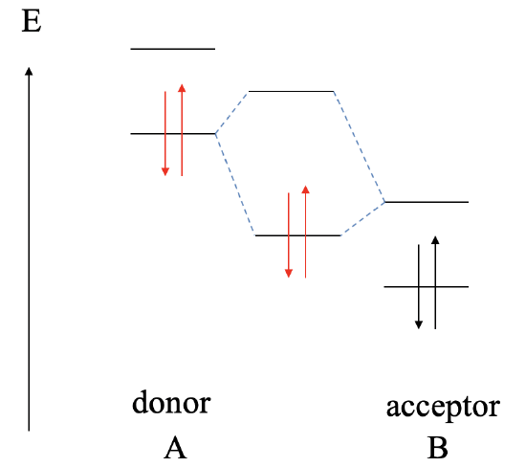
Case II : LUMO of B is somewhat lower in energy than the HOMO of A
The exact match of the HOMO and LUMO energies of the donor and acceptor is rarely achieved.
Let us consider a number of scenarios in which these energies are not the same, and what consequences this has for the dative bond.
Let us assume next, that the LUMO of the acceptor B is somewhat lower than the HOMO of donor A. In this case, we can still form a bonding MO and an anti-bonding MO due to covalent interaction between the HOMO of A and the LUMO of B. However, now the bonding MO will be localized primarily at B, and the anti-bonding MO will be localized mostly at A. The electrons from the HOMO of A will be in the bonding MO, and thus the bonding electrons in the dative bond will be localized mostly at B. This means that the dative bond is polar and polarized toward the acceptor.
Figure 4.1.10 Covalent interaction between LUMO of acceptor B and HOMO of donor A, when the LUMO of B is somewhat lower in energy than the HOMO of A.

Slide 12
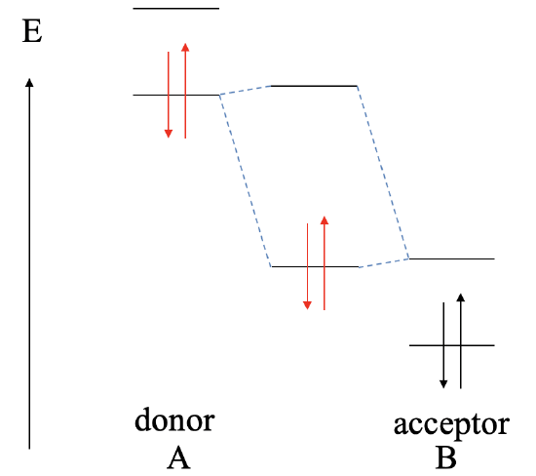
Case III : LUMO of B is MUCH lower in energy than the HOMO of A
Let us consider next, what the bonding will be if the LUMO of the acceptor is much lower than the HOMO of the donor (Fig. 4.1.11). In this case, there is still the possibility to form a bonding MO and an anti-bonding MO, but the bonding MO will be localized practically exclusively at the acceptor, and the anti-bonding MO will be localized practically completely at the donor. The electrons from the donor will be in the bonding MO, but because the bonding MO is located almost entirely at the acceptor, the electrons are transferred completely from A to B in a redox reaction, and the bonding will be ionic, and we have an ionic compound AB made of A²⁺ cations and B²⁻ anions. This reaction would no longer be considered a Lewis acid-base reaction, and the reaction product will no longer be considered a Lewis acid-base adduct.
Figure 4.1.11 Covalent interaction between LUMO of acceptor B and HOMO of donor A, when the LUMO of B is much lower in energy than the HOMO of A.

Slide 13
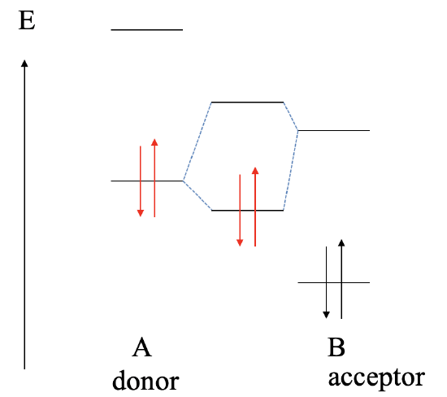
Case IV: LUMO of B is higher in energy than the HOMO of A
The next possibility to consider is that the LUMO of B is higher in energy than the HOMO of A (Fig. 4.1.12). In this case the bonding MO will be localized primarily at the donor A and the electrons in the dative bond will be predominantly at A. We have a polar, dative bond which is polarized toward A.
Figure 4.1.12 Covalent interaction between LUMO of acceptor B and HOMO of donor A, when the LUMO of B is higher in energy than the HOMO of A.

Slide 14
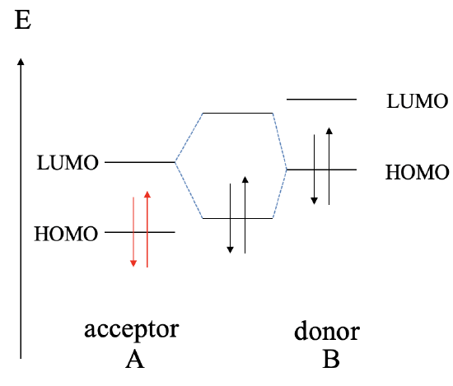
Case V: LUMO of B is energetically MUCH higher than the LUMO of A
Next, let us raise the energy of the HOMO and the LUMO of B even higher. This leads to the fact that now the HOMO of B is energetically closer to the LUMO of A, compared to the energy difference between the HOMO of A and the LUMO of B. This results in the fact that the interaction will be mostly between the HOMO of B and the LUMO of A. As a consequence, B will act now as the donor, and A will act as the acceptor. The dative bond may be polarized toward A or B, or not be polar at all depending on the relative energy of the HOMO of B and the LUMO of A.
Figure 4.1.13 Covalent interaction when the LUMO of A is of similar energy compared to the HOMO of B and the LUMO of B is energetically much higher than the LUMO of A.

Slide 15
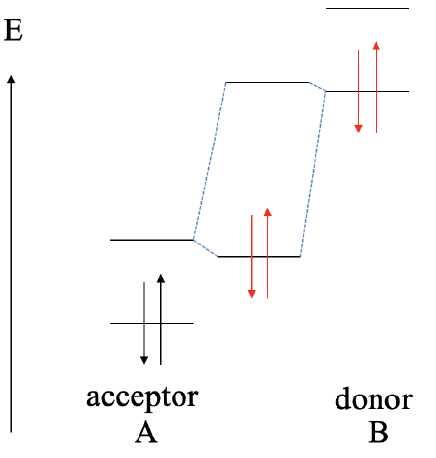
Case VI: HOMO of B is MUCH higher in energy than the HOMO of A
If we raise the orbital energies of B even further, and the HOMO of B is much higher than the HOMO of A, then we will get a redox reaction. B gets oxidized, and A gets reduced.
B²⁺ cations and A²⁻ anions will form an ionic compound of the composition AB.
Figure 4.1.14 Covalent interaction between LUMO of acceptor A and HOMO of donor B, when the HOMO of B is much higher in energy than the HOMO of A

Slide 16
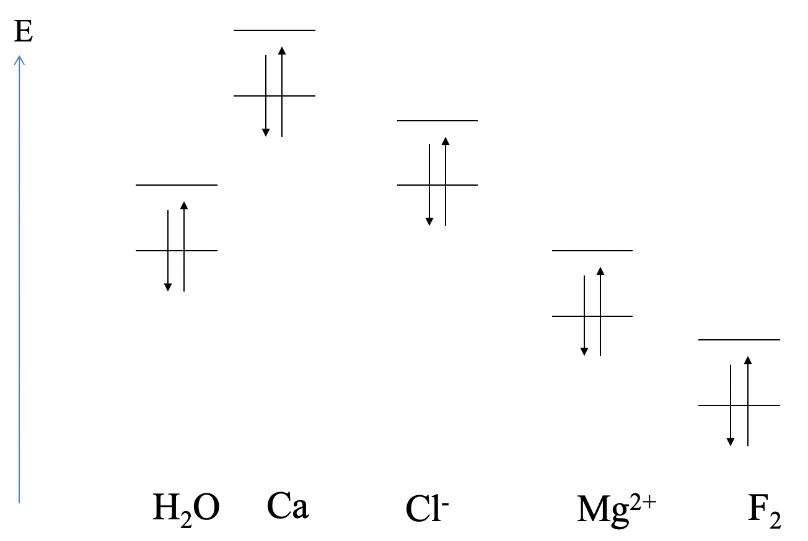

Examples
Generally, the relative HOMO and LUMO energies of reaction partners decide if a Lewis acid-base, or a redox reaction takes place, and what the polarity of the bond is. Here are a few examples that will illustrate our general considerations (Fig. 4.1.15).
The relative orbital energies of the highest occupied atomic orbitals and the lowest unoccupied atomic orbitals of calcium, and the HOMO and LUMO energies of H₂O are shown (Fig. 4.1.15).
Can we predict the type of reaction? We can see that the highest occupied Ca orbital has a much higher energy than the LUMO of water. We would therefore expect that Ca gets oxidized, and water gets reduced. An ionic compound would be expected. This is what actually happens in experiment.
Ca(s) + 2H₂O(l) → Ca(OH)₂(aq) + H₂(g)
Figure 4.1.15 Practical examples of covalent Lewis acid-base reactions
There is the possibility of competing reaction pathways depending upon which reactants are present, and the relative energies of possible products. As a result, a compound such as water may serve as an acid, a base, an oxidizing agent (with Group IA and IIA metals) or a reducing agent (with F₂).

Slide 17
Next, let us consider a possible reaction between water and chloride. We can see that the HOMO of Cl⁻ is similar in energy compared to the LUMO of H₂O. We would therefore expect a Lewis acid-base interaction with Cl⁻ as the donor and H₂O as the acceptor. Such an interaction indeed occurs in aqueous solutions containing Cl⁻ in the form of weak hydrogen bonding between Cl⁻ and H₂O.
Next, let us consider the interactions between Mg²⁺ and H₂O. In this case the LUMO of Mg²⁺ has about the energy of the HOMO of the water molecule. We would therefore expect that the water molecule acts as the donor and the Mg²⁺ acts as the acceptor. Indeed, Mg²⁺ forms a hexa-aqua complex with water, which has the composition Mg(H₂O)₆²⁺. The bonding should be very little polar.
Lastly, what are the interactions between F₂ and H₂O? The HOMO of H₂O is much higher than the LUMO of F₂. We would therefore expect a redox reaction in which F₂ is reduced, and H₂O is oxidized. In reality, F₂ can oxidize H₂O to form OF₂ and HF.
From the above examples it becomes also clear that we cannot necessarily predict the strength of the Lewis-acid base interactions. For example, the hydrogen bonding between H₂O and Cl⁻ is much weaker than the dative bonds between H₂O and Mg²⁺. Other factors such as orbital overlap also need to be taken into consideration to make statements about the strength of the interactions.

Slide 18
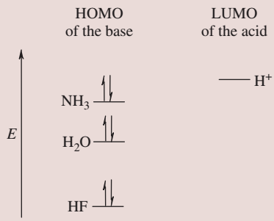
The proton affinities (PAs) for NH₃, H₂O, and HF are 854, 697, and 399 kJ/mol, respectively. Explain this trend in terms of the energies of the bonding MOs in the acid–base interaction diagrams of each species with H⁺.
Hint: The lower in energy the (resulting) bonding MO is, the greater the magnitude of the PA.
…..
A more universal measure of the basicity of a species is its gas-phase proton affinity (PA), which is defined below. Like electron affinities, proton affinities are reported as positive values even though their enthalpies of reaction are always negative:
B(g) + H⁺(g) → BH⁺(g) PA = −ΔH_{rxn}
The energy of the HOMO for each species decreases in the order: NH₃, H₂O, HF because the energies of the 2p AOs decrease in this same order across a row of the periodic table. Given that the energy of the 1s AO for H⁺ is higher in energy than any of the 2p AOs on the heteroatoms, as shown in the diagram, the HOMO for NH₃ will lie closest in energy to the LUMO for H⁺. Thus, the bonding MO formed in the NH₃ + H⁺ → NH₄⁺ interaction diagram will be lower in energy than the analogous bonding MOs formed in H₃O⁺ and HFH⁺. The lower in energy the bonding MO is, the greater the magnitude of the PA.

Slide 19
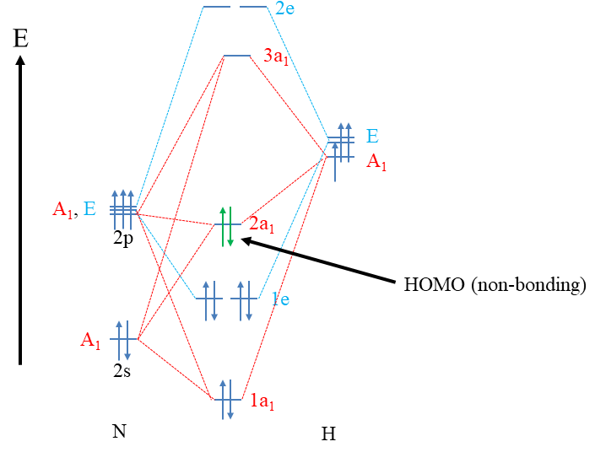
MO theory and Lewis Bases
MO theory states that a molecule is a Lewis base when its HOMO is approximately non-bonding (see below the MO Diagram of NH₃: Fig. 4.1.6). This explains, for example, that NH₃ is a Lewis base. Remember, its HOMO, the 2a₁ orbital, is approximately non-bonding.
Why does an approximately non-bonding HOMO make a molecule a Lewis base?
Firstly, because the HOMO electrons are the highest energy electrons and thus the most reactive electrons, they get donated preferentially over all other electrons. The non-bonding nature of the HOMO is ideal, because if the HOMO was anti-bonding, the electrons would be so reactive, so that they would likely get completely transferred to the reaction partner. In this case we would not have a Lewis acid-base reaction, but a redox reaction. We would not form a covalent bond, but an ionic bond. If the HOMO was bonding, then the energy of the electrons would be too unreactive, simply no reaction would likely be observed.

Slide 20
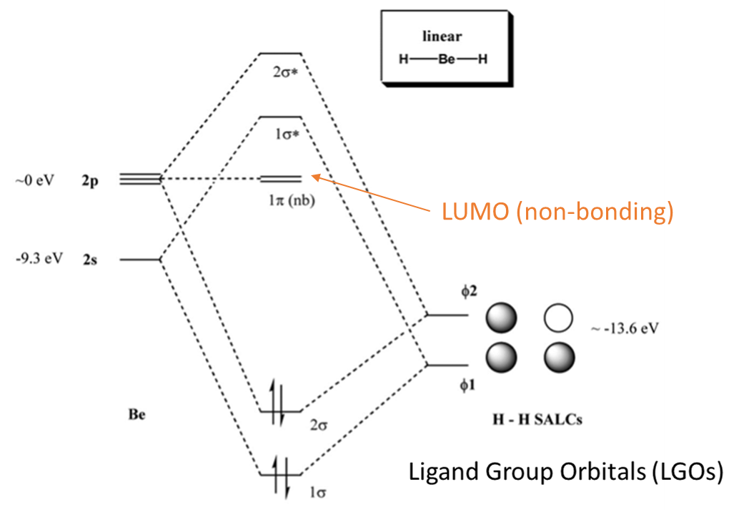
MO theory and Lewis Acids
So, what is then a Lewis acid according to MO theory?
A Lewis acid, from the MO theory perspective, is a molecule that has an approximately non-bonding lowest unoccupied molecular orbital. The orbital needs to be unoccupied, otherwise no electrons could be donated into it. For energy minimization arguments, electrons would be donated into the unoccupied orbital that has the lowest energy, which is the LUMO. So why is it ideal if the LUMO is non-bonding?
If it was anti-bonding, its energy would likely be too high, and the donor would be unable to donate its electrons. There would not be a stabilization of electrons due to the high energy of the LUMO. The molecule would remain unreactive. If the LUMO was a bonding orbital, then its energy would likely be so low so that the electrons would likely be completely transferred to the Lewis acid. In this case we would not form a dative bond but an ionic bond via a redox reaction.
An example of a Lewis acid is the BeH₂ molecule.
The central atom of the molecule is the Be atom, and its valence orbitals are the 2s and the 2p orbitals. The two 1s orbitals of H make two ligand group orbitals.
LGOs via SALC would give two bonding and two anti-bonding orbital of σ_{g} types. The 2p_{x} and the 2p_{y} orbitals remain non-bonding. The Be atom has two valence electrons in the 2s orbital, and the 2 H atoms contribute two valence electrons each, so there are overall four electrons that we need to fill into the MOs. This fills the bonding 1σ and the 2σ, making the 2σ the HOMO. You see that we have a bonding HOMO here, which would argue that BeH₂ is not a Lewis base. However, we see that the LUMOs are the non-bonding 2p_{x} and 2p_{y} orbitals. This explains the Lewis-acidic character of the molecule.

Slide 21
Pearson's Hard Soft [Lewis] Acid Base Principle: The HSAB Principle
Hard and Soft Acids and Bases, Ralph G. Pearson, J. Am. Chem. Soc. 1963, 85, 22, 3533–3539, https://doi.org/10.1021/ja00905a001
Earlier what Arland, Chatt, and Davies somewhat boringly termed some groups class a and class b, today they are known by Ralph Pearson's name for them. Pearson called the class a acids and bases hard and class b acids and bases soft.
Ralph Pearson introduced his Hard Soft [Lewis] Acid Base (HSAB) principle in the early nineteen sixties, and in doing so attempted to unify inorganic and organic reaction chemistry. The impact of the new idea was immediate, however, over the years the HSAB principle has rather fallen by the wayside while other approaches developed at the same time, such as frontier molecular orbital (FMO) theory and molecular mechanics, have flourished.
However, Pearson classified a very wide range of atoms, ions, molecules and molecular ions as hard, borderline or soft, moving the analysis from traditional metal/ligand inorganic chemistry into – and combining with – the realm of organic chemistry.

Slide 22
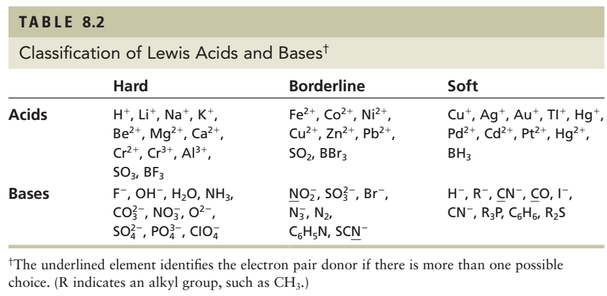
hard acids tend to be found towards the left side of the periodic table and involve higher oxidation states and/or electron withdrawing substituents
while soft acids are more common to the right of the periodic table and involve lower oxidation states and/or electron donating substituents.

Slide 23
In the nineteen sixties, Ralph Pearson greatly expanded the Type A–Type B logic by explaining the differential complexation behavior of cations and ligands in terms of electron pair accepting Lewis acids and electron pair donating Lewis bases:
Lewis acid + Lewis base → Lewis acid/base complex
Pearson classified Lewis acids and Lewis bases as hard, borderline or soft.
According to Pearson's hard soft (Lewis) acid base (HSAB) principle:
Hard (Lewis) acids prefer to bind to (complex with) Hard (Lewis) bases
and
Soft (Lewis) acids prefer to bind to (complex with) Soft (Lewis) bases.

Slide 24
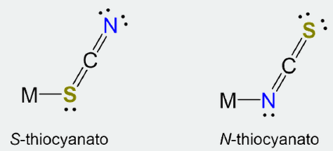
The hard-soft acid-base (HSAB) principle stems from the recognition that some Lewis acids and bases seem to have a natural affinity for one another.
Consider the following:
Some metals are commonly found in nature as salts of chloride or as oxide ores while others are found in combination with sulfur. Geochemists even use the Goldschmidtt classification scheme to classify the halide and oxide formers as lithophiles and the sulfide formers as chalcophiles.
In living systems small highly charged metals ions like Fe³⁺ are usually found bound to N and O atoms while larger metals with lower charges such as Zn²⁺ are often found attached to at least one S atom.
Similarly, metals prefer to bind to one coordination site over the other when forming complexes with ambidentate ligands. The most well-known instances involve complexes of cyanate and thiocyanate, which can coordinate metals through either the N or chalcogen atom. For instance, Cu²⁺ and Zn²⁺ form N-thiocyanato complexes in species like [Cu(NCS)₂(py)₂] and [Zn(NCS)₄]²⁻ while their larger cogeners Au³⁺ and Hg²⁺ preferentially forms S-thiocyanato complexes, giving speciles like [Hg(SCN)₄]²⁻.

Slide 25
The solubility trends for the alkali metal halides and silver halides are opposite, even though both involve salts of formula M⁺X⁻ (salts can be thought of as involving Lewis acid-base adduct formation between the anions and cations). Specifically, although the silver halides are all relatively insoluble in water, the very modest solubility they possess follows the order:
X = F >> Cl > Br > I (for the solubility of AgX)
In contrast, the much more ample solubility of the alkali metal halides follows the opposite order. For example, the order for the lithium halides is
X = F << Cl < Br << I (for the solubility of LiX)
Qualitative HSAB Principle
The hard-soft acid-base principle is a conceptual tool for thinking about patterns of Lewis acid base reactivity.
The explanation of the trends in metal distribution, halide salt solubility, and preferred metal coordination patterns is rooted in Arland, Chatt, and Davies' observation that Lewis acids and bases could be classified into two groups based on their propensity to form stable compounds with one another (e.g. acids in a class tend to form more stable adducts with bases in the same class than they did with bases in the other).

Slide 26
Note that the hard-soft classification should not be thought of as if all hard acids and bases are equally hard and all soft acids and bases equally soft. There is a graduation in hardness and softness and a number of intermediate acids and bases which do not fit neatly in either category. With this caveat in mind, representative hard, soft, and borderline acids are given below. Notice how they illustrate the trends just outlined.

Slide 27
Origin of the Hard-Soft Acid-Base (HSAB) Principle
One of the strengths of the Lewis acid-base concept is the readiness with which it illuminates the role that covalent and electrostatic interactions in acid base behavior, specifically through its ability to explain chemical interactions in terms of frontier orbitals and the interactions between charged groups as electrons are donated from a base to an acid.
However, simply acknowledging the presence of such interactions does little to illuminate the degree to which each mode of explanation best explains the bonding in a given system?
To what extent is a given adduct better described as held together by covalent bonds as opposed to ionic ones - e.g. better described as a molecule rather than an ion pair?
Moreover, does it even matter, given that the orbitals of quantum mechanics result from the combination of electrons' wavelike behavior with their electrostatic attraction to nuclei in either case?
These questions and more are addressed by one of the most important conceptual tools in contemporary inorganic chemistry, the hard-soft acid-base (SHAB) principle.

Slide 28
Most of the elements in the periodic table are metals that tend to form positive ions because of their relatively low ionization energies and low electron affinities (or, equivalently, their low electronegativities). These metal cations are electron pair acceptors and are classified as Lewis acids. They may be classified as hard, soft, or borderline. Most metal ions are hard acids because of their low electronegativities and their propensity to accept electrons. Charge density is also a good measure of hardness; small, multiply charged ions like Be²⁺ and Mg²⁺ are hard acids, for example, and the hardness of a given transition metal increases with the increasing oxidation number as the charge density of the cation increases.
The soft acids are found in the lower-right region of the metallic elements in the periodic table; they have high electronegativities and relatively low charge densities because of their large size and generally low oxidation states. Finally, a few elements form borderline acids because their physical properties are intermediate between those of the hard and soft acids.
We may discuss some examples in passing, but note that the classification of several of these ions changes with oxidation state. Cu⁺, with its relatively low charge density, is a soft acid, whereas Cu²⁺, with a somewhat higher charge density due to its 2+ charge, is a borderline acid. Representative examples are shown in Table 8.2.

Slide 29
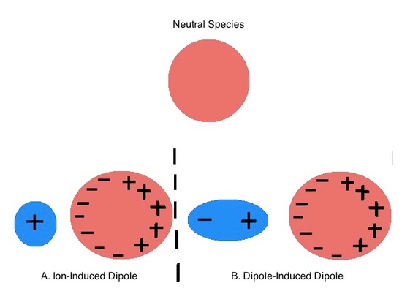
These terms reflect how "soft" these substance's electron clouds are towards distortion or, in other words, their polarizability (Figure 6.4.1).
Pearson terms acids and bases which are relatively polarizable soft and those which are difficult to polarize hard.
Figure 6.4.1: Polarizability refers to the ease with which a substance's electron cloud may be distorted under the action of an electric field. An fragment's polarizability determines the degree to which its electron cloud is distorted by A.) an Ion and B.) a polar molecule to induce a dipole moment.

Slide 30
Larger, more polarizable metal ions with lower charges are called soft acids. "Polarizable" means they have large, easily distorted clouds of electrons. They are more likely to bind to soft bases, which are typically large anions such as sulfide or selenide.
"hard" acids are small or highly charged species
"hard" bases contain smaller, less polarizable donor atoms, usually oxygen or nitrogen
"soft" acids are larger or more polarizable or have lower charge
"soft" bases contain larger, more polarizable donor atoms (e.g., S, P, Se, etc)
Hard and soft acid and base phenomena have been studied using molecular orbital theory and other quantitative approaches. In MO theory, it has been shown that interactions between hard anions and cations are characterized by large HOMO-LUMO separations, whereas interactions between soft anions and cations are characterized by small HOMO-LUMO separations. In other words, hard acid-base interactions are dominated by more strongly ionic character, but soft acid-base interactions are dominated by more strongly covalent character.

Slide 31
To get an idea about the electron distortion, it is useful to use the hardness and electronegativity as defined below.
The American physicist Robert Mulliken proposed, in 1934, that the ionization energy and the electron affinity of atoms could be used to define a new quantity called the electronegativity that would measure their tendency to attract electrons.
He observed that elements located in the lower left corner of the periodic table have both small ionization energies and small electron affinities. This means that they give up electrons readily (to form positive ions) but do not readily accept electrons (to form negative ions). They tend to act as electron donors when forming bonds with other elements.
In contrast, elements in the upper right corner of the periodic table have large ionization energies and also (except for the noble gases) large electron affinities. As a result, these elements accept electrons easily but give them up only reluctantly; they act as electron acceptors when forming bonds with other elements.
Mulliken simply defined electronegativity (χ), based on these observations, as a quantity that is proportional to the average of the ionization energy and the electron affinity:
χ = (IE₁ + EA)/2, where IE₁ = (first) ionization energy and EA = electron affinity and IE and EA are in eV.

Slide 32
In 1988, Ralph Pearson, building on the work of Klopman, published a paper defining absolute hardness, 𝜂, as half the difference between the ionization energy and the electron affinity (measured in units of eV):
η = (IE₁ - EA)/2.
Since acid’s and base’s hardness and softness are inversely related, Pearson’s absolute softness, σ, is just the inverse of hardness. Pearson’s softness, σ =1/η.
Using this definition, a hard compound will be one where the IE and EA are dissimilar, and a soft compound will be one where the IE and EA have approximately similar magnitude.
Because the ionization energy of a species is the amount of energy necessary to remove an electron from its HOMO and the electron affinity is a measure of how much energy is gained by the addition of an electron to its LUMO, the connection between Pearson’s absolute hardness/softness and the HOMO-LUMO gap then follows from Koopman’s theorem, in which the ionization energy (IE) is just the opposite of the HOMO energy.
IE = −E_{HOMO}.

Slide 33
Similarly, the electron affinity (EA), defined as the opposite of the energy released on absorption of an electron, may be taken as an approximation of the LUMO energy.
EA ≈ −E_{LUMO}.
So Pearson’s absolute hardness is just half the HOMO-LUMO gap (band gap) size in electron volts:
Pearson's absolute hardness = η = (IE₁ - EA)/2 ≈ E_{LUMO} – E_{HOMO}/2 = E_{g}/2, where all values are given in eV, and the Mulliken electronegativity is just the average of the HOMO and LUMO energies (~Fermi energy):
Mulliken electronegativity, χ ≈ −(E_{LUMO} + E_{HOMO})/2, where all values are given in eV.
The relationships between the Pearson absolute hardness, Mulliken electronegativity, and HOMO and LUMO energies are depicted schematically for the group 1A monocations in Figure 6.6.1.1.

Slide 34
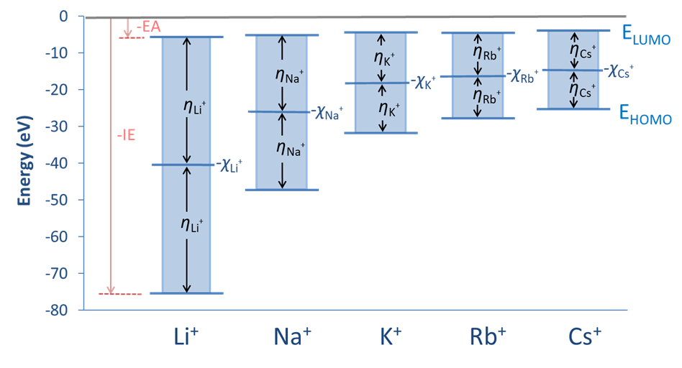
Figure 6.6.1.1. Relationships between Pearson absolute hardness, Mulliken electronegativity, and HOMO and LUMO energies for the group 1A monocations.

Slide 35
The hardness of an atom is a parameter which attempts to quantify the ability of electrons to redistribute themselves within the atom and thus is a measure of the polarizability of the atom.
Atoms with small ionization energies and small electron affinities, such as the heavy halogens and oxygen Group elements (i.e. those elements on the bottom right-hand side of the p-block), are termed 'soft’.
Small atoms, such as sodium, oxygen and fluorine, are termed 'hard’.
The hardness of the donor atoms of a ligand bonding to a metal atom is of great consequence in determining the strength of the bonding interaction and this topic is discussed in later sections. The general rule is that ‘like bonds to like’, i.e. soft metal centres such as Hg(II) and Ag(I) have a strong preference for binding to soft donor atoms such as P, S, Se and I.

Slide 36
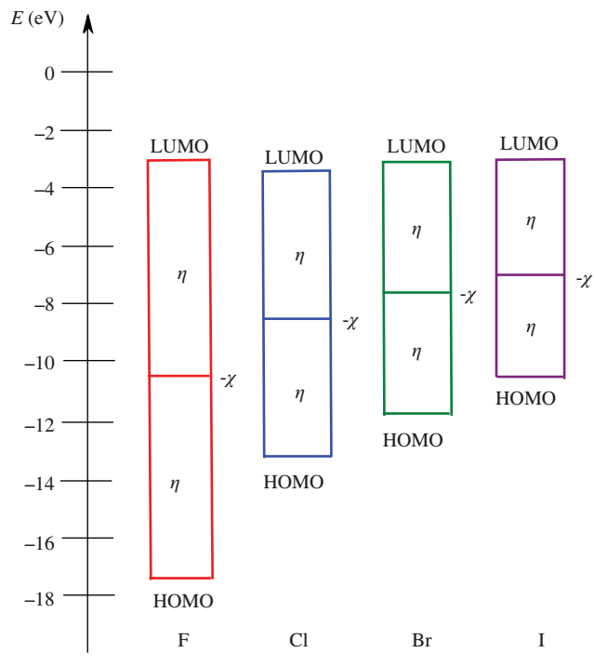
While the electronegativity represents the average valence electron energy, absolute hardness (𝜂) is a measure of the breadth of the LUMO–HOMO energy difference, as shown in Figure 14.9 for the halide ions.
FIGURE 14.9 Mulliken–Jaffe electronegativity (𝜒) and absolute hardness (𝜂) for the halide ions, defined using
the frontier molecular orbital model.
Hard species: large HOMO–LUMO gap & χ
Soft species: small HOMO–LUMO gap

Slide 37
The energy difference is greatest for the F⁻ ion, which falls under the “hard” category in Pearson’s HSAB model. Iodide, which has the smallest energy difference, falls under the “soft” classification. This quantitative scale allows for direct comparisons between two different species belonging to the same classification. For instance, Li⁺ and Al³⁺ are both hard Lewis acids, but it did not specify exactly where along the hardness spectrum each of these two ions fell. Using the data, it becomes clear that the Al³⁺ ion is the stronger Lewis acid of the pair. This also makes sense intuitively, as Al³⁺ has a higher charge density than Li⁺.
The FMO definition also helps explain why Pearson’s hard–hard and soft–soft interactions form stable complexes.
Hard species have a large HOMO–LUMO gap, as shown in Figure 14.9 for F. Therefore, hard Lewis acid–base complexes tend to form strongly ionic compounds, such as LiF, where the interaction is dominated by electrostatic attractions.
Soft species, on the other hand, have a small HOMO–LUMO gap, as shown in Figure 14.9 for I, so that these types of interactions form covalently bonded acid–base adducts, where the strength of the interaction is controlled primarily by the energies of the FMOs that participate in the bonding.

Slide 38
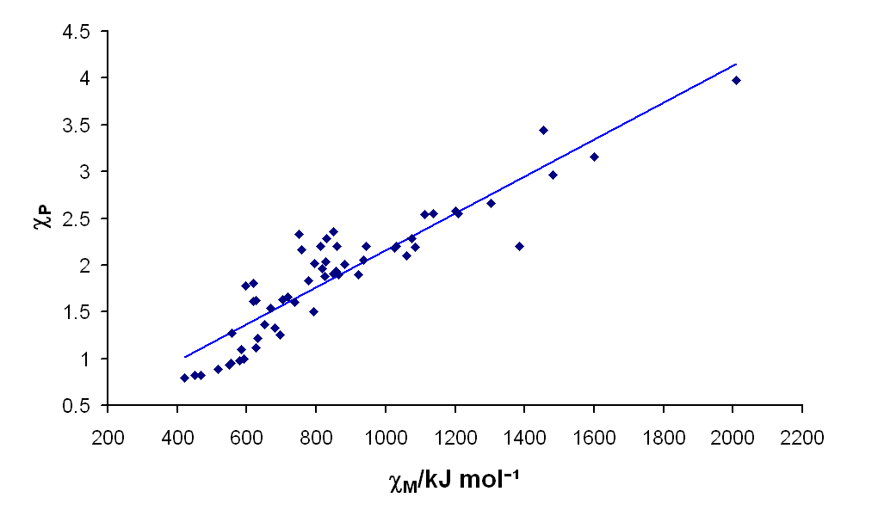
Pauling and Mulliken electronegativity scales give essentially the same results for one element relative to another. Even though the Mulliken scale is based on the properties of individual atoms and the Pauling scale is based on the properties of atoms in molecules, they both apparently measure the same basic property of an element.
In the following discussion, we will focus on the relationship between electronegativity and the tendency of atoms to form positive or negative ions. We will therefore be implicitly using the Mulliken definition of electronegativity. Because of the parallels between the Mulliken and Pauling definitions, however, the conclusions are likely to apply to atoms in molecules as well.
Although Pauling electronegativities are usually what are found in textbooks, the Mulliken electronegativity more intuitively corresponds to the "ability of an atom to draw electrons toward itself in bonding," and is probably a better indicator of that property. However, because of the good correlation between the two scales, using the Pauling scale is sufficient for most purposes.

Slide 39
Species | Ionization Energy, IE or I (eV) | Electron Affinity, EA or A (eV) | Mulliken Electronegativity, χ (eV) | Pearson Absolute Hardness, η (eV)
Selected Acids
Group 1A monocations
Li⁺ | 75.64 | 5.39 | 40.52 | 35.12
Na⁺ | 47.29 | 5.14 | 26.21 | 21.08
K⁺ | 31.63 | 4.34 | 17.99 | 13.64
Rb⁺ | 27.28 | 4.18 | 15.77 | 11.55
Cs⁺ | 25.1 | 3.89 | 14.5 | 10.6
Group 11 monocations
Cu⁺ | 20.29 | 7.73 | 14.01 | 6.28
Ag⁺ | 21.49 | 7.58 | 14.53 | 6.96
Au⁺ | 20.5 | 9.23 | 14.9 | 5.6

Slide 40
Species | Ionization Energy, IE or I (eV) | Electron Affinity, EA or A (eV) | Mulliken Electronegativity, χ (eV) | Pearson Absolute Hardness, η (eV)
Selected Acids
Isoelectronic Row 3 Metal Cations
Na⁺ | 47.29 | 5.14 | 26.21 | 21.08
Mg²⁺ | 80.14 | 15.04 | 47.59 | 32.55
Al³⁺ | 119.99 | 28.45 | 74.22 | 45.77
Changes with Transition Metal Ion Charge
Fe²⁺ | 30.65 | 16.18 | 23.42 | 7.24
Fe³⁺ | 54.8 | 30.65 | 42.73 | 12.08
Co²⁺ | 33.50 | 17.06 | 25.28 | 8.22
Co³⁺ | 51.3 | 22.5 | 42.4 | 8.9
CO₂ | 13.8 | -3.8 | 5.0 | 8.8
CS₂ | 10.08 | 0.62 | 5.35 | 5.56

Slide 41
Species | Ionization Energy, IE or I (eV) | Electron Affinity, EA or A (eV) | Mulliken Electronegativity, χ (eV) | Pearson Absolute Hardness, η (eV)
Selected Bases
Group 17 monoanions (taken to be identical to the free atom values)
F⁻ | 17.42 | 3.40 | 10.41 | 7.01
Cl⁻ | 13.01 | 3.62 | 8.31 | 4.70
Br⁻ | 11.84 | 3.36 | 7.60 | 4.24
I⁻ | 10.45 | 3.06 | 6.76 | 3.70
Group 15 hydrides
NH₃ | 10.7 | -5.6 | 2.6 | 8.2
PH₃ | 10.0 | -1.9 | 4.1 | 6.0
Group 16 hydrides
H₂O | 12.6 | -6.4 | 3.1 | 9.5
H₂S | 10.5 | -2.1 | 4.2 | 6.2

Slide 42
In general, a hard acid has a small ionic radius, high positive charge, no electron pairs in its valence shell, low EA, is strongly solvated, and/or has a high-energy LUMO.
Soft acids, on the other hand, have large radii, have low or partial positive charge, have electron pairs in their valence shells, are easy to polarize and oxidize, and have low-energy LUMOs with large magnitude coefficients.
Hard bases have small radii, are hard to oxidize, are weakly polarizable, have very electronegative centers, are strongly solvated, and/or have high-energy HOMOs.
Soft bases tend to have large radii, have intermediate values for the electronegativity, are easily polarized and oxidized, and have low-energy HOMOs with large magnitude coefficients.

Slide 43
Theoretical Interpretation of the Hard Soft Acid-Base Principle
The Theoretical Interpretation of the Hard Soft Acid-Base Principle is that hard-hard preferences reflect superior electrostatic stabilization while soft-soft preferences reflect superior covalent stabilization.
The hard-hard and soft-soft preferences in Lewis acid-base interactions reflect that
The lone pair of a hard base is strongly stabilized electrostatically by a hard acid
The lone pair of a soft base is strongly stabilized by forming a covalent bond with a soft acid
The lone pair of a hard or soft base is comparatively weakly stabilized by an acid opposite to it in hardness or softness since the overall electrostatic and covalent stabilization of the adduct is comparatively weak.

Slide 44
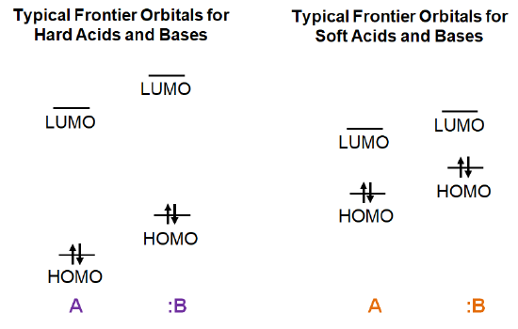
Both hard acids and bases will have comparatively low energy HOMO levels and high energy LUMO levels, with a correspondingly high HOMO-LUMO gap (E_{g}).
In contrast, soft acids and bases will have comparatively high-energy HOMO levels and low-energy LUMO levels, giving a comparatively smaller HOMO-LUMO gap (E_{g}).
E_{g}
E_{g}

Slide 45
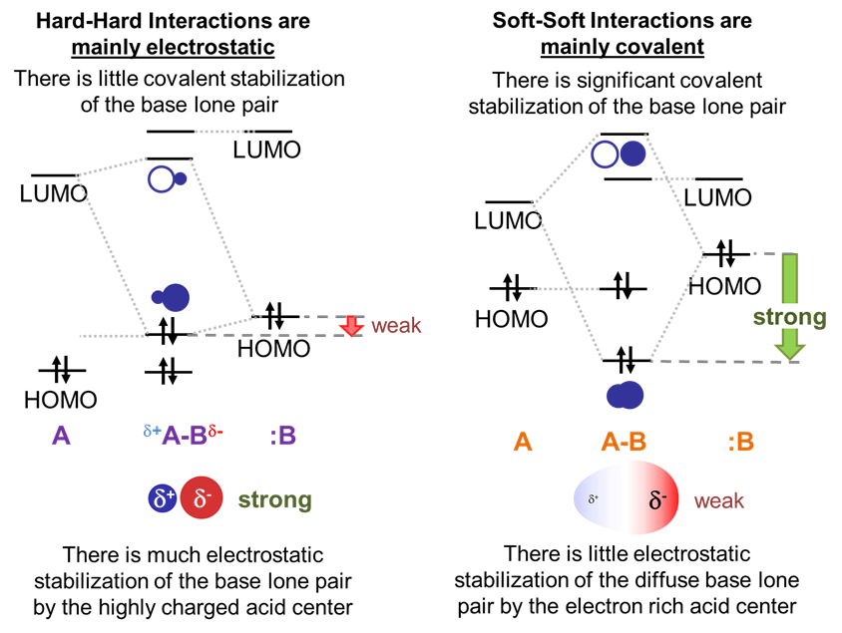
Given this, consider the frontier orbital interactions involved in the formation of an acid-base complex for the possible cases, as illustrated schematically below.

Slide 46
The large gap in energy between hard bases’ highly stabilized HOMO lone pairs and the high energy LUMO of hard acids ensures that in hard acid-hard base adducts the dominant stabilizing interaction will involve electrostatic attraction between the base lone pair and the electropositive Lewis acid center. Fortunately, since the electron clouds in hard bases are relatively dense and electron rich while hard Lewis acids are highly charged and small these electrostatic interactions are strong.
In contrast, in soft acid-soft base adducts the dominant stabilizing interaction will be covalent. This is because the small gap in energy between a soft base HOMO and soft acid LUMO enables the formation of a well-stabilized bonding orbital with significant electron density between the acid and base.
The orbitals interactions between hard acids and soft bases and soft acids and hard bases are intermediate between the hard acid-hard base and soft acid-soft base cases.
This means that the adducts are stable relative to free acid and base – just not as well stabilized as in the hard acid and hard base case. In the case of hard acids and soft bases the hard acids are less able to stabilize the soft bases’ relatively diffuse electron pair electrostatically and there isn’t as much covalent stabilization as in adducts of soft acids and bases due to hard acid’s high energy.

Slide 47
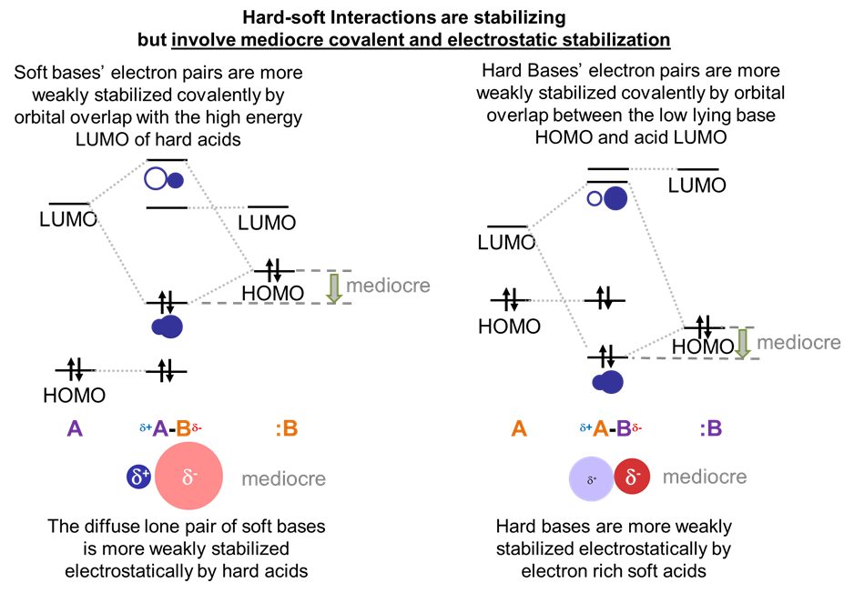

Slide 48
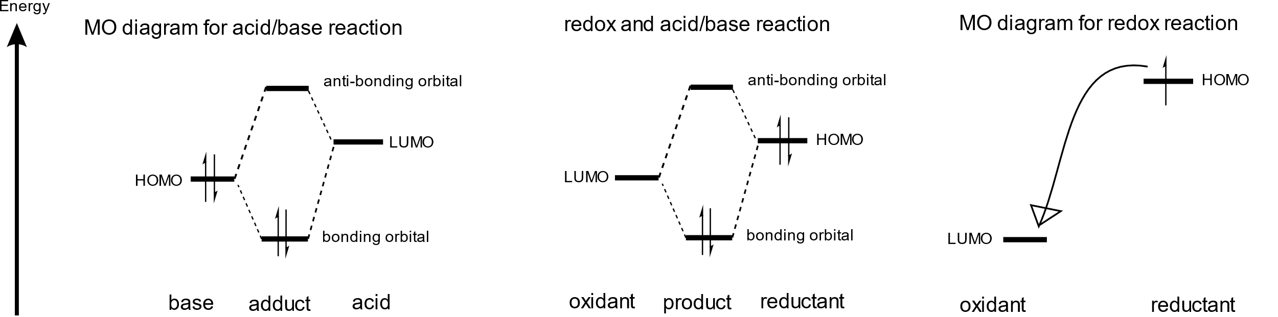
In a redox reaction, the oxidant has a low LUMO, and the reductant has a high HOMO, but this time the oxidant LUMO is lower than the reductant HOMO, so that the electrons in the reductant HOMO move completely to the oxidant LUMO. Often the energy match is bad, so that no covalent bond forms, just the electron moves. Sometimes a covalent bond forms also. This depends on the MO/AO energies, which depends on the electronegativity, just like you would expect. You can still predict covalent/ionic bonding based on electronegativity.
Molecules with low HOMO and high LUMO (a big HOMO-LUMO gap), are not very reactive! Hydrocarbons are a good example (like oil, etc.). They do burn easily, but you have to get them hot first. At room temperature, they don't react. This is why if you want to store something reactive like K metal, you probably keep it in a bottle of (pure) oil.

Slide 49
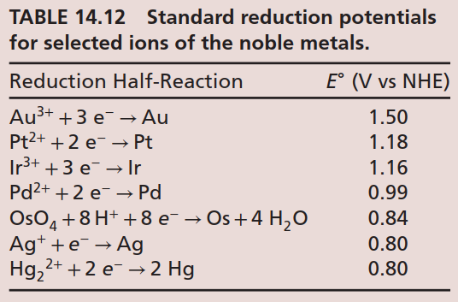
Perhaps, not surprisingly, there is also a connection between the HSAB properties of ions and their redox properties.
For example, the noble metals, those that are resistant to corrosion or oxidation in air, are all derived from soft-acid cations (Ru, Rh, Pd, Ag, Os, Ir, Pt, Au, and Hg). In fact, Pd, Pt, Au, and Hg can only be dissolved in aqua regia (or “king’s water”), which is a 1:3 (v:v) mixture of concentrated HNO₃ with HCl.
The E∘ values for selected noble metals are listed in Table 14.12. As expected, these metals have very positive standard reduction potentials.

Slide 50
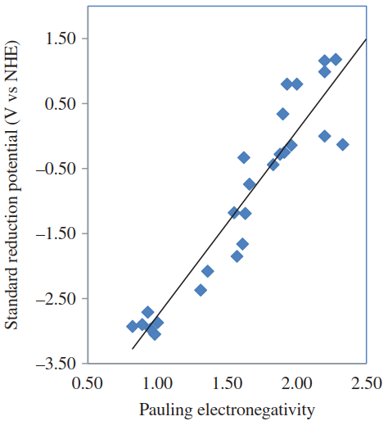
Because, in general, the soft-acid cations tend to have large electronegativities, it follows that there might be a trend in the standard reduction potentials of the metal cations and their Pauling electronegativities. In fact, there is quite an excellent correlation between the two, as demonstrated by the data in Figure 14.10.
FIGURE 14.10
Plot of the standard reduction potential E∘ (V vs NHE) for the most common oxidation state of representative metal cations versus their corresponding Pauling electronegativities.

Slide 51
Wulfsberg has classified the redox properties of the elements into five broad categories on the basis of their electronegativities.
The hard-acid metal cations having 𝜒 < 1.4 tend to have very negative standard reduction potentials (E∘ < −1.6V) and comprise the very active metals. These include all of the alkali metals and most of the alkaline earth metals (with the exception of Be). The heavier alkali metals are extremely reactive and can reduce water to hydrogen gas. The alkali metals can also dissolve in liquid ammonia to yield blue solutions containing a solvated electron.
The second category consists of the borderline-acid cations having 1.4 < 𝜒 < 1.9. These metal ions typically have standard reduction potentials in the range −1.6V < E∘ < 0V and are known as the moderately active metals. Examples include most of the first-row transition metals and the early period second- and third-row metals, as well as Be, Al, and Ga.
The third category contains the soft-acid metals having 1.9 < 𝜒 < 2.55. These include the later period second- and third-row transition metals, as well as In, Tl, Sn, and Pb. These metals typically have E∘ > 0 and are known collectively as the inactive metals because they cannot reduce hydrogen. As stated earlier, the noble metals are particularly unreactive.

Slide 52
The fourth category are the soft-basic anions formed from the less electronegative nonmetals (1.9 < 𝜒 < 2.8) such as B, C, P, S, As, Se, Te, and I. These are referred to as the relatively inactive nonmetals.
Lastly, the inactive nonmetals are those derived from borderline or hard-basic anions and having electronegativities greater than 2.8. These include the most electronegative nonmetals N, O, F, Cl, and Br. With the exception of N₂, the elemental forms of these compounds are potent oxidizing agents.
Taken collectively: “soft-acid cations make good oxidizing agents and soft-base anions make good reducing agents.”

Slide 53
Applications of HSAB Principle
The Hard-Soft acid-base principle (HSAB Principle) explains patterns in Lewis acid-base reactivity in terms of a like reacts with like preference.
Both thermodynamically and kinetically hard acids prefer hard bases and soft acids soft bases.
Specifically,
Thermodynamically, hard acids form stronger acid-base complexes with hard bases while soft acids form stronger complexes with soft bases.
Kinetically, hard acids/electrophiles react more quickly with hard bases/nucleophiles while soft acids/electrophiles react more quickly with soft bases/nucleophiles.

Slide 54
Example Frontier MOs: CO Toxicity
You probably know that CO is toxic (which is why you shouldn't stay in a garage with a car running, because the CO from incomplete combustion can kill you). The reason CO is toxic because it binds metal ions really tightly. Fe(II) ions in your blood bind to O₂ and carry it to our cells. CO binds to the Fe(II) more tightly than O₂, so if you breathe too much CO, your cells won't get any oxygen, because all the Fe(II) in your blood bound CO instead. We can understand how and why CO binds Fe(II) using MO theory. Go back and look at the MO diagram for CO. The HOMO is a slightly-bonding orbital that is mostly on carbon. It is pretty high-energy. The LUMO is a π* orbital that is also mostly on carbon, and it is kind of low-energy because the splitting of π MOs is smaller (because of less overlap) than σ MOs. CO has a small gap between the HOMO and LUMO. Fe(II) also has a small gap between HOMO and LUMO, because it has 6 electrons in 3d orbitals. The HOMO is high, because 3d is not so stable, and the LUMO is low, because it is also 3d and not much higher than the HOMO (there is a gap because the other atoms around the Fe(II) in hemoglobin make the d orbitals different energies). So, what can happen is that the HOMO on CO makes a σ bond with the LUMO on Fe(II), and the HOMO on Fe(II) makes a π bond with the LUMO on CO. This "multiple bond" between CO and Fe(II) makes CO toxic. And because the HOMO and LUMO of CO are big on carbon, you won't be surprised that the bond is Fe-C=O, not Fe-O=C.

Slide 55
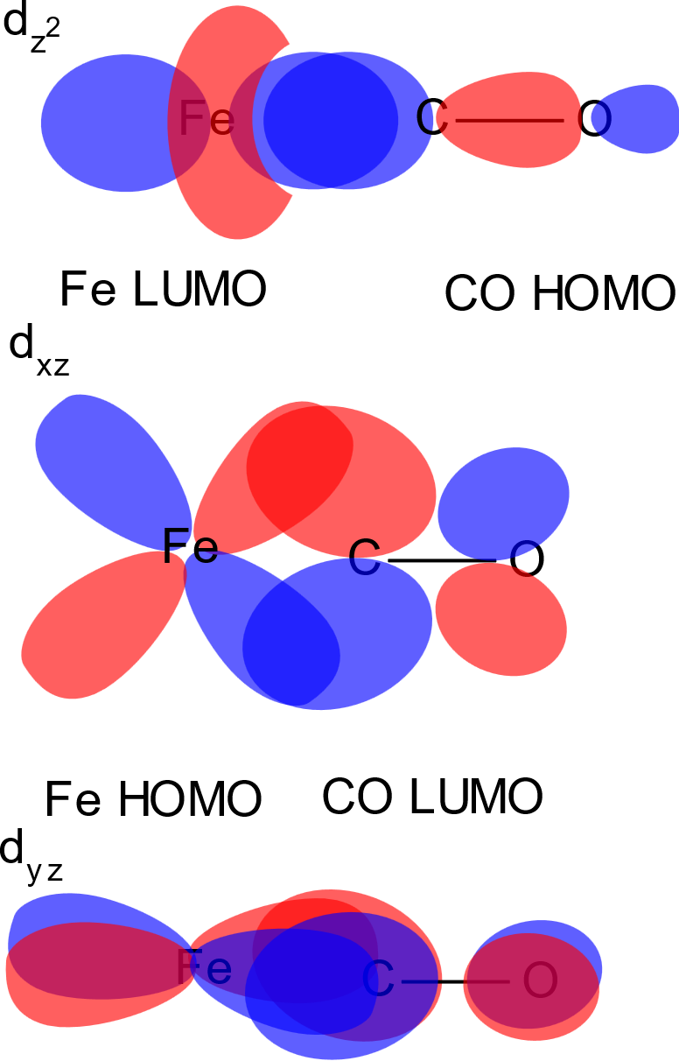
MO interactions between Fe and CO frontier MOs.
Top: σ interaction.
Bottom: π interactions (2 CO LUMOs, 2 Fe HOMOs, related by 90° rotation)

