Slide 1

Key cloak
Presented By- Chandra S
cnsnoida@gmail.com
#9560333719
About Me:
--------------------------
Name- CHANDRA S
Domain- Telecom, Database,Testing,Full stack Development
(java/python/scala/GO),Hadoop,Spark,BI,Datascience,aws,Azure,K8
Industry Experience- 20 years
10 years development(java,python,scala,GO)
10 years Database and Unix
10+ years in Hadoop/Spark/Cloud/DataScience
Clients- TechMahindra Ltd ,Axtria ,NIIT ,NIC ,Indian Universities
Math graduate
MCA- Agra Univerity
MBA- Symbiosys,sales
AWS certified professional
CKAD certified
Azure Certified
Coursera -AI for All

Slide 2
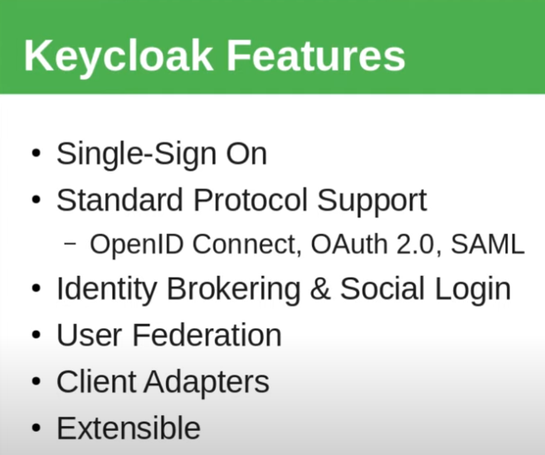
Keycloak
Prerequisites:
--------------------
knowledge of Computers
knowledge of Internet
knowledge of Networking concepts
Topics:
----------------
Realms
Themes
Managing Users in Keycloak
Managing Groups in Keycloak
Keycloak Events
What is KeyCloak?:
--------------------
Keycloak is a software product to allow single sign-on with identity and access management aimed at
modern applications and services.
WildFly community of Red Hat, who use it as the upstream project for their Red Hat build of Keycloak.

Slide 3
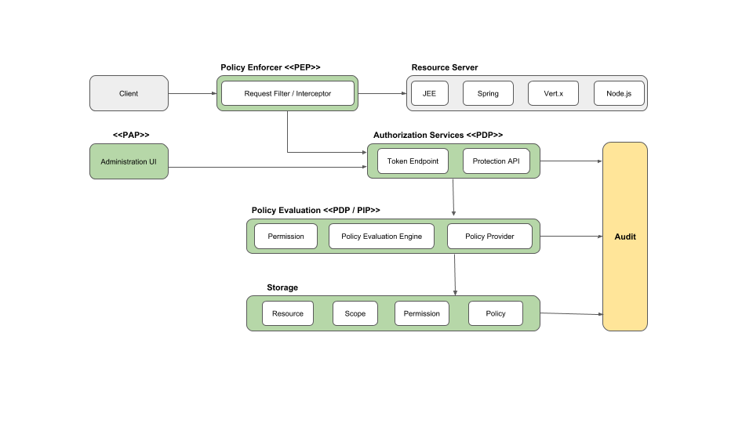
Keycloak

Slide 4
Keycloak
Installation:
------
#download keycloak
#create certificate
openssl req -newkey rsa:2048 -nodes \
-keyout keycloak-server.key.pem -x509 -days 365 -out keycloak-server.crt.pem
#start postgres -docker
docker run -d --name postgres -p 5432:5432 -e POSTGRES_USER=postgres -e POSTGRES_PASSWORD=postgres postgres:16 postgres
docker exec -it 8ecaf89379aa bash
psql -U postgres
create database keycloak;
postgres=# create user admin with encrypted password 'Admin@1234';
postgres=# grant all privileges on database keycloak to admin;
GRANT CONNECT ON DATABASE keycloak TO admin;
GRANT pg_read_all_data TO admin;
GRANT pg_write_all_data TO admin;
\c keycloak
# You are now connected to database "keycloak" as user "postgres".
GRANT ALL ON SCHEMA public TO admin;

Slide 5
Keycloak
#.env file set in HOME
------------------
POSTGRES_DB=keycloak
POSTGRES_USER=postgres
POSTGRES_PASSWORD=postgres
KEYCLOAK_ADMIN=admin
KEYCLOAK_ADMIN_PASSWORD=Admin@1234
#correct config file-->/conf/keycloak.conf
#download postgres driver
https://jdbc.postgresql.org/download/
42.7.3
/home/ckumar/postgres/lib/<driver>
--permission
chmod 777 postgresql-42.7.3.jar
#copy postgres.jar into <keycloak-Home>/lib/lib/deployment
#.bashrc
export POSTGRES_HOME=/home/ckumar/postgres
export CLASSPATH=$POSTGRES_HOME/lib:$CLASSPATH
#ssl or HTTPS
#Prod
./bin/kc.sh start --https-port=8081 --http-port=8080 –https-certificate-file=/home/ckumar/keycloak-server.crt.pem
--https-certificate-key-file=/home/ckumar/keycloak-server.key.pem --db postgres --db-url-host localhost
--db-username admin --db-password Admin@1234 --hostname-strict false

Slide 6
Keycloak
A Realm manages a set of users, credentials, roles, and groups.
A user belongs to and logs into a realm.
Realms are isolated from one another and can only manage and authenticate the users that they control.
Clients are entities that can request Keycloak to authenticate a user.
Realms are great in case of tenancy
Manager Users:
------------
Self Registration
From Admin console
User Federation
Automation via API
http://localhost:8080/
https://localhost:8081/
KeyCloak security:
--------------------
Authentication
Authorization
Encryption
#commands
./bin/kc.sh export --dir /home/ckumar
./bin/kc.sh import
./bin/kc.sh start --import-realm --hostname-strict false # will import from data/import directory
#ssl or HTTPS
#DEV
./bin/kc.sh start-dev --https-port=8081 --https-certificate-file=/home/ckumar/keycloak-server.crt.pem
--https-certificate-key-file=/home/ckumar/keycloak-server.key.pem --db postgres --db-url-host localhost
--db-username admin --db-password Admin@1234

Slide 7
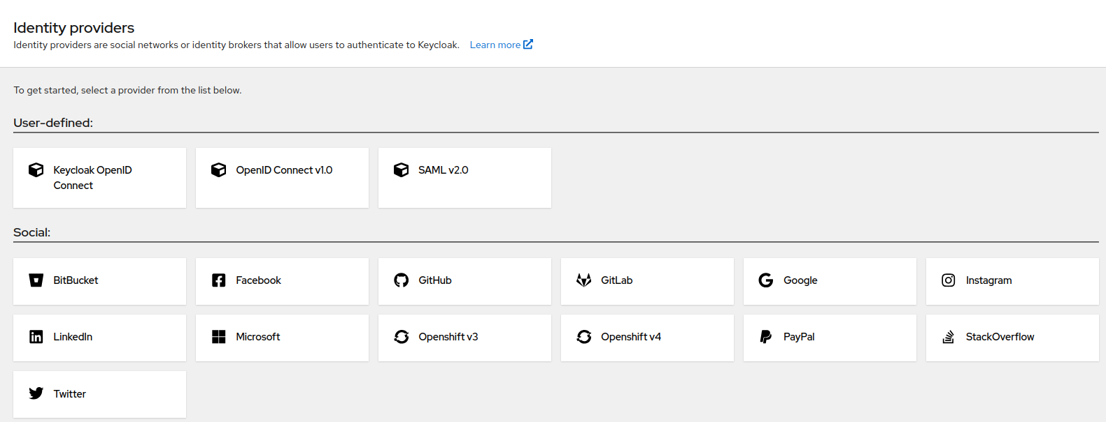
Keycloak
Authorization services
---------------------
Attribute-based access control (ABAC)
Role-based access control (RBAC)
User-based access control (UBAC)
Context-based access control (CBAC)
Rule-based access control
Using JavaScript
Time-based access control
Support for custom access control mechanisms (ACMs) through a Service Provider Interface (SPI)

Slide 8
Keycloak
#.bashrc
export POSTGRES_HOME=/home/ckumar/postgres
export CLASSPATH=$POSTGRES_HOME/lib:$CLASSPATH
aa

Slide 9
Keycloak
#steps
Create realm - test
create client- login-app
redirect URI- http://localhost:9090
create role: user
create user:test123
client scope: click on roles->Include in token scope(ON)
Mappers tab click on Realm Roles->Add to userinfo is On
Postman:
----------------------
Generating Access Tokens With Keycloak’s API
POST -x-www-form-urlencoded format:
https://localhost:8443/realms/test/protocol/openid-connect/token
client_id:login-app
username:test123
password:test123
grant_type:password

Slide 10
Keycloak
aa
aa

Slide 11
Useful Links
https://www.keycloak.org/docs-api/22.0.1/rest-api/index.html

Slide 12


THANKS

