Slide 1
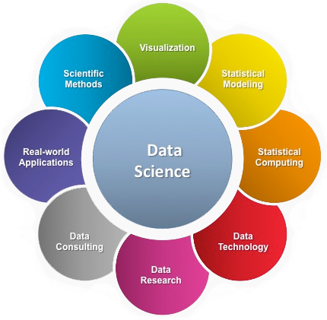
Data-Science
Presented By- Chandrashekhar
cnsnoida@gmail.com
#9560333719

Slide 2
Concept
Data science?
Data mining?
Machine learning?
Deep Learning?
Statistics?
Operations research?

Slide 3
Data science Topics
Python/R- Visualizing Data
Linear Algebra
Statistics
Probability
Machine Learning

Slide 4
Data science Path
Visualization for Data Mining
Modelling
Data Preparation
Communication & Presentation
Machine Learning

Slide 5
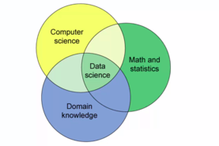
Old Data Science

Slide 6
New Data-Science Concept
Creativity
Programming
Real-Life practice
Communication
Presentation
Domain Knowledge

Slide 7
Data Science Domain
Statistics
Visualization
Data Mining
Database Data process
Patteren recognise
Machine learning
Neurocomputing

Slide 8
Visualization
There are two primary uses for data visualization:
To explore data
To communicate data
Tool -
Matplotlib
Tableau:
Tableau Desktop – Paid version
Tableau public - Free
Tableau Cloud

Slide 9
Data Modeling
Linear regression
Multiple Linear Regression
Logistic Regression
Geodemographic Segmentation Mode

Slide 10
Data Preparation
Data Wrangling- process of transforming and mapping data from one "raw" data form into another format to make more appropriate and valuable for a variety of downstream purposes such as analytics.
Handling Errors During ETL

Slide 11
Communication
Data scientist will communicate to real world in form of data.

Slide 12


THANKS

