Slide 1
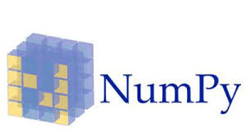
NumPy
Presented By- Chandrashekhar
cnsnoida@gmail.com
#9560333719

Slide 2
Prerequisites
Python 2.X or 3.x with Anaconda library
Basic knowledge of any computer language
Eclipse-python/intelli-j/pycharm should be installed
Jupyter notebook/IDLE/Spider
sudo apt-get install python-numpy
python-scipy python-matplotlibipythonipythonnotebook python-pandas
python-sympy python-nose
$>pip install numpy

Slide 3
NumPy
NumPy (stands for Numerical Python)
It provides useful features for operations on n-arrays and matrices.
The library provides vectorization of mathematical operations on the NumPy array type.
It is a library consisting of multidimensional array objects and a collection of routines for processing of array.
http://www.numpy.org/

Slide 4
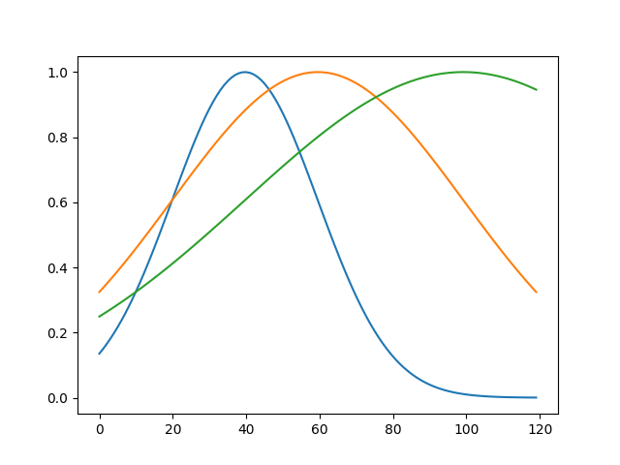
Sample Code
import numpy as np
test = 'hello Anylytics'
#python2
print test
#python3
print (test)
-- Gaussian graph
from matplotlib import pyplot as mp
import numpy as np
def gaussian(x, mu, sig):
return np.exp(-np.power(x - mu, 2.) / (2 * np.power(sig, 2.)))
for mu, sig in [(-1, 1), (0, 2), (2, 3)]:
mp.plot(gaussian(np.linspace(-3, 3, 120), mu, sig))
mp.show()

Slide 5
Operations
Mathematical and logical operations on arrays.
Fourier transforms and routines for shape manipulation.
Operations related to linear algebra. NumPy has in-built functions for linear algebra and random number generation.

Slide 6
Relation with Matlab
NumPy is used along with SciPy (Scientific Python) packages and Mat−plotlib (plotting library).
This combination is widely used as a replacement for MatLab, a popular platform for technical computing.

Slide 7
Array Object
Object defined in NumPy is an N-dimensional array type called ndarray.
It describes the collection of items of the same type.
Items in the collection can be accessed using a zero-based index.
Every item in an ndarray takes the same size of block in the memory.
Each element in ndarray is an object of data-type object (called dtype).

Slide 8
Data Types
Bool_ int_
Intc intp
Int8 int16
Int32 int64
Uint8 uint16
Uint32 uint64
Float_ float16
float32
float64
complex_
complex64
complex128

Slide 9
dtype object
numpy.dtype(object, align, copy)
Object − To be converted to data type object
Align − If true, adds padding to the field to make it similar to C-struct
Copy − Makes a new copy of dtype object. If false, the result is reference to builtin data type object

Slide 10
Array
ndarray.shape
This array attribute returns a tuple consisting of array dimensions. It can also be used to resize the array.
Example:
import numpy as np
ar = np.array([[3,5,6],[4,5,6]])
print (ar.shape)

Slide 11
Linear Algebra
NumPy package contains numpy.linalg module that provides all the functionality required for linear algebra
dot-Dot product of the two arraysvdot
Dot- product of the two vectors
inner-Inner product of the two arrays
matmul-Matrix product of the two arrays
determinant-Computes the determinant of the array
solve-Solves the linear matrix equation
inv-Finds the multiplicative inverse of the matrix

Slide 12
Histogram(Matplotlib)
NumPy has a numpy.histogram() function that is a graphical representation of the frequency distribution of data.
Rectangles of equal horizontal size corresponding to class interval called bin and variable height corresponding to frequency.

Slide 13
Sort, Search & Counting Functions
kind speed worst case work space stable
-------------------------------------------------------------------------
‘quicksort’ 1 O(n^2) 0 no
‘mergesort’ 2 O(n*log(n)) ~n/2 yes
‘heapsort’ 3 O(n*log(n)) 0 no
The sort() function returns a sorted copy of the input array.
numpy.sort(a, axis, kind, order)

Slide 14
Arithmetic operation
Input arrays for performing arithmetic operations such as add(), subtract(), multiply(), and divide() must be either of the same shape or should conform to array broadcasting rules.

Slide 15
Matrix
NumPy package contains a Matrix library numpy.matlib.
matlib.empty()
The matlib.empty() function returns a new matrix without initializing the entries.
shape- int or tuple of int defining the shape of the new matrix
Dtype-Optional. Data type of the output
order-C or F

Slide 16
Broadcasting
It allows numpy to work with arrays of different shapes when performing arithmetic operations.
Have a smaller array and a larger array, and want to use the smaller array multiple times to perform some operation on the larger array.

Slide 17
Useful Links
https://www.machinelearningplus.com/python/101-numpy-exercises-python/

Slide 18
Broadcasting
It allows numpy to work with arrays of different shapes when performing arithmetic operations.
Have a smaller array and a larger array, and want to use the smaller array multiple times to perform some operation on the larger array.

Slide 19

THANKS

