Slide 1
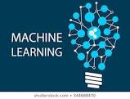
Machine Learning-1
Presented By- Chandrashekhar
cnsnoida@gmail.com
#9560333719

Slide 2
Prerequisites
Java(1.8) must be installed.(optional)
Python 2.X or 3.x with Anaconda library
Basic knowledge of java/scala/python
Mini conda env/Jupyter notebook or Lab
IDE:
Jupyter notebook(Conda env)
IDLE
Spider
Eclipse-python
Intelli-j
pycharm

Slide 3
ML Topics
Machine Learning
Deep Learning
Cafe
Torch
Tensor flow
Python is the best language for data science.
It’s free.
It’s relatively simple to code and understand.
It has lots of useful data science–related libraries.

Slide 4
What is Machine Learning?
Machine learning and statistics are part of data science.
The word learning in machine learning means that the algorithms depend on some data, used as a training set, to fine-tune some model or algorithm parameters.
This encompasses many techniques such as regression, naive Bayes or supervised clustering.
Machine learning is a branch of programming the systems in such a way that they automatically learn and improve with experience.
Machine learning is a method of data analysis that automates analytical model building. It is a branch of artificial intelligence based on the idea that machines should be able to learn and adapt through experience.

Slide 5
ML Problem
A machine learning problem consist of three things:
1. There exist a pattern.
2. We cannot solve it mathematically (even by writing exponential equations).
3. Have data on it.
Always look for these three factors to decide if machine learning is a tool to solve a particular problem.

Slide 6
Uses of ML with Applications
Algorithms used for various applications :
Vision processing
Language processing
Forecasting (e.g., stock market trends)
Pattern recognition
Games
Data mining
Expert systems
Robotics

Slide 7
ML steps
Data preparation
Data Modelling
Data set Loading
Features
Features names
Feature matrix
Response
Response Vector
Target Names
Splitting the dataset
Train dataset
Test dataset
Validation Split
Data Cleaning /Missing Data
Pre-processing the Data
Binarization
Mean Removal
Scaling
Normalisation
L1 Normalisation- Least Absolute Deviations
L2 Normalisation- Least Square
Estimator API
Data visualization
Descriptive Analysis
Predictive analysis

Slide 8
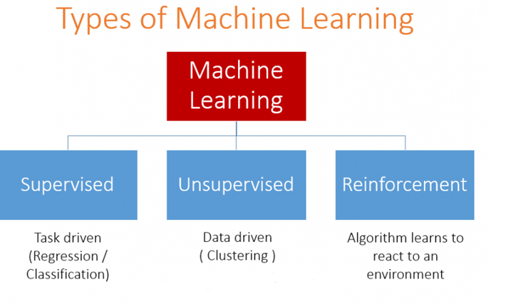
ML -Types

Slide 9
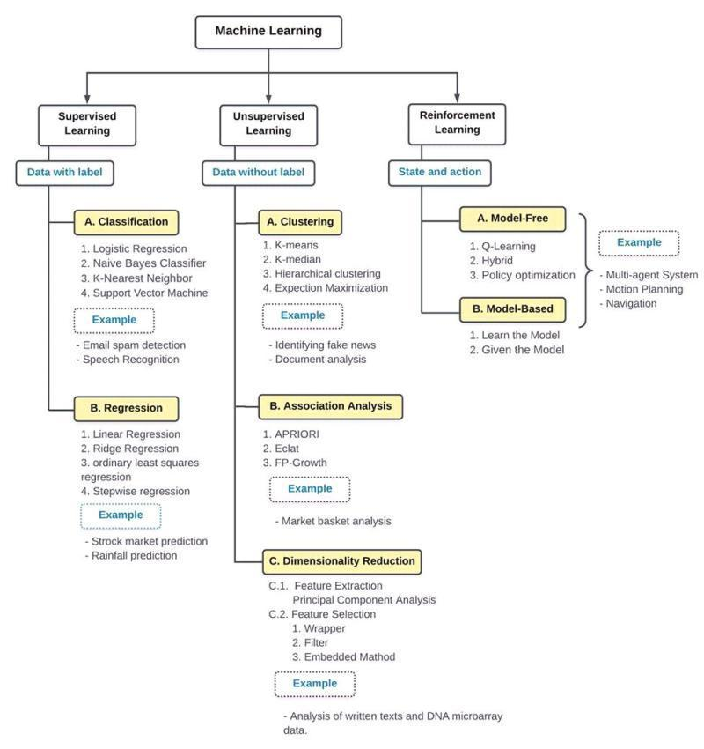
Machine Learning

Slide 10
Data Modeling packages
Gretl- GNU Regression Econotrics and time-series Library
SAS-
R-
IBM SPSS-
Python

Slide 11
Steps used in ML
Collecting data: raw data from excel, access, text files etc., (gathering past data) forms the foundation of the future learning. The better the variety, density and volume of relevant data, better the learning prospects for the machine becomes.
Preparing the data: Analytical process requires quality of the data used. One needs to spend time determining the quality of data and then taking steps for fixing issues such as missing data and treatment of outliers.
Training a model: This step involves choosing the appropriate algorithm and representation of data in the form of the model. The cleaned data is split into two parts – Train and Test .
Training data is used for developing the model.
Test data, is used as a reference.
Evaluating the model: To test the accuracy ,test data is used. This step determines the precision in the choice of the algorithm based on the outcome.
Improving the performance: This step might involve choosing a different model altogether or introducing more variables to augment the efficiency.

Slide 12
Libraries for ML
scipy
numpy
matplotlib
pandas
sklearn
Deeplearning4j
Theano

Slide 13
Visualizations Tools
R’s ggplot
Python’s seaborn
matplotlib
Plot.ly
Tableau.
Kibana
Google’s chart
Datawrapper
Power BI
qlikview

Slide 14
ML Fields
Adversarial machine learning
Predictive analytics
Quantum machine learning
Robot learning

Slide 15
Supervised Learning
Supervised learning deals with learning a function from available training data.
A supervised learning algorithm analyzes the training data and produces an inferred function, which can be used for mapping new examples.
Common examples of supervised learning include:
classifying e-mails as spam,
labeling web pages based on their content
voice recognition.
Mahout implements Naive Bayes classifier.

Slide 16
Supervised Algorithm
k-nearest neighbor
Apriori algorithm
Eclat algorithm
Naive Bayes
Bayesian networks
Hidden Markov models
Case-based reasoning
Gaussian process regression
Gene expression programming
Support vector machines
Random Forests
Nearest Neighbor Algorithm

Slide 17
Supervised Algorithm
Group method of data handling (GMDH)
Inductive logic programming, Instance-based learning
Lazy learning,AODE, ANOVA,Quadratic classifiers,Boosting, SPRINT
Association rule learning algorithms
Learning Automata, Learning Vector Quantization
Logistic Model Tree, Analogical modeling
Minimum message length (decision trees, decision graphs, etc.)
Probably approximately correct learning (PAC) learning
Ripple down rules, a knowledge acquisition methodology
Symbolic machine learning algorithms
Ensembles of classifiers,Conditional Random Field
Bootstrap aggregating (bagging),Boosting (meta-algorithm)
Ordinal classification,Information fuzzy networks (IFN)

Slide 18
Unsupervised Learning
Unsupervised learning is of unlabeled data without having any predefined dataset for its training.
Unsupervised learning is an extremely powerful tool for analyzing available data and look for patterns and trends.
It is most commonly used for clustering similar input into logical groups.
Approaches to unsupervised learning :
k-means
self-organizing maps, and
hierarchical clustering
Expectation-maximization algorithm
Vector Quantization
Generative topographic map
Information bottleneck method

Slide 19
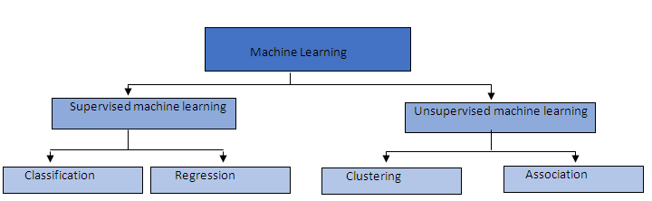
Classification vs Regression
Output variable in regression is numerical (or continuous) while that for classification is categorical (or discrete).
Regression:
linear regression
Support Vector Regression (SVR)
regression trees.
Classification:
logistic regression
Naïve Bayes
decision trees
K Nearest Neighbors.

Slide 20
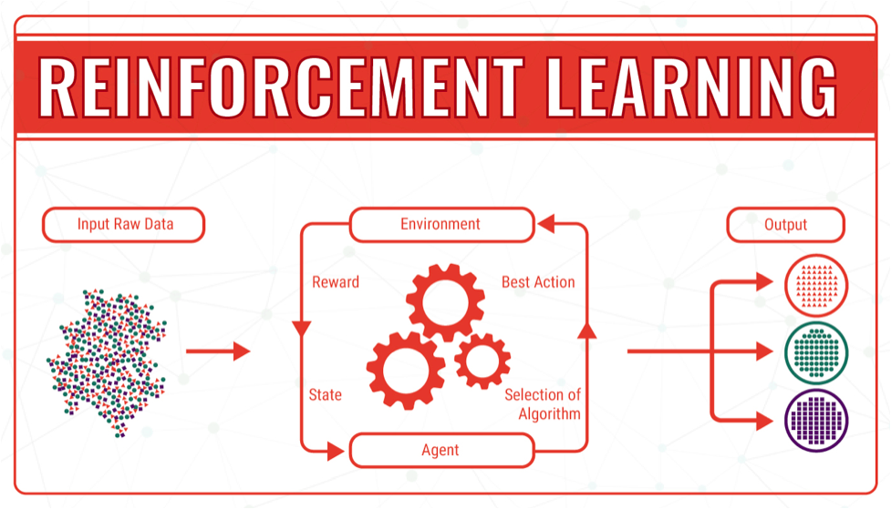
Reinforcement learning
Reinforcement Learning is a type of ML, and branch of Artificial Intelligence.
Machines and software agents to automatically determine the ideal behavior within a specific context, in order to maximize its performance.
Reinforcement Learning is a specific type of problem, and all its solutions are classed as Reinforcement Learning algorithms. Agent is supposed decide the best action to select based on his current state. When this step is repeated, the problem is known as a Markov Decision Process.

Slide 21
Techniques for Machine Learning
1. Classification- An email is spam or not, based on the data of an email: the sender, recipients, subject, and message body. Classification takes a set of data with known labels and learns how to label new records based on that information. Ex- gmail,credit card fraud detection
2.Clustering-Google News uses a technique called clustering to group news articles into different categories, based on title and content. Clustering algorithms discover groupings that occur in collections of data.
3.Collaborative Filtering/recommendation - Amazon uses a machine learning technique called collaborative filtering (commonly referred to as recommendation), to determine which products users will like based on their history and similarity to other users.

Slide 22
Classification
Classification is the problem of identifying to which of a set of categories (sub-populations) a new observation belongs, on the basis of a training set of data containing observations (or instances) whose category membership is known.
It is an example of pattern recognition.
Recommendation System:
A recommendation system is a subclass of information filtering system that predict the “rating” or “preference” that a user would give to an item. Recommender systems are utilized in a variety of areas including movies, music, news, books, research articles, search queries, social tags, and products in general.
Recommender systems produce a list of recommendations in two ways –
Collaborative Filtering approaches building a model from a user’s past behavior (items previously purchased or selected and/or numerical ratings given to those items) as well as similar decisions made by other users. This model is then used to predict items (or ratings for items) that the user may have an interest in.
Content-Based Filtering approaches utilize a series of discrete characteristics of an item in order to recommend additional items with similar properties.

Slide 23
Classification
Initially a new data model is prepared using any of the learning algorithms.
Then the prepared data model is tested.
Thereafter, data model is used to evaluate new data and to determine its class.
Classification, also known as categorization
Applications of Classification-
Credit card fraud detection - The Classification mechanism is used to predict credit card frauds. Using historical information of previous frauds, the classifier can predict which future transactions may turn into frauds.
Spam e-mails - Depending on the characteristics of previous spam mails, the classifier determines whether a newly encountered e-mail should be sent to the spam folder.
iTunes application uses classification to prepare playlists.
Naive Bayes Classifier-
Distributed Naive Bayes classification
Complementary Naive Bayes classification

Slide 24
Clustering
Clustering is used to form groups or clusters of similar data based on common characteristics. Clustering is a form of unsupervised learning.
Search engines such as Google and Yahoo! use clustering techniques to group data with similar characteristics.
Newsgroups use clustering techniques to group various articles based on related topics.
The clustering engine goes through the input data completely and based on the characteristics of the data, it will decide under which cluster it should be grouped.

Slide 25
Clustering
A set of objects in such a way that objects in the same group (called a cluster) are more similar to each other than to those in other groups (clusters).
it is the main task of exploratory data mining, and a common technique for statistical data analysis, used in many fields, including machine learning, pattern recognition, image analysis, information retrieval, bio informatics, data compression and computer graphics.
Dimensionality Reduction- is the process of reducing the number of random variables under consideration, via obtaining a set of principal variables.
Types:
Feature Selection: Feature selection finds a subset of the original variables (also called features or attributes).
Feature Extraction: This transforms the data in the high-dimensional space to a space of fewer dimensions.The data transformation may be linear, as in Principal Component Analysis(PCA)

Slide 26
Applications of Clustering
Clustering is used in market research, pattern recognition, data analysis, and image processing.
Clustering can help marketers discover distinct groups in their customer basis. and characterize their customer groups based on purchasing patterns.
Used to derive plant and animal taxonomies, categorize genes with similar functionality and gain insight into structures inherent in populations.
Clustering helps in identification of areas of similar land use in an earth observation database, documents on the web for information discovery, detection of credit card fraud.
Applications of clustering:
Recommendation engines
Market segmentation
Social network analysis
Search result grouping
Medical imaging
Image segmentation
Anomaly detection

Slide 27
Recommendation
Recommendation is a popular technique that provides close recommendations based on user information such as previous purchases, clicks, and ratings.
Amazon uses this technique to display a list of recommended items that you might be interested in, drawing information from your past actions. There are recommender engines that work behind Amazon to capture user behavior and recommend selected items based on your earlier actions.
Facebook uses the recommender technique to identify and recommend the “people you may know list”.

Slide 28
KNN vs K-means Clustering
K-Nearest Neighbors is a supervised classification algorithm
k-means clustering is an unsupervised clustering algorithm.
Regression is used to predict continuous values.
Classification is used to predict which class a data point is part of (discrete value).

Slide 29
ML Frameworks
Amazon Machine Learning
Azure ML Studio
DistBelief – replaced by TensorFlow
Microsoft Cognitive Toolkit
Apache Singa (open source)
Caffe
H2O
MLPACK
TensorFlow
Torch

Slide 30
Useful Links
https://towardsdatascience.com/hypothesis-testing-in-machine-learning-using-python-a0dc89e169ce

Slide 31


THANKS

