Slide 1
Regression
Presented By- Chandrashekhar
cnsnoida@gmail.com
#9560333719

Slide 2
Prerequisites
Java(1.8) must be installed.(optional)
Python 2.x/3.x must be installed
Gretl
Basic knowledge of java/scala
Spark2.0 must be installed

Slide 3
Definition
Linear regression is a linear model that assumes a linear relationship between the input variables (x) and the single output variable (y).
y can be calculated from a linear combination of the input variables (x).
When there is a single input variable (x), the method is referred to as simple linear regression.
When there are multiple input variables, literature from statistics often refers to the method as multiple linear regression.

Slide 4

Model Representation
Linear regression is an attractive model because the representation is so simple.
The representation is a linear equation that combines a specific set of input values (x) the solution to which is the predicted output for that set of input values (y).
The linear equation assigns one scale factor to each input value or column, called a coefficient and represented by the capital Greek letter Beta (B). additional coefficient is also added, giving the line an additional degree of freedom and is often called the intercept or the bias coefficient.
Example-
y = B0 + B1*x
Higher dimensions have more than one input (x), the line is called a plane or a hyper-plane.

Slide 5
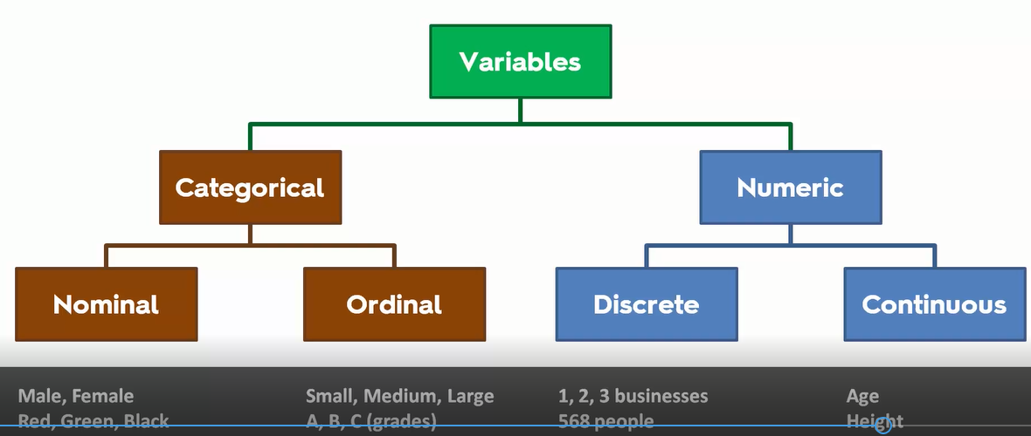
Stat Variables

Slide 6
All Types Regression
Linear Regression
Logistic Regression
Polynomial Regression
Stepwise Regression
Ridge Regression
Lasso Regression
ElasticNet Regression

Slide 7
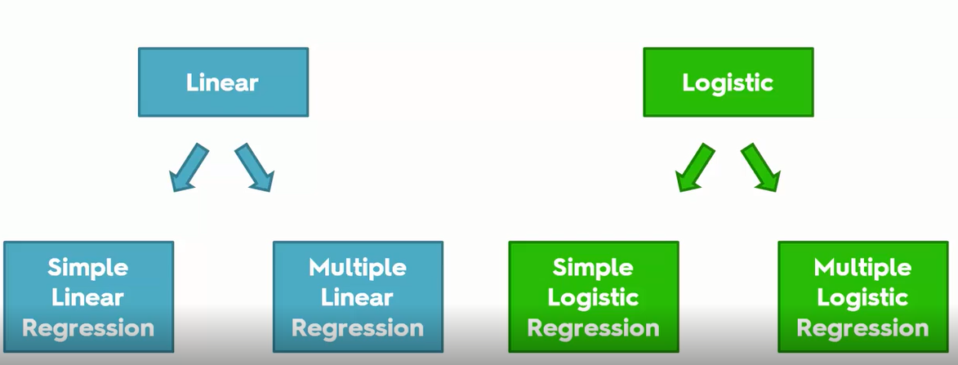
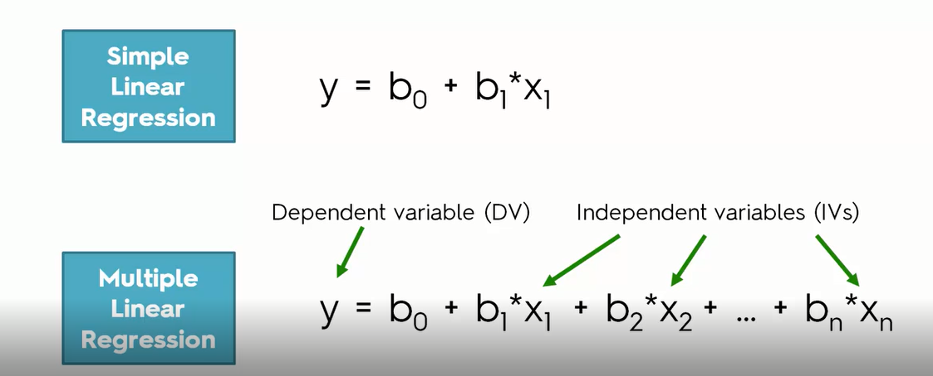
Regression

Slide 8
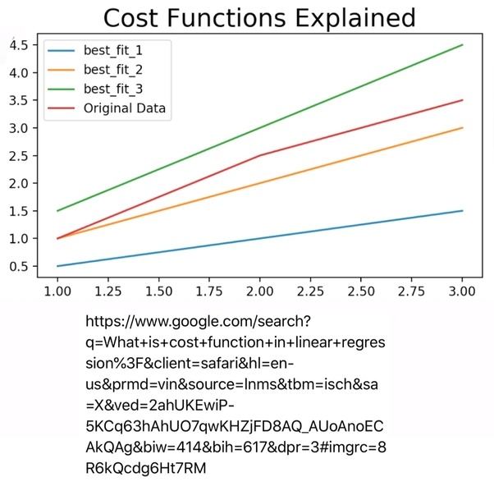

Cost Function
Cost - is a way to, using your training data, determine values for θ values which make the hypothesis as accurate as possible. This cost function is also called the squared error cost function. This cost function is reasonable choice for most regression functions.
can measure the accuracy of hypothesis function by using a cost function. This takes an average difference (actually a fancier version of an average) of all the results of the hypothesis with inputs from x's and the actual output y's.
Also called the "Squared error function", or "Mean squared error". The mean is halved (1/2) as a convenience for the computation of the gradient descent, as the derivative term of the square function will cancel out the (1/2) term.
Cost Function is function of the parameters (theta ). If we plot a
cost function then for each value of theta there will be a
different hypothesis. Our objective is to lower the cost function.

Slide 9
Gradient Descent
When there are one or more inputs and use a process of optimizing the values of the coefficients by iteratively minimizing the error of the model on training data.

Slide 10
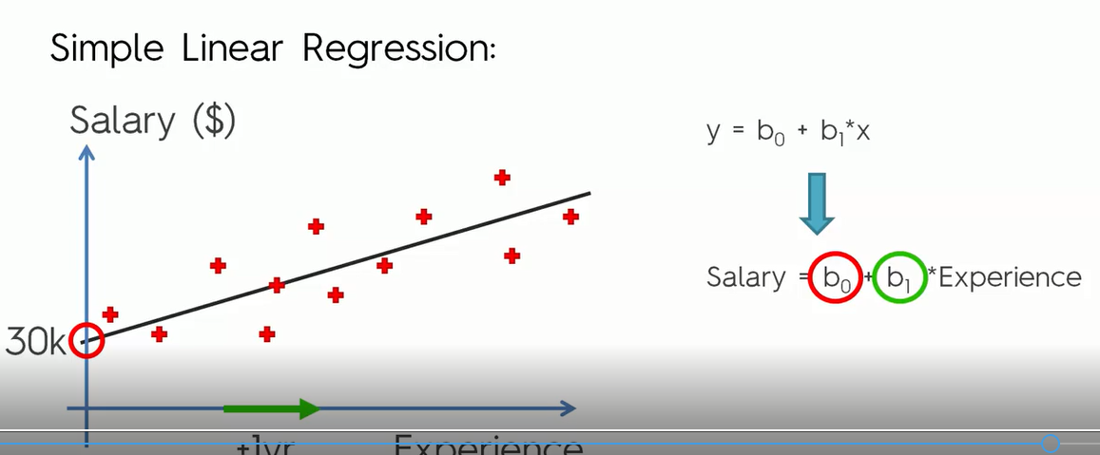
Simple Linear Regression
simple linear regression when single input, use statistics to estimate the coefficients.

Slide 11
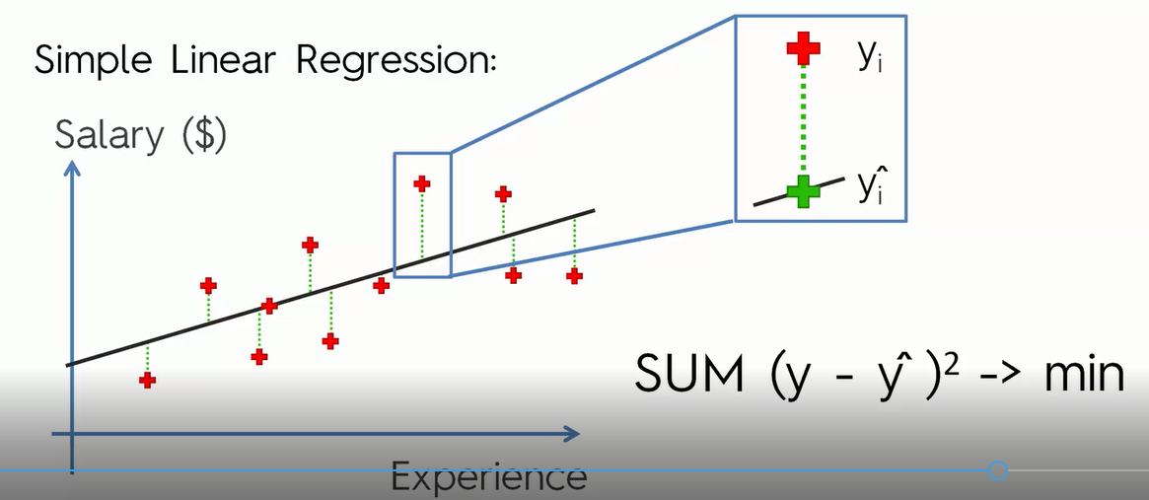
Least Square
Different techniques can be used to prepare or train the linear regression equation from data, the most common of which is called Ordinary Least Squares.
It is common to refer to a model prepared this way as Ordinary Least Squares Linear Regression or just Least Squares Regression.

Slide 12
Assumptions LR
Linearity
Homoscedasticity
Multivariate normality
Independence of errors
Lack of multicollinearity

Slide 13
Regularization
There are extensions of the training of the linear model called regularization methods. These seek to both minimize the sum of the squared error of the model on the training data (using ordinary least squares) but also to reduce the complexity of the model (like the number or absolute size of the sum of all coefficients in the model).
Two examples of regularization procedures for linear regression are:
Lasso Regression: where Ordinary Least Squares is modified to also minimize the absolute sum of the coefficients (called L1 regularization).
Ridge Regression: where Ordinary Least Squares is modified to also minimize the squared absolute sum of the coefficients (called L2 regularization).

Slide 14
Data Preparation For LR
Linear Assumption. Linear regression assumes that the relationship between your input and output is linear. It does not support anything else. Need to transform data to make the relationship linear (e.g. log transform for an exponential relationship).
Remove Noise. Linear regression assumes that input and output variables are not noisy. Consider using data cleaning operations that better expose and clarify the signal in data.
Remove Collinearity. Linear regression will over-fit in data when we have highly correlated input variables. Consider calculating pairwise correlations for input data and removing the most correlated.
Gaussian Distributions. Linear regression will make more reliable predictions if input and output variables have a Gaussian distribution. using transforms (e.g. log or BoxCox) on variables to make their distribution more Gaussian looking.
Rescale Inputs: Linear regression will often make more reliable predictions if rescale input variables using standardization or normalization.

Slide 15
Non Linear Regression
Multivariate Adaptive Regression Splines
Support Vector Machine-
k-Nearest Neighbor
Neural Network

Slide 16
sample
asd

Slide 17
Useful Links
https://medium.com/@lachlanmiller_52885/understanding-and-calculating-the-cost-function-for-linear-regression-39b8a3519fcb

Slide 18


THANKS

