Slide 1

MaplotLib
Presented By- Chandrashekhar
cnsnoida@gmail.com
#9560333719

Slide 2
Prerequisites
Python 2.X or 3.x with Anaconda library
Basic knowledge of any computer language
python -mpip install -U pip
python -mpip install -U matplotlib
sudo apt-get install python3-matplotlib
https://matplotlib.org/

Slide 3
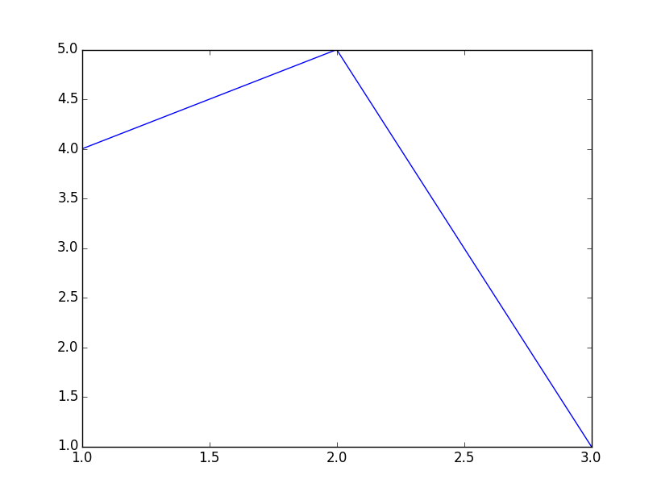
Matplotlib
Matplotlib, the most popular graphing and data visualization module for Python.
#Importing pyplot
from matplotlib import pyplot as plt
#Plotting to our canvas
plt.plot([1,2,3],[4,5,1])
#Showing what we plotted
plt.show()

Slide 4
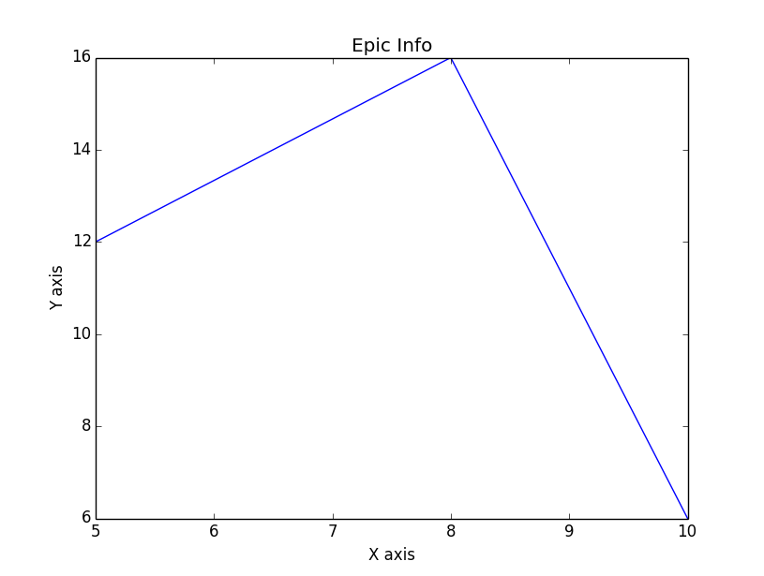
Matplotlib
from matplotlib import pyplot as plt
x = [5,8,10]
y = [12,16,6]
plt.plot(x,y)
plt.title('Epic Info')
plt.ylabel('Y axis')
plt.xlabel('X axis')
plt.show()

Slide 5
Style
from matplotlib import pyplot as plt
from matplotlib import style
style.use('ggplot')
x = [5,8,10]
y = [12,16,6]
x2 = [6,9,11]
y2 = [6,15,7]
plt.show()

Slide 6
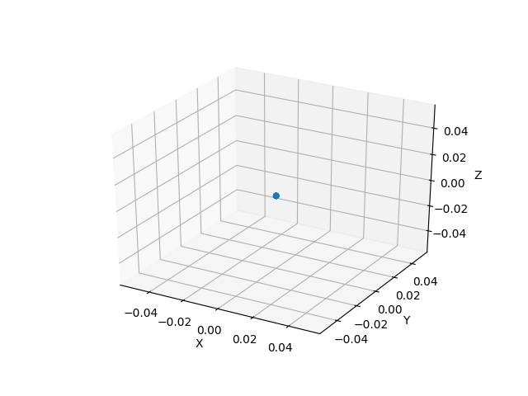
3DStyle

Slide 7
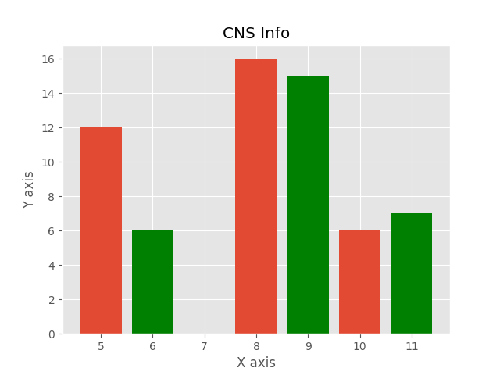
Histogram

Slide 8


THANKS

