Slide 1
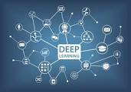
Deep- Learning
Presented By- Chandrashekhar
cnsnoida@gmail.com
#9560333719

Slide 2
Prerequisites
Java(1.8) must be installed.
Basic knowledge of Python
Python 2.X/3.x installed
Pip/pip3/Pycharm
Anaconda/jupyter

Slide 3
Before Start….
Knowledge of Mathematics(Calculus, Algebra, Trigonometry)
Knowledge of statistics
Knowledge of probability
Basics of ML(Famous algorithm)
Tools

Slide 4
Installation
Mechanism by which to install TensorFlow
Virtualenv
pip
Docker
Anaconda
sudo apt-get install python-pip python-dev python-virtualenv

Slide 5
Algorithms
k-nearest neighbours
linear and logistic regression
SVM
Decision trees
Random forests
Neural networks (RNN, CNN, ANN)
Clustering (k-means, HCA)

Slide 6
Deep Learning
Deep learning is a subset of machine learning i,e concerned with neural networks.
Deep learning represents an unsupervised learning algorithm that learns representations of data through the use of neural nets.
Deep Neural Network has three types of layers:
The Input Layer
The Hidden Layer
The Output Layer

Slide 7
DL vs ML
Deep Learning is subset of Machine Learning.
DL mainly deals in picture, images ,video
Machine algorithm is used to parse data, learn from that data, and make informed decisions based on what it has learned.
Deep Learning is used in layers to create an Artificial “Neural Network” that can learn and make intelligent decisions on its own.
ML needs CPU where DL needs GPU.

Slide 8
DL vs CNN
CNN are part of Deep Learning.
Deep Learning is the branch of Machine Learning based on Deep Neural Networks (neural networks composed of more than 1 hidden layer).
CNN are one of the most popular DNN architectures.
Deep nets include Autoencoders, Deep Belief Nets (DBN = a stack of Restricted Boltzmann Machines, RBM), Recurrent Neural Networks (RNN) and more.
shallow RNNs can be considered part of Deep Learning since training them requires unrolling them through time, resulting in a deep net.

Slide 9
Caffe
Caffe is a deep learning framework made with expression, speed, and modularity in mind.
Why Caffe?
Caffe can process over 60M images per day with a single NVIDIA K40 GPU*. That’s 1 ms/image for inference and 4 ms/image for learning and more recent library versions and hardware are faster still.
Caffe is among the fastest convnet implementations available.
Caffe already powers academic research projects, startup prototypes, and even large-scale industrial applications in vision, speech, and multimedia.

Slide 10
Torch
It is an open source ML library, a scientific computing framework, and a script language based on the Lua programming language.
It provides a wide range of algorithms for deep machine learning, and uses the scripting language LuaJIT, and an underlying C implementation.
It support for machine learning algorithms that puts GPUs first.

Slide 11
Tensorflow
Developed by Google to meet their needs for systems capable of building and training neural networks to detect and decipher patterns and correlations, analogous to the learning and reasoning which humans use.
It is for numerical computation using data flow graphs.
Nodes in the graph represent mathematical operations, while the graph edges represent the multidimensional data arrays (tensors) communicated between them.
Architecture allows to deploy computation to one or more CPUs or GPUs in a desktop, server, or mobile device with a single API.

Slide 12
Keras
It is an open source software library for machine learning .
Keras is a wrapper that allows to use either the Theano or the TensorFlow backend.
it has guiding principles: modularity, minimalism, extensibility, and Python-nativeness.

Slide 13
CPU vs GPU
GPU- (Graphics Processing Unit)
The GPU renders images, animations and video for the computer's screen. GPUs are located on plug-in cards, in a chipset on the motherboard
CPU- central processing unit

Slide 14
Steps to create model
Loading data
Define epochs ,batch_size ,LearningRate ,decay
choose optimizers- like sgd = SGD(lr=lrate, momentum=0.9, decay=decay, nesterov=False)
Define Loss Function ( model.compile(loss='binary_crossentropy',optimizer='sgd',metrics=['accuracy'])
Make model
Compile model using Keras algorithm (model.compile(loss='binary_crossentropy',optimizer='sgd',metrics=['accuracy'])
Train data
Validate Data
Use history to map graph epoch vs loss (overfitting vs underfitting)
Actual image testing

Slide 15
Activation Function
Tanh-
ReLU- ReLU gives continuous output in range 0 to infinity.
SIGMOID-
Hard_sigmoid-
Softmax-
Elu-
Selu-
Softplus-
Softsign-
Exponential-

Slide 16
Optimizers
Optimizer is one of the two arguments required for compiling a Keras model:
SGD-
Adam-
Adamax-
RMSprop-
Adagrad-
Adadelta-
Nadam-
from keras import optimizers
model = Sequential()
model.add(Dense(64, kernel_initializer='uniform', input_shape=(10,)))
model.add(Activation('softmax'))
sgd = optimizers.SGD(lr=0.01, decay=1e-6, momentum=0.9, nesterov=True)
model.compile(loss='mean_squared_error', optimizer=sgd)

Slide 17
Loss Function
Default callbacks that is registered when training all deep learning models is the History callback.
# list all data in history
print(history.history.keys())
For example, for a model trained on a classification problem with a validation dataset, produce the following listing:
['acc', 'loss', 'val_acc', 'val_loss']

Slide 18
Loss Function…
mean_squared_error-
'binary_crossentropy
categorical_crossentropy
mean_absolute_error
mean_absolute_percentage_error
mean_squared_logarithmic_error
squared_hinge
Hinge
categorical_hinge
Logcosh
model.compile(loss='mean_squared_error', optimizer='sgd', metrics=['accuracy’])
model.compile(loss='binary_crossentropy', optimizer='adam', metrics=['accuracy'])

Slide 19
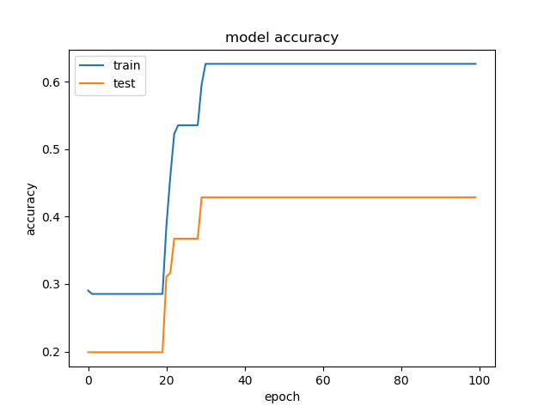
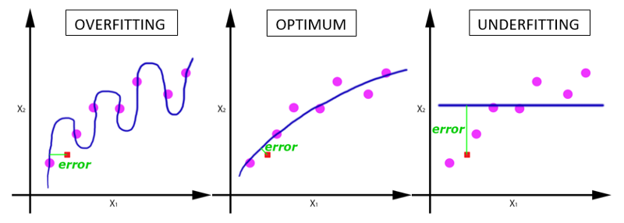
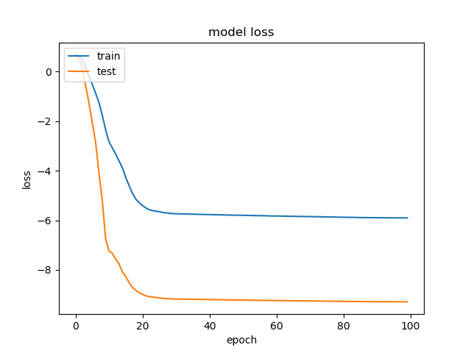

Overfitting vs Underfitting

Slide 20
Pooling
Pooling is a concept in deep learning visual object recognition that goes hand-in-hand with convolution.
The idea is that a convolution (or a local neural network feature detector) maps a region of an image to a feature map.
Pooling (RoI pooling) is a variant of max pooling, in which output size is fixed and input rectangle is a parameter.
Pooling is an important component of convolutional neural networks for object detection based on Fast R-CNN architecture.

Slide 21
Dropout Layer
Dropout refers to ignoring units (i.e. neurons) during the training phase of certain set of neurons which is chosen at random.
These units are not considered during a particular forward or backward pass.
Dropout is a regularization technique for reducing overfitting in neural networks by preventing complex co-adaptations on training data.
It is a very efficient way of performing model averaging with neural networks.

Slide 22
Vanishing Gradient
Vanishing Gradient Problem is a difficulty found in training certain Artificial Neural Networks with gradient based methods (e.g Back Propagation).
This problem makes it really hard to learn and tune the parameters of the earlier layers in the network. This problem becomes worse as the number of layers in the architecture increases.
This is not a fundamental problem with neural networks - it's a problem with gradient based learning methods caused by certain activation functions.
Vanishing gradient problem depends on the choice of the activation function.

Slide 23
Approximators
Kernel SVM
Neural Networks
Boosted Decision Trees

Slide 24
Decision Tree
Decision Trees are a type of Supervised Machine Learning where the data is continuously split according to a certain parameter.
Tree can be explained by two entities, namely decision nodes and leaves.
Classification trees-
Regression trees-

Slide 25
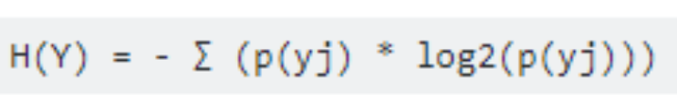
Entropy
Entropy is a measure of disorder.
Entropy is an indicator of how messy data is.
Entropy is a measure of the randomness in the information being processed.
Ex-
Outcome of tosses(Head or Tail) with coin is difficult to predict.

Slide 26
Limitations
Deep learning models are very limited in what they can represent,

Slide 27
Topics
hashing
histogram
orb
shift
pre trained model of neural n/w
autoencoder

Slide 28
Skip gram model
asd

Slide 29
Word2vec algorithm
asd

Slide 30
Useful Links
https://towardsdatascience.com/epoch-vs-iterations-vs-batch-size-4dfb9c7ce9c9
https://machinelearningmastery.com/display-deep-learning-model-training-history-in-keras/
Books:
Active Calculus 2.1
DATA SCIENCE: THEORIES, MODELS, ALGORITHMS, AND ANALYTICS
Think stats

Slide 31
Sample Project
1. Mobile screen scratch identification
2. Face recognition-
3.

Slide 32
Sample
asd

Slide 33


THANKS

