Slide 1

TensorFlow
Presented By- Chandrashekhar
      cnsnoida@gmail.com

Slide 2
Prerequisites
Basic knowledge of Python
Spark2.0 must be installed
Python 2.X/3.x installed
Pip/pip3/Pycharm
Anaconda/jupyter
import tensorflow as tf
from tensorflow import keras

Slide 3
Installation
Mechanism by which to install TensorFlow
Virtualenv
pip
Docker
Anaconda
sudo apt-get install python-pip python-dev python-virtualenv
conda create -n tensorflow_env tensorflow
conda activate tensorflow_env

Slide 4
TensorFlow
TensorFlow is an open-source ML library for research and production.
TensorFlow offers APIs to develop for desktop, mobile, web, and cloud.
https://www.kaggle.com/

Slide 5
API
tf.keras
tf.data
Eager execution

Slide 6
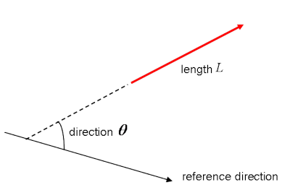
Vectors
Vectors are special types of matrices, which are rectangular arrays of numbers.
vectors are ordered collections of numbers, seen as column matrices.
They have just one column and a certain number of rows.
Plane vectors are the simplest setup of tensors.
Example of a scalar is “5 meters” or “60 m/sec”, while a vector - “5 metres north” or “60 m/sec East”

Slide 7
Tensor
A tensor is the mathematical representation of a physical entity characterized by magnitude and multiple directions.
Ex-
# Import `tensorflow`
import tensorflow as tf
# Initialize two constants
x1 = tf.constant([1,2,3,4])
x2 = tf.constant([5,6,7,8])
# Multiply
result = tf.multiply(x1, x2)
# Intialize the Session
sess = tf.Session()
# Print the result
print(sess.run(result))
# Close the session
sess.close()

Slide 8
Classification
tf.keras
tf.data
Eager execution

Slide 9
EPOCH
as

Slide 10
File Format
.csv
.h5
.pickle

Slide 11
API
tf.keras
tf.data
Eager execution

Slide 12
API
tf.keras
tf.data
Eager execution

Slide 13

THANKS

