Slide 1
Convolution Learning
Presented By- Chandrashekhar
      cnsnoida@gmail.com

Slide 2
Prerequisites
Basic knowledge of Python
Basic Knowledge of Stat

Slide 3
Installation
Mechanism by which to install TensorFlow
Virtualenv
pip
Docker
Anaconda
sudo apt-get install python-pip python-dev python-virtualenv
Import keras

Slide 4
What is CNN?
Deep learning is a subfield of machine learning that is inspired by Artificial Neural Networks(ANN)
A specific kind of such a Deep Neural Network is the convolutional network, which is commonly referred to as CNN or ConvNet.
It's a deep, feed-forward artificial neural network.
Feed-forward neural networks are called multi-layer perceptrons(MLPs).
feed-forward- information flows right through the model. There are no feedback connections in which outputs of the model are fed back into itself.
CNNs are inspired by the biological visual cortex.
The cortex has small regions of cells that are sensitive to the specific areas of the visual field.

Slide 5
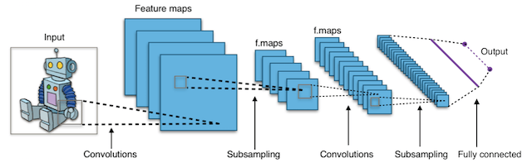
Convolutional Neural Networks
Convolutional Neural Networks (CNN’s) are multi-layer neural networks (up to 17 or more layers) that assume the input data to be images.
It is WTF.
The image depicts that feed an image as an input to the network, which goes through multiple convolutions, subsampling, a fully connected layer and finally outputs.

Slide 6
Example
Image or facial recognition
Self-driving cars

Slide 7
Loading Data
from keras.datasets import fashion_mnist
(train_X,train_Y), (test_X,test_Y) = fashion_mnist.load_data()

Slide 8
Concept
The convolution layer computes the output of neurons that are connected to local regions or receptive fields in the input
Each computing a dot product between their weights and a small receptive field to which they are connected to in the input volume.
Each computation leads to extraction of a feature map from the input image.

Slide 9
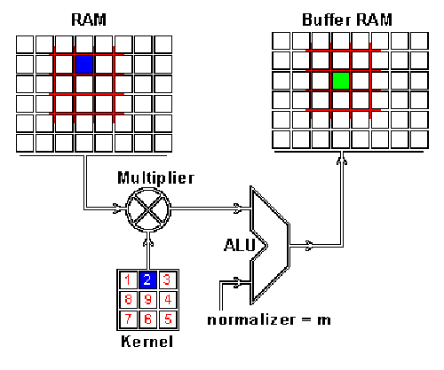
Convolution
M

Slide 10

THANKS

