Slide 1

SkLearn
Presented By- Chandrashekhar
cnsnoida@gmail.com
#9560333719

Slide 2
Prerequisites
Python 2.X or 3.x with Anaconda library
Basic knowledge of any computer language
pip install sklearn
pip install -U scikit-learn

Slide 3
Scikit-learn
Scikit-learn is a data mining library for Python.
It provides a powerful array of tools to classify, cluster, reduce, select.
Need to install NumPy and SciPy, before proceed with installing scikit-learn.
from sklearn import datasets, linear_model
from sklearn.model_selection import train_test_split
http://scikit-learn.org/

Slide 4
Training Set and Testing Set
Machine learning is learning some properties of a data set and applying them to new data.
Machine learning to evaluate an algorithm is to split the data at hand into two sets
Training set - learn data properties
Testing set- test these properties.

Slide 5
Train_test_split FN
train_test_split(df, y, test_size=0.2)
test_size=0.2 - percentage of the data should be held over for testing. It’s 80/20 or 70/30.

Slide 6
Learning and Predicting
In scikit-learn, an estimator for classification is a Python object that implements the methods fit(X, y) and predict(T).
# fit a model
lm = linear_model.LinearRegression()
model = lm.fit(X_train, y_train)
predictions = lm.predict(X_test)
predictions[0:5]

Slide 7
Accuracy
print “Score:”, model.score(X_test, y_test)

Slide 8
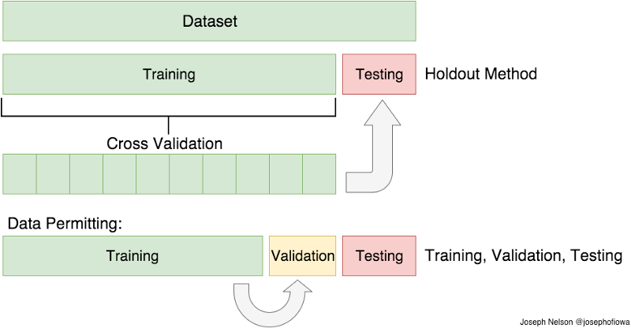
Cross Validation
If train/test split method don’t follow,can perform cross validation.
It’s very similar to train/test split, but it’s applied to more subsets.
we split our data into k subsets, and train on k-1 one of those subset.
Hold the last subset for test and do it for each of the subsets.

Slide 9
Topics
K-Folds Cross Validation
Leave One Out Cross Validation (LOOCV)

Slide 10
Feature Scaling
Feature scaling though standardization (or Z-score normalization) is an important preprocessing step for many machine learning algorithms.
Standardization involves rescaling the features such that they have the properties of a standard normal distribution with a mean of zero and a standard deviation of one.
Many algorithms (such as SVM, K-nearest neighbors, and logistic regression) require features to be normalized
Principle Component Analysis (PCA) as being a prime example when normalization is important.
PCA-interested in the components that maximize the variance.

Slide 11
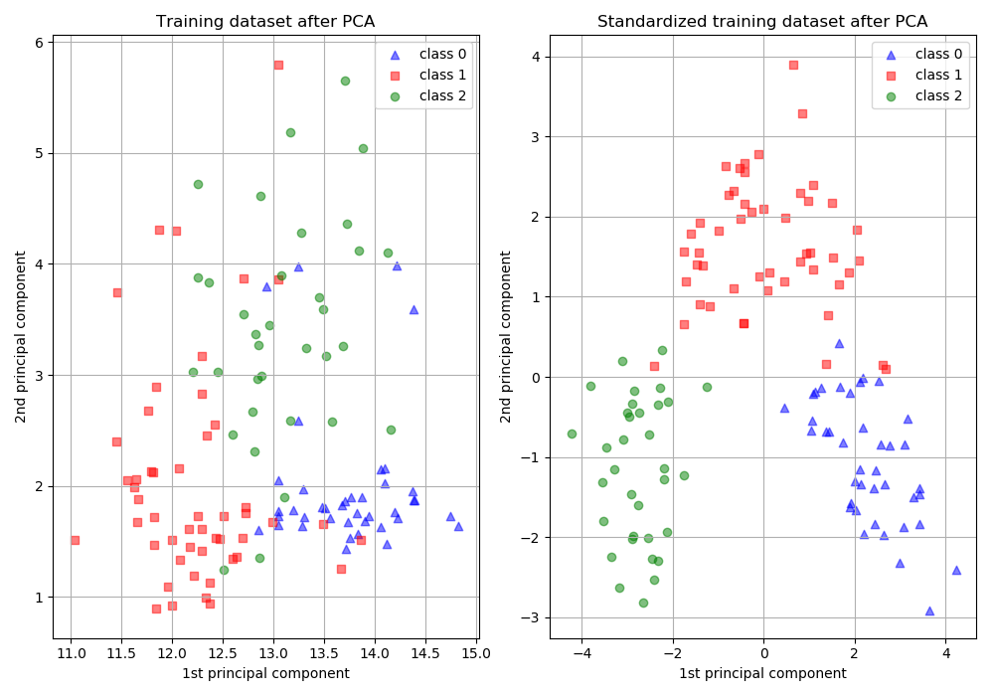
Before and after PCA

Slide 12
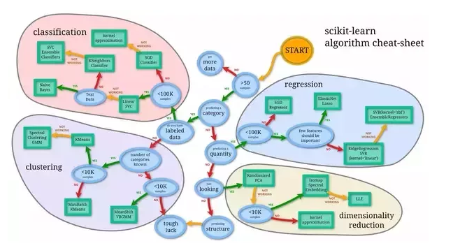
Algorithm Cheat Sheet

Slide 13


THANKS

