Slide 1
NLP
Natural Language Processing
Presented By- Chandrashekhar

Slide 2
Installation
Ubuntu:
Install NLTK with Python 2.x using:
sudo pip install nltk
Install NLTK with Python 3.x using:
sudo pip3 install nltk
import nltk
nltk.download()
NLTK on Python 2.7, 3.4, and 3.5

Slide 3
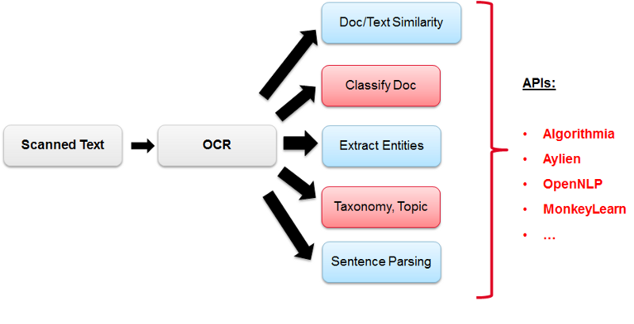
What is NLP?
Natural language processing:
NLP is applications and services that are able to understand human languages.

Slide 4
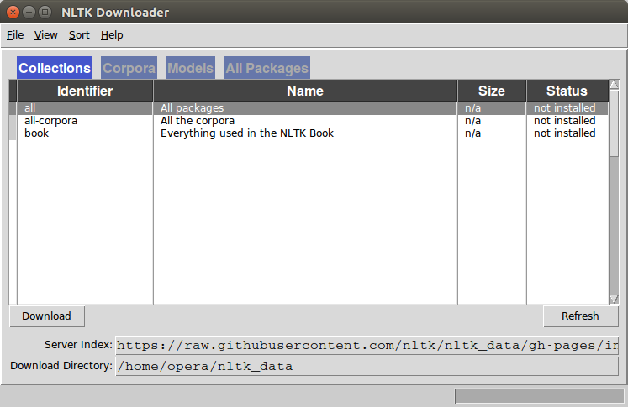
Graphical Interface
import nltk
nltk.download()

Slide 5
Example of NLP
Speech recognition
speech translation
understanding complete sentences
understanding synonyms of matching words
writing complete grammatically correct sentences and paragraphs.

Slide 6
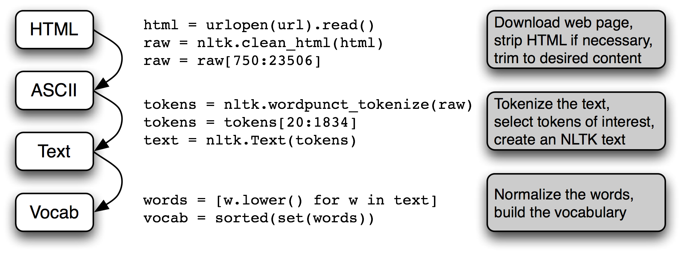
Tokenize
from nltk.tokenize import sent_tokenize, word_tokenize
data = "All work and no play makes ram a dull boy, all work and no play"
print(word_tokenize(data))
Output: ['All', 'work', 'and', 'no', 'play', 'makes', 'jack', 'dull', 'boy', ',', 'all', 'work', 'and', 'no', 'play']
Tokenizing sentences
data = "All work and no play makes jack dull boy. All work and no play makes jack a dull boy."
print(sent_tokenize(data))

Slide 7
Arrays
Store the words and sentences in arrays:
from nltk.tokenize import sent_tokenize, word_tokenize
data = "All work and no play makes ram dull boy. All work and no play makes jack a dull boy."
phrases = sent_tokenize(data)
words = word_tokenize(data)
print(phrases)
print(words)

Slide 8
Stop-words
A stop word is a commonly used word (such as "the", "a", "an", "in") that a search engine has been programmed to ignore, both when indexing entries for searching and when retrieving them as the result of a search query.Do not want these words taking up space in our database
from nltk.tokenize import sent_tokenize, word_tokenize
from nltk.corpus import stopwords
data = "All work and no play makes ram dull boy. All work and no play makes jack a dull boy."
stopWords = set(stopwords.words('english'))
words = word_tokenize(data)
wordsFiltered = []
for w in words:
if w not in stopWords:
wordsFiltered.append(w)
print(wordsFiltered)

Slide 9
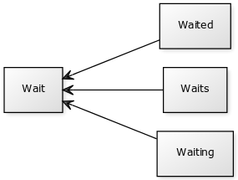
Stemming
A word stem is part of a word. It is sort of a normalization idea, but linguistic.
from nltk.stem import PorterStemmer
from nltk.tokenize import sent_tokenize, word_tokenize
words = ["game","gaming","gamed","games"]
ps = PorterStemmer()
for word in words:
print(ps.stem(word))

Slide 10
Speech Tagging
Module NLTK can automatically tag speech.
For a sentence or paragraph, it can label words such as verbs, nouns and POS
import nltk
from nltk.tokenize import PunktSentenceTokenizer
document = 'Whether you\'re new to programming or an experienced developer, it\'s easy to learn and use Python.'
sentences = nltk.sent_tokenize(document)
for sent in sentences:
print(nltk.pos_tag(nltk.word_tokenize(sent)))

Slide 11
NLP Prediction
Data preparation
Feature extraction
Training
Prediction

Slide 12
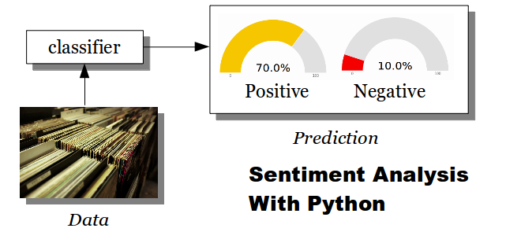
Sentiment Analysis
Given a review or a tweet, it can be automatically classified in categories.
These categories can be user defined (positive, negative)

Slide 13
Benifits of NLP
Understand users and their passions

Slide 14
Implementation
Search engines like Google, Yahoo, etc. so it shows results related to that.
Social website feeds like Facebook news feed. The news feed algorithm understands interests using natural language processing and shows you related ads and posts more likely than other posts.
Speech engines like Apple Siri.
Spam filters like Google spam filters. It's not just about usual spam filtering; but, spam filters understand what's inside the email content and see if it's spam or not.

Slide 15
Libraries
Natural language toolkit (NLTK)
Apache OpenNLP
Stanford NLP suite
Gate NLP library

Slide 16

THANKS

